Slide 1


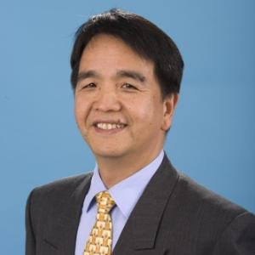
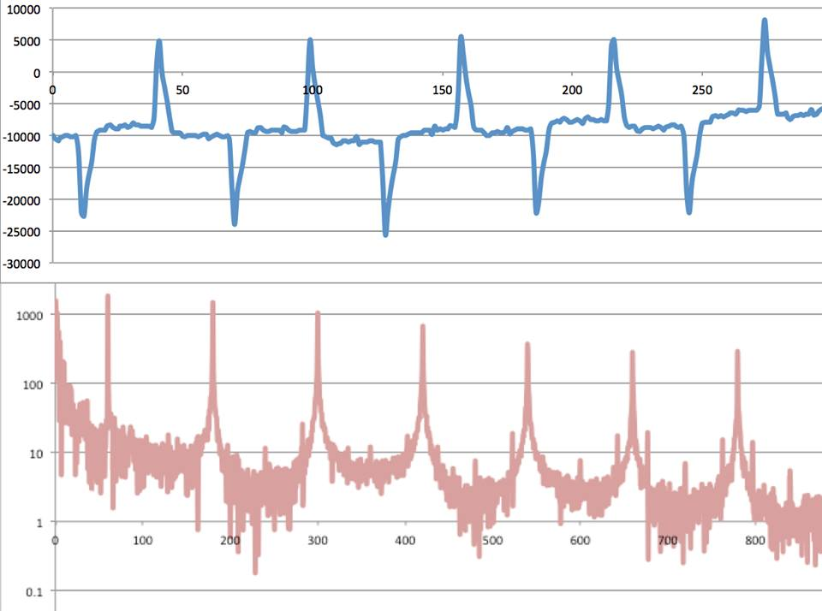

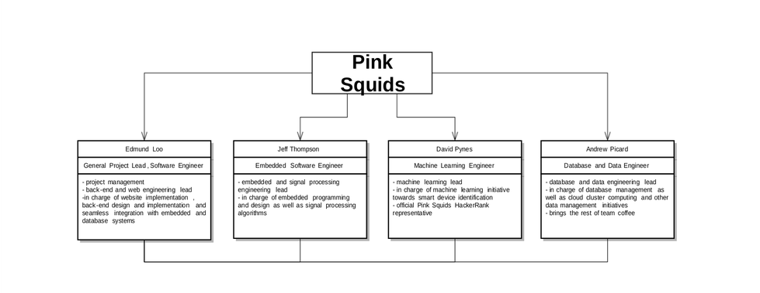
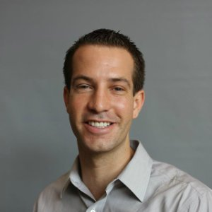
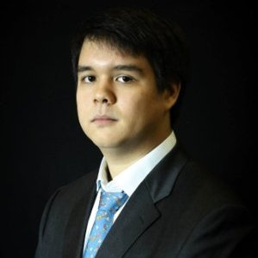
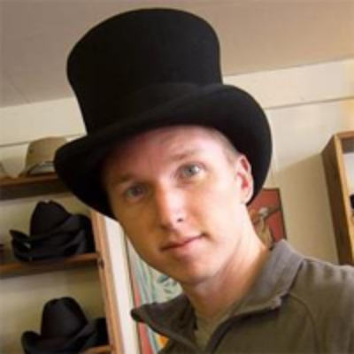
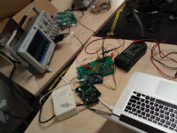
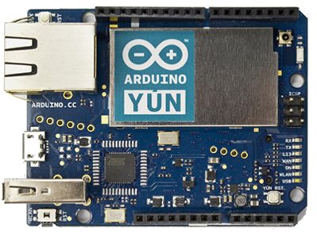
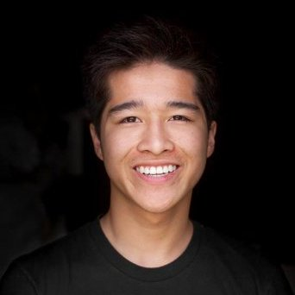
SparkyStrip
A power strip built to raise energy awareness.
MEET THE TEAM
GOAL
INNOVATIONS:
DISCUSSION
At SparkyStrip, we believe that the first step to any kind of change is awareness. One of our planet’s most pivotal problems is the issue of energy usage and energy consumption. Energy isn’t infinite and is often destructive to produce. In order to slow down the demise of our planet and all the life on it as much as possible, energy must be conserved whenever possible. As a way to encourage this notion, our team has invented a power strip that will allow users to plug in any device and check on a web or mobile application the time the device was plugged in, the energy consumed by the device, and what the power strip identified the device to be. This way, users can be constantly aware of what devices are plugged in, what devices are consuming energy, and the amount of energy each device is pulling. Making the consumer aware of the energy consumed is a great way to get them to unplug devices, turn off devices, and conserve more energy through making them aware of how much energy many devices consume when left on or even just left plugged in.
-Touchless device identification.
-Interprets unique appliances.
-Gathers data based off their emitted frequencies.
-Creates energy awareness.
-Unique among other products that are marketed as similar.
-Implemented using machine learning.
Click here to insert your Discussion text. Type it in or copy and paste from your Word document or other source.
This text box will automatically re-size to your text. To turn off that feature, right click inside this box and go to Format Shape, Text Box, Autofit, and select the “Do Not Autofit” radio button.
To change the background color of any text box, click once on the box so it is outlined with a dashed border. Then select Shape Fill from the Drawing Tools, Format tab on the ribbon bar above. It’s the one with the ‘paint can’ icon.
G.P. Li
Director of the California Plug Load Research Center, Mentor
Time Domain
Linyi Xia
Research Specialist at California Plug Load Research Center,
Technical Advisor
TEAM ORGANIZATION
Table 1. Label in 20pt Calibri.
David Pynes
Computer Science and Engineering Major,
Machine Learning Engineer
CONCLUSIONS
Click here to insert your Conclusions text. Type it in or copy and paste from your Word document or other source.
To change the font style of this text box: Click on the border once to highlight the entire text box, then select a different font or font size that suits you. This text is Calibri 22pt and is easily read up to 4 feet away on a 24x36 poster.
Zoom out to 100% to preview what this will look like on your printed poster.
Andrew Picard
Computer Science and Engineering Major,
Database Engineer
Frequency Domain
Jeffrey Thompson
Computer Science and Engineering Major,
Embedded Systems Engineer
WEB SITE:
Edmund Loo
Computer Science and Engineering Major,
Project Lead and Software Engineer
Follow this link to find more information on the Sparky Strip
https://sites.google.com/a/uci.edu/eecs-cse-srproj-15-16/team39
Figure 1. In lab testing.
Figure 2. Arduino.
Example: samples being sent to server.

