Slide 1
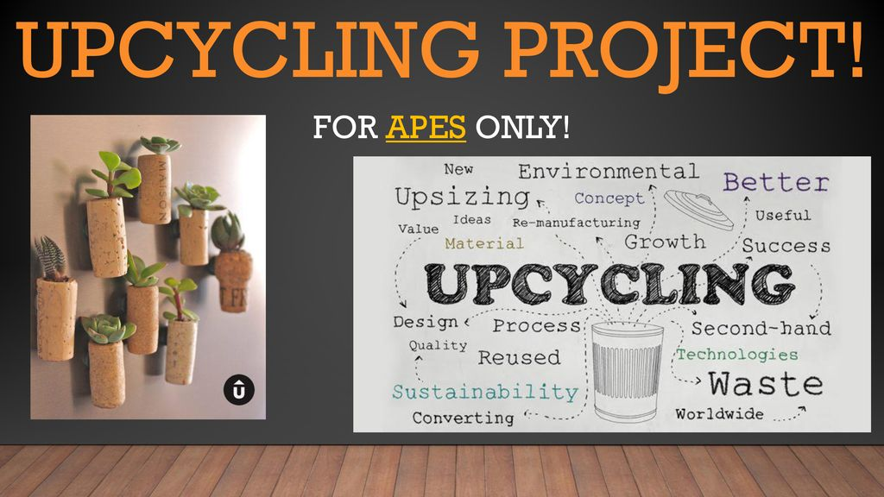

Slide 2
Upcycle
Group Members – Yogesh Mahajan (220343120055)
Ajay Auti (220343120018)
Chimay Alandkar (220343120009)
Govind Kulkarni (220343120051)
Project Guide – Mrs. Harshita Maheshwari

Slide 3
Contents
Introduction
Choice of topic
Proposed System
Methodology
Proposed System Model
Proposed Approach
Screenshot
System Requirements
Applications
Advantages & Limitations
Conclusion
Future Scopes
References

Slide 4
Introduction
Upcycle is a web application to help users as well as shoppers.
This application allows best customize and ready upcycle products.
It provides admin, shop and customer login.
Shops can add upcycle products .
Shops & customers can register them by themselves.

Slide 5
Choice of topic
Through this project customers can able to modify their own products.
Easy & Fast
Upcycle products to save nature
Product categories

Slide 6
Proposed System
AIM:
1. It will help users who want their old product to convert into new by creative way
Proposed System:
1. Digitalize great upcycle collection
2. Communication can take place even through mobile
3. Eliminate Intermediates

Slide 7
Methodology
The objective is to create a web site that can perform the following:-
Connecting to an HTTPS site through GPRS/WIFI.
Opening the relevant HTML page using HTTPS POST & GET methods.
Read the data logically into customer, shop and admin.
Creating a local database.

Slide 8
Proposed System Model
There are three main modules:
Admin Customer Seller
1 Home 1 Home 1 Home
2 Product Category 2 Product Category 2 All Product
3 Sellers 3 All Products 3 Add product
4 Customers 4 view cart 4 Products
5 Orders 5 My orders 5 Log Out
6 Logout 6 Logout

Slide 9
Proposed Approach

Slide 10
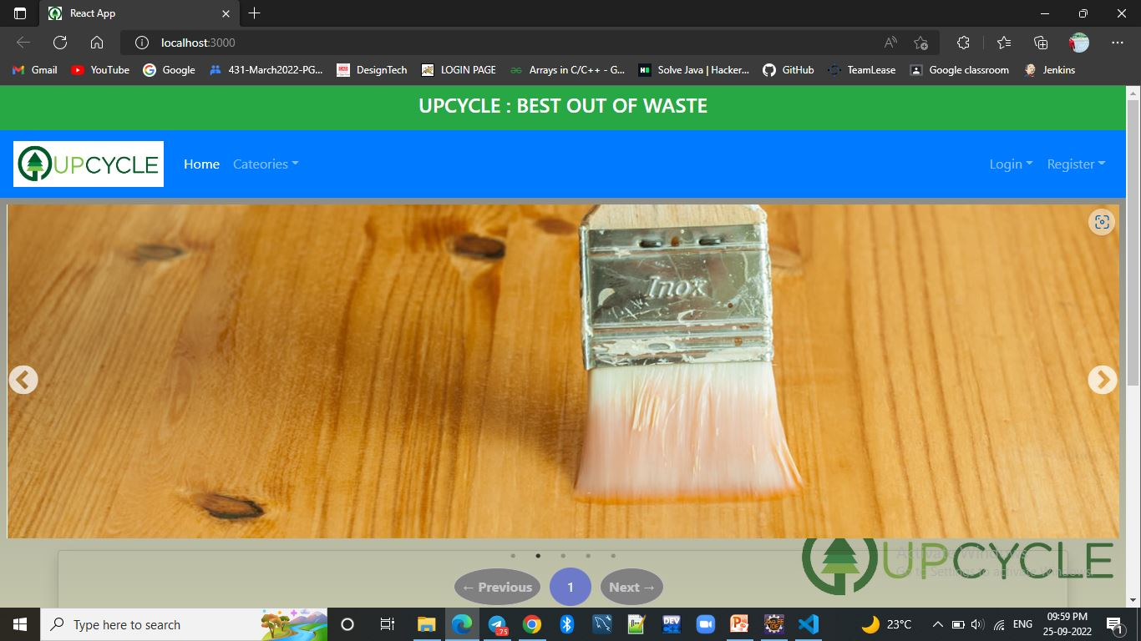
Screenshots

Slide 11
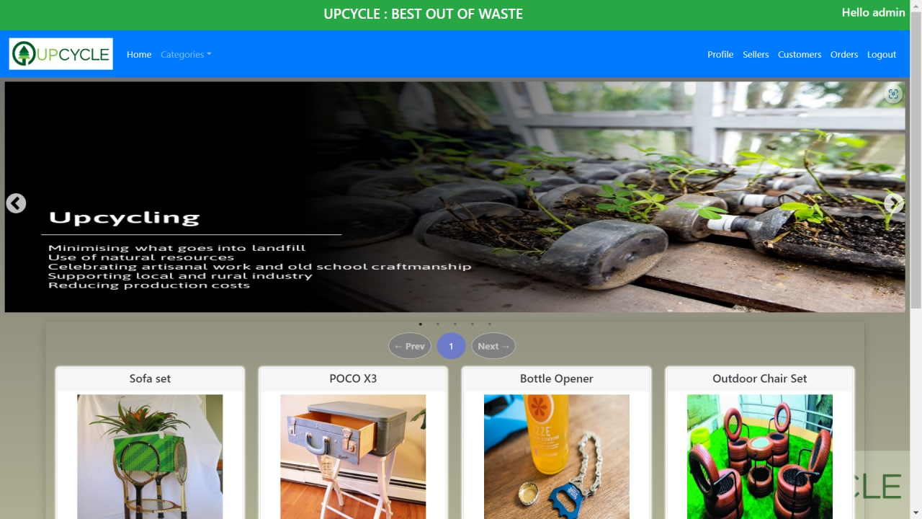
Admin Login

Slide 12

Shop Login

Slide 13
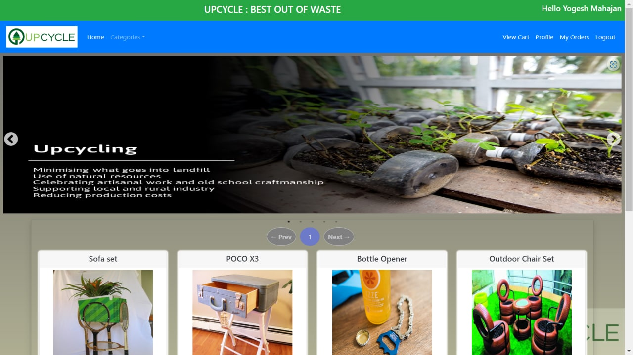
User Login

Slide 14
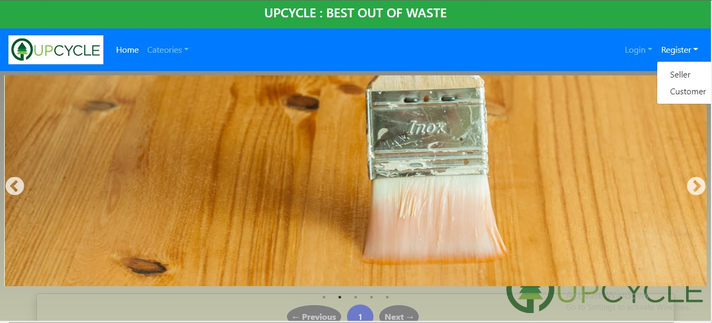
Registration for shop and user

Slide 15
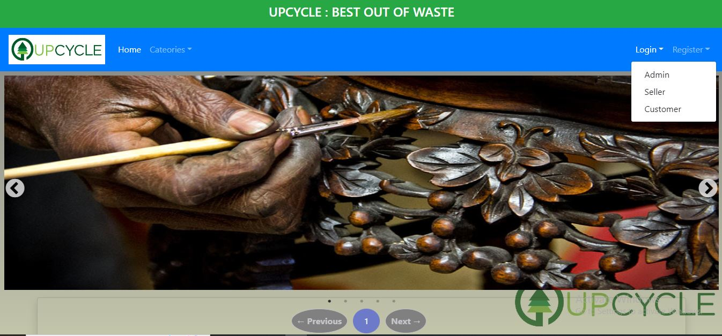
Login for user, admin, shop

Slide 16
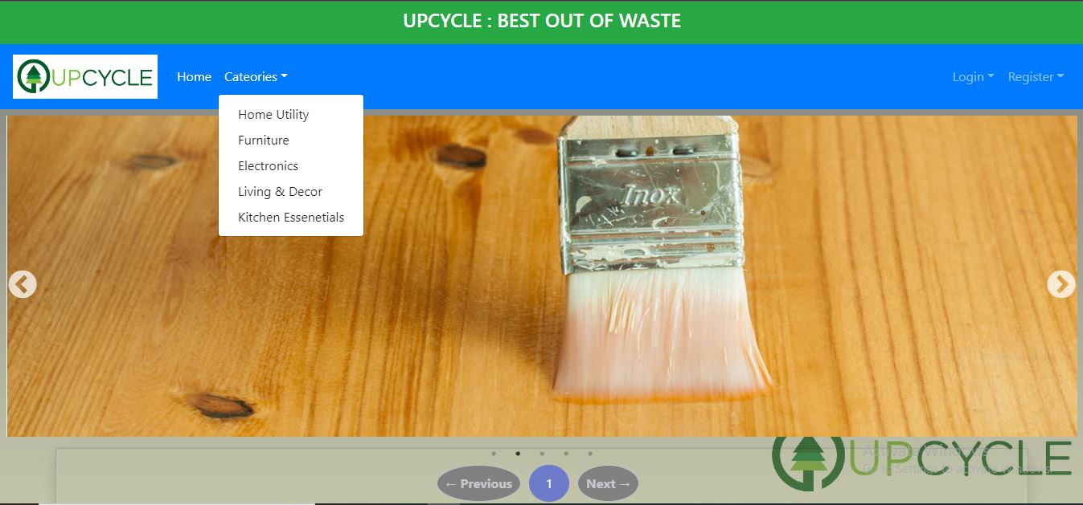
Categories

Slide 17
System Requirements
Software Requirements:
• Windows (All Versions)
• Tomcat 9
• Eclipse, MySQL, React libraries, VS Code.
Hardware Components:
• Processor – i3
• Hard Disk – 500 GB
• Memory – 4GB RAM

Slide 18
Technologies Used
HTML : Page Layout has been designed in HTML.
CSS : Used for all designing part to achieve user-friendly and user-engagine UI.
JavaScript : All Validation task and animations has been developed by JS.
React Js : A JavaScript Library, potential to reuse components and form interactive applications.
JAVA : All the business logic has been written in JAVA using Springboot framework.
MySQL : MySQL database has been used as database.
Tomcat : Project will run using Tomcat server.
Hibernate: Provides tool for ORM(Object Relational Mapping)

Slide 19
Applications
Digital connectivity between Upcycle products, customers and manufacturers and sellers.
Can be used in other countries
Reuse products

Slide 20
Advantages
Transparency in the system.
Saves Time, cost and energy.
Customers can submit their complaints and feedbacks online.
They can get notifications of any new offers.
They can customize their own products.

Slide 21
Limitations
Accurate verification of the users cannot be done online.
It requires an extensive database and memory.

Slide 22
Conclusion
The upcycle web service will be designed and developed to overcome the drawbacks of old manual system and meet the requirement of modern age. This system will digitalize and provide service to find accurate and best shop which will give service as user wants at reasonable cost. It will bring transparency between customers, suppliers and buyers by removing intermediates. It will save time & energy of everyone using this portal. Lastly it can be improved in future according to rising demand of users.

Slide 23
Future Scope
Verification of users.
Improvement in design.
Mobile Application
UPI payment
Integration of new function like can rent equipment according to their need
Chat BOT

Slide 24
References
Mr. Saleel Bagde for Database (MySQL).
Mrs. Harshita Maheshwari for HTML, JavaScript, CSS and React JS; also she is our project guide.
Mrs. Mayuri mam for JAVA, Hibernate, Spring boot Framework, REST API.
https://www.slideshare.net
https://www.projectideas.co.in
Europol report, 2016
International Conference on I2C2, 2017
A special thanks to Infoway Management who arranged extra lab time for us.

Slide 25
THANK YOU

