Slide 1


Slide 2


Sprint #1
Project #9 - PAyTEL
Alexander Dapoz, Anthony Calandra, Axel Van Hoyweghen, Lauren Lingeman, Marsol Daman, Noah McGivern

Slide 3

Project Vision
Credit card fraud is currently at an all time high due to popularity of cyber retail making identity checks difficult
Purpose of this project is to create a new system for secure transactions utilizing front-facing mobile cameras as well as fingerprint and username/password authentication
System consists of a web portal and database for managing transactions, a buyer mobile app for approval of transactions, and a seller mobile app for issuing charges

Slide 4
Project Requirements
Functional Requirements
User must be able to create a user account based on their Google login
User must be able to offer payment to another user (buyer role)
User must be able to accept payment from another user (seller role)
User must pass face scan to access their personal account
User must be able to see their transaction history
User must be able to change their payment method through the settings page
User must be able to generate a QR code
User must be able to scan a QR code
Admin must be able to access all transactions
Admin must be able to report malicious transactions to users
Non-functional Requirements
User must have a valid Google login consisting of username and password
User must have a valid credit card
User must have an phone running Android API 26 or higher
Database must store user account information securely
Database must store all transactions
Server must be able to handle all incoming transactions real-time
Website and mobile app must both use the same color palette throughout.
Data must be encrypted when transferred between web-app / mobile-app and the server
Web-app interface must be responsive for variable screen sizes
Server must remove pending transactions that have timed out

Slide 5



Project Tools
Collaboration tools:
GitHub
Slack
Google Drive

Slide 6
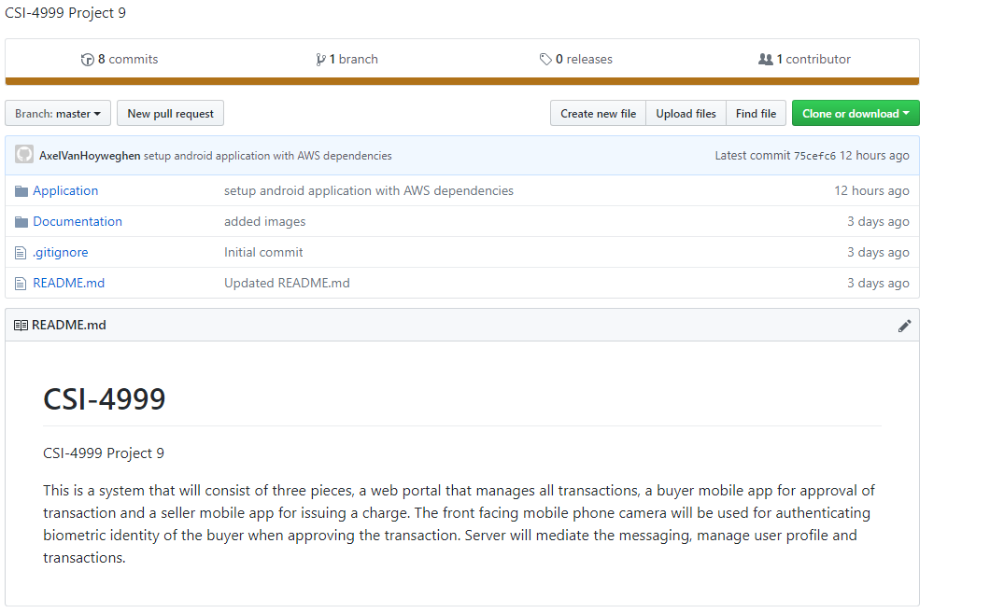
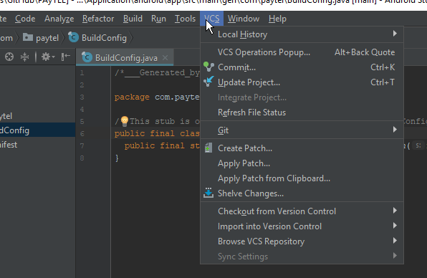
Github
We will be using Github to maintain version control for our project. In preparation, we have already set up a repository and made sure everyone has access. Additionally, Android Studio has Git/Github integration and we will be using that too.

Slide 7
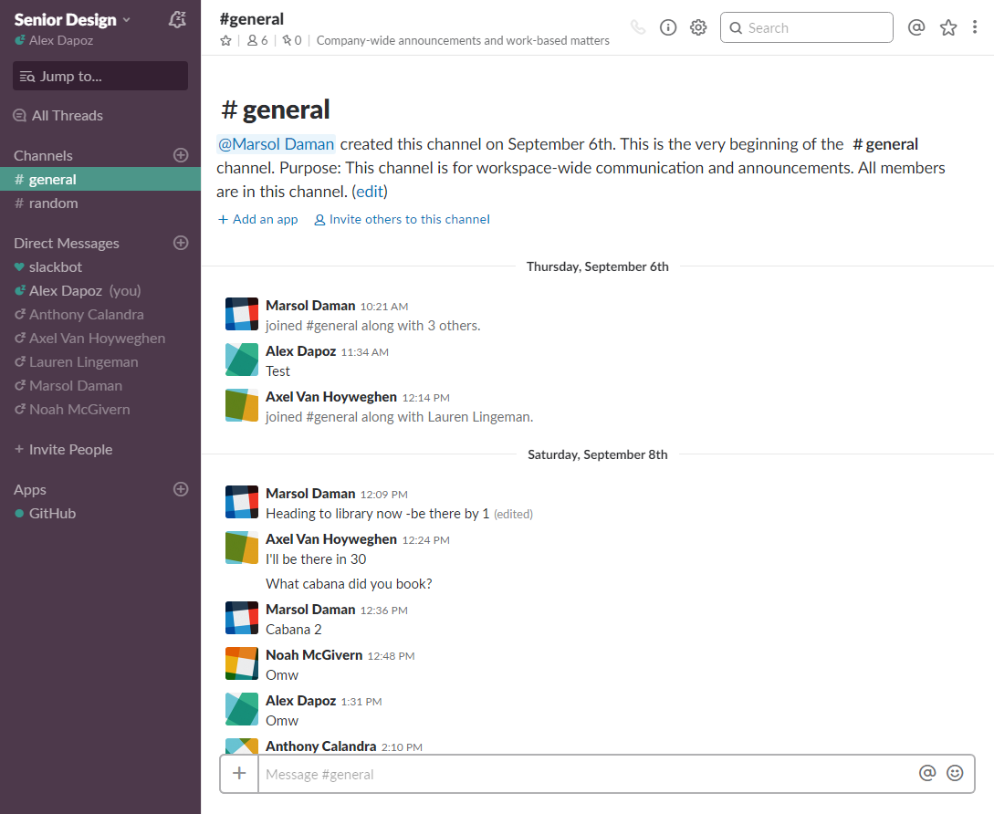
Slack/Communication
We will also have at least one meeting before each iteration and use Slack to communicate frequently. Slack is a cloud-based set of proprietary team collaboration tools and services available on both desktop and mobile. We will use Slack to communicate at any time or when we can’t meet together as a group.

Slide 8
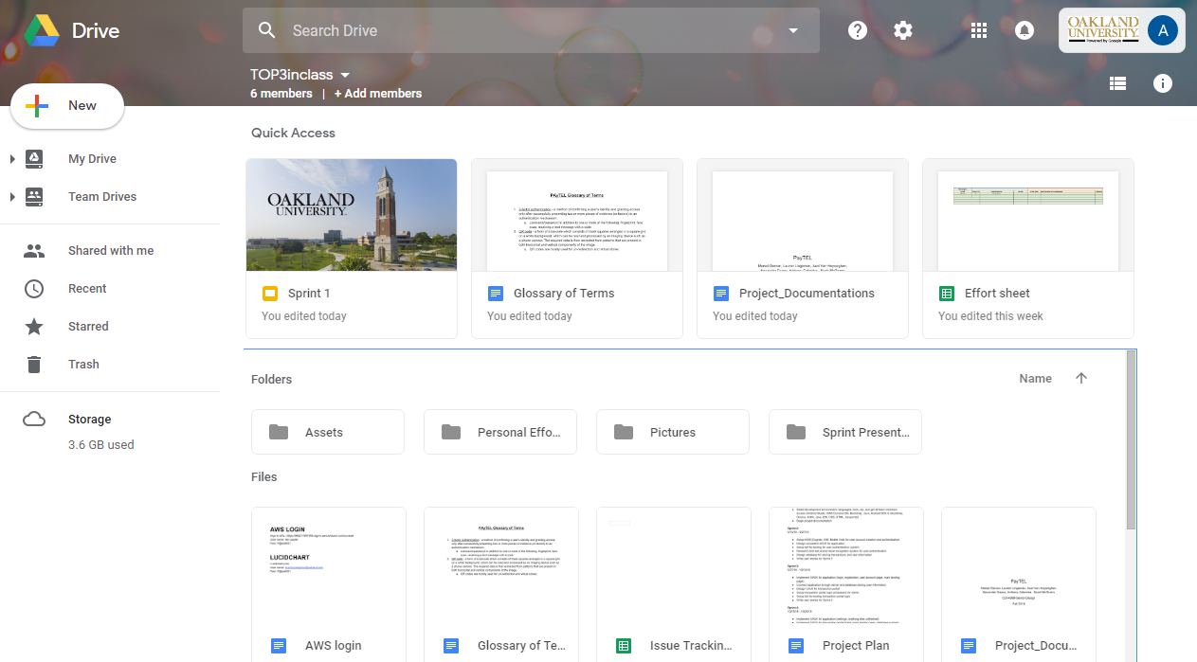
Google Drive
We’ve set up a team drive on Google Drive to manage non-coding related files, documents, and other assets.

Slide 9
Team Responsibilities
Name | Role
Alex | Front-end development and documentation
Anthony | Application development and documentation
Axel | Lead back-end (server, database, etc) design, implementation, and documentation
Lauren | Application development and managing documentation
Marsol | Application development and documentation
Noah | Front-end development and documentation

Slide 10





Project Tools
Languages:
Java
HTML/CSS/JavaScript
Kotlin
Groovy
IDE:
Android Studio
Frameworks & Services:
AWS (DynamoDB, Cognito, IAM, Mobile Hub)
Bootstrap

Slide 11
Project Plan
Sprint 1 (9/6 - 9/13)
Define requirements
Layout basic sprint schedule
Setup collaboration tools
Select development environment, languages, tools, etc. and get all team members access
Begin project documentation
Sprint 2 (9/14 - 9/27)
Setup AWS (Cognito, IAM, Mobile Hub) for user account creation and authentication
Design consistent UI/UX for application
Setup QA for testing for user authentication system
Research and test phone facial recognition system for user authentication
Design database for storing transactions and user information
Write user stories for Sprint 3

Slide 12
Project Plan
Sprint 3 (9/28 - 10/13)
Implement UI/UX for application (login, registration, user account page, main landing page)
Connect application to login server and database storing user information
Design UI/UX for transaction portal
Setup transaction portal login at backend for admin
Setup QA for testing transaction portal login
Write user stories for Sprint 4
Sprint 4 (10/14 - 10/25)
Implement UI/UX for application (settings, anything else unfinished)
Implement UI/UX for transaction portal (login, main landing page, database queries)
Finalize database design
Setup QA for testing database queries and storage
Write user stories for Sprint 5

Slide 13
Project Plan
Sprint 5 (10/26 - 11/8)
Implement UI/UX for transaction portal (anything unfinished)
Debug and testing for whole application
Feature lock by end of this sprint
Sprint 6 (11/9 - 11/22)
Continue debug and testing
Finish final documentation
Prepare final presentation and poster board

Slide 14
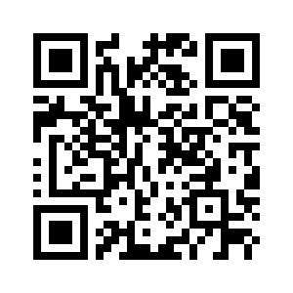
Risks & Challenges
Integrating facial recognition and QR code scanning is new to us, could have unexpected challenges
Making sure all data is secured throughout the entire transaction process is important

Slide 15
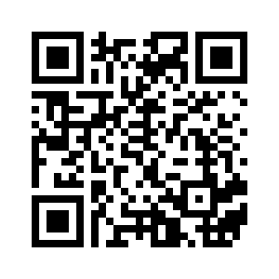
Risks Mitigation
Research and test facial recognition system and QR code integration early to get ahead of potential problems
Thoroughly test and monitor security of data during every sprint

Slide 16
User Stories for Sprint 2
As a user, I want to be able to create an account on PAyTEL that is tied to my personal google account.
As a user, I want to be able to login to my PAyTEL account using my personal google account.
As a user, I want to make sure my account is secure by using facial recognition in addition to my login information.
As a user, I want to be able to add information to my PAyTEL profile including credit card details and name.
As an administrator, I want to be able to access the PAyTEL web portal to view transactions and user information.

Slide 17


