Slide 1


Slide 2


Sprint #4
Project #9 - PAyTEL
Alexander Dapoz, Anthony Calandra, Axel Van Hoyweghen, Lauren Lingeman, Marsol Daman, Noah McGivern

Slide 3

Objectives For Sprint 4
Sprint 4 (10/14 - 10/25)
Implement UI/UX for application (settings, main landing page, transaction flow, user history)
Implement UI/UX for transaction portal (database queries)
Finalize database design
Setup QA for testing database queries and storage
Write user stories for Sprint 5

Slide 4
Facial Recognition
Must take photo with a face present to sign-up
Before taking photo, user prompted with random pose to perform (e.g. frown, close eyes)
Once photo is taken, user is only allowed to proceed if they pass authentication, otherwise they are prompted to take a new picture

Slide 5
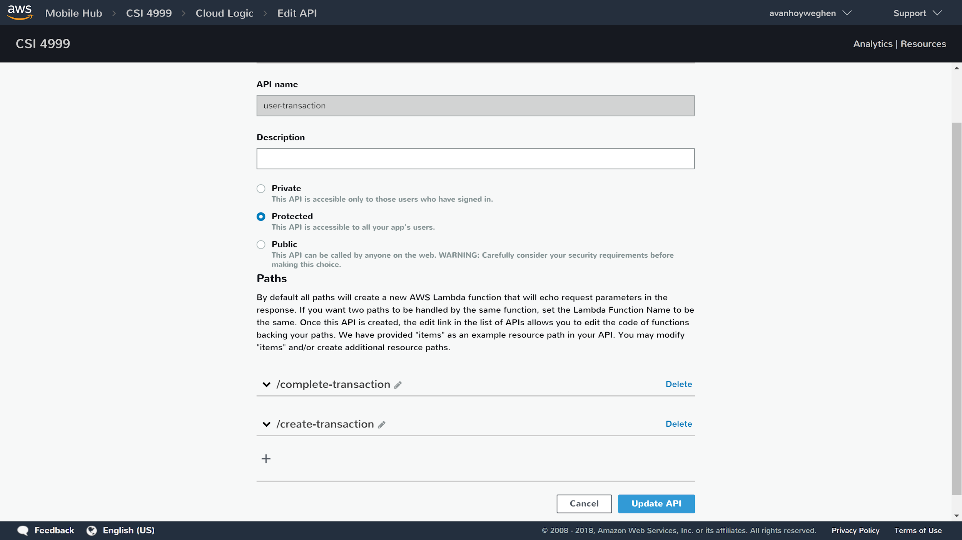
Backend -transaction

Slide 6
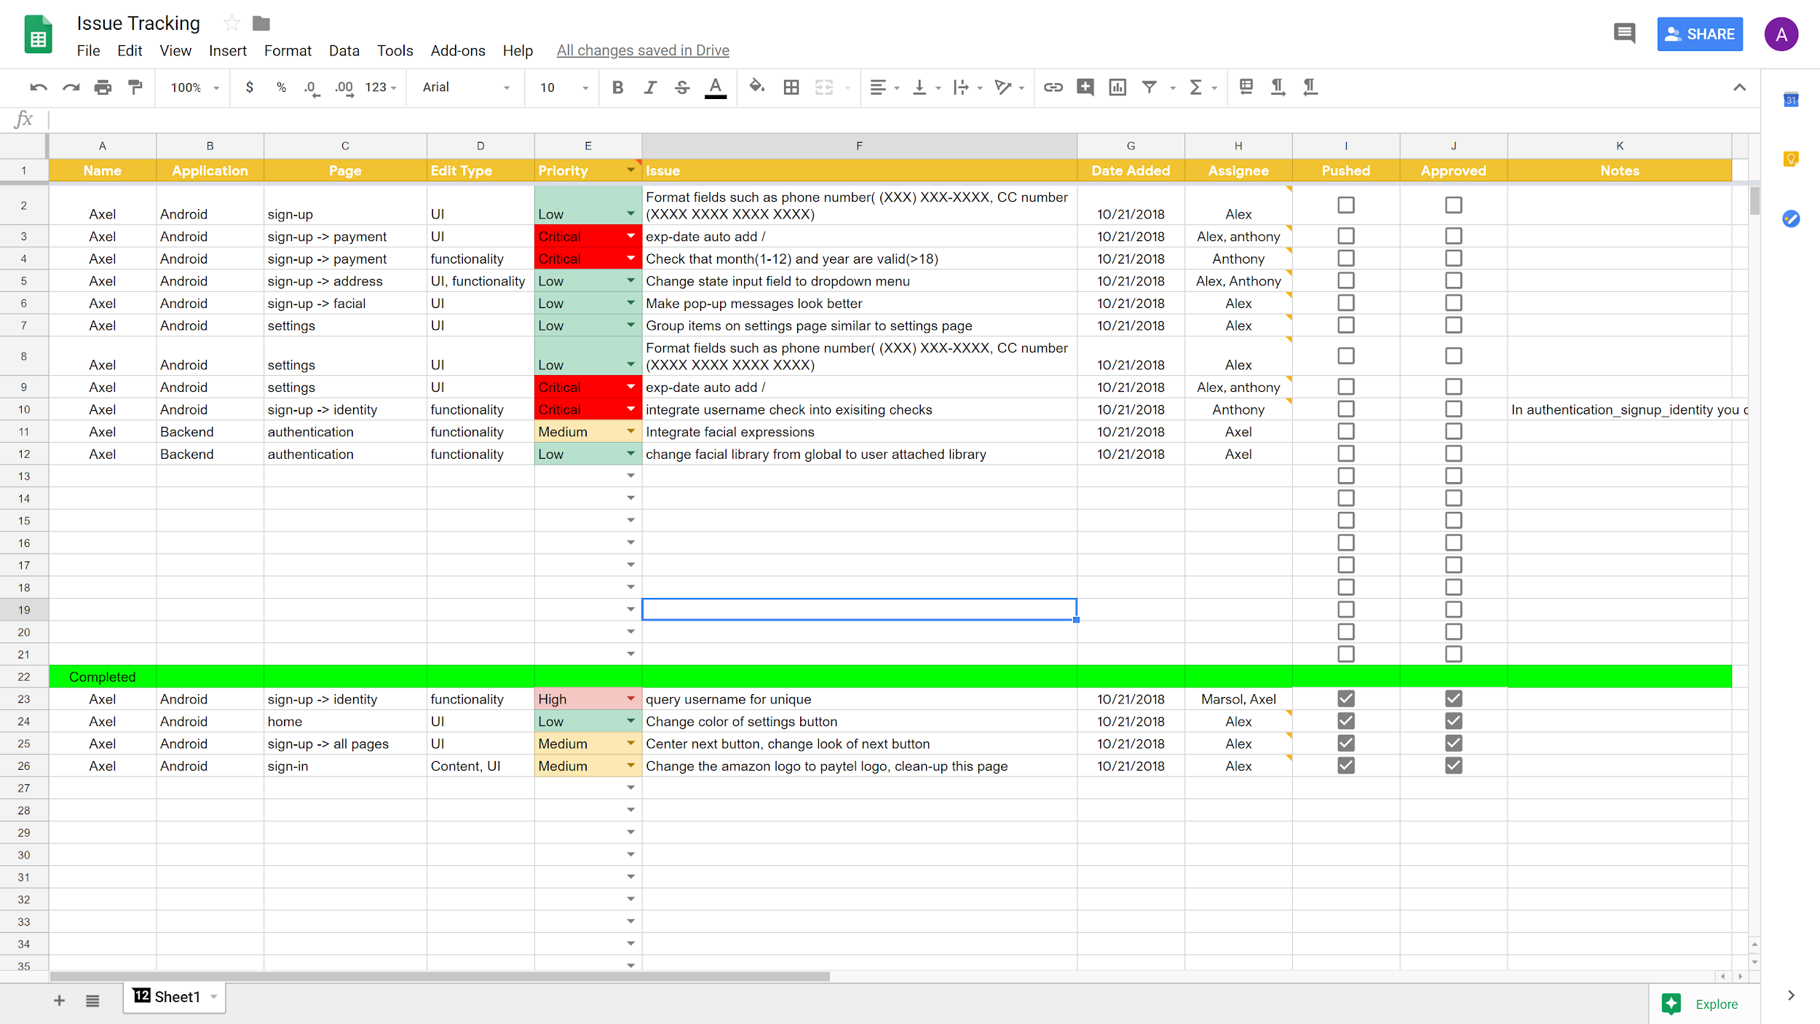
Issue tracking

Slide 7
Demo
Demo

Slide 8
Challenges
Properly implementing the facial recognition
Querying databases with the most recent transaction
Design of GUI and choosing a color scheme

Slide 9
Looking Ahead
Sprint 5 (10/26 - 11/8)
Implement UI/UX for application (user history(continued), main-page)
Implement UI/UX for transaction portal (transaction overview, transaction-flags)
Debug and testing for whole application
Feature lock by end of this sprint
Sprint 6 (11/9 - 11/22)
Continue debug and testing
Finish final documentation
Prepare final presentation and poster board

Slide 10
User Stories for Sprint 5
As a user, I must be able to view my transaction history on my account.
As a user, I want to make sure any initiated transaction is secure through facial recognition.
As an admin, I must be able to manage user accounts and transactions from the database, including being able to flag particular accounts or transactions.
As a user, I want to be sure my data is secure in the database.

Slide 11


