Slide 1


Slide 2


Sprint #3
Project #9 - PAyTEL
Alexander Dapoz, Anthony Calandra, Axel Van Hoyweghen, Lauren Lingeman, Marsol Daman, Noah McGivern

Slide 3

Objectives For Sprint 3
Sprint 3 (9/28 - 10/13)
Implement UI/UX for application (login, registration, user settings page)
Connect application to login server and database storing user information
Design & implement UI/UX for transaction portal
Setup transaction portal login at backend for admin
Setup QA for testing transaction portal login
Setup & test backend facial recognition
Write user stories for Sprint 4

Slide 4
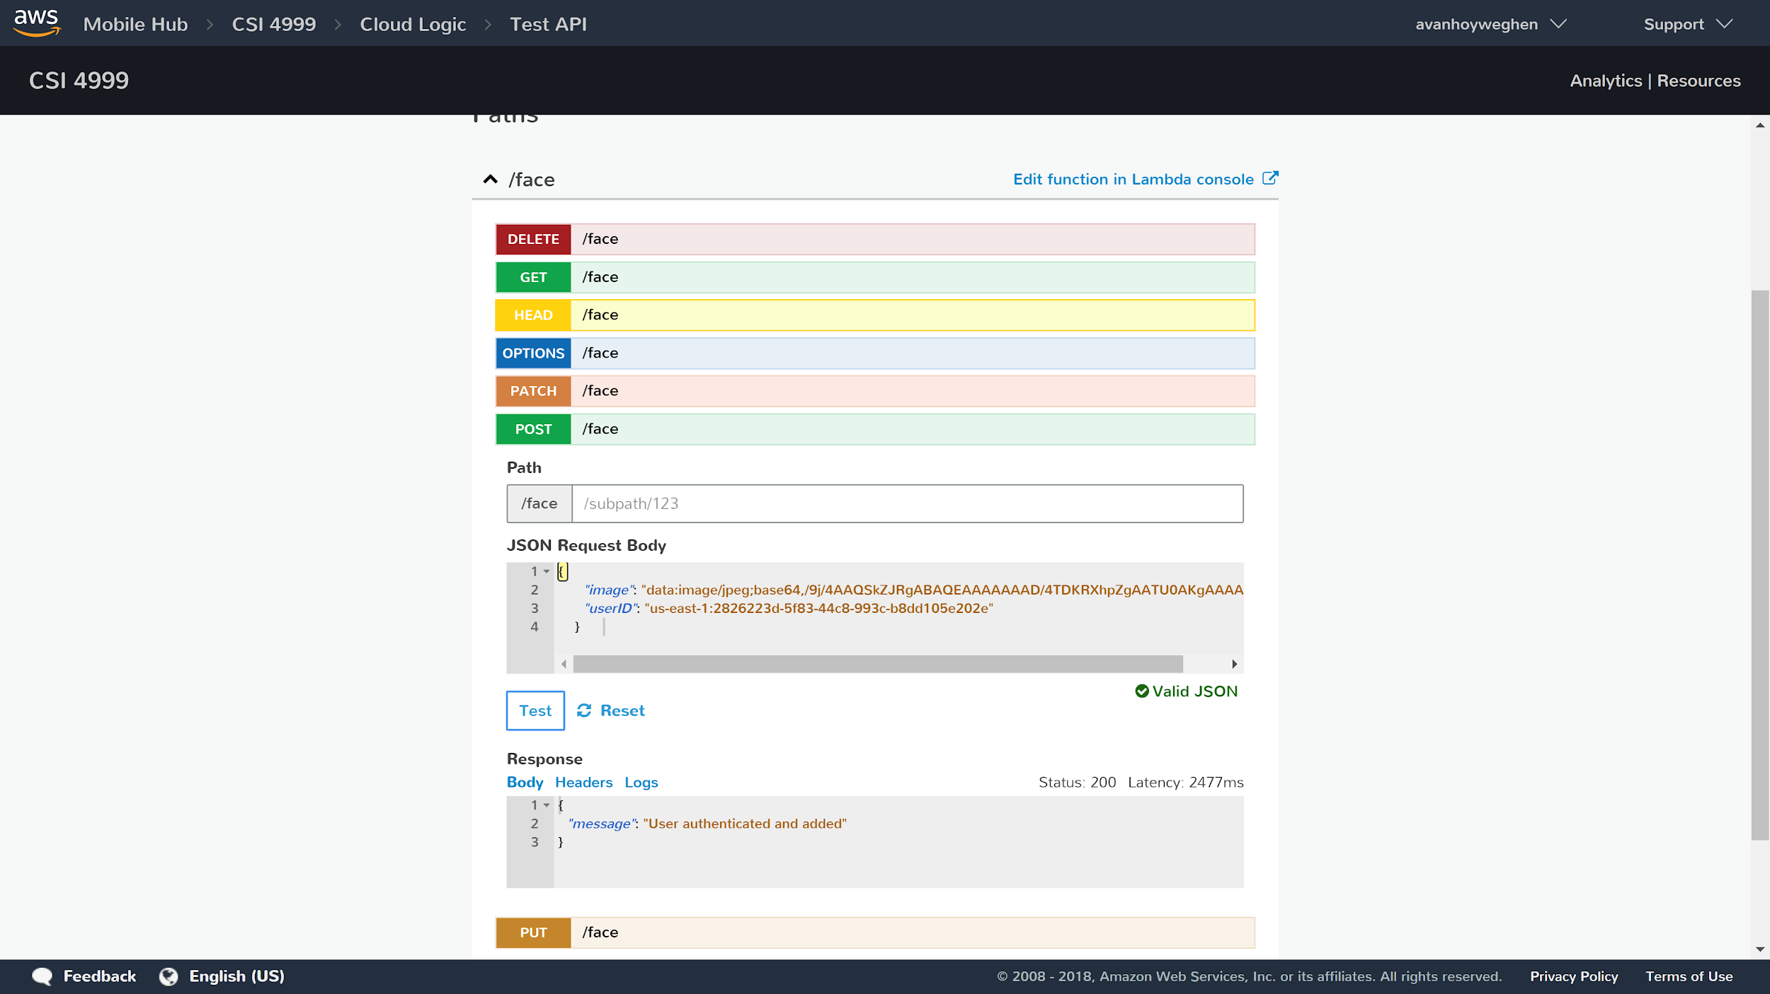
Facial Recognition -sign up

Slide 5
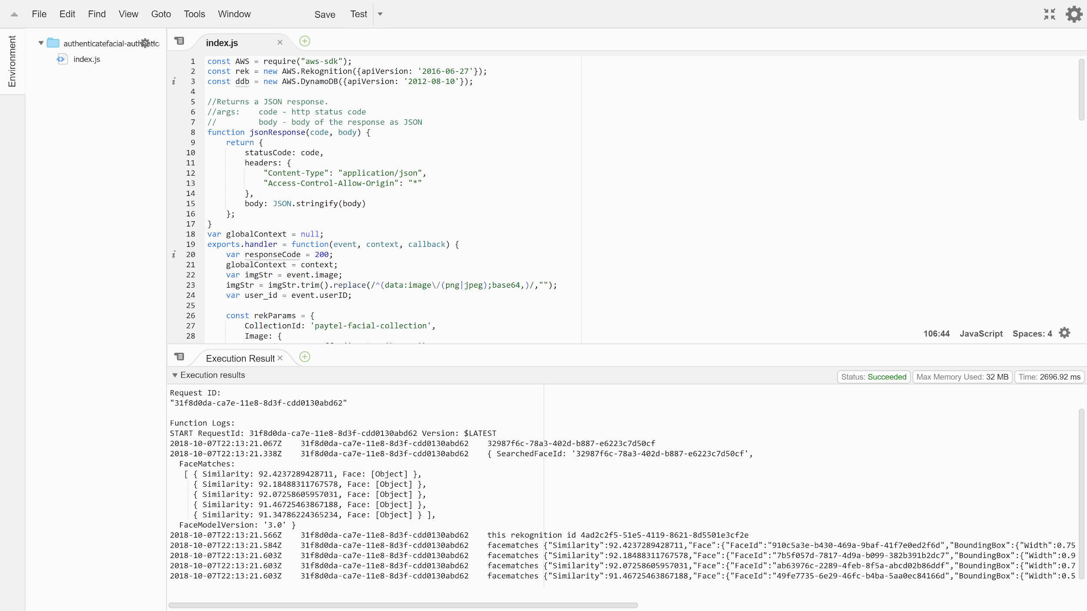
Facial Recognition - auth

Slide 6
Demo
Demo

Slide 7
Challenges
Making sure the camera is taking a useable picture for facial recognition
Making sure the picture is being sent to backend correctly
Only allowing user to proceed if a good picture is retrieved
Consistent UI layout
Merging code/branches
Learning to utilize React in conjunction with AWS

Slide 8
Looking Ahead
Sprint 4 (10/14 - 10/25)
Implement UI/UX for application (settings, main landing page, transaction flow, user history)
Implement UI/UX for transaction portal (main landing page, database queries)
Finalize database design
Setup QA for testing database queries and storage
Write user stories for Sprint 5
Sprint 5 (10/26 - 11/8)
Implement UI/UX for transaction portal (anything unfinished)
Debug and testing for whole application
Feature lock by end of this sprint

Slide 9
User Stories for Sprint 4
As an admin, I must to be able to access the web portal and manage user accounts and transactions from the database.
As a user, I must be able to create a transaction through my PAyTEL account.
As a user, I must be able to view my transaction history on my account.
As a user, I should be able to update my profile information after account creation.
As a user, I want to make sure my account is secure by using facial recognition in addition to my login information.

Slide 10


