Slide 1


Slide 2


Sprint #2
Project #9 - PAyTEL
Alexander Dapoz, Anthony Calandra, Axel Van Hoyweghen, Lauren Lingeman, Marsol Daman, Noah McGivern

Slide 3

Objectives For Sprint 2
Sprint 2 (9/14 - 9/27)
Setup AWS (Cognito, IAM, Mobile Hub) for user account creation and authentication
Design consistent UI/UX for application
Setup QA for testing for user authentication system
Research and test phone facial recognition system for user authentication
Design database for storing transactions and user information
Write user stories for Sprint 3

Slide 4
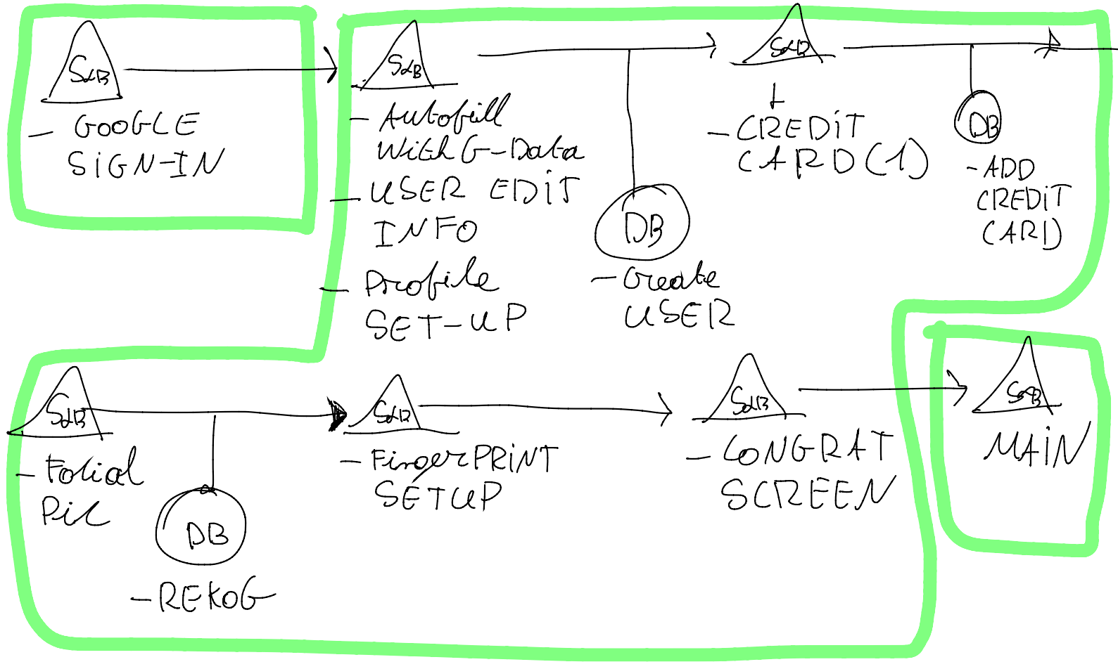
New User Flow

Slide 5
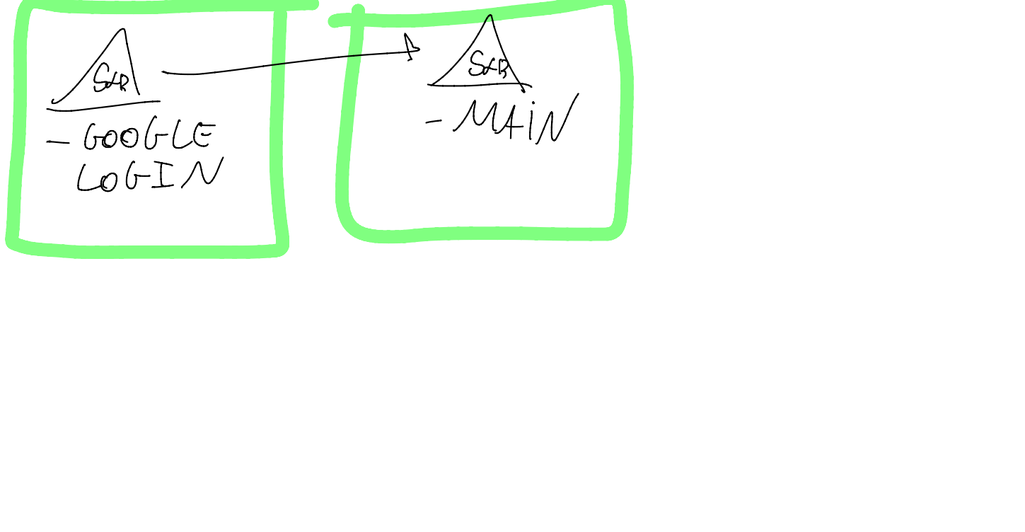
Regular Sign-in Flow

Slide 6
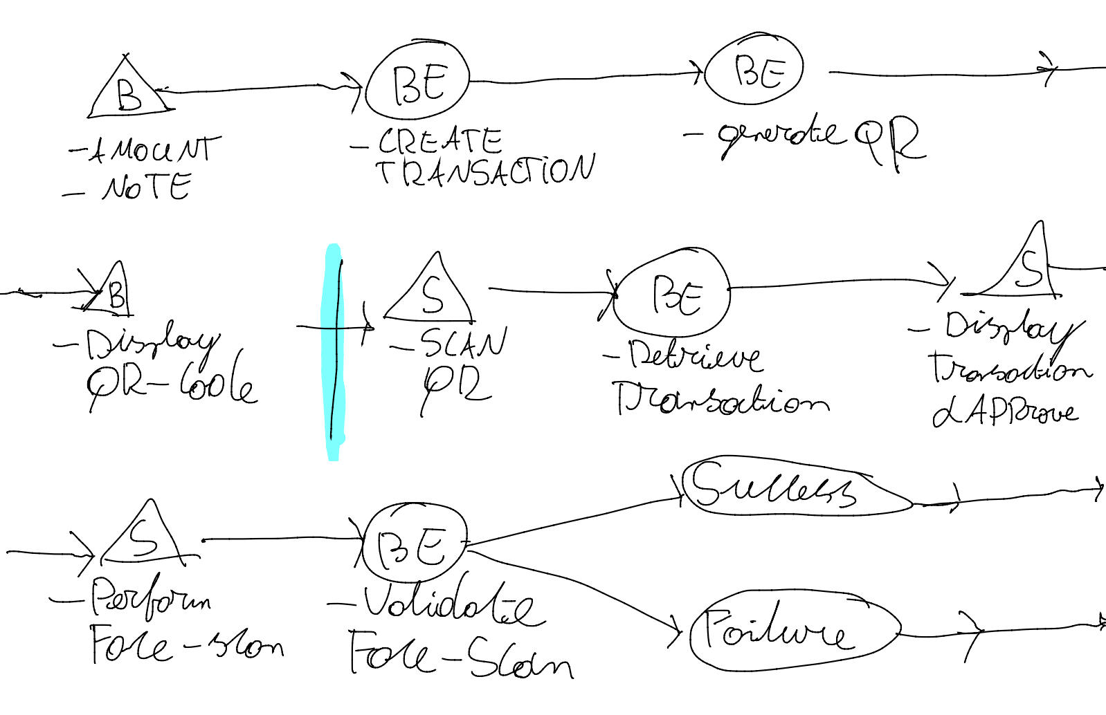
Transaction Flow

Slide 7
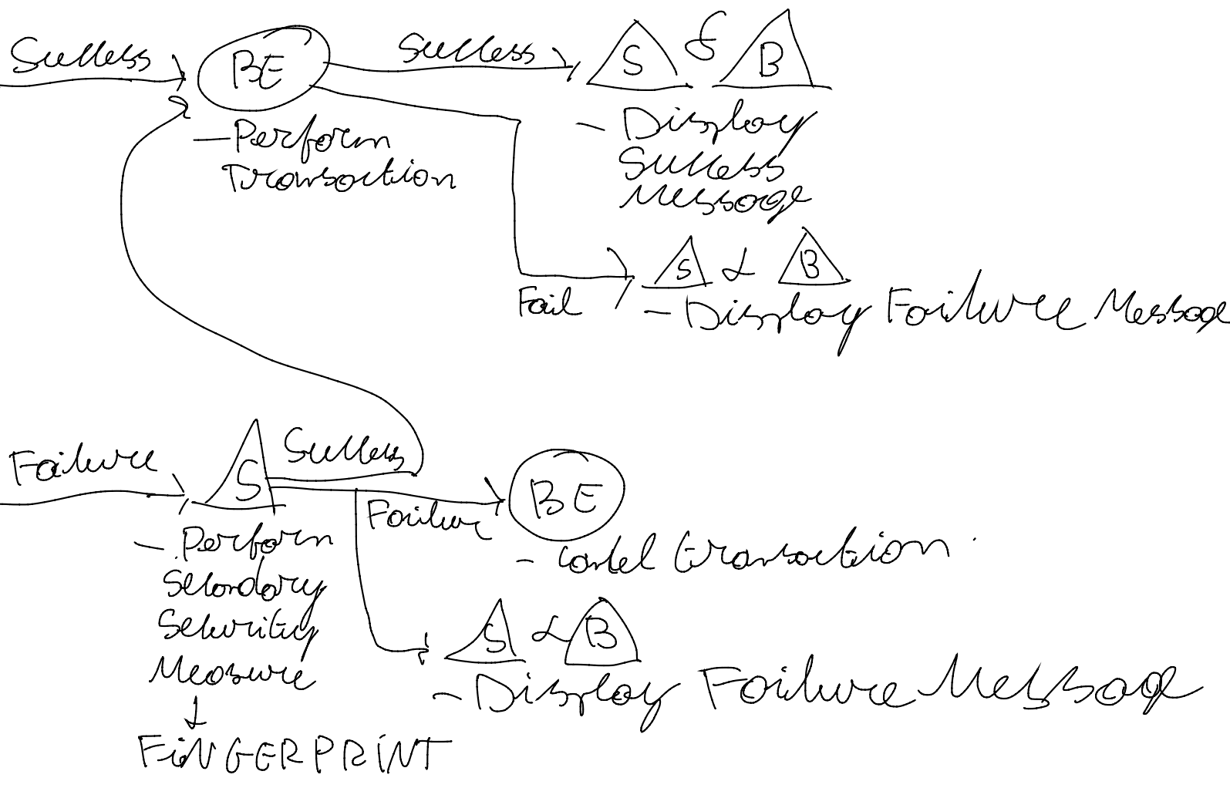
Transaction Flow (continued)

Slide 8
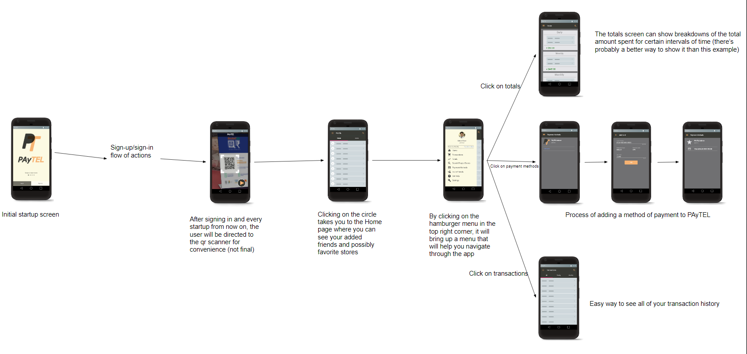
App Mockup Flow

Slide 9
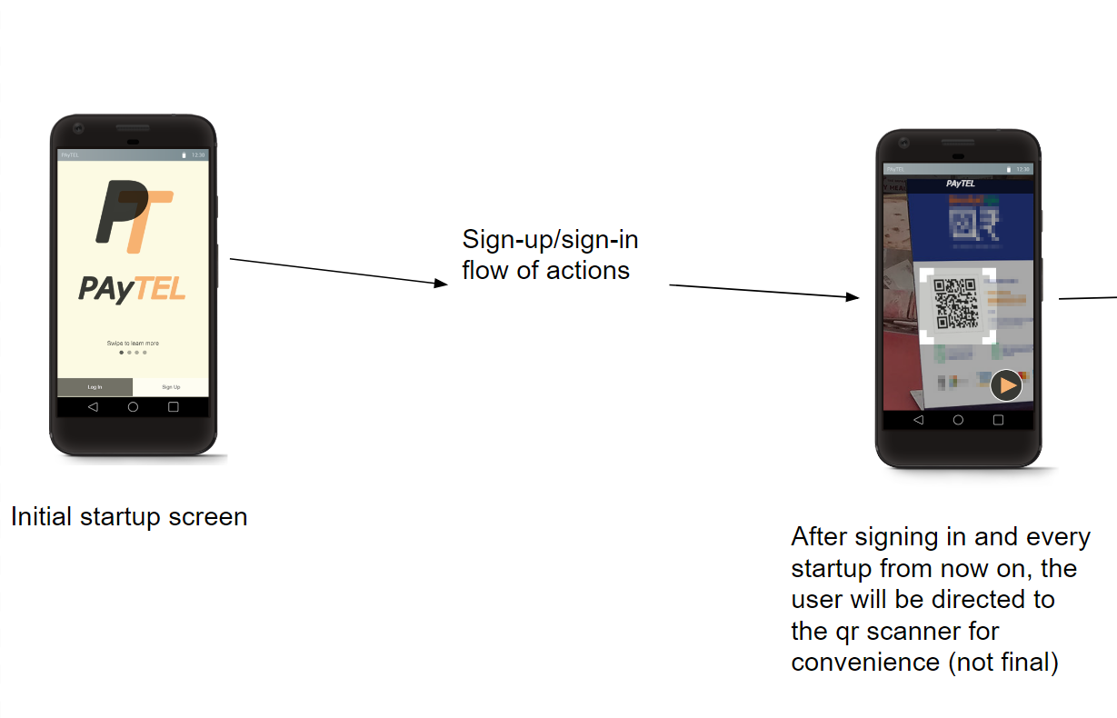
App Mockup Flow

Slide 10
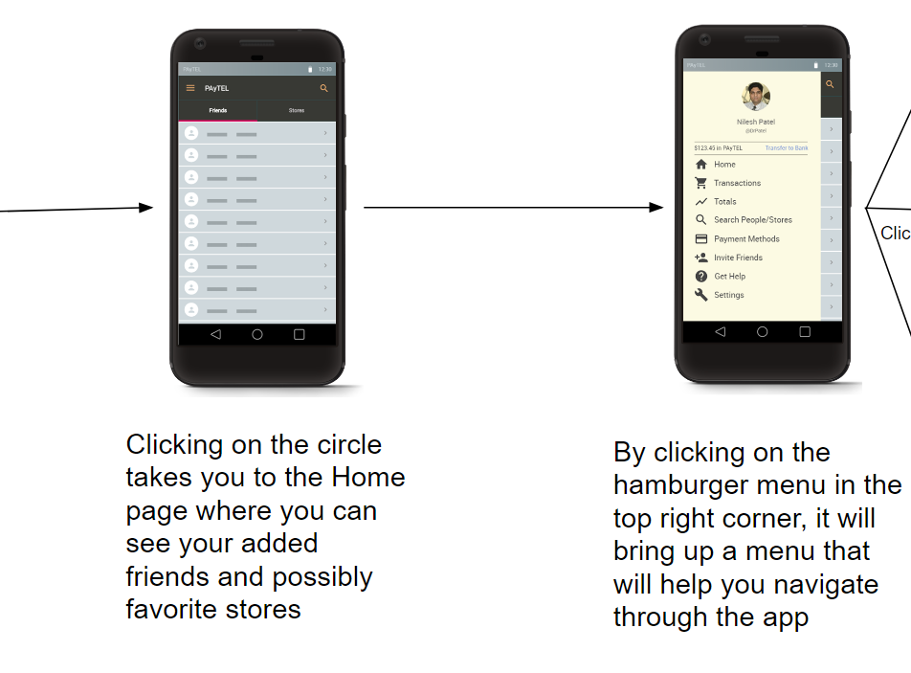
App Mockup Flow

Slide 11
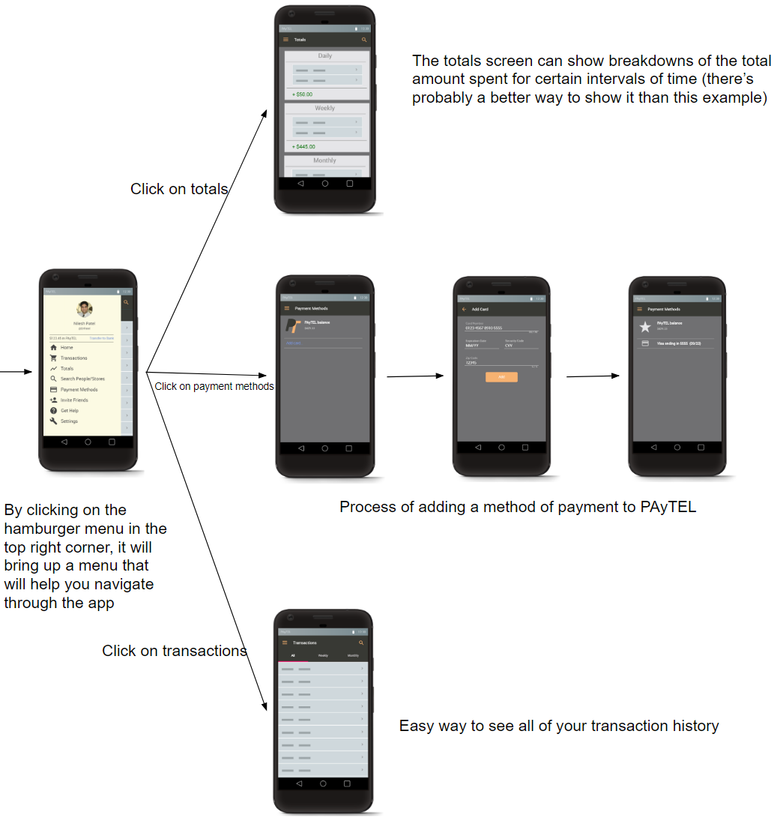
App Mockup Flow

Slide 12
Looking Ahead
Sprint 3 (9/28 - 10/13)
Implement UI/UX for application (login, registration, user account page, main landing page)
Connect application to login server and database storing user information
Design UI/UX for transaction portal
Setup transaction portal login at backend for admin
Setup QA for testing transaction portal login
Write user stories for Sprint 4
Sprint 4 (10/14 - 10/25)
Implement UI/UX for application (settings, anything else unfinished)
Implement UI/UX for transaction portal (login, main landing page, database queries)
Finalize database design
Setup QA for testing database queries and storage
Write user stories for Sprint 5

Slide 13
User Stories for Sprint 3
As an admin user, I want to be able to login to the web portal.
As a user, I want to be able to login to see a nice UI and be on the main landing page.
As a user, I want to have my login information stored securely.
As an admin user, I want all the user accounts and profile information stored securely in a database.

Slide 14


