Slide 1


Slide 2
Day of market predictions based on S&P 500 Historical data
Presentation:
Anthony Calandra

Slide 3

Hypothesis
Problem: For casual traders who play the market as a hobby or a side avenue for added income, tracking optimal times to buy and sell can be time consuming and often impractical. This can lead to woefully sub-optimal portfolio management.
Hypothesis: Using historical data from the S&P 500, specifically, the last 5 years performance of each stock. I’m delving into the idea that you can use predict what will be good buying and selling days, as well, days to avoid the market based on the previous days historical data. This assumes that a historically good or poor day on the market will allude to consistent market influences that will cause predictable ebbs and flows in the market.

Slide 4
Model
Preprocessing
Truncating Date column: This is done by using simple base python code
This is done to remove the last slash and year from the date, as they aren’t relevant and get in the way of later preprocessing
Data encoding: This is done using sklearn’s preprocessing library
This casts the truncated date and Name columns into int64 values fit for training models later.
“clustering” data: here I “cluster” all data from the same day into a single row by taking the mean of all stock performance on a specific day (e.g. 2/28) for all stocks across all 5 years
Taking the average of all performance across 5 years along with the standard deviate which is used show a consistent rise or fall in stock market health on that day
I then create a DataFrame to be a response variable for my later model
This response variable is a classification of the following stock market day
Buy, Pass, Sell
This is done by taking the mean and standard deviation for, open, high, low, close information for the S&P 500 over the last 5 years
So If the current days mean, open, high, low, close are all higher than the mean + ½ standard deviation then next day will be a predicated sell day
The data is then split into 80/20 Training Testing datasets

Slide 5
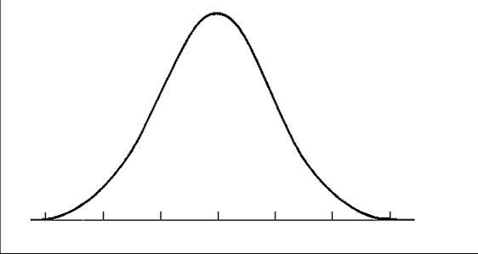



Model
Days market is in each class
Sell
Pass
Buy
Market up Market Down

Slide 6
Model
Logistical Regression
A simple multi class logistical Regression is used
Predictors being the mean open, high, low, close data from the previous days historical report
The Response is a Buy, Pass, or Sell classification for the next day
Visualization
A confusion matrix is then made and utilized with a Seaborn Heatmap for data visualization

Slide 7
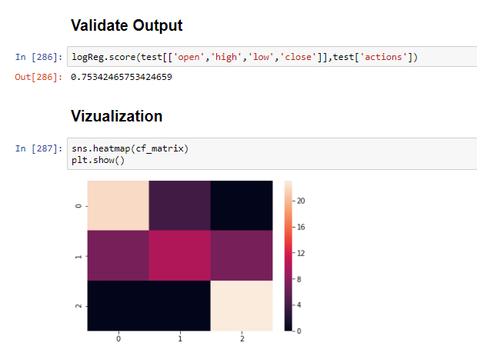
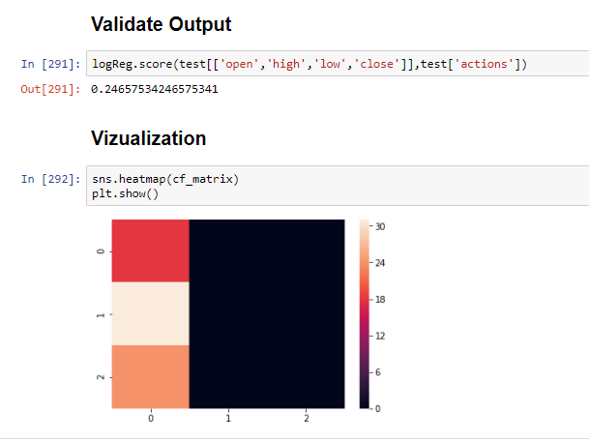
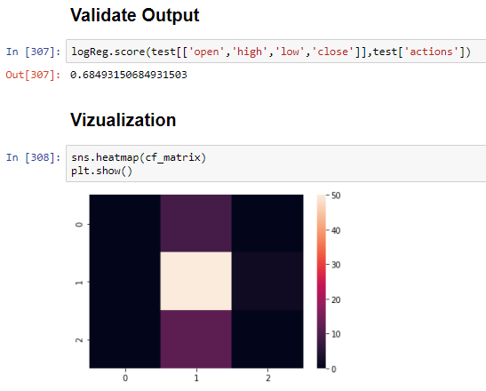
Tuning and design
Data is unnormalized – Results were far superior without normalization
½ standard deviation also used for response instead of 1 SD
Top Left: unnormalized with ½ SD
Top Right: normalized with ½ SD
Bottom Left: 1 SD

Slide 8
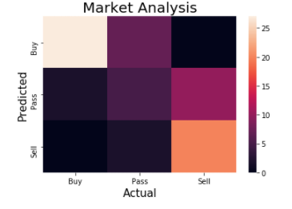
Results
The result of the trained logistic regression without normalization on the 20% test set was an accuracy of 0.7260
I see these results as positive and promising, while this logistic regression didn’t result in full proof data, there is at least a decent ¾ accuracy in predication.
I suspect that with added tuning and research this topic could yield high accuracy predictions for daily stock market analysis

Slide 9

Questions?

