Slide 1
Fast Cylinder and Plane Extraction from Depth Cameras for Visual Odometry
Paper Authors:Pedro Proenca, Yang Gao
Presentation: Anthony Calandra

Slide 2
Intro and related Work
Visual Odometry(VO)
Relevance to Visual Computing
Selected Related Works
PEAC
RANSAC
What this paper does

Slide 3
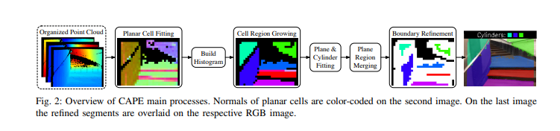
Cylinder and Plane Extraction(CAPE)
Flowchart is sourced from the associated paper

Slide 4
Planer Cell Fitting(CAPE)
Classifying nonplaner cells in the image
Significant missing points or discontinuous depth
How is discontinuity checked
A depth pixel is compared to all depth pixels in a cross centered at the pixel
If any adjacent pixel is outside a threshold relative to the center pixel there is discontinuity thus it is non planer
Plane fitting on passing cells
Done using Principle Component Analysis(PCA)
Plane normal is the eigenvector with the lowest eigenvalue
Mean Square Error(MSE) is given from that eigenvector
The cell is planer if
MSE < (Estimated Standard Unverity + Tolerance Coefficient)^2
Notes:
Nonplaner on missing points is based on a tolerance of missing points per cell

Slide 5
Histogram of Normals(CAPE)
A histogram of Normals is needed for region growing
What is region growing?
We need a 2D histogram of normal in the represented in spherical coordinate angles
Converting normal vectors of planner cells into polar and azimuth angles

Slide 6
Cell-Wise Region Growing(CAPE)

Slide 7
Plane and Cylinder Fitting(CAPE)

Slide 8
Model Segment Refinement(CAPE)

Slide 9

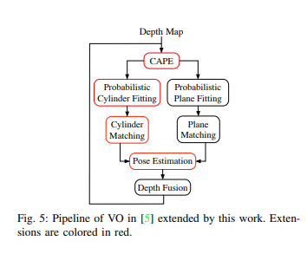
Cylinders for RGB-D Odometry
To Exploit both the extracted planes and cylinder primitives for VO
To address noise a probabilistic depth filter is used for depth fusion
This is based on a mixture of Gaussians that models the depth uncertainty

Slide 10
Probabilistic Cylinder fitting

Slide 11
Cylinder Matching

Slide 12
Pose Estimation Based on Cylinders

Slide 13
Experiments

Slide 14
Results

Slide 15
Conclusions

Slide 16
Q&A
☺

