Slide 1
The BANANAade Stand
An example

Slide 2
JavaScript is Complex
JavaScript programs can be pretty complex.
There are a lot of floating pieces that must be assembled perfectly.
The syntax is hard
Everything must be spelled exactly
JavaScript has some weird issues like using this as a keyword.
I'm going to walk you through some things you can do with JavaScript.
Hopefully, it will help you see how the different pieces come together.
Most of this is simple. But if you are new, getting the pieces to fit can be cumbersome to say the least.

Slide 3
Setting up 1
We are going to start with exercise 19.
If you didn't get exercise 19 going, shame on you. This is going to be tough for you.
Copy your exercise 19 files and name them for exercise 20.
Make sure to change the links in your HTML file.
Add some fields to your BananaadeStand for minimum number each ingredient needed to make bananaade (6 bananas, 1 gallon of water, 1 cup of sugar, 8 empty glasses)
Your BananaadeStand class should only have the following methods:
constructor
makeBananaade
sellBananaade
showIngredients
showAdmin
sellMoreBananaade
and any helper methods you may have used for the above methods.
Copy the two image files from AsULearn into your images folder.

Slide 4
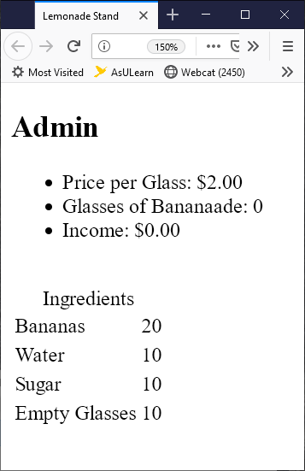
Setting up 2
Delete everything out of the body of your HTML page.
Delete everything out of your CSS file.
Make your test function an init function that looks like the following. Make sure ls is a global variable.
let ls = new BananaadeStand(20,10,10,10, 2.0);
function init() {
ls.showAdmin();
ls.showIngredients();
}
init();
If you did exercise 19 correctly you should have something that looks like the image to the right.

Slide 5
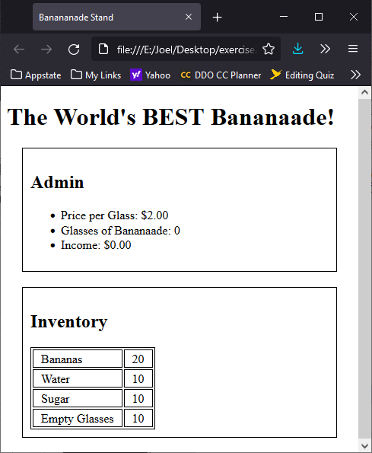
More changes
In your HTML file, add an h1 to the top of the body with text "The World's BEST Bananaade!"
In your JS file, change the Admin h1 header into an h2 header.
In your JS file, change the table caption so that it is an h2 header before the table. (Tricky)
In your JS file, change the above h2 to Inventory.
Add styles to CSS to put a one-pixel solid border around the articles.
article {border: 1px solid black;}
Add styles to CSS to put a border on the ingredients table.
table, td {border: 1px solid black;}
Throw in some padding and margins on the articles and table elements to get some separation.
It should look something like the image to the right at this point.

Slide 6
More articles
I wish I had used sections. These seem more like sections than articles.
Add two more articles to your HTML file.
We created the previous articles using DOM methods only as an exercise in using DOM methods. You don't normally want to add elements this way.
We will leave the previous articles as they are, so we don't have to redo them, but do the next two as simple HTML in the html file.
The first article is to allow adding of ingredients to the BananaadeStand.
The second article is to have some buttons that can call makeBananaade and sellBananaade.

Slide 7
Adding ingredients
Add an article to the body
Add an h2 header "Add Ingredients" to the article
Add four labels to the article
Make labels block level in css
label {display:block;}
Each label will contain the following and will be FOR each text input.
The plus_light.png image
A span with the appropriate text
Add bananas
Add gallons of water
Add cups of sugar
Add empty glasses
A text input (number?) with an id
tbBananas
tbWater
tbSugar
tbEmptyGlasses
<article>
<label for='tbBananas'>
<img src='../images/plus_light.png'>
<span>Add bananas</span>
<input id='tbBananas'></input>
</label>
…more labels…
</article>

Slide 8
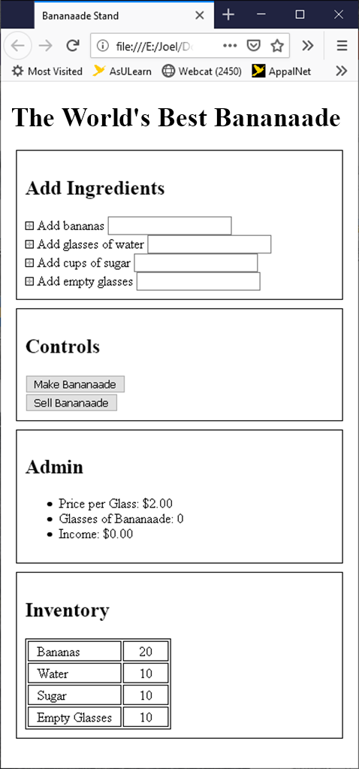
Adding controls
Add an article to the body
Add an h2 header to the article with the text "Controls"
Add two buttons to the article.
Use the button tag instead of the input tag.
Button - Make Bananaade
Button - Sell Bananaade
Make buttons block level in your CSS file.
button {display: block;}
It should look like the image to the right.
How else could we format our buttons?

Slide 9
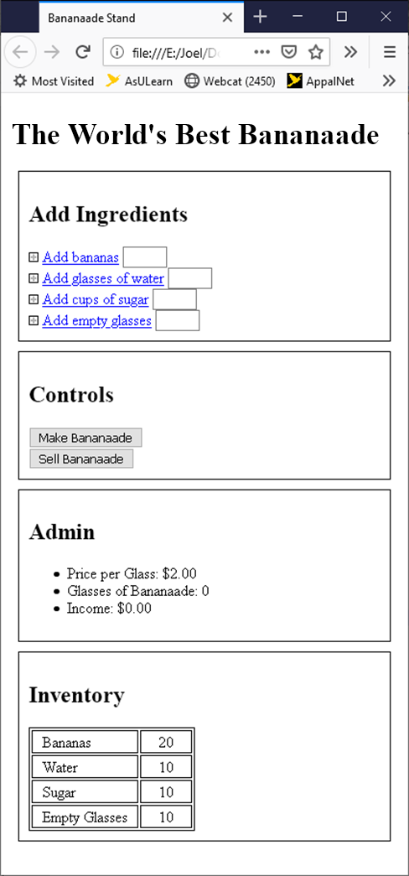
Clickable things
We are going to click on the labels to add ingredients.
We need to style the add ingredients elements.
Make all span tags be of the clickable class.
In the CSS file
Make it so clickable class elements have a pointer cursor when the mouse hovers.
Make it so clickable has underlined text
Make it so clickable has blue text
Make it so the label has a pointer cursor on hover. (Might cause a problem if you add other images later.)
Shorten up the text boxes to around 3em using the input selector.

Slide 10
Now for some javascript
If you started with my files, the following is already done.
Rename the test function to init.
Move the BananaadeStand object creation outside and before init so that it is a global variable.
let ls = new BananaadeStand(20,10,10,10, 2.0);
function init() {
ls.showAdmin();
ls.showIngredients();
//Put new code below here
}
init();

Slide 11
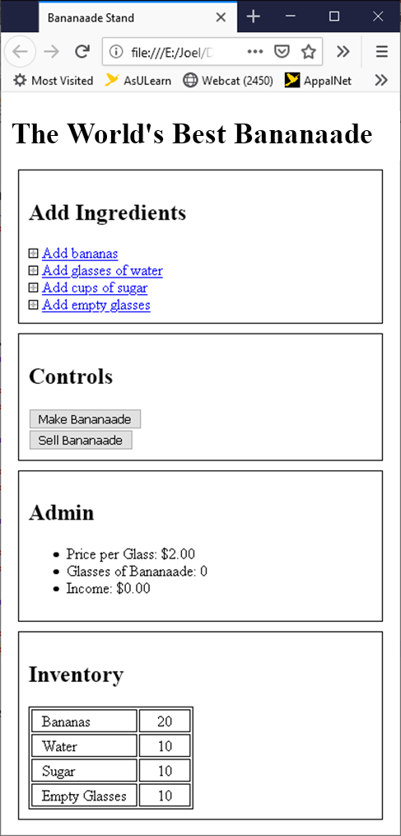
Hide the input boxes for add ingredients
We want the text boxes to only appear when the label is clicked.
We need to be able to hide those boxes in several places, so we are going to make a function to hide all of them.
Add class='hide_me' to all the input text boxes.
In the JS file, create a function above init (not in BananaadeStand) named hideAll.
In hideAll
Get a collection of elements with the hide_me class using getElementsByClassName
In a loop, set the display style of all elements in the collection to none (use for/of loop)
ele.style.visibility='hidden';
Call hideAll from the bottom of init.
We could have very easily done this from the CSS file. But this is a good example of getting a node list and changing each item.
If you did everything correctly, you should be able to refresh your web page and see all the text boxes disappear.

Slide 12
Adding ingredients
We want it so that when you click on one of the add spans, the text box appears and allows entry of the number of items to add.
We could specifically make one function for each add span, but that is wasteful.
We will make one general function to handle all the add span functionality (showInput).
We also need a function to initialize the spans and link them with the handler code (initEvents).
NOTE WE ARE MAKING TWO FUNCTIONS:
The event handler is showInput. It will be what happened when the item is clicked.
Function initEvents binds the click event on the item to the showInput function.
In your JS file, create a new function above init named initEvents.
Call initEvents from the bottom of init.
Inside of initEvents
Get a node list of all the hide_me inputs using querySelectorAll.
Add an onclick event to each input from the node list that calls a function named showInput.
The inputs are hidden, so how can we click on them? Since they are inside of a label with a for, clicking on anything in the label will be the same as clicking on the input.
Add a function showInput as described on the next slide.

Slide 13
showInput
Call hideAll first. If any other input text box is visible, we want to close it.
Keyword this will be set to the current element that caused this event handler to fire.
Show the text box. The .style below is how you access an elements style data.
this.style.visibility='visible';
If there was any previous text stored in the input, get rid of it by setting the value to an empty string.
this.value="";
Make sure this input has the keyboard focus which means the cursor is there ready for typing.
this.focus();
When you have all these complete, the input textbox should appear next to the span text when you click on it.
If you click on a different span, the box will disappear from the last and appear on the one you clicked.

Slide 14
Getting the input
Right now, when you enter a number of ingredients, it doesn't do anything.
We need to take the number and add it to the appropriate ingredient.
The issue is that the input doesn't know when you are done.
Typically, the enter key signifies when you are finished.
Like before we need to set up the click event (we will use the existing initEvents).
Then we need a function to handle the event and actually adds the ingredients (addIngredient).
So, we need a KeyboardEvent to detect when enter is pressed.
In the previously created initEvents function, we added the onclick event to all the inputs.
We also need to add a keydown event. Why keydown?
Add the keydown event to run a new function named addIngredient.
Create function addIngredient as described in the next slide.

Slide 15
Keyboard input with keyboardEvent
Functions designated as event handlers are automatically passed an event object.
You can access that object by providing a parameter as shown (e is the event).
In the function, e.key will return the ASCII value of the key typed.
All we need to do is see if it is the enter key.
function addIngredient(e)
{
if (e.key == "Enter")
{
//We are done so process the value.
}
}

Slide 16
Processing the keydown event
There are four possible inputs that could have been typed.
How to tell which one started this event? We can use e.target and the id.
function addIngredient(e) {
if (e.key == "Enter") {
if (e.target.id == "tbBananas) { ls.bananas += (+e.target.value); }
else if (e.target.id == "tbWater") { ls. Water += (+e.target.value); }
else if (e.target.id == "tbSugar") { ls. Sugar += (+e.target.value); }
else if (e.target.id == "tbEmptyGlasses") { ls.emptyGlasses += (+e.target.value); }
alert(ls.bananas)
}
}

Slide 17
Some error checking
We only want digits in the input.
We will use a regular expression to check the input before finishing.
function addIngredient(e) {
if (e.key == "Enter") {
let re = /^[0-9]*$/; //This is a regular expression for pattern matching
if (re.test(e.target.value)) {
if (e.target.id == "tbBananas) { ls.bananas += (+e.target.value); }
else if (e.target.id == "tbWater") { ls. Water += (+e.target.value); }
else if (e.target.id == "tbSugar") { ls. Sugar += (+e.target.value); }
else if (e.target.id == "tbEmptyGlasses") { ls.emptyGlasses += (+e.target.value); }
} else {
e.target.style.backgroundColor="#FFAAAA";} //Turn the input red
}
}
} //We need to change the backgroundColor back to white at some point.

Slide 18
Regular expressions
Create a regular expression this way. The / act like " in a string to define the bounds of a regular expression.
let re = /^[0-9]*$/;
re.test(e.target.value); //Returns true if the value matches the pattern.
[] represents a range of characters
[0-9] matches any SINGLE character 0 through 9.
[a-z] matches any SINGLE character a through z.
[0-9a-zA-Z] matches any SINGLE character that is a number or letter.
* after the [] means match zero or more of the previous. (+ means 1 or more. ? Means 0 or 1.)
[0-9]* means match no digits or any number of digits.
^ means start of the string.
$ means end of the string.
^[0-9]$ means exactly one digit
^[0-9]*$ means between start and end of string can be zero or more digits
if re.test(e.target.value) returns true it means e.target.value matches the pattern and contains only digits.

Slide 19
The addBananas Function
//FUNCTION addBananas MUST BE CREATED IN THE BananaadeStand CLASS.
addBananas(value) {
this.bananas += value; //Update the inventory
this.updateInventory("Bananas", this.bananas, this.minBananas);
//add updateInventory to the BananaadeStand class but leave it blank for now.
}
Create addWater, addSugar, and addEmptyClasses functions also.
Change addIngredients to use these functions.

Slide 20
Updating the inventory
FUNCTION updateInvnetory MUST BE CREATED IN THE BananaadeStand CLASS.
The table that displays the inventory needs to be updated any time the inventory changes.
There are two ways to do this.
Wipe out the old HTML and recreate it.
Find the appropriate text and modify it.
We will do the latter. The former is an option as long as there are few elements.
Another thing to accomplish here is if the inventory is too low to make a new batch of Bananaade, we will color that row of the table pink.
To find the correct td, we are going to search the table for the label text and then assume that the next sibling td is the value that needs to be updated.
This is a bit tricky sometimes because blank space between nodes are treated as extra nodes.
Our call to updateInventory passes three arguments
A string to search for. It doesn't have to be the whole value, but it must be unique to the row.
A value to put in the sibling td.
A minimum value for making a new batch of Bananaade. You should have added these as fields to your BananaadeStand class

Slide 21
updateInventory()
Get a reference to the table element using querySelector.
Search the table element node for all the td elements using the following
table.getElementsByTagName("td");
Loop through the td elements looking for the text string.
When you find it
Assume the next element sibling is the td to change, so change it.
If the value set is less than the minimum to make Bananaade, change the background of this element and the next sibling to pink.
If the value is NOT less than the minimum to make Bananaade, change the background of this element and the next sibling to whatever the current background is.

Slide 22
Making the buttons work
Complete the following in the initEvents function.
Get both buttons
Set the onclick to run makeBananaade and sellBananaade
let buttons = document.querySelectorAll('button');
We know there are two buttons so just use indexes this time.
Note the bold text is a problem, it messes up this in the Bananaade stand.
buttons[0].addEventListener('click', ls.makeBananaade, false);
buttons[1].addEventListener('click', ls.sellBananaade, false);
A workaround. Add an anonymous function to call makeBananaade. The event handler now isn't calling makeBananaade, it is simply calling an anonymous function.
buttons[0].addEventListener('click', function() { ls.makeBananaade(); }, false);
buttons[1].addEventListener('click', function() { ls.sellBananaade(); }, false);

Slide 23
Update after buttons
We need to update ALL the ingredients, not just one specific ingredient.
Make an updateAllIngredients function INSIDE OF THE BananaadeStand class that calls updateIngredients four times.
Look at the addValue function and see how we call updateIngredients from each individual add.
Call updateAllIngredients from the event handler for Make Lemonade.
We also need to update the admin section when Sell Lemonade is clicked.
Make an updateAdmin function inside the BananaadeStand class.
Get all the list items (getElementsByTag) and set the textContent using template literals.

Slide 24
Add mouseover visuals
Use mouseover and mouseout to modify add elements
Image will change to a darker plus sign when the mouse is over the element.
Span text will turn purple when the mouse is over the element.
The purple text we could do through CSS, but we're not.
Create a function named initImageMouseOver and call it from init.
Get a collection of span elements.
Go through the collection and add event handlers. We will use anonymous functions instead of creating new functions.
Do the same for the images. Copy the code you created and paste it into the bottom of the function and modify it for the img tags.
let nodes = document.querySelectorAll('span');
for (let ele of nodes) {
ele.addEventListener('mouseover', (e) => {
//set image to plus_dark.png' using nextSibling
//set the text to purple
}, false);
ele.addEventListener('mouseout', function (e) {
//set image to plus_dark.png' using nextSibling
//set the text to purple
}, false);
}
//Note the difference in the two anonymous functions
//above, one using function one using arrow notation.
//What does the difference mean?

Slide 25
More…
Make it so the admin function gets updated when you make or sell bananaade.
Make it so that you can change the price of a glass of Bananaade.
Add a button for sellMoreBananaade. You will need a number from 0 to 8.
Make it look good with CSS.
Put some margins around the buttons
Center the numbers in the inventory table
More, much more. Make it look good with colors and images and …

