Slide 1
JavaScript
A Quick Introduction and Assignment

Slide 2

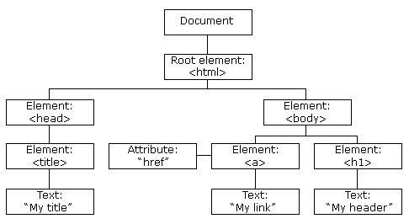

The document object model or dom
Browsers must store web pages.
They must store all the elements and the relationships between those elements.
The easiest way to store this data is as objects stored in a tree structure
That tree is called the DOM or sometimes HTML DOM.
These objects are JavaScript objects.
Since they are JavaScript objects it is possible to interact with them using the familiar dot notation.
As objects there are also built-in methods that we can use.

Slide 3
Using the dom
JavaScript can change all the HTML elements in the page
JavaScript can change all the HTML attributes in the page
JavaScript can change all the CSS styles in the page
JavaScript can remove existing HTML elements and attributes
JavaScript can add new HTML elements and attributes
JavaScript can react to all existing HTML events in the page
JavaScript can create new HTML events in the page

Slide 4
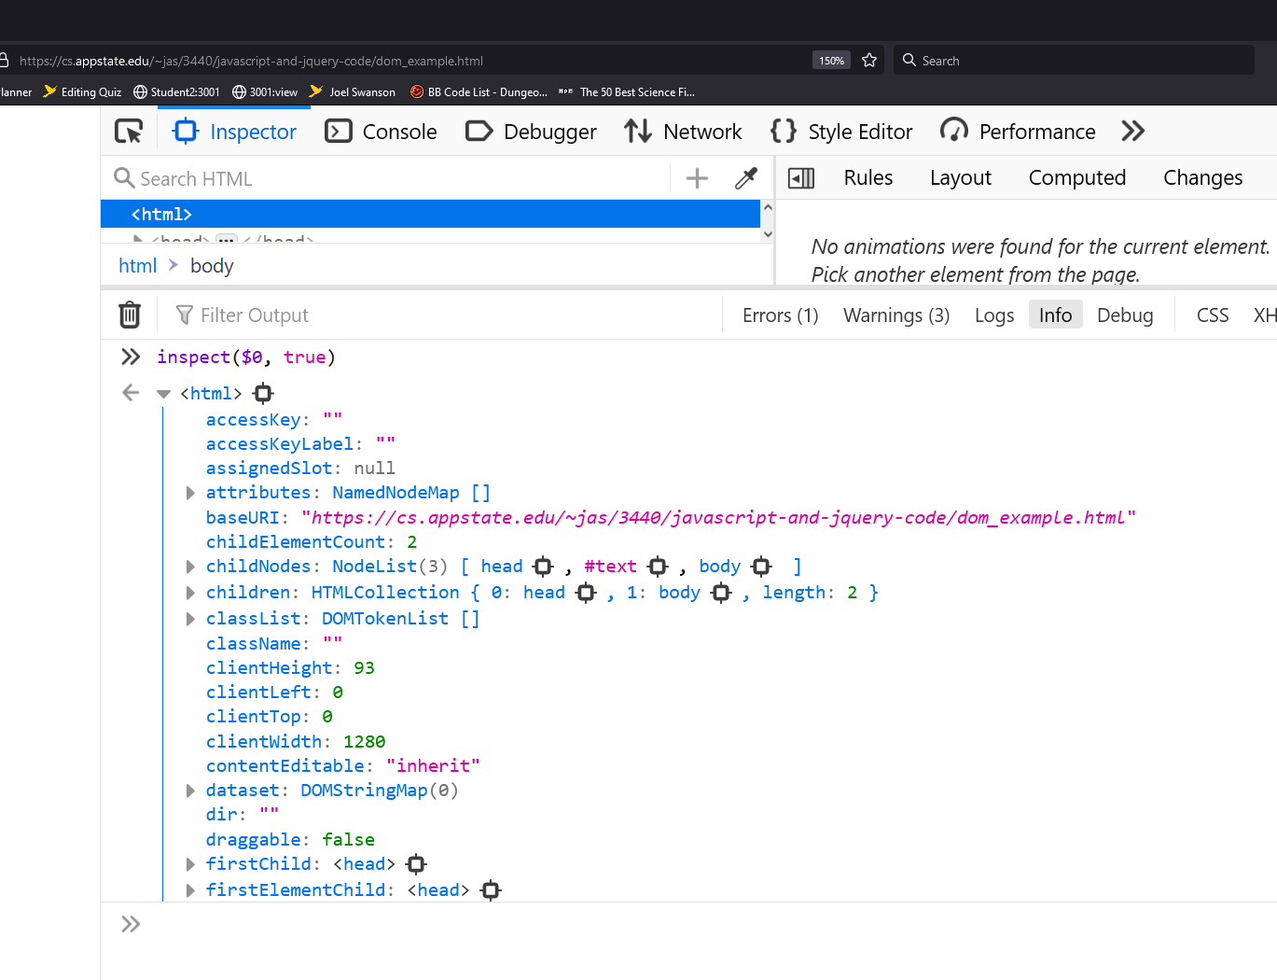
Seeing the html Dom in firefox
Example 1
Ctrl-Shift-I to bring up web console or use menu (same in Chrome).
Right click on the <html> tag and select "Show DOM Properties"
DOM will appear in bottom, third pane.

Slide 5
Items of note
childNodes
children
classList
className
clientHeight, clientLeft, clientTop, clientWidth
Random text nodes
firstChild, firstElementChild
lastChild, lastElementChild
nextSibling, nextElementSibling
textContent, innerHTML, innerText, outerHTML

Slide 6
Interacting with the html dom
The "document" object has many methods designed to find and interact with DOM elements.
console.log(
document.getElementsByTagName("html")[0].childElementCount
)
document.getElementsByTagName("h1")[0].textContent = "Hi"
document.getElementsByTagName("a")[0].textContent = "Your link"
document.getElementsByTagName("a")[0].id = "x"
document.getElementById("x").href="http://www.google.com"

Slide 7
document.write();
document.write() simply writes things to the web page.
The following will put the word Hello on the screen as a h1 level header.
document.write("<h1>Hello</h1>");
So why not just put the following in the body? Why use document.write() to do essentially the same thing?
<h1>Hello</h1>

Slide 8
When to use document.write() (NEVER)
When you are between the script tags (<script></script>) your browser goes into script mode.
You CANNOT use plain HTML when between the script tags.
You MUST use document.write for any HTML you would like to output when you are in script mode.
You cannot use document.write() after the web page is rendered or it will overwrite ALL HTML.
The document.write() function is VERY limited in its use.
DON’T use document.write() in any of the most basic operations.

Slide 9
These do the same thing.
<body>
<script type="text/javascript">
document.write("<h1>Hello</h1>");
</script>
</body>
<body>
<h1>Hello</h1>
</body>
Scripting uses document.write() to create parts of the web page.
Anywhere you put a script and use document.write() the text will appear directly there in the HTML.
I show the type because older HTML required it.
But JavaScript is now the default for HTML so type is no longer required.

Slide 10
These are errors.
Using html (or anything that isn't JavaScript) in a script
<body>
<script>
<h1>Hello</h1>
</script>
</body>
Using document.write (or any JavaScript) outside of a script
<body>
document.write("<h1>Hello</h1>");
</body>

Slide 11
You can have multiple script tags
<body>
… some HTML …
<script>
document.write("<h1>Hello</h1>");
</script>
… some more HTML …
<script>
document.write("<h1>Hello</h1>");
</script>
… some more HTML …
</body>

Slide 12
For this Assignment
Some things needed for this assignment.
Functions – a function is a set of JavaScript instructions that is grouped together and named.
textContent – This is how we can change text that is already being displayed on a web page.
setTimeout() – A built in JavaScript function or event that can call another function after a certain amount of time.
Date() - A build in JavaScript object for time.
getElementById() - How to get access to the HTML elements from JavaScript

Slide 13
Javascript output
Writing into an HTML element, using innerHTML or innerText.
Writing into the HTML output using document.write().
Writing into an alert box, using window.alert().
Writing into the browser console, using console.log().

Slide 14
JavaScript Programming and Functions
A program is a series of instructions.
Those instructions are executed one at a time from top to bottom in order.
Some instructions can jump to other instructions and change the order.
A function is a set of instructions which is set apart and can be executed when needed.
A function's instructions WILL NOT be executed unless specifically invoked (told to) by the program.
Functions are usually defined in the head section (inside of script tags) or in a separate JavaScript file.
We will be using a function which is defined in the head section.
Even if you think you know about functions, JavaScript functions are VERY, VERY unlike functions you have used in any other language.

Slide 15
camelCase or Hungarian notation
It is common in programming languages to name things like variables and functions in a way that describes what they are or what they do.
The names sometimes take more of a sentence form.
Since spaces are not allowed, the words get pushed together.
Camelcase notation makes it easier to read, by simply capitalize the first letter of each word.
So instead of a function named averageallgrades
You get averageAllGrades
You should use this notation in your programs.
JavaScript IS case sensitive, so if you mess up the capitalization of ANY variable or function it will simply not work.

Slide 16
How to define a function
Things underlined below are required and must be exactly as shown.
Things italicized and bold are required but you can change them at need.
<head>
<meta charset="utf-8">
<title>Time Page</title>
<script>
function nameOfFunction()
{
//Code goes here between { and }.
//{ and } defines the start and end of this function's code.
//Things that start with // are comments and are ignored.
//You can change nameOfFunction to anything you like.
}
</script>
</head>
Functions can go inside of any script tags but should be grouped together in the head section or, preferably, in their own file.

Slide 17
You can have any number of functions
<script>
function funFunction1()
{
//Code for funFunction1.
}
function anotherFunFunction()
{
//Code for anotherFunFunction.
}
</script>

Slide 18
External javascript files
<head>
<meta charset="utf-8">
<title>Time</title>
<script src="../scripts/exercise16.js"></script>
</head>
Create a scripts directory at the same level as exercises, styles, images, and media.
Note that if you specify a JS file, the script tags MUST be empty.
The JavaScript file should ONLY contain JavaScript. It should not have HTML or <script> tags.
For this assignment copy ONLY the function updateTime() to exercise16.js.

Slide 19
Run or Execute a Function
<head>
<script src="../scripts/exercise16.js"></script>
</head>
<body>
<script> updateTime(); </script>
</body>
The code in updateTime() will get executed from the body section.
Note a type is not required in the script tag in the body section. JavaScript is assumed if there is no type.
Of course, the code to the left is an example, you would definitely STILL NEED to put in a meta tag and a title, which was left out for brevity.

Slide 20
Getting the time
JavaScript has built in classes like Date(), Math(), and String().
The Date() object has many functions for time related information
let currentDate = new Date();
A new Date object is created at the time the code is executed.
That date's information can be referenced with the currentData object.
Note that the time and date are locked in when the code is executed. It will not change. You must create a new Date object if you want to update the time.
Get the hour that the Date object was created using the reference variable
let hours = currentDate.getHours();
You must do the same for minutes and seconds.

Slide 21
textContent
When using any element which contains text, like the XX:XX below
<h1 id="timeheader" >XX:XX</h1>
The XX:XX is called the textContent (case IS VERY important here).

Slide 22
Changing textContent
The <h1> is in the body of the web page as shown on the last slide.
The function is in the head section.
To change the textContent you have to first find the correct element.
Do this inside of the function in the head section
let th = document.getElementById("timeheader"); //Find the correct element with ID.
th.textContent = "Something"; //Change the text on the element.
The above will replace the XX:XX from the previous slide as it appears on the web page with the word Something.
We want to replace XX:XX with the updated time. SEE NEXT SLIDE.

Slide 23
FORMAtting the correct time
Once you have hours and minutes you can create the time like this:
th.textContent = hours + ":" + minutes;
A string is one or more characters like the colon above (":").
Variables hours and minutes are numbers, not strings.
When you add a number variable to a string it pushes the values together instead of adding.
So if hours is 5 and minutes is 36, then hours + ":" + minutes would be "5:36"
th.textContent = hours + ":" + minutes;
will update the web page with the correct time.

Slide 24
Alternatives to textcontent
Any of the following would work.
th.textContent=time; //Best
th.innerHTML = time; //Not really safe since it parses html
th.firstChild.nodeValue = time; //Works

Slide 25
An issue
There is a small issue that leaves me unsatisfied with the assignment as is.
If the time is 5 hours, 5 minutes, and 5 seconds the display looks like this:
5:5:5 (which isn't very time-like)
I would prefer this with leading zeros for minutes and seconds:
5:05:05

Slide 26
The problem is …
The problem is leading zeros are never displayed on numbers.
th.textContent = hours + ":" + minutes;
Variables hours and minutes hold numbers.
So if hours and minutes are 5 JavaScript does this:
th.textContent = 5 + ":" + 5
Which turns into "5:5" and that doesn't look very good for a time.
YOU MUST ALSO HAVE SECONDS!!!

Slide 27
Making the page update
setTimout("function_name", time_in_milliseconds )
A built-in function/event which tells the browser to wait a certain amount of time and then run the named function.
This instruction tells the browser to wait 1 second then run updateTime();
setTimeout("updateTime", 1000);
Note that we are NOT running updateTime here. We are passing a reference to a function as if updateTime is simply a variable. So, you SHOULD NOT include the (); when using a function as an argument.
If you put this code at the bottom of updateTime, every time updateTime runs, it will reschedule itself to run again in 1 second.

Slide 28
Turn in the assignment.
Name your files exercise16.html and exercise16.js.
Validate the HTML file (You don’t validate JavaScript).
Upload to AsULearn.

