Slide 1
CSS Grid
Mozilla Grid Tutorial

Slide 2


What is a CSS grid?
A way to specify rows and columns using purely CSS.
Fixed and flexible sizing
Precise placement of elements
Alignment control
Overlap control

Slide 3
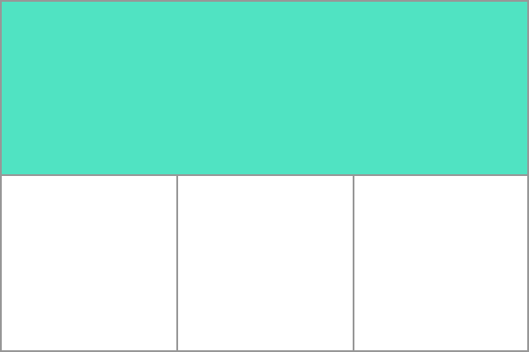
Grid tracks
We define rows and columns on our grid with the grid-template-columns and grid-template-rows properties.
These define grid tracks.
A grid track is the space between any two lines on the grid.
In the below image you can see a track highlighted – this is the first-row track in our grid.

Slide 4

GRID setup
Use the display attribute
Set up a block level grid
display: grid;
Set up an inline grid (
the grid itself is set as an inline element
display: inline-grid;
.wrapper {
display: grid;
}

Slide 5
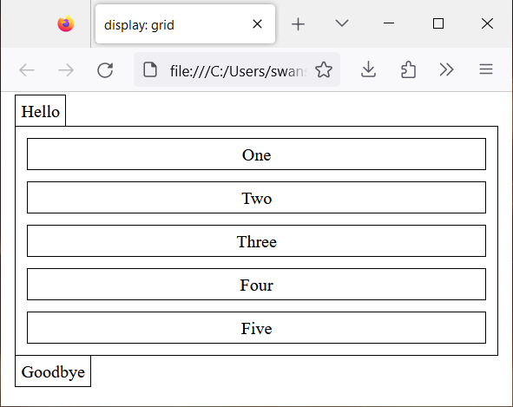
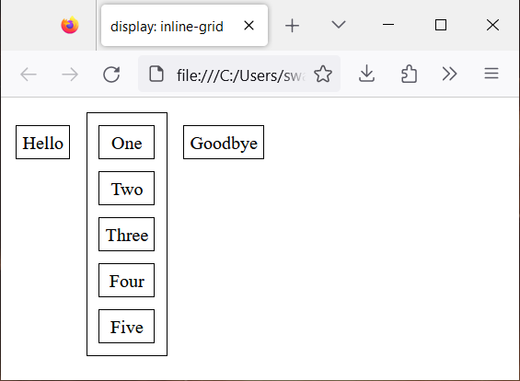
Display: Grid and display: inline-grid
<span>Hello</span>
<div class="wrapper">
<div>One</div>
<div>Two</div>
<div>Three</div>
<div>Four</div>
<div>Five</div>
</div>
<span>Goodbye</span>

Slide 6
Example grid setup
<!DOCTYPE html>
<html lang="en">
<head>
<meta charset="utf-8">
<title>Simple Grid</title>
<link rel="stylesheet" href="grid.css" >
</head>
<body>
<div class="wrapper">
<div class="one">One</div>
<div class="two">Two</div>
<div class="three">Three</div>
<div class="four">Four</div>
<div class="five">Five</div>
<div class="six">Six</div>
</div>
</body>
</html>
Example
div div {
border: 1px solid black;
}
.wrapper {
display: grid;
}
.one {}
.two {}
.three {}
.four {}
.five {}
.six {}

Slide 7
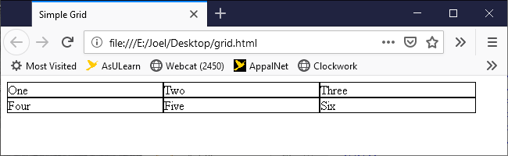
Grid columns
.wrapper {
display: grid;
grid-template-columns: 200px 200px 200px;
}
Fixed size columns at 200px each.
The individual elements are automatically laid out from left to right in the columns as provided
Example

Slide 8
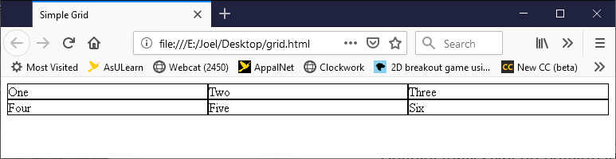
The fr unit
Column tracks can be defined using any length unit.
Grid also introduces an additional length unit to help us create flexible grid tracks.
The new fr unit represents a fraction of the available space in the grid container.
The next grid definition would create three equal width tracks that grow and shrink according to the available space (33.3% for each column).
.wrapper {
display: grid;
grid-template-columns: 1fr 1fr 1fr;
}
Example

Slide 9
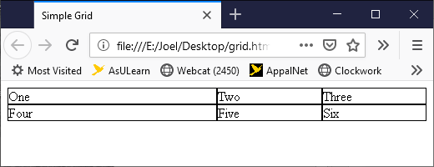
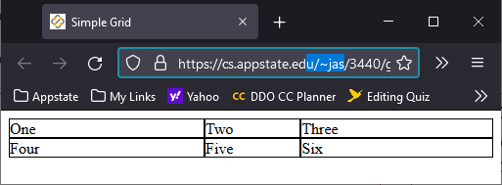
Mixed sizes
grid-template-columns: 2fr 1fr 1fr;
Example
grid-template-columns: 200px 1fr 2fr;
Note One and Four do not change size with browser resize.
Two, Three, Five, and Six resize with available space.
Example

Slide 10
Column repeat
Repeat 1fr column three times. Same as 1fr 1fr 1fr
grid-template-columns: repeat(3, 1fr);
Repeat in the middle puts 1fr six times. Same as 40px 1fr 1fr 1fr 1fr 40px
grid-template-columns: 40px repeat(4, 1fr) 40px;
Repeat a pattern. Same as 1fr 2ft 1fr 2ft 1fr 2ft
grid-template-columns: repeat(3, 1fr 2fr);

Slide 11
Implicit and explicit grid
Note in the examples, we didn't create rows. The rows were created for us.
The three defined columns are explicit.
The rows are implicit. The browser decided for us how to create those.
We can define parameters for implicit columns and rows
grid-auto-rows
grid-auto-columns
.wrapper {
display: grid;
grid-template-columns: repeat(3, 1fr);
grid-auto-rows: 200px; /* ensure any added rows will be 200 pixels high */
}

Slide 12
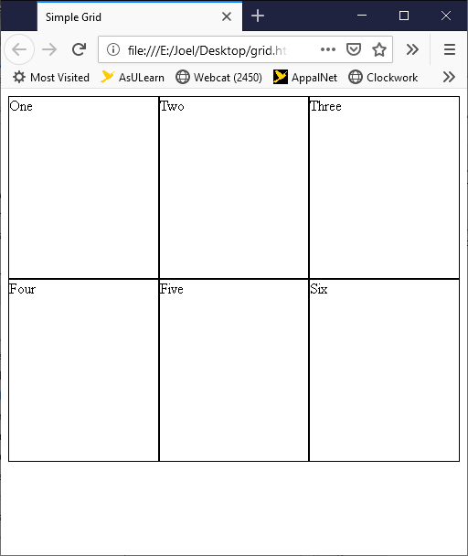
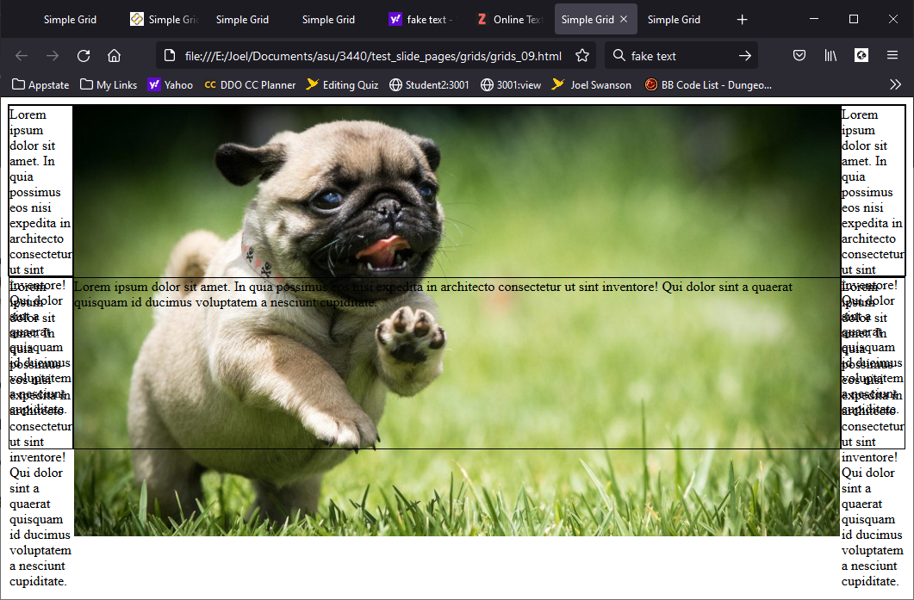
Grid-auto-rows
.wrapper {
display: grid;
grid-template-columns: repeat(3, 1fr);
grid-auto-rows: 200px;
}
A drawback is that the 200px row will not grow to fit bigger content.
Example

Slide 13
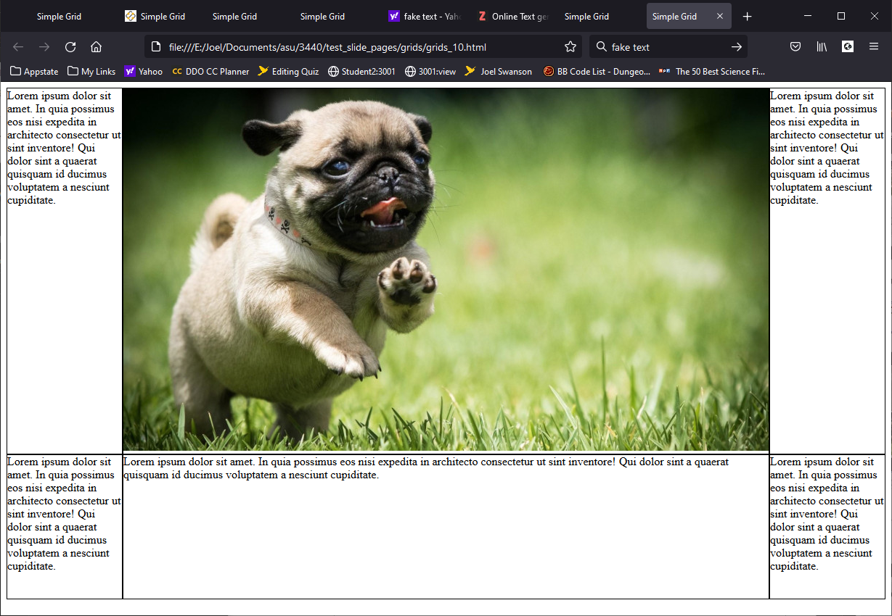
Grid-auto-rows: minmax
.wrapper {
display: grid;
grid-template-columns: repeat(3, 1fr);
grid-auto-rows:
minmax(200px, auto);
}
minmax defines a minimum and a maximum.
auto means resize as necessary.
Example

Slide 14

Grid cell
The smallest unit on a cell

Slide 15

Grid area
Items can span one or more cells both by row or by column, and this creates a grid area.
Grid areas must be rectangular – it isn’t possible to create an L-shaped area for example.

Slide 16
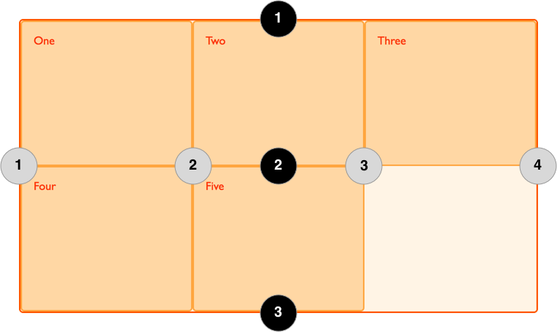
Grid lines
When we define a grid we define the grid tracks, not the lines.
Grid then gives us numbered lines to use when positioning items.
In our three column, two row grid we have four column lines.
Lines are numbered according to the writing mode of the document.

Slide 17
Grid spacing using lines
.one {
grid-column-start: 1;
grid-column-end: 4;
grid-row-start: 1;
grid-row-end: 3;
}
How will this change .one?
Where will the rest go?

Slide 18
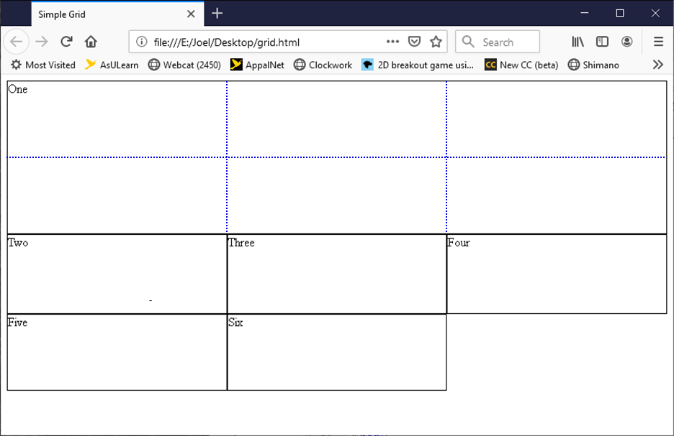
Using lines to specify
.one {
grid-column-start: 1;
grid-column-end: 4;
grid-row-start: 1;
grid-row-end: 3;
}
Note these are specified in the class for the cell NOT the wrapper.
The blue dotted lines are only shown for reference.

Slide 19
Shorthand Using lines to specify
.one_old {
grid-column-start: 1;
grid-column-end: 4;
grid-row-start: 1;
grid-row-end: 3;
}
.one {
grid-column: 1 / 4;
grid-row: 1 / 3;
}

Slide 20
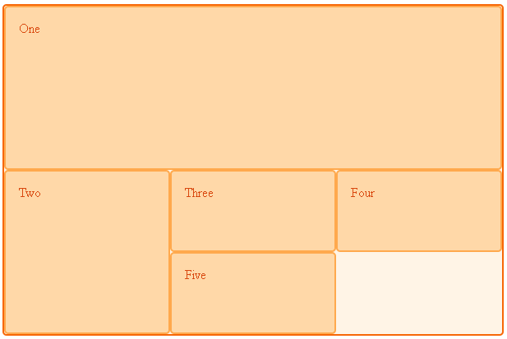
Positioning using lines
How could we change div two to this this using lines?
Where would the specification go?

Slide 21
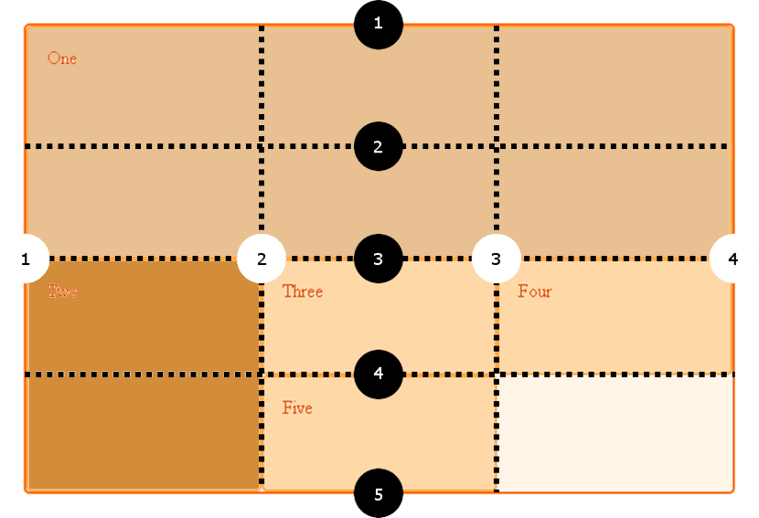
Positioning using lines questions
How could we change div two to this this using lines?
Where would the specification go?

Slide 22
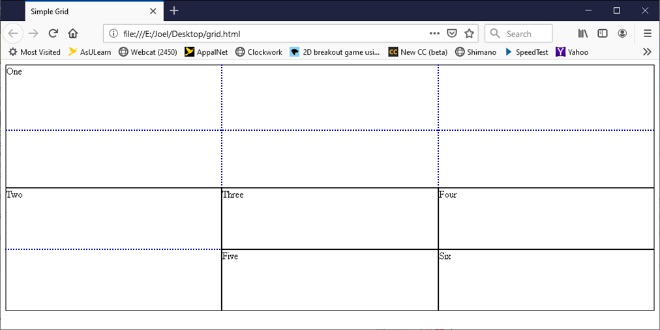
Grid line Solution
.one {
grid-column: 1 / 4;
grid-row: 1 / 3;
}
.two {
grid-row: 3 / 5;
}

Slide 23
Grid-area style
Values in this order
grid-row-start
grid-column-start
grid-row-end
grid-column-end
grid-area: 1 / 1 / 3 / 4;

Slide 24
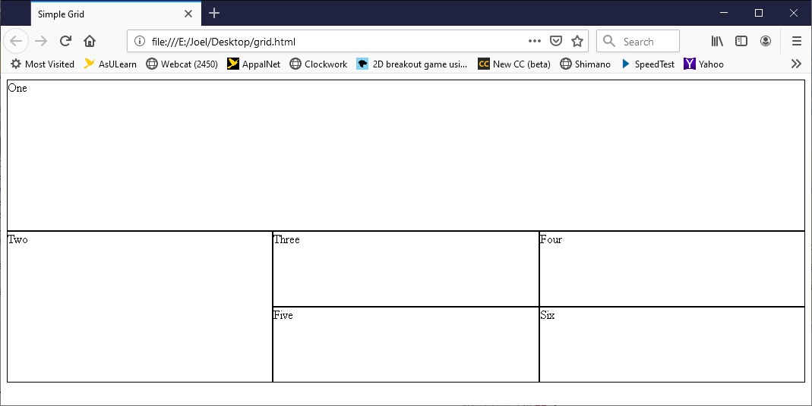
Grid Area Example
.one_old {
grid-column: 1 / 4;
grid-row: 1 / 3;
}
.one{
grid-area: 1 / 1 / 3 / 4;
}
.two {
grid-row: 3 / 5;
}

Slide 25
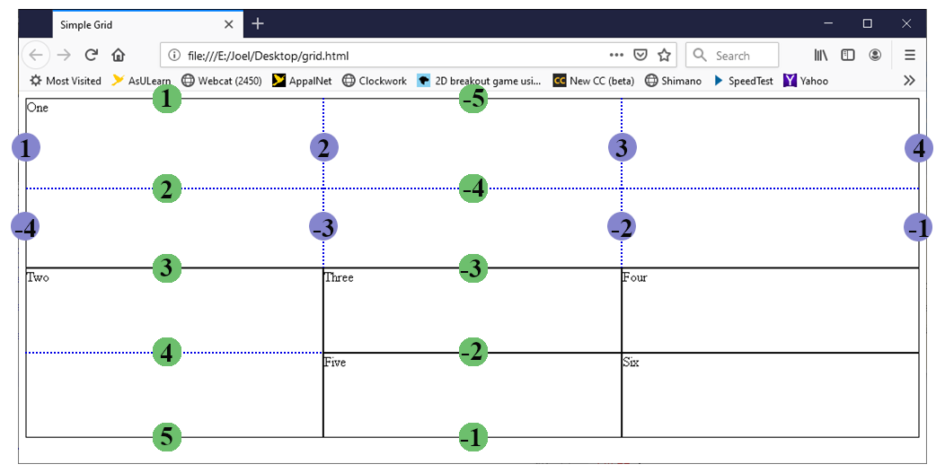
Grid Area Example negatives
.one_old {
grid-area: 1 / 1 / 3 / 4;
}
.one {
grid-area: -5 / -4 / -3 / -1;
}
.two_old {
grid-row: 3 / 5;
}
.two {
grid-row: -1 / -3;
}
You can specify negative values. It will count backwards from the left or bottom.
If you mix positive and negative on the same axis odd things may happen.

Slide 26
Spanning columns using -1
.one {
grid-column: 1 / -1;
grid-row: 1 / 3;
}
.two {
grid-row: 3 / 5;
}
You can specify negative values. It will count backwards from the left or bottom.

Slide 27
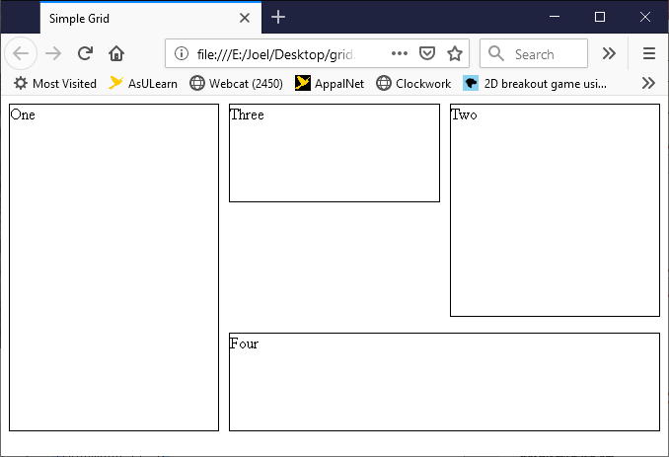
Using the span keyword
.one {
grid-column: 1;
grid-row: 1 / span 3;}
.two {
grid-column: 3;
grid-row: 1 / span 2;}
.three {
grid-column: 2;
grid-row: 1; }
.four {
grid-column: 2 / span 2;
grid-row: 3;}

Slide 28
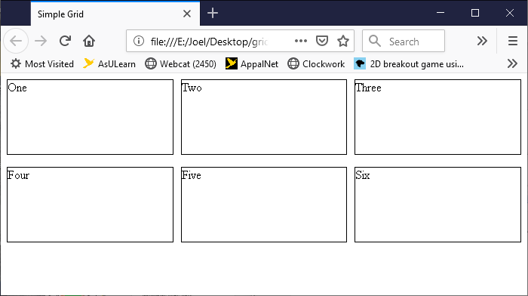
gutters
Gutters or alleys represent spacing between grid cells
created using the column-gap and row-gap properties, or the shorthand gap.
.wrapper {
display: grid;
grid-template-columns: repeat(3, 1fr);
column-gap: 10px;
row-gap: 1em;
}

Slide 29
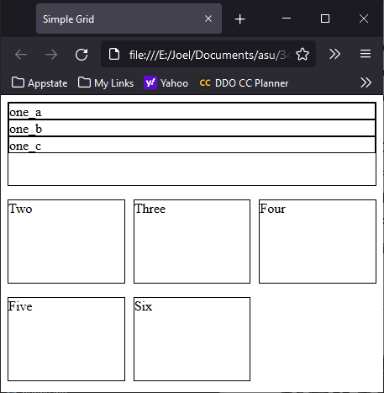
Nesting grids
<div class="wrapper">
<div class="one">
<div class="nested">one_a</div>
<div class="nested">one_b</div>
<div class="nested">one_c</div>
</div>
<div class="two">Two</div>
<div class="three">Three</div>
<div class="four">Four</div>
<div class="five">Five</div>
<div class="six">Six</div>
</div>
Example
.wrapper {
display: grid;
grid-template-columns: repeat(3, 1fr);
grid-auto-rows: minmax(100px, auto);
column-gap: 10px;
row-gap: 1em;
}
.one {
grid-column-start: 1;
grid-column-end: 4;
}

Slide 30
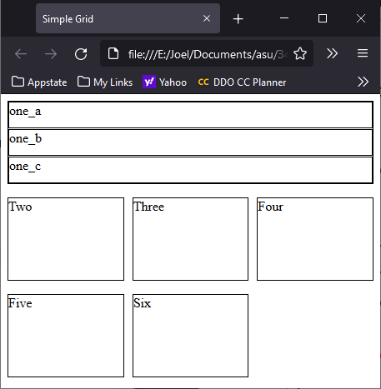
Nesting grids 2
.wrapper {
display: grid;
grid-template-columns: repeat(3, 1fr);
grid-auto-rows: minmax(100px, auto);
column-gap: 10px;
row-gap: 1em;
}
.one {
grid-column-start: 1;
grid-column-end: 4;
display: grid;
row-gap: 1px;
}
.one now has its own display:grid with separate grid specifications.
Note the difference from previous slide
Example

Slide 31

Example 1 – moving things around
.wrapper {
display: grid;
grid-template-columns: repeat(3, 1fr);
grid-auto-rows: minmax(100px, auto);
column-gap: 10px;
row-gap: 1em;
}
.one { grid-area: 2 / 3;}
.two { grid-area: 2 / 2;}
.three { grid-area: 2 / 1;}
.four { grid-area: 1 / 3;}
.five { grid-area: 1 / 2;}
.six { grid-area: 1 / 1;} (NOTE THE ORDERING OF THE DIVS)

Slide 32
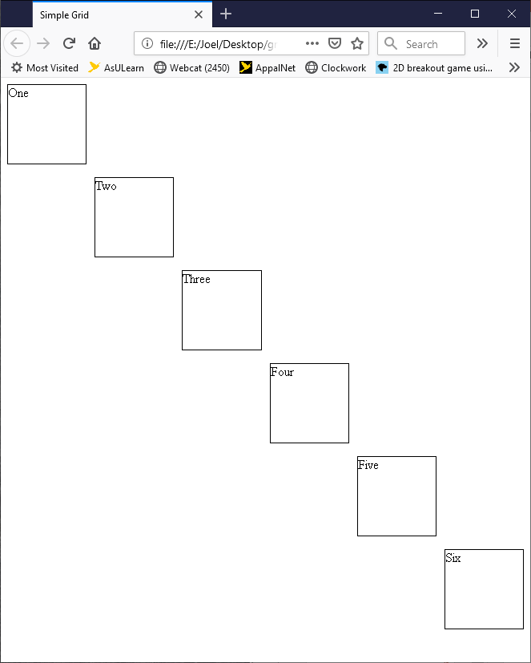
Example 2
wrapper {
display: grid;
grid-template-columns: repeat(6, 1fr);
grid-auto-rows: minmax(100px, auto);
column-gap: 10px;
row-gap: 1em;
}
.one { grid-area: 1 / 1; }
.two { grid-area: 2 / 2;}
.three { grid-area: 3 / 3;}
.four { grid-area: 4 / 4;}
.five { grid-area: 5 / 5;}
.six { grid-area: 6 / 6;}

Slide 33
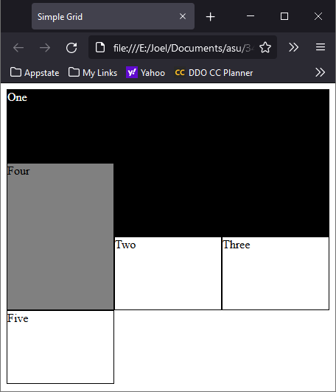
Overlapping grids
You can specify overlaps with grids.
.one {
grid-column-start: 1;
grid-column-end: 4;
grid-row-start: 1;
grid-row-end: 3;
color: white;
background-color: black;
}
.four {
grid-column-start: 1;
grid-row-start: 2;
grid-row-end: 4;
background-color: gray;
}

Slide 34
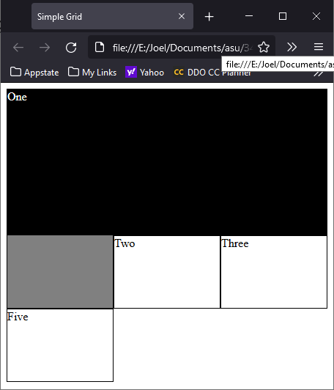
Overlapping grids and Z-index
You can specify which is on top by using z-index.
.one {
grid-column-start: 1;
grid-column-end: 4;
grid-row-start: 1;
grid-row-end: 3;
color: white;
background-color: black;
z-index : 2
}
.four {
grid-column-start: 1;
grid-row-start: 2;
grid-row-end: 4;
background-color: gray;
z-index: 1;
}

Slide 35
Grid template areas
You can specify areas by naming them and then using the name in a template

Slide 36
Naming areas
.header {
grid-area: hd;
}
.footer {
grid-area: ft;
}
.sidebar {
grid-area: sd;
}
.content {
grid-area: main;
}
.wrapper {
display: grid;
grid-template-columns: repeat(9, 1fr);
grid-auto-rows: minmax(100px, auto);
grid-template-areas:
"hd hd hd hd hd hd hd hd hd"
"sd sd sd main main main main main main"
"ft ft ft ft ft ft ft ft ft";
}
You can define an area by giving it a name and then specify the location of that area in the value of the grid-template-areas property.
You can choose what you would like to name your area.
a header
a footer
a sidebar
the main content

Slide 37
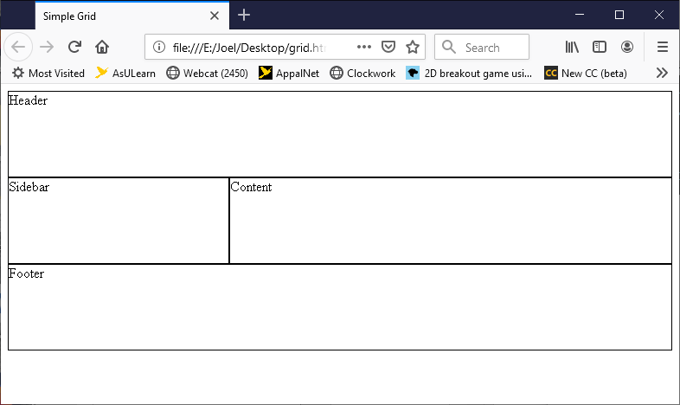
Example with named areas
<div class="wrapper">
<div class="header">Header</div>
<div class="footer">Footer</div>
<div class="sidebar">Sidebar</div>
<div class="content">Content</div>
</div>
.header {
grid-area: hd;
}
.footer {
grid-area: ft;
}
.sidebar {
grid-area: sd;
}
.content {
grid-area: main;
}
.wrapper {
display: grid;
grid-template-columns: repeat(9, 1fr);
grid-auto-rows: minmax(100px, auto);
grid-template-areas:
"hd hd hd hd hd hd hd hd hd "
"sd sd sd main main main main main main"
"ft ft ft ft ft ft ft ft ft ";
}

Slide 38
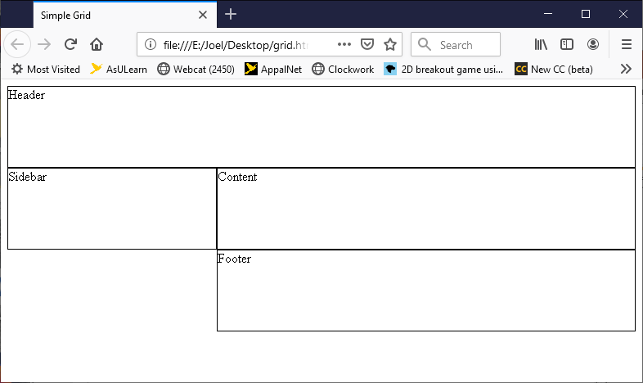
Leaving a grid cell empty
.wrapper {
display: grid;
grid-template-columns: repeat(9, 1fr);
grid-auto-rows: minmax(100px, auto);
grid-template-areas:
"hd hd hd hd hd hd hd hd hd"
"sd sd sd main main main main main main"
". . . ft ft ft ft ft ft";
}

Slide 39
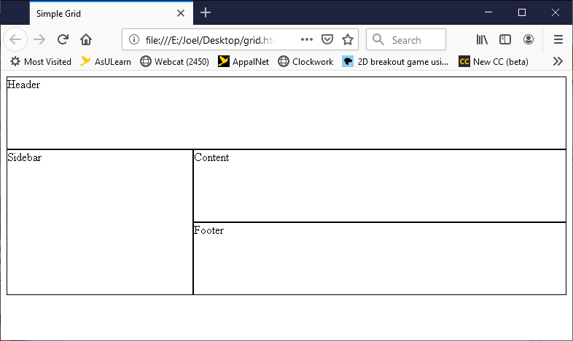
Spanning rows
.wrapper {
display: grid;
grid-template-columns: repeat(9, 1fr);
grid-auto-rows: minmax(100px, auto);
grid-template-areas:
"hd hd hd hd hd hd hd hd hd "
"sd sd sd main main main main main main"
"sd sd sd ft ft ft ft ft ft ";
}

Slide 40
Sizing for Media
@media screen and (min-width: 500px) {
.wrapper {
display: grid;
grid-template-columns: repeat(9, 1fr);
grid-auto-rows: minmax(100px, auto);
grid-template-areas:
"hd hd hd hd hd hd hd hd hd "
"sd sd sd main main main main main main"
"sd sd sd ft ft ft ft ft ft ";
}
}
@media screen and (min-width: 700px) {
.wrapper {
display: grid;
grid-template-columns: repeat(9, 1fr);
grid-auto-rows: minmax(100px, auto);
grid-template-areas:
"hd hd hd hd hd hd hd hd hd "
"sd sd main main main main main ft ft";
}
}
Formatting your page for different sized
display devices can be done easily.
NOTE: You will have to zoom in using CTRL +
on some browsers if the size is too small to
notice the effect.

Slide 41
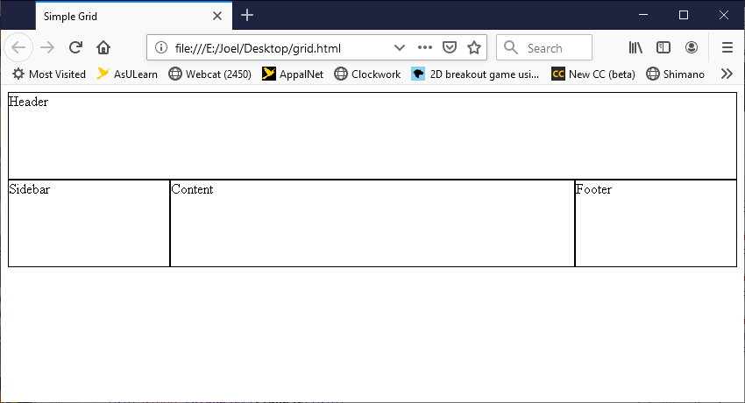
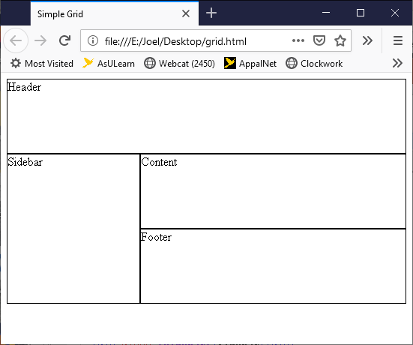
Note the formats

Slide 42
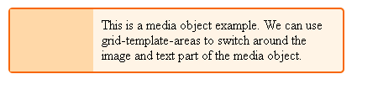
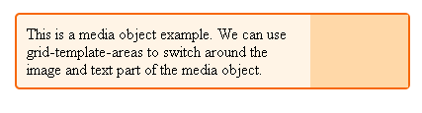
Using grids on ui elements
* {box-sizing: border-box;}
.media {
border: 2px solid #f76707;
border-radius: 5px;
background-color: #fff4e6;
max-width: 400px;}
.media {
display: grid;
grid-template-columns: 1fr 3fr;
grid-template-areas: "img content";
margin-bottom: 1em;}
.media .image {
grid-area: img;
background-color: #ffd8a8;}
.media .text {
grid-area: content;
padding: 10px; }
<div class="media">
<div class="image"></div>
<div class="text">This is a media object example.
We can use grid-template-areas to switch around
the image and text part of the media object.
</div>
</div>
An easy switch between the two.
Switch img and content
Switch 1fr and 3fr

Slide 43
Grid-template shortcut
.wrapper {
display: grid;
grid-template:
"hd hd hd hd hd hd hd hd hd" minmax(100px, auto)
"sd sd sd main main main main main main" minmax(100px, auto)
"ft ft ft ft ft ft ft ft ft" minmax(100px, auto)
/ 1fr 1fr 1fr 1fr 1fr 1fr 1fr 1fr 1fr ;
}
Sets all at once
grid-template-rows
grid-template-columns
grid-template-areas

