Slide 1
Rubik’s Cube
杨维铠
周玉枭

Slide 2
1. What is it like

Slide 3
2. What we have done
3D-object’s render and operation
modeling a cube and solve it

Slide 4
3. Why did we do this
front end: 3D is the future
back end: high-level abstract is challenging

Slide 5
4. What were the problems
3D rendering & operation
Cube’s modeling and solving

Slide 6
3D rendering & operation
Rotation
Animation

Slide 7
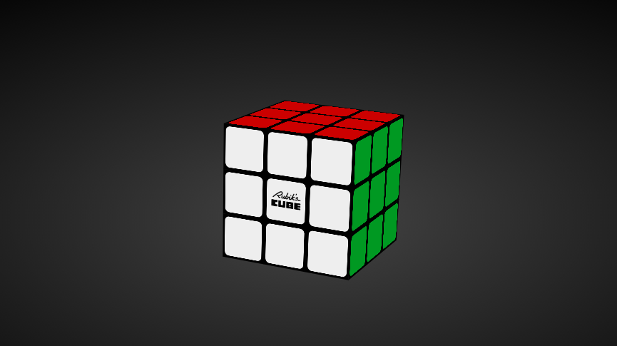
Cube modeling
UFL
FL

Slide 8
Cube solving
Kociemba's Two Phase Algorithm
IDA* Search

Slide 9
Q & A

