Slide 1
Modelling infectious disease transmission
in Lui Che-woo building
using an agent-based model
Jiayi Chen, Yihan Chen, Xiaoyang Sheng
2024/5/22
Notes:
We plan to focus on solving the transmission probability of infectious disease among a fixed group of people that stay in a shared environment for a long time. In our research, we choose the third floor of Lui Che-woo building as the environment.

Slide 2
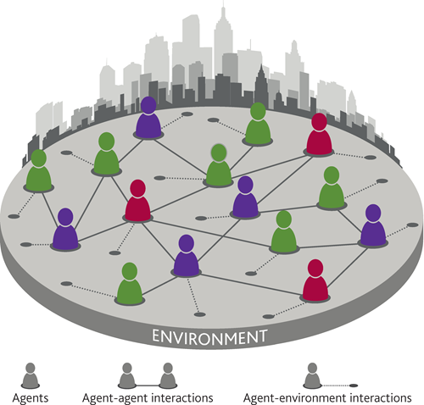
Why agent-based model?
ABM : Simulate the actions and interactions of autonomous agents within a system. These agents typically represent individuals, groups, or entities with specified behaviors and decision-making rules.
> Individual differences, behaviors
> Environmental factors
> Assess how different interventions affect the risk
Notes:
Agent-based model is a computational model that simulate the actions and interactions of autonomous agents within a system. These agents typically represent individuals, groups, or entities with specified behaviors and decision-making rules.
Different from classical mathematical models (which consider a homogenous population), agent-based approaches model individuals with distinct characteristics and provide more realistic results.Common models, such as SIR, overlook the effects of individual differences, behaviors, and environmental factors on the dynamics of disease transmission. But with agent-based model, we can determine the dynamics of a disease in a more fine-context way, particularly when it is necessary to characterize the transmission process person-to-person and assese how different interventions affect the risk in a particular place.

Slide 3
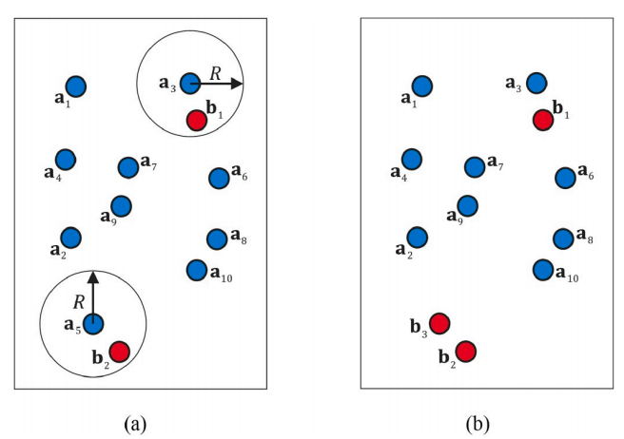
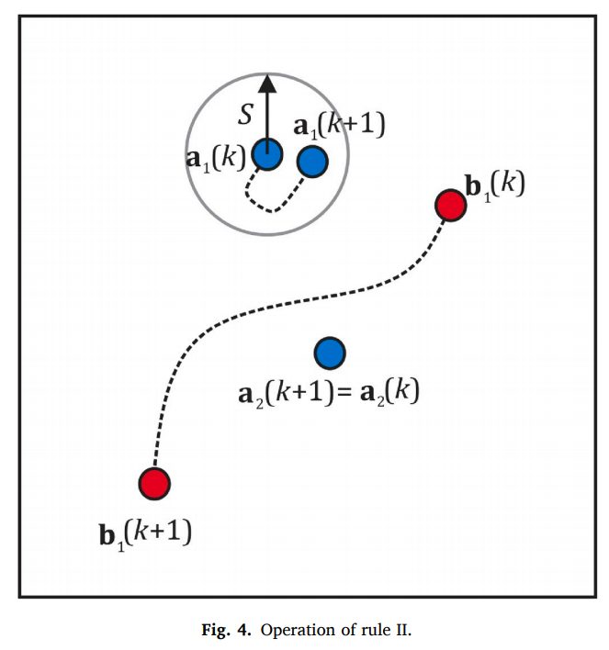
Previous studies
Rule I: Transmission
Rule II: Movement
Cuevas E. An agent-based model to evaluate the COVID-19 transmission risks in facilities. Comput Biol Med. 2020 Jun;121:103827. doi: 10.1016/j.compbiomed.2020.103827. Epub 2020 May 20.
Notes:
In previous study, some basic rules are described. Like the transmission rule and how the agents move.
In the contagious rule or Rule I, for each agent ai from A it is analyzed the existence of an infected agent bj inside a determined neighborhood R. If this existence is verified, a probabilistic decision process is considered to know if the agent ai has been infected or not.
As for rule2, the model includes two different movement types: local and long-distance displacement. Both movements
emulate the basic displacements performed by individuals inside the facilities. Local displacements represent the most frequent movements when individuals interact in their workspace. On the other hand, long-distance displacements refer to movements carried out by the individuals far from their previous position.

Slide 4
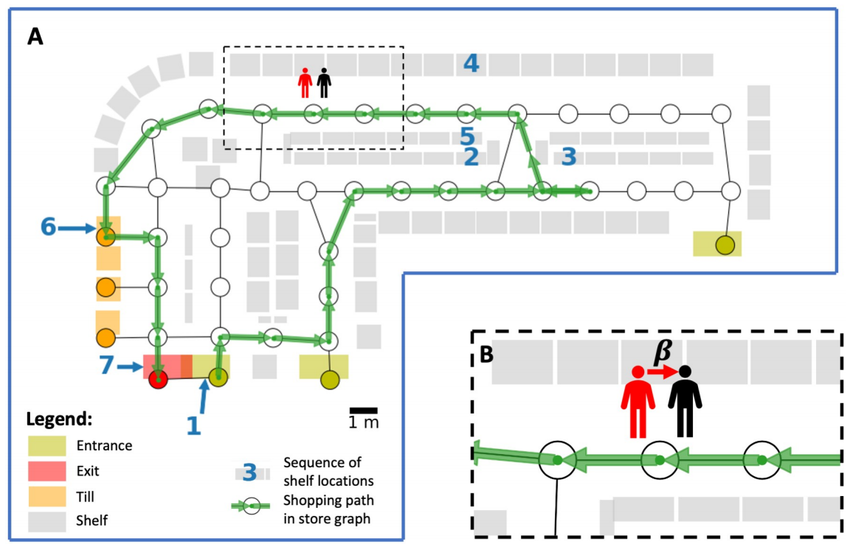
Previous studies
Ying F, O'Clery N. Modelling COVID-19 transmission in supermarkets using an agent-based model. PLoS One. 2021 Apr 9;16(4):e0249821. doi: 10.1371/journal.pone.0249821.
Notes:
We also found a paper that studied COVID-19 transmission in supermarkets using an agent-based model.

Slide 5
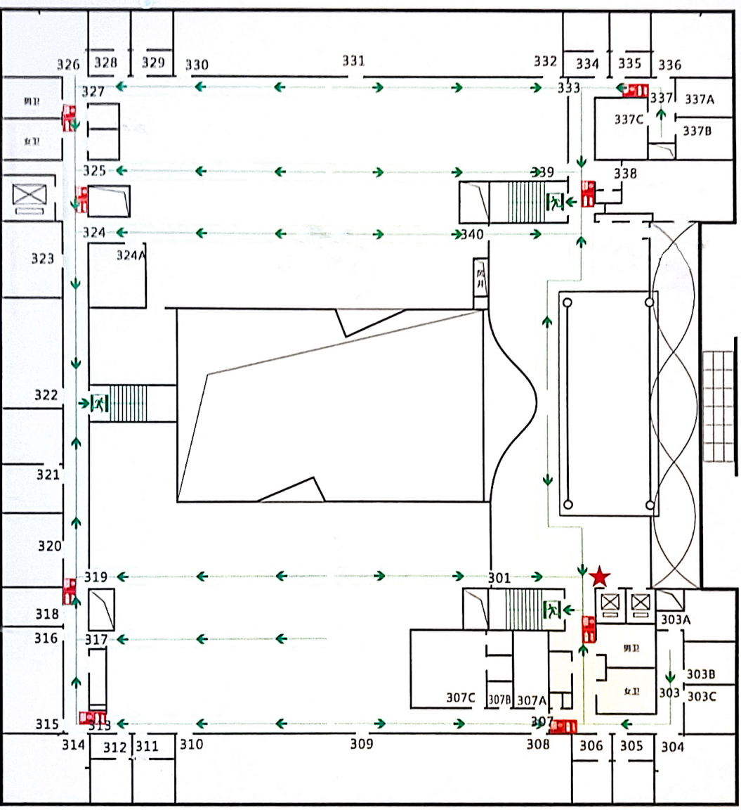
Model construction
Agent types:
Professor 1,2,3: stay in a seperate room(Office 1,2,3)
Students from Lab 1,2,3: public experimental and work areas
Areas:
Office
Experimental areas
Work areas
Toilet
Meeting room
Notes:
Therefore, we chose the third floor of Lui Che-woo Building as the research object, and went to observe it. We got the following floor plan of the third floor of Lui Che-woo Building. Then we will conduct a model study based on this figure

Slide 6
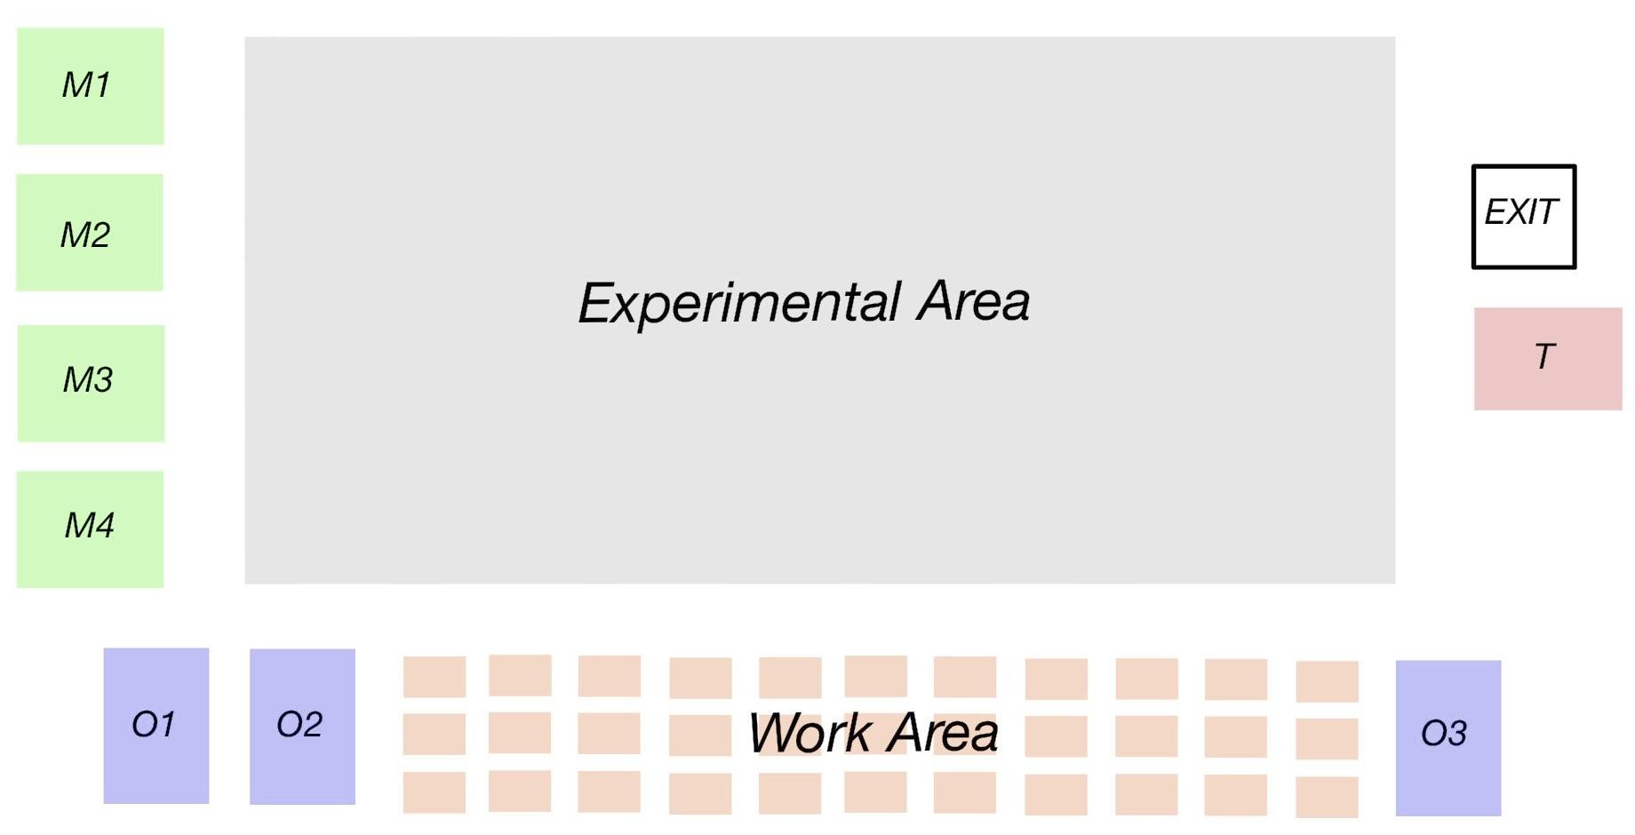
Model construction
Agent types:
Professor 1,2,3: stay in a seperate room(Office 1,2,3)
Students from Lab 1,2,3: public experimental and work areas
Areas:
Office
Experimental areas
Work areas
Toilet
Meeting room
Notes:
Therefore, we chose the third floor of Lui Che-woo Building as the research object, and went to observe it. We got the following floor plan of the third floor of Lui Che-woo Building. Then we will conduct a model study based on this figure

Slide 7
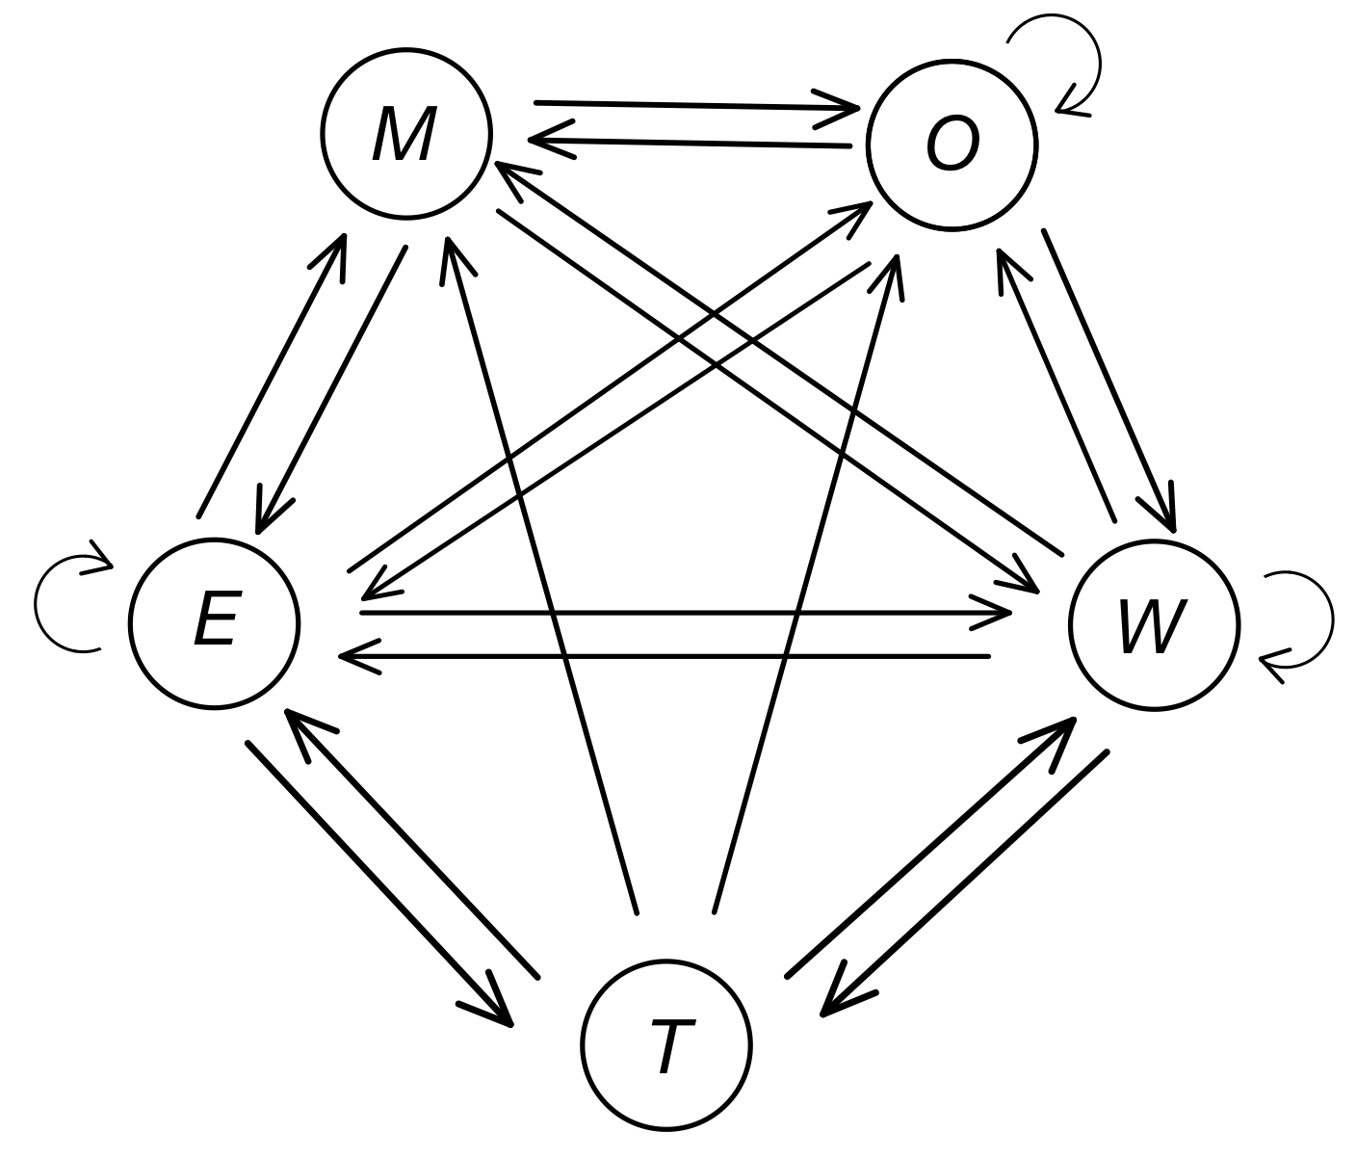
Movement rule I-Transition
Office
Experimental areas
Work areas
Toilet
Meeting room

Slide 8
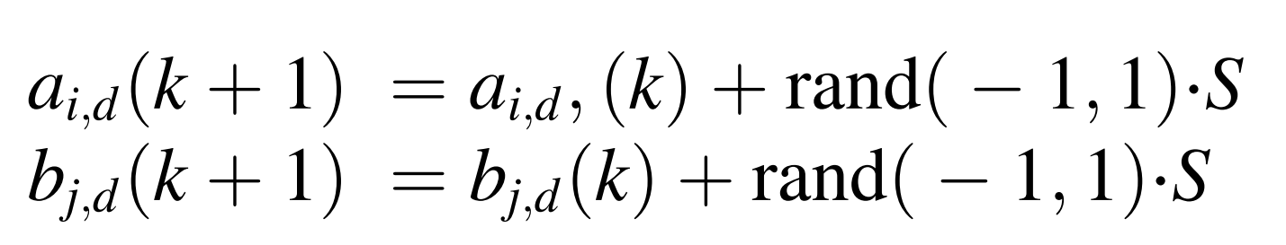
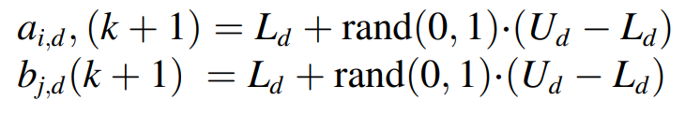
Movement rule II - Experimental Area
1. Stay still
2. Local movement
3. Long-distance movement

Slide 9
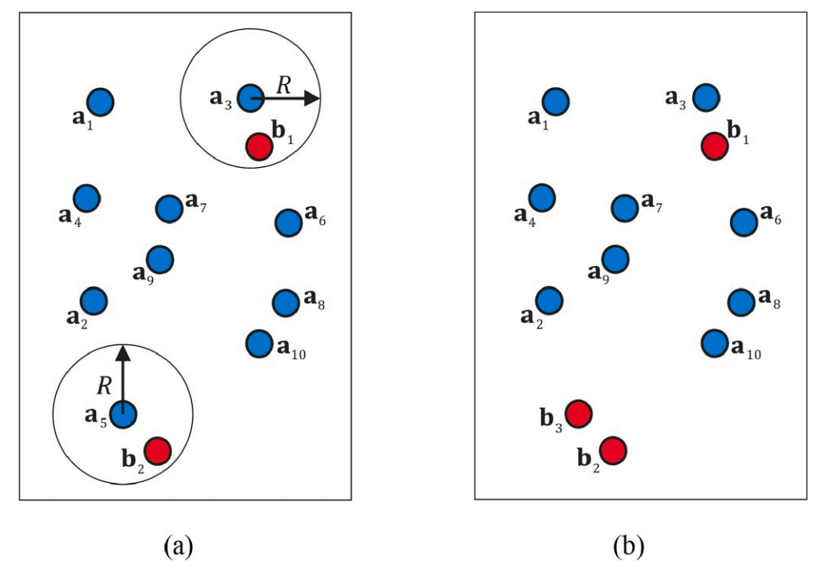
Transmission rule: Work area & Experimental area / Others
Exposure time: the total amount of time that customers are in close proximity to infected customers.
Infection probability: LogisticF(Exposure time)
Experimental & Work Area
Others: Increasing exposure time as long as they are in the same space.
Notes:
We define the individual exposure time to an infectious customer i as the total time that customer s was in the same zone as an infectious customer i during the shopping trip of s.
Each exposed customer becomes infected after the shopping trip with probability min(βEs, 1) for some transmission rate β > 0. we model the infection probability of an exposed customer as a logistic function of the exposure
time with infectious customers.

Slide 10
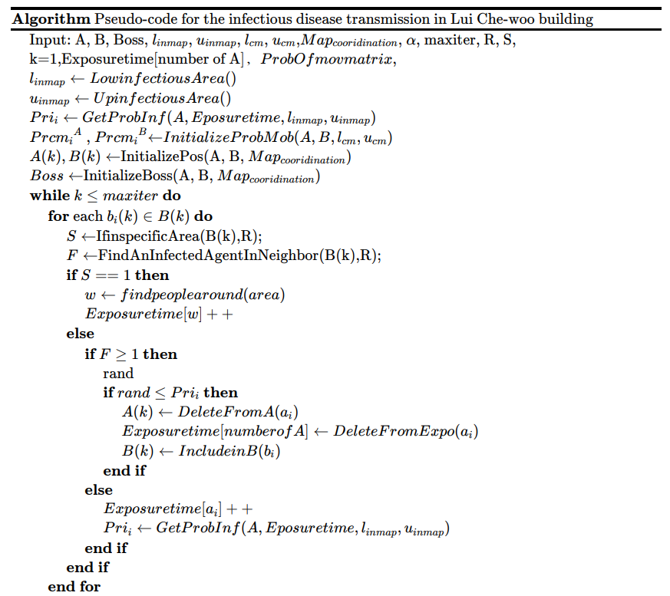
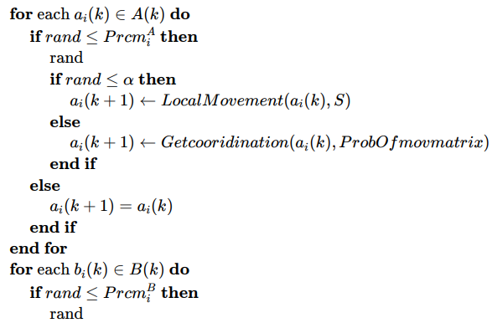
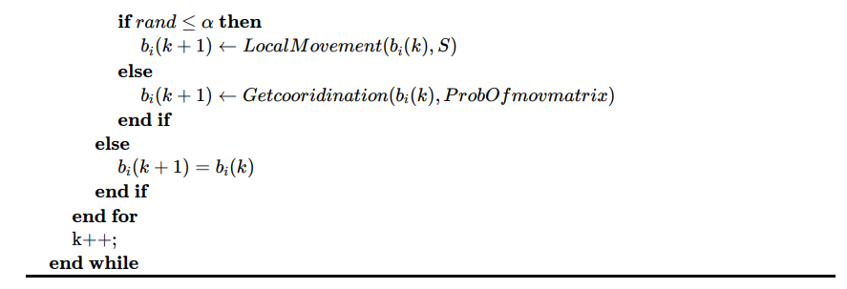

Slide 11
Thanks for your listening!
Jiayi Chen, Yihan Chen, Xiaoyang Sheng
2024/5/22
Notes:
We plan to focus on solving the transmission probability of infectious disease among a fixed group of people that stay in a shared environment for a long time. In our research, we choose the third floor of Lui Che-woo building as the environment.

