Slide 1

Bike Usage of Casual Users vs. Subscribers
Nathanael J. Reynolds
Last updated: May 28, 2023

Slide 2

Table of Contents
Objective
Data Findings
Conclusion

Slide 3

Problem: Cyclistic’s success as a company depends on maximizing the number of annual subscriptions
Solution:
Develop a strategy to turn casual users of Cyclistic’s bike services into annual subscription members

Slide 4
Objective
Identify how casual users of Cyclistic’s bike service differ in their usage from Cyclistic annual subscription members

Slide 5
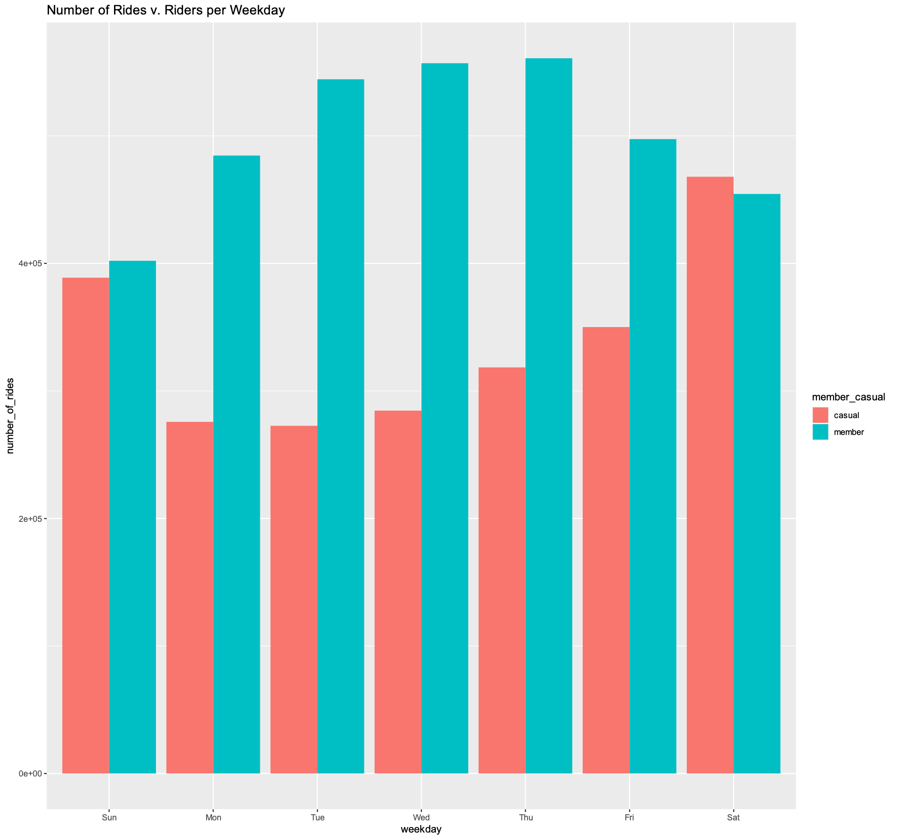
Number of Rides
Casual users take fewer rides than subscribers
Subscriber usage peaks during weekdays and dies off on weekends
Casual usage peaks during weekends and dies off during weekdays
*Data provided by Motivation International Inc.

Slide 6
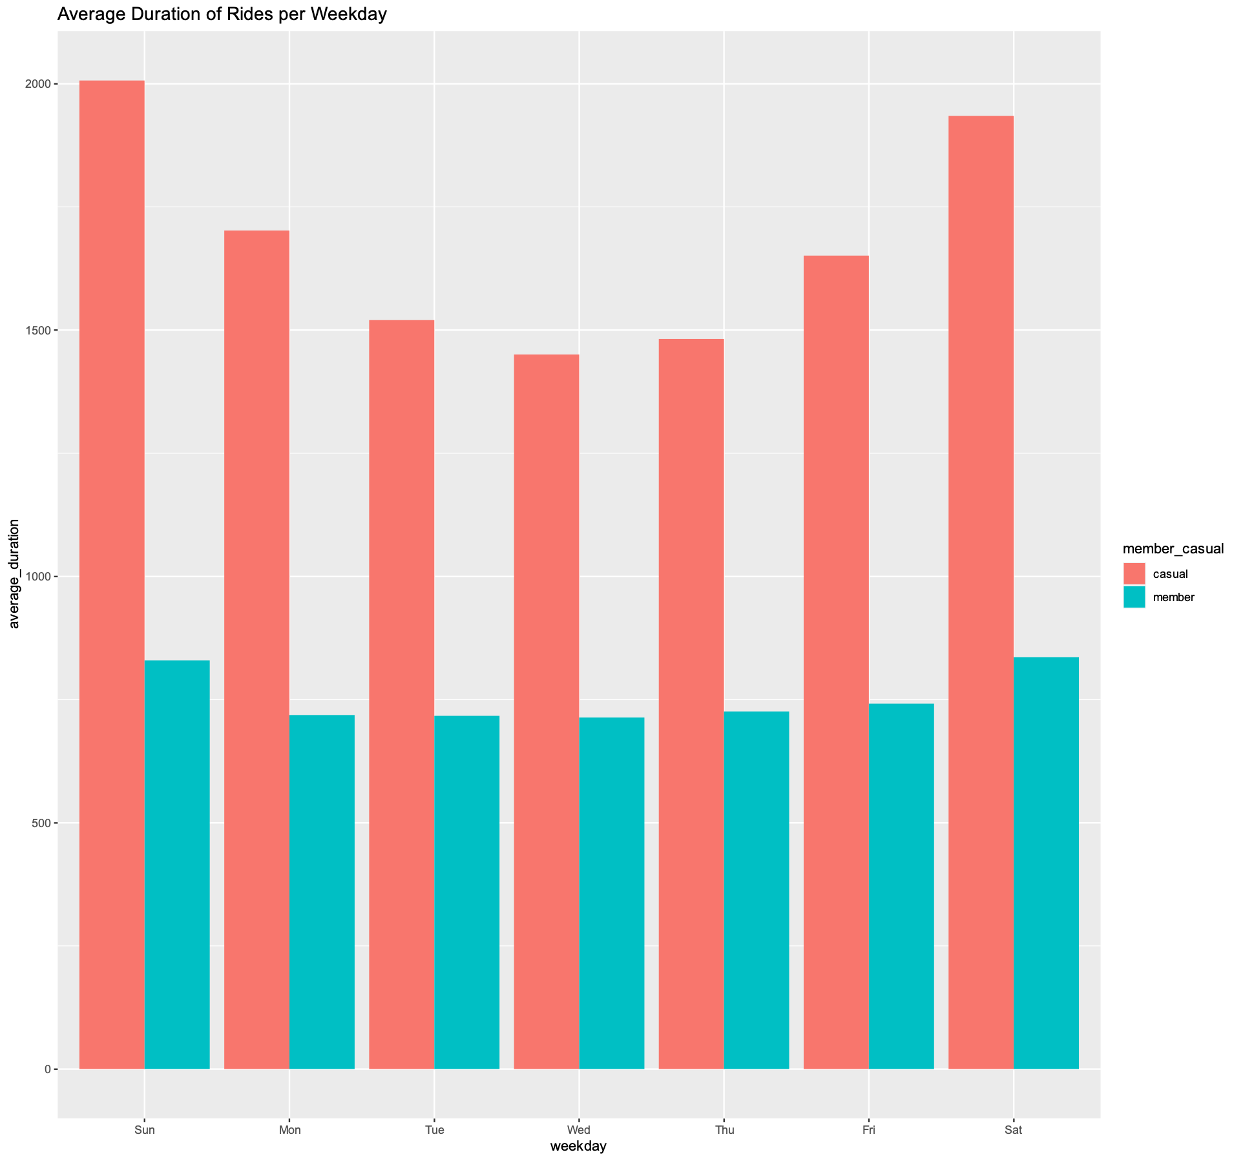
Ride Duration
Casual users take longer rides over all
Longest rides occur during the weekend
Little variation in ride length for subscribers

Slide 7
Summary
1
2
3
Casual users take longer but fewer rides than subscribers
Casual usage peaks on weekends whereas subscriber usage peaks during weekdays
Longest rides for casual users occurs on weekends and subscribers vary little in ride length

Slide 8
Conclusion
Casual users use Cyclistic bikes for recreation whereas subscribers use our service as a commuting tool

Slide 9

Recommendations
Offer a 14-day free trial of subscription service
Social media campaign promoting Cyclistic membership as a fun and recreation tool
Tiered subscriptions for recreational users and “professional” users

Slide 10
Thank You!

