Slide 1
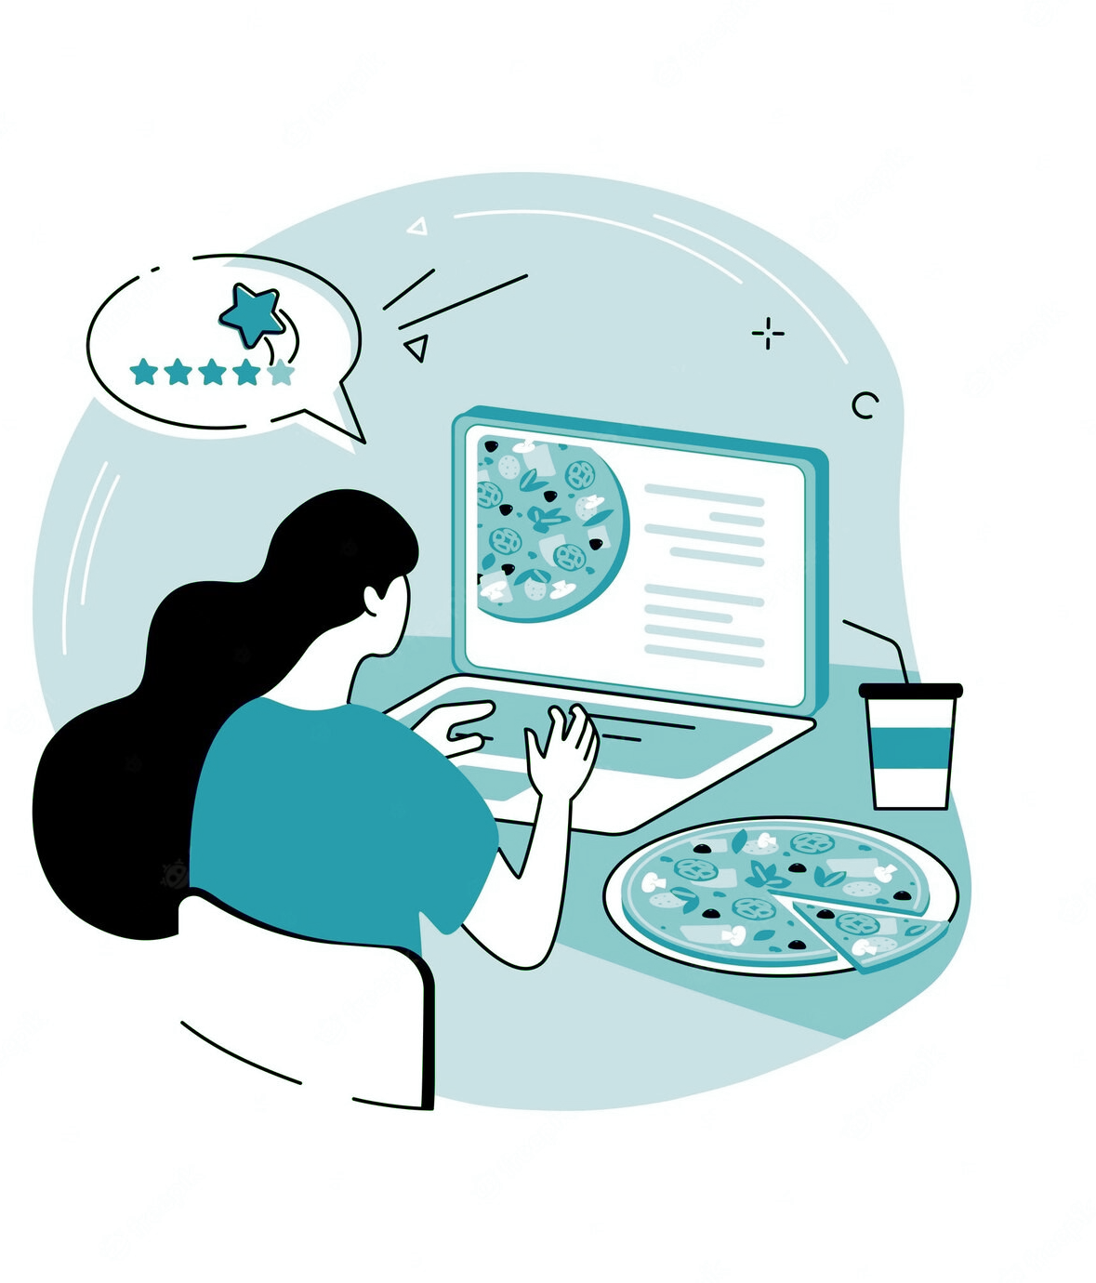

‘mine was a little burnt but still delicious…’
LADy
A System for Latent Aspect Detection
Christine Wong, Farinam Hemmatizadeh, Hossein Fani​
Proposal ID: 152
UWill Discover Conference
Notes:
Things that may be asked: - what are some challenges when working on the project? - what would you change if you start the project all over again?
Goal: 5-7 slides (excluding intro and conclusion + bibliography) and keep it within 6-7 minutes (since I often go overboard when nervous)

Slide 2
What are Latent Aspects?
Aspect: targeted in an opinion to convey a sentiment.
Latent Aspects: aspects where the term is not explicitly mentioned.
‘…advertise free wifi but charge you for that,…’
Aspect: ‘advertisement’
Sentiment: ‘negative’
‘mine was a little burnt but still delicious…’
Aspect: ‘food’ (“…[my food] was…”)
Sentiment: ‘neutral’
2/8
Introduction
Applications
Results
Challenges
Notes:
Current idea for the presentation flow: - talk about what latent aspect is (how LADy is different from other review analysis tool) - brief overview of the methodology and result (focus a bit more on the result side since UWill is not a CS-specific conference) - the application of LADy (with more idea of applications, preferably closer to SDG goals as per reviewer feedback)

Slide 3
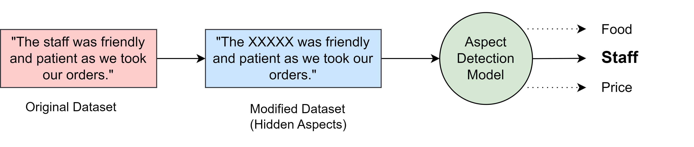
LADy’s Pipeline
Datasets: SemEval 2014-15-16
Aspect Modelling
Methods:
Evaluation
Unify Dataset Formats
Remove Aspects to Mimic latency
Success if Aspect is in Top-K Prediction
Data Processing
Associate Aspects and Tokens
LDA (Latent Dirichlet Allocation)
BTM (Biterm Topic Model)
Pontiki et al., 2014, 2015, and 2016. Aspect based sentiment analysis. Association for Computational Linguistics.​
Blei et al., 2003. Latent dirichlet allocation. Journal of Machine Learning Research.
Cheng et al., 2014. BTM: Topic Modeling over Short Texts. IEEE Transactions on Knowledge and Data Engineering.
3/8
Introduction
Applications
Results
Challenges

Slide 4
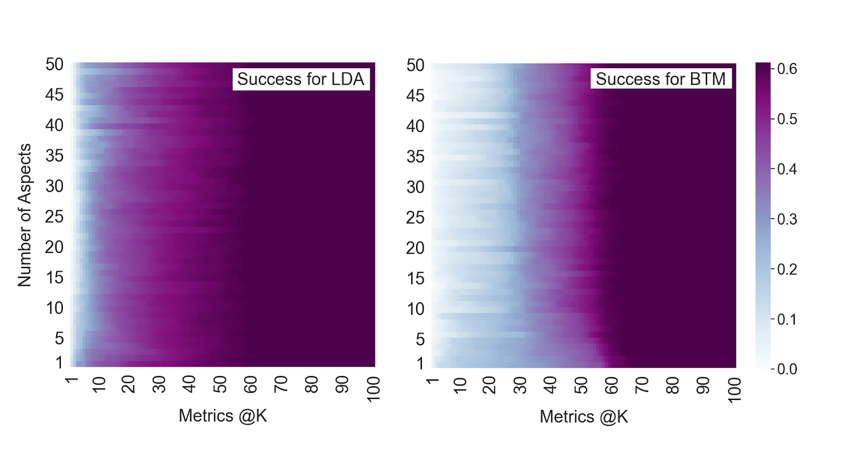
LADy’s Results
Heatmap comparison of success between LDA and BTM.
4/8
Introduction
Applications
Results
Challenges
Notes:
Number of aspects: different topics, within each have words that are close to each other
Change number of aspect to fine tune
metrics@K: try at kth time, find the aspect
Heatmap: a pixel means the value for success

Slide 5




LADy’s Applications
Business Consultation Tool
HR Analysis Tool
Personalized Analysis
Entrepreneurship Idea Identification
Use consumer reviews to identify business strengths and weaknesses.
Analyze workplace dynamic from employee reviews.
Study user’s past reviews to better understand current reviews.
Analyze popular industry and trend patterns from community posts and news.
Napitu et al., 2017. Twitter opinion mining predicts broadband internet’s customer churn rate. IEEE International Conference on Cybernetics and Computational Intelligence.
5/8
Introduction
Applications
Results
Challenges
Notes:
Current application, using online unsolicited social media reviews for products and services, focuses on:
Business Consultation Tool
Enhances customer satisfaction (customer care)
Increase business support
It benefits (1) customer care (i.e. enhancing customer satisfaction), and (2) business support (i.e. increasing customer retention, and identifying business opportunities and emergent community trends). The key characteristic of online reviews is the aspect targeted to convey a sentiment. For example, in the review ‘advertise free wifi but charge you for that,’ an opinion is expressed with ‘negative’ sentiment towards the aspect ‘advertisement’. Detection of aspects is crucial in review analysis for products or services as it helps product owners and service providers to find shortcomings and prioritize the improvements according to customers needs, and hence, maintaining revenues and decreasing customer churn (Napitu et al., 2017).
For applications relevant to the Sustainable Development Goals, business owners may use LADy to analyze areas for production optimization to maintain sustainable resource consumption. With the ability to identify business opportunities, owners will be able to diversify innovative business products as strategies for future growth.

Slide 6

LADy’s Benefits to SDG Goals
Optimize for sustainable resource consumption and economic growth
1
Promote tailored business opportunities for local communities
2
Improve workplace environment, attract suitable talent, and increase productivity
3
6/8
Introduction
Applications
Results
Challenges
Notes:
SDG goals to connect with (https://sdgs.un.org/goals/goal9, https://sdgs.un.org/goals/goal8, https://sdgs.un.org/goals/goal12):
SDG 9: Build resilient infrastructure, promote inclusive and sustainable industrialization and foster innovation
Target 9.3: Increase the access of small-scale industrial and other enterprises, in particular in developing countries, to financial services, including affordable credit, and their integration into value chains and markets
Target 9.a: Facilitate sustainable and resilient infrastructure development in developing countries through enhanced financial, technological and technical support to African countries, least developed countries, landlocked developing countries and small island developing States
Target 9.b: Support domestic technology development, research and innovation in developing countries, including by ensuring a conducive policy environment for, inter alia, industrial diversification and value addition to commodities (#2)
SDG 8: Promote sustained, inclusive and sustainable economic growth, full and productive employment and decent work for all
Target 8.2: Achieve higher levels of economic productivity through diversification, technological upgrading and innovation, including through a focus on high-value added and labour-intensive sectors
Target 8.3: Promote development-oriented policies that support productive activities, decent job creation, entrepreneurship, creativity and innovation, and encourage the formalization and growth of micro-, small- and medium-sized enterprises, including through access to financial services (#3)
Target 8.4: Improve progressively, through 2030, global resource efficiency in consumption and production and endeavour to decouple economic growth from environmental degradation, in accordance with the 10-Year Framework of Programmes on Sustainable Consumption and Production, with developed countries taking the lead
SDG 12: Ensure sustainable consumption and production patterns
Target 12.3: By 2030, halve per capita global food waste at the retail and consumer levels and reduce food losses along production and supply chains, including post-harvest losses
Target 12.6: Encourage companies, especially large and transnational companies, to adopt sustainable practices and to integrate sustainability information into their reporting cycle (#1)
Target 12.7: Promote public procurement practices that are sustainable, in accordance with national policies and priorities

Slide 7
LADy’s Challenges
Identification of New Aspects
Falls short for aspects not seen in the training dataset
Differentiation of Polysemous Words
The same word may convey different semantics with opposite sentiments
“…items are great and cheap…”
“…not above ordinary and had cheap beef…”
Smartphone
‘face-id’
‘camera’
7/8
Introduction
Applications
Results
Challenges

Slide 8

Thank You!
Christine Wong​
wong93@uwindsor.ca
Farinam Hemmatizadeh
hemmatif@uwindsor.ca
Hossein Fani
hfani@uwindsor.ca

Slide 9
Topic Modelling Methods
Train Model with Training Datasets
Clusters of documents by topics
Clusters of words by topics
Model Outputs Topics
Input New Data into Model
Assumes all document chooses from the same set of topics
Probability that the document writes about the topic
Notes:
Supplementary Slides

Slide 10
Topic Modelling Methods
Notes:
Supplementary Slides

Slide 11
Topic Modelling Methods
The pepperoni pizza is mediocre.
Notes:
Supplementary Slides

