Slide 1
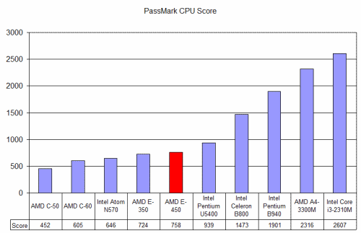
SCRIPT Protocol
Introduction:
SCRIPT is an acronym for Searle’s Chinese Room Interprocess and Telecommunications Protocol. The protocol was developed using using concepts from biomimicry allied to Artificial Intelligence philosophy and retro computer history. The SCRIPT Protocol is based on ASCII C0 Control Codes and tries to mimic the flow of data as close as possible.
The Chinese Room Thought Experiment
Similar to the Turing Test, the Chinese Room Thought Experiment (CRTE) deals with the difference between strong and weak AI. It questions whether a machine that walks like a duck, and talks like a duck, is a duck; or a conscious person in our case.
Competitive Benchmarks
Benchmark compared to 1000 calls to Boost, eRPC, and Thrift, to 1000 calls to both Serial SPRIPT and
Interprocess scripts.

