Slide 1
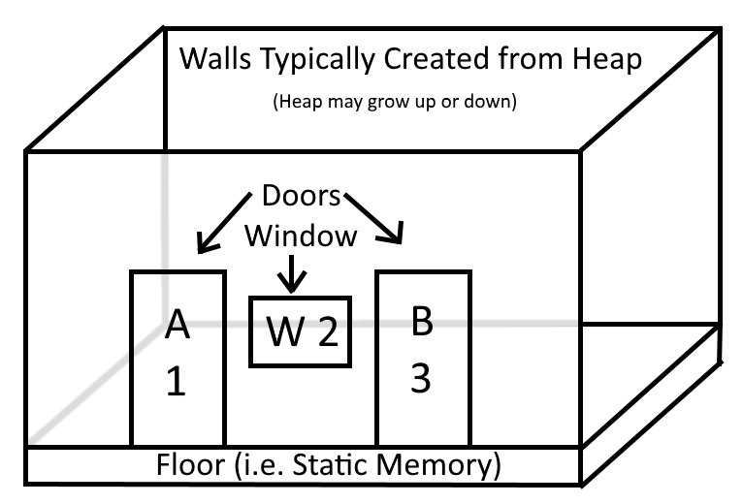
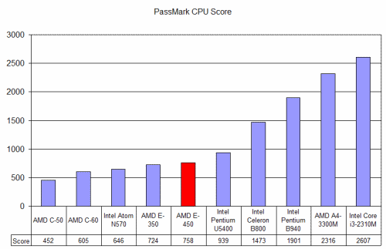
Script:
Searle’s Chinese Room, Interprocess, & Telemetry Protocol
Mimicry in Computer Science & Engineering
Chinese Room The Chinese Room (CR) is a Abstract Stack Machine (ASM) and famous AI philosophy theory related to the Turing Test that highlights the differences between strong and weak AI (@wiki Chinese Room). Script mimics the philosophy theory using the A=A*B Group Theory where A is a set of states in a state machine and B is a sequence of B-Input and B-Output messages that get routed to Rooms through Slots in Doors that closely parallel TCP Ports. In the CR Thought Experiment the person in the room gets a message through the slot in the door written in Chinese, performs manual computer vision to translate the message into a B-Sequence that use the Plus (+) Operation for Asynchronous ASM Operations, exponents for to create Program Loops, and multiplication to perform Function Composition for Turning Complete Syncronous ASM Operations. Script uses single Unicode Characters, Indexes, or Key Strings to call Operations and a set of data structures outlined in the Script RFC that word identically on 16-bit, 32-bit, and 64-bit processors.
Data Types Script supports 32 data types (TTypes) that can be used to represent almost any object.
* UTF-8, UTF-16, and UTF Strings.
* 8, 16, 32, and 64-bit singed Integers (SI1, SI2, SI4, and SI8) and unsigned integers (UI1, UI2, UI4, and UI8).
* 16, 32, and 64-bit floating-point numbers (HLF, FLT, and DBL).
* 32-bit Unix timestamps and 64-bit Microsecond Timestamps (TMS and TMU).
* Compressed integers called Signed Varints (SV2, SV4, and SV8) and Unsigned Varints (UV2, UV4, and UV8).
* Standard data types Ordered and Unordered Maps of Id-TType-Value (MAP) and Key-TType-Value Tuples (BOK and BAG
respectively), and Lists of Type-Value Tuples (LST).
* Multi-dimensional c-style arrays and std::vector style Stacks can be created of any number or timestamp.
* Generic Object (OBJ) used to store and transceive any object type with 8, 16, 32, or 64-bit widths.
* Observer (OBV) object used to update observers of state changes and hot-swap data out of page-aligned caches.
A*B Operations = Local and Remote Procedure Call Interface
+----------- Result: The same set of states /** All script Local and Remote Operations use a single RPC function. */
| +--------- Operation struct Operand {
| | +------- Set of states /** An A*B abstract algebra Script Expression
| | | +----- Star Operation @param index The index of the Operation.
| | | | +--- Operands (input values) @param io The Bin for the IO slot.
| | | | | @return Returns an Operation Header or null upon success, or
v v v v v an Error Evaluation upon failure. */
A = A * B virtual const Operation* Star (char_t index, Expression* expr) = 0;
|<->| Operation };
|<----->| Evaluation B-Sequences A=(A*B)(A⁻¹)
Benchmarks Benchmark compared to 1000 calls to Boost, eRPC, and Thrift, to 1000 calls to both Serial SPRIPT and Interprocess scripts.
Room Construction Each Chinese Room gets a Unique Key that uses a standard hash function to map the unique key to the Door. Each Room is an the root-level A in the A*B Operation that gets pushed on to the Abstract Stack. Walls may contain Doors. aont Stack to create Walls. Walls are composed of a Book (A BOK is a unique-key dictionary with nested dictionaries). A
Applications
Script licensed under the Apache 2.0 License and is the Intellectual Property of Cale McCollough © Copyright 2017: Free as in Freedom to Create.

