Slide 1
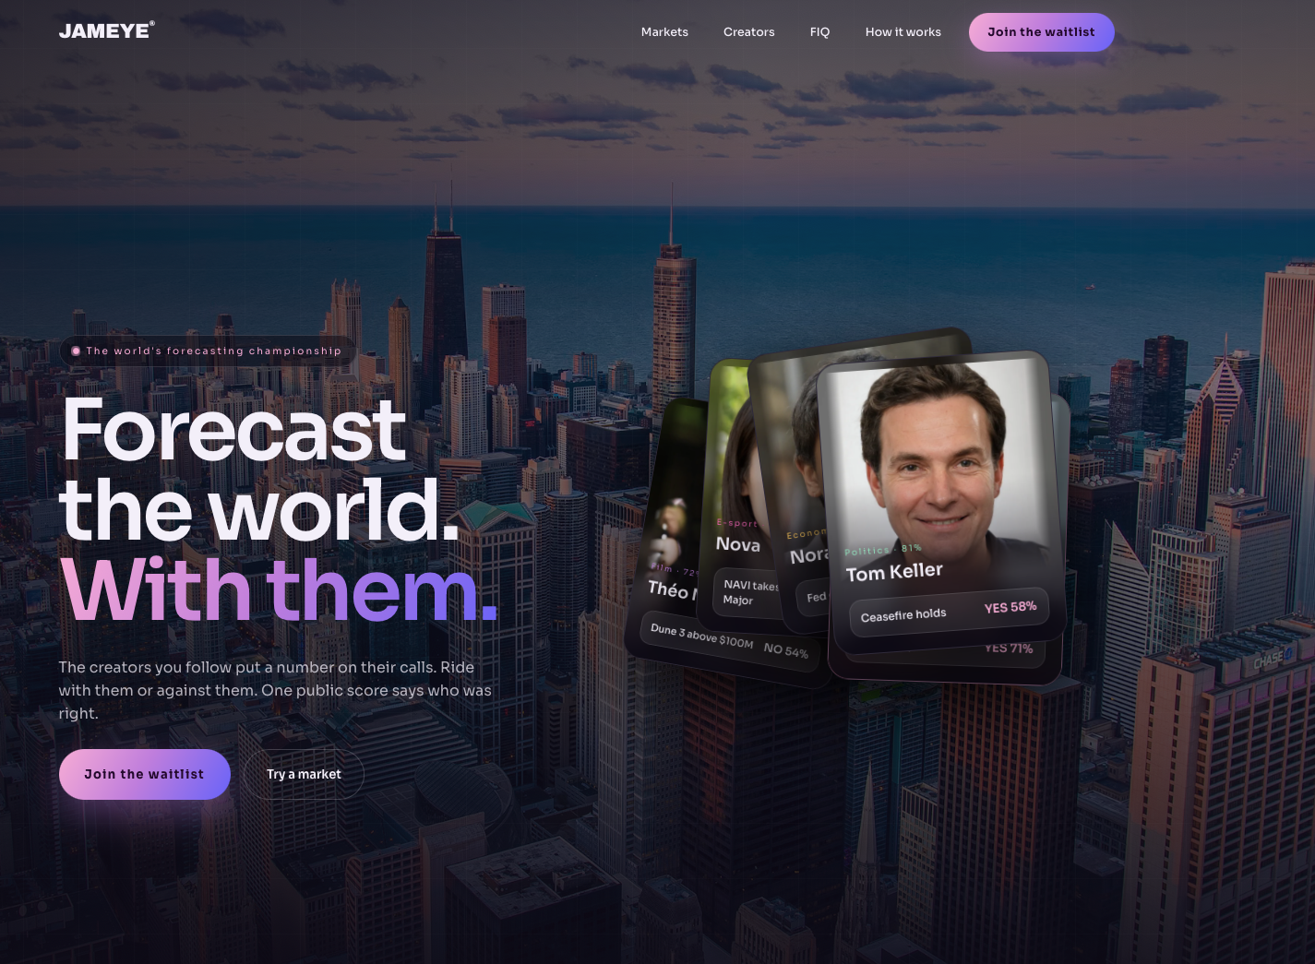
Remove AI signature
Add out movie in the bakground
Forecast with the voices you love
Do market card but only sports
Join tournaments where your favorite creators make predictions and share their thinking through short-form video. Compete with them — and the community.

Slide 2
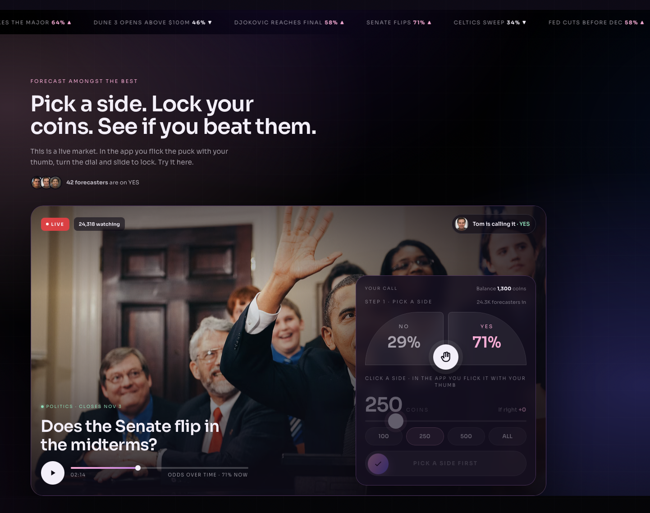
Make your call. Put your JC behind it. See if you can beat them.
Remove
Change to a soccer card from Premier League
Don’t like the arcs
Everything looks very compressed here
The play botton does not work
Slider does not work

Slide 3
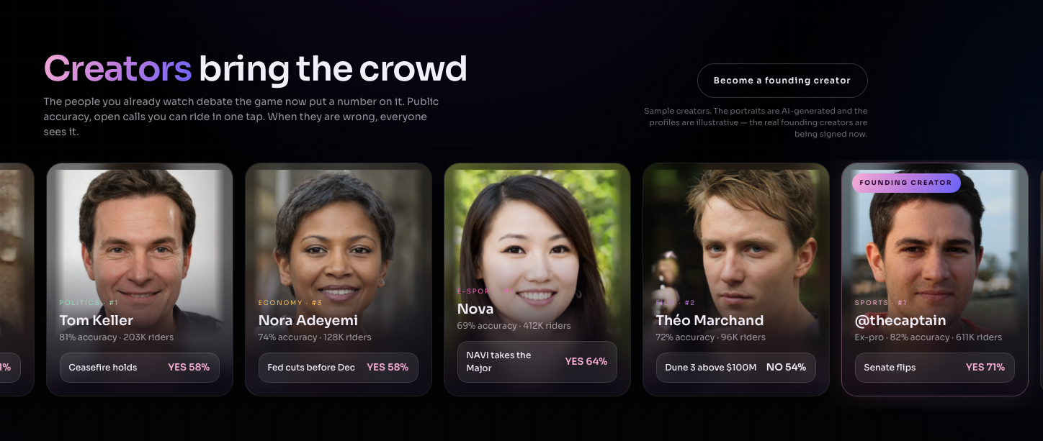
Remove all this text
Watch the match. Predict with your community.
We need better faces or change to market cards or just remove this section

Slide 4
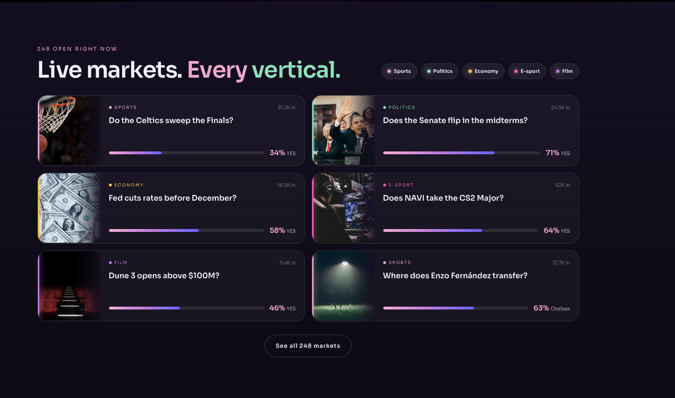
No war markets. Just action and fun.
Real pics from polymarket
Don’t like this green at all
Remove AI signs

Slide 5
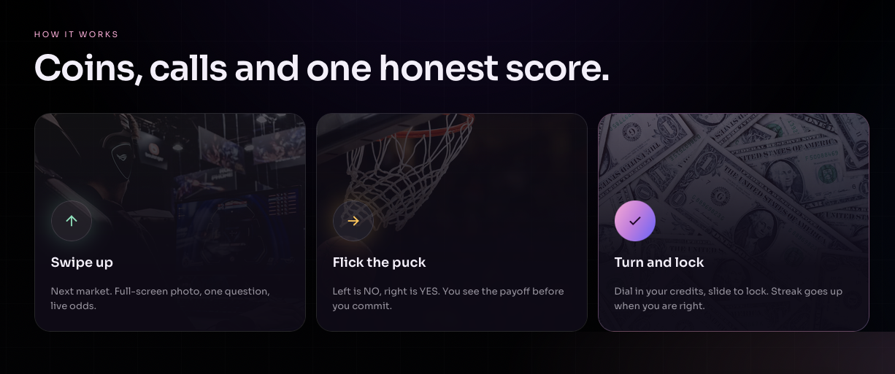
Real polymarket pics
Ugly Green
Ugly yellow

Slide 6
Real polymarket pics
Ugly Green
Ugly yellow

Slide 7
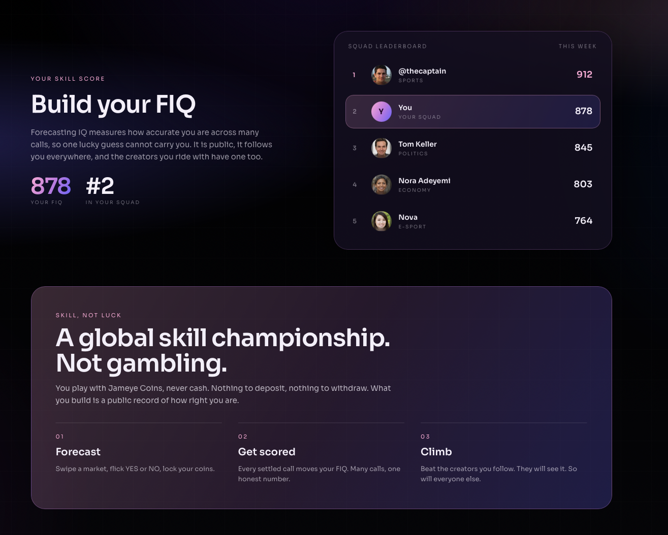
Avatar or realistic non AI pics
04 Win real prizes where local rules allow.
Play with Jameye Coins, never cash. Nothing to deposit. Nothing to withdraw. Just a public record of how good you are at forecasting. Win real prizes where local rules allow.

