Slide 1

AUTOPEN
Sprint 1 Demo
By: Caleb Hall, Calla Robison, Michael Allen, Myles Scott, Joshua Buscher

Slide 2
PRESENTATION OVERVIEW
Goals of sprint and what we achieved
SCRUM PROGRESS - BACKLOG ITEMS
What’s implemented?
What’s next for sprint 2

Slide 3





OUR TEAM & ROLES
Caleb Hall – Scrum Master
Michael Allen – Developer
Calla Robison – Developer
Myles Scott – Developer
Joshua Buscher – Developer

Slide 4

What is AutoPen?
Artificial Intelligence
Task Automation
Web Based Application
Backend Algorithm
Penetration Testing
Cybersecurity Vulnerability Testing

Slide 5
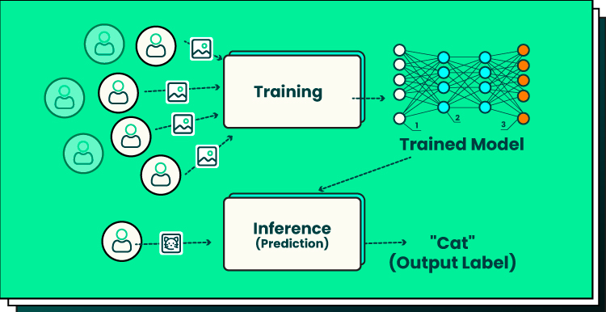
VISION & BACKLOG
Backlog:
Prepare for sprint 2
Integrate data from AI model into visual graphical representations in the website
Create access for customer login and admin login
Edit permissions on site for user and administrator
Set-up encryption on login passwords
Set up user input to start pen-test in the automation
Implement MFA
Create database to store user information
Goal: Use AI to automate penetration testing

Slide 6
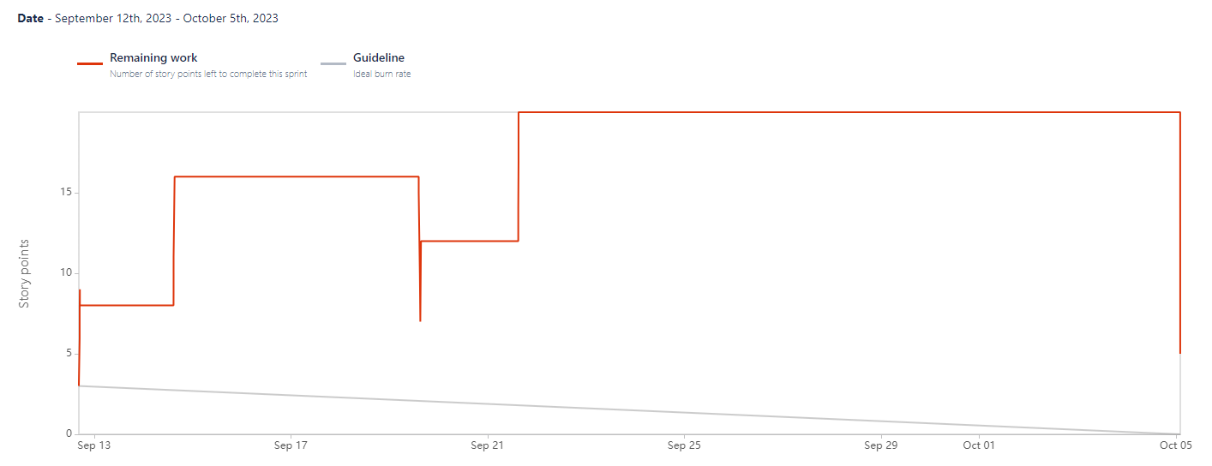
BURNDOWN

Slide 7

COMPLETED TASKS
Generally administrative
Setting up documentation
GitHub, Google Drive, Jira, Discord
Deciding what we are going to do for the semester
SRS, SDD
Learning
Little to no experience with AI or pen testing
Basic website
Basic AI model

Slide 8

UNFINISHED BUSINESS
Not much
We mostly completed what we set out to do within this sprint
Focusing down priorities
Decide on codebase structure for website

Slide 9

VM ENVIRONMENT
VMWare running Kali
MySQL and Apache2 instances
DVWA as pen testing target
Localhost

Slide 10
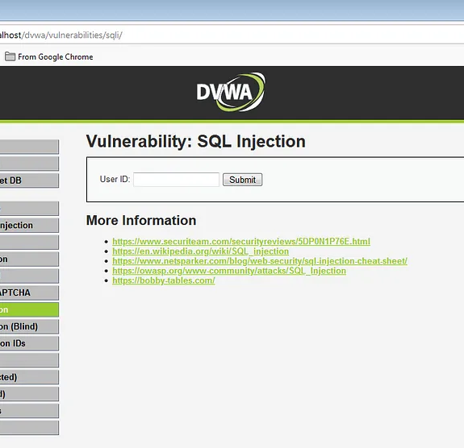
DVWA
Web app with built in vulnerabilities
Going to focus on SQL injection
Start with one attack, expanding later

Slide 11

MODEL
Python
Deep Q Network
Selenium to interact with DVWA
It’s not happy
Does not function

Slide 12
SRS V1 DOCUMENT
External Interface Requirements
User Interface with GUI/error messaging
Allow any hardware to access website
Use server/database to maintain connection to AI
Main System features
Automated pen testing
User profile management
Examples of Requirements
Performance Requirement: respond in at least two seconds
Safety Requirement: only pentest website specified by user
Security Requirement: all user data must be encrypted

Slide 13
SDD V1 DOCUMENT
Hardware design
There is no hardware
Software design
Web ui frontend, server middle end, database backend
Communication design
HTTP
Inputs
Entry screens on website
Output
Results display on website

Slide 14
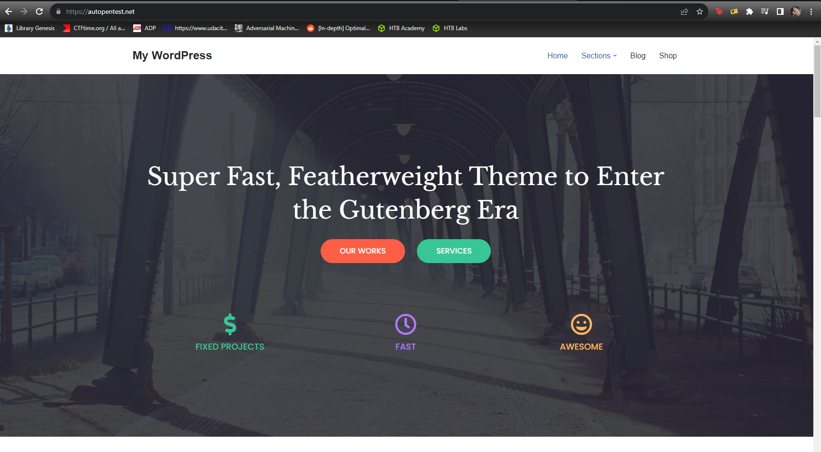
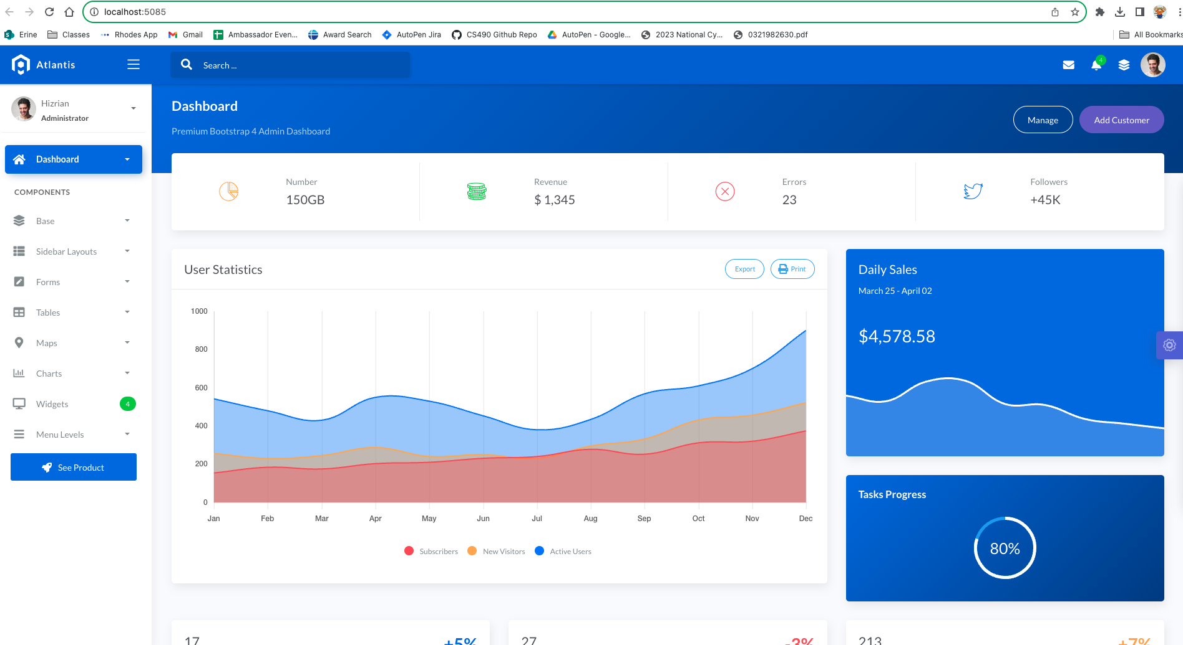
STARTING WEBSITE
https://autopentest.net/
Secured the domain
Random template
Django Framework Template
Uses Docker
Cloud host on Heroku linked to AutoPen github repo

Slide 15

WHAT’S NEXT
AI Algorithm
Complete Website (Login, FAQ, URL/Address Bar, …)
Updated Charts and Documents
Test Plan

Slide 16

QUESTIONS

