Slide 1
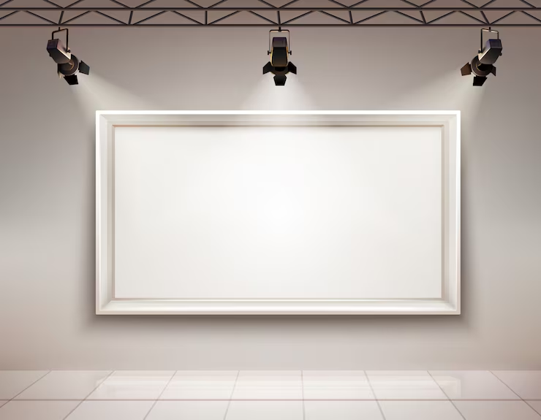
Studio Share
Caleb James
&
Clay Hyka

Slide 2
Description
Studio Share is an online platform that connects artists, musicians, makers, and other creative individuals with local creative spaces available for hourly rental. Users can search for and book spaces such as recording studios, rehearsal rooms, photography studios, and maker spaces based on their needs and availability.
The goal of Studio Share is to make finding and renting creative spaces simple, convenient, and accessible while also helping space owners generate income from unused or available spaces.

Slide 3
Main Features
Provider
Create/List Creative Spaces
Edit listing
Manage bookings
Customer
Search for Creative Spaces
Book a time slot for Creative Spaces
View Details about each space

Slide 4
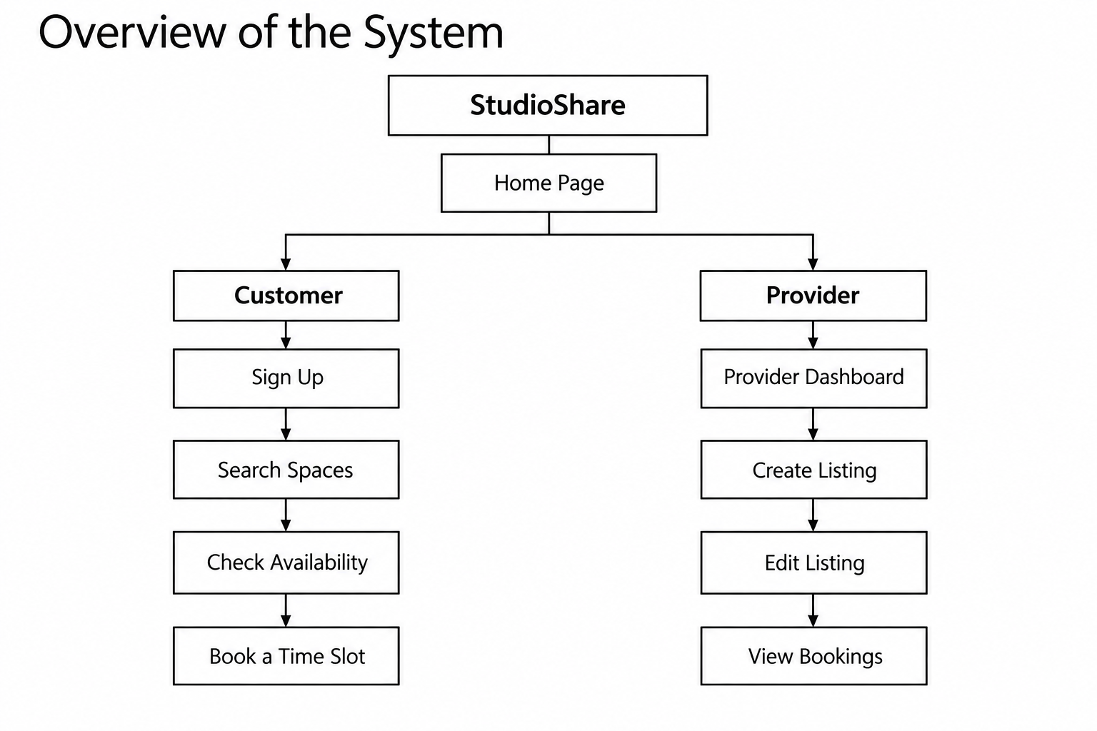
Overview of the system

