Slide 1
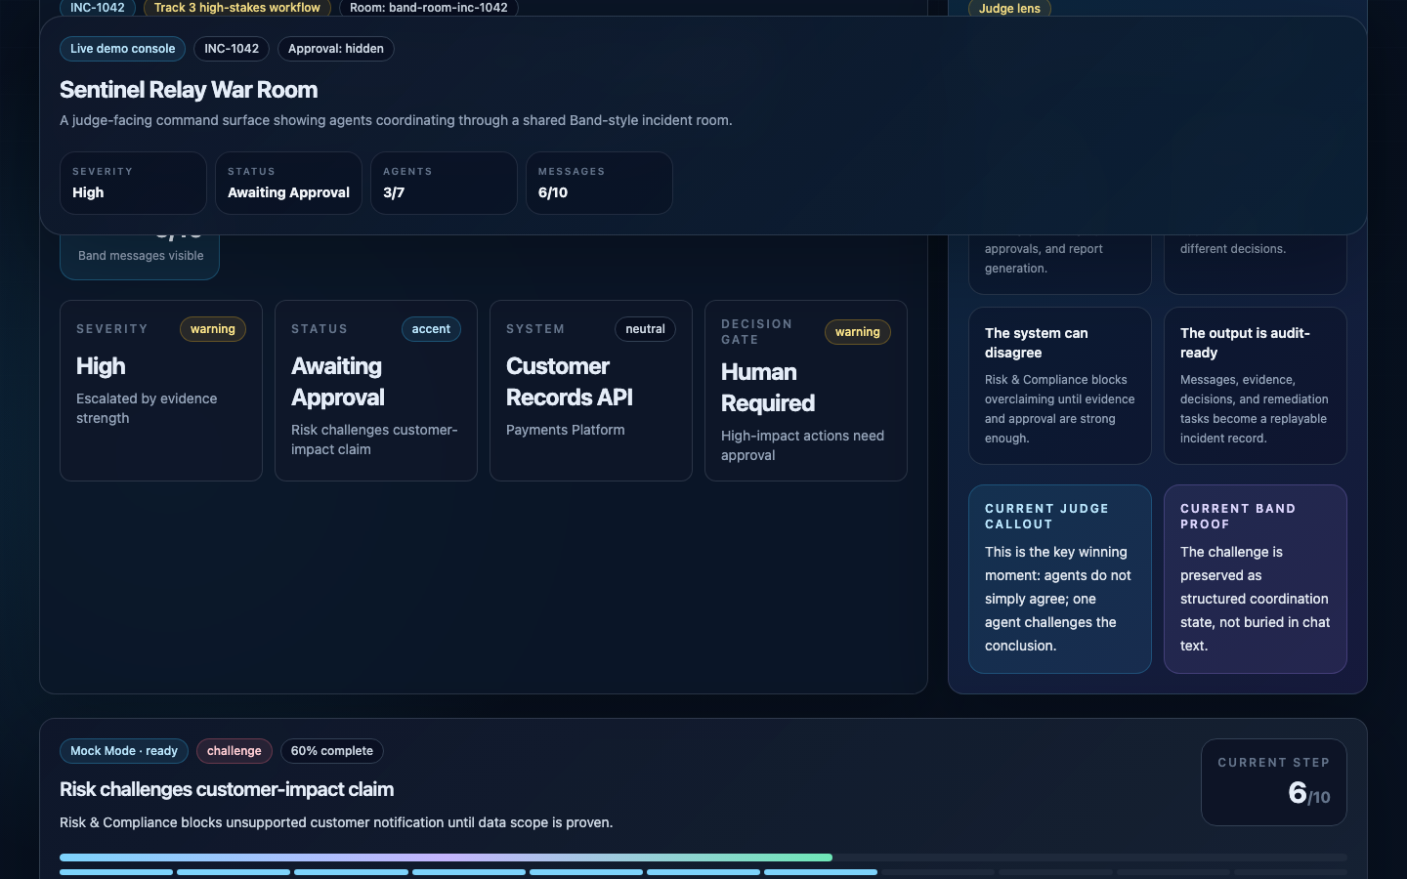
TRACK 3 / HIGH-STAKES
Agents shouldn’t
agree by default.
Sentinel Relay turns isolated security agents into an accountable incident-response team through Band.
7
18
1
SPECIALIZED AGENTS
VALIDATED MESSAGES
ACCOUNTABLE TRAIL
RISK CHALLENGES THE CURRENT CONCLUSION
Band-powered cybersecurity incident command center
SENTINEL RELAY / BAND OF AGENTS
01
Notes:
Security incidents are not single-prompt problems. Sentinel Relay coordinates specialist agents through Band and makes disagreement, approval, and accountability visible.

Slide 2
THE COORDINATION GAP
Incidents fail between specialists—not inside a prompt.
The dangerous moments are where context, authority, and evidence cross team boundaries.
Detect
Investigate
Decide
Approve
Report
Signals arrive without shared case context.
Findings fragment across security and engineering.
Weak claims can survive without an explicit challenger.
Action scope gets blurred or reconstructed later.
Audit evidence is rebuilt after the fact.
ONE AGENT CAN SUMMARIZE. IT CANNOT CREATE SEPARATION OF DUTIES.
Enterprise response needs specialized roles, shared context, explicit challenge, scoped authority, and a durable record.
SENTINEL RELAY / BAND OF AGENTS
02
Notes:
Enterprise incidents fail at handoffs. A single assistant collapses investigation, review, approval, and action into one opaque answer.

Slide 3
THE OPERATING MODEL
Band turns isolated agents into one accountable system.
Structured room context moves through planning, execution, review, decision, and handoff.
Shared Band room
Specialist agents
Human Security Lead
Evidence
Agent identity
Task routing
Structured findings
Challenges
Approval state
Audit context
Forensics
Code Review
Threat Intelligence
Risk & Compliance
Approves a precise action scope.
API logs
Auth events
Code diff
Incident policy
Remediation + report
Acts only inside approved scope.
PLANNING
EXECUTION
REVIEW
DECISION
HANDOFF
Band is present before the first finding and after the final decision—it is the workflow’s shared coordination layer.
SENTINEL RELAY / BAND OF AGENTS
03
Notes:
Band is not a final notification channel. It holds room context, routing, challenges, approvals, and the collaboration record that drives remediation and reporting.

Slide 4
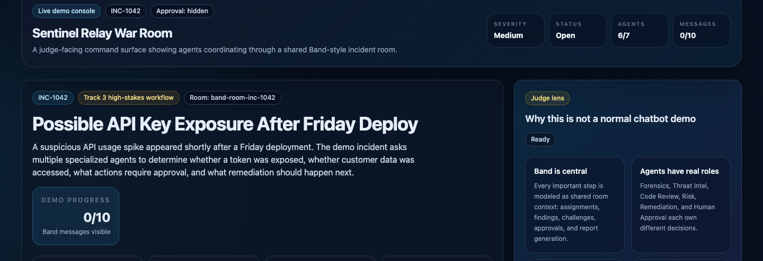
PRODUCT PROOF
The War Room makes coordination legible in seconds.
SHARED ROOM
EVIDENCE STATE
AGENT ROLES
DECISION GATE
AUDIT OUTPUT
SENTINEL RELAY / BAND OF AGENTS
04
Notes:
The War Room shows who owns each decision, what evidence is visible, what remains blocked, and why Band matters—without asking judges to inspect code.

Slide 5
THE WINNING CONTROL
Disagreement is a control—not a failure.
Risk & Compliance limits the conclusion before authority unlocks action.
1 Challenge
Unauthorized access is proven; downstream exfiltration is not.
2 Human gate
Containment remains blocked until a Security Lead decides.
3 Constrained action
Revoke and rotate now; hold customer notification pending scope.
The system preserves dissent as structured coordination state.
SENTINEL RELAY / BAND OF AGENTS
05
Notes:
This is the differentiator. Risk challenges the exfiltration claim, the human gate opens, and remediation acts only inside the approved scope.

Slide 6
TECHNICAL ARCHITECTURE
Every visible action maps to a concrete system boundary.
Next.js War Room
/api/collaboration
Band room
Python agent workers
Typed UI state
SSE updates
Approval controls
Server-side secrets
Room + message routes
Local mirror
Identity
Routing
Shared context
Approval events
handle_turn(ctx)
Schema validation
Bounded retry
Evidence packets
AI/ML API
Audit report model
Replay mode
API, auth, cloud, code, policy
Risk policy gate
Band Leader synthesis
Messages + evidence + approval + tasks
Stable judge path
One message contract connects live Band, deterministic replay, the UI, and the final audit artifact.
SENTINEL RELAY / BAND OF AGENTS
06
Notes:
The interface, server adapter, Band room, agents, evidence, AI reasoning, and report share one typed message contract. Mock mode changes transport, not the product story.

Slide 7
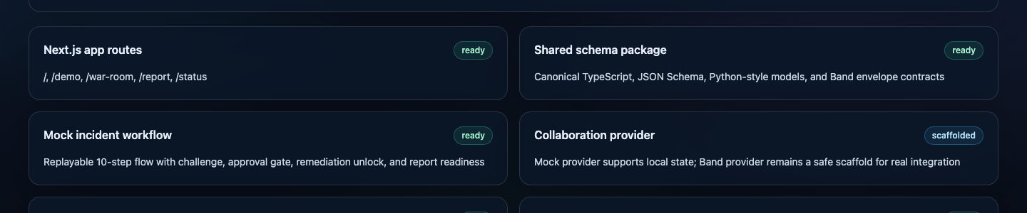
RELIABILITY PROOF
Demo reliability is engineered—not hoped for.
The submission path passes production build, schema, evidence, agent-quality, routing, and report checks.
18/18
2
5/5
Ready
SCHEMA-VALID MESSAGES
GENERALIZED INCIDENTS
REPORT INTEGRITY
VERCEL PRODUCTION
✓ PRODUCTION BUILD
✓ SHARED SCHEMAS
✓ EVIDENCE GROUNDING
✓ AGENT DISSENT
✓ HUMAN APPROVAL
✓ BAND ROUTING
✓ AUDIT TRACEABILITY
THE FALLBACK IS A PRODUCT DECISION
Deterministic replay preserves the exact coordination contract when external services wobble.
SENTINEL RELAY / BAND OF AGENTS
07
Notes:
The full verification gate passes. Deterministic replay is not a fake product; it is a reliability mode against the same structured workflow contract.

Slide 8
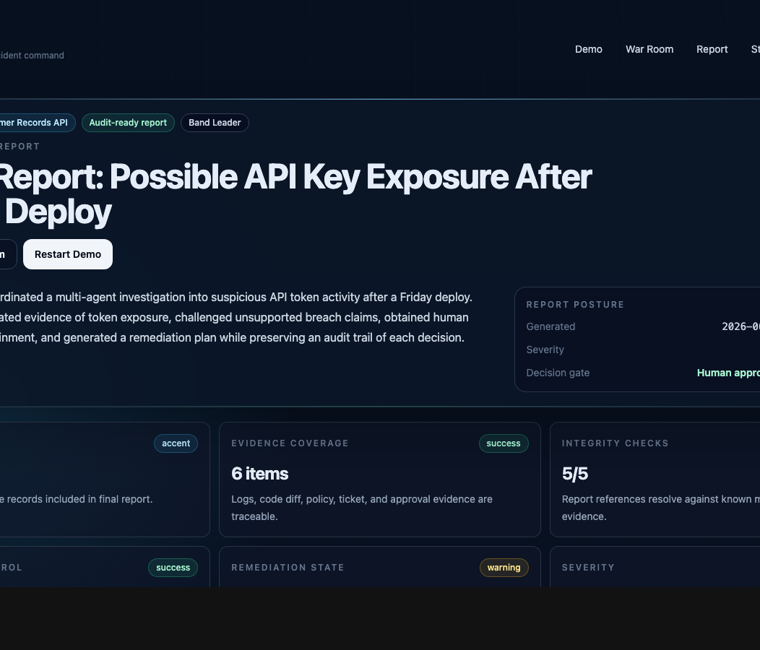
SENTINEL RELAY
From isolated assistants
to accountable response.
Carry context forward.
Challenge weak conclusions.
Keep humans in control.
Leave a report the company can trust.
LIVE APPLICATION
sentinel-relay-alpha.vercel.app
Band is the room where evidence becomes accountable action.
PUBLIC REPOSITORY
github.com/Caleb-Todd-commits/sentinel-relay
SENTINEL RELAY / BAND OF AGENTS
08
Notes:
Without Band these are disconnected assistants. With Band they become an accountable response team. Sentinel Relay carries context forward, challenges itself, keeps humans in control, and leaves a report the company can trust.

