Slide 1
STRENGTH OF MATERIALS
Thin and Thick Cylinders
Pressure vessel classification, hoop & longitudinal stress, dimensional changes, and Lame's theory for thick cylinders
Classification
Thin-Shell Stresses
Hoop & Longitudinal Stress
Dimensional Change
Lame's Theory

Slide 2
TOPIC 1
Classification of Cylinders
1
According to Dimensions
2
According to End Construction
Vessels are classified by wall thickness t relative to shell diameter d.
Open End
Thin Shell
Only circumferential (hoop) stress is induced by the fluid pressure.
t
≤
1
d
15
Thick Shell
t
>
1
(or
d
> 15)
Closed End
d
15
t
Both circumferential (hoop) stress and longitudinal stress are induced in addition to each other.
Thin shell: wall thickness is small compared to diameter — stress is assumed uniform across the wall.
Thick shell: wall thickness is significant — stress varies across the wall thickness (analysed using Lame's theory).

Slide 3
TOPIC 2
Stresses in a Thin Cylindrical Shell due to Internal Pressure
Assumptions in the Analysis
Three Types of Stress Developed
1
The effect of curvature of the cylinder wall is neglected.
Hoop / Circumferential Stress (σθ)
Acts tangentially to the circumference of the shell.
2
Tensile stresses are uniformly distributed over the section of the walls.
3
The effect of the restraining action of the heads at the ends of the vessel is neglected.
Longitudinal Stress (σL)
Acts parallel to the longitudinal axis of the shell.
Modes of Failure Under Internal Pressure
Failure along the longitudinal section (circumferentially) — resisted by hoop stress.
Failure across the transverse section, splitting the cylinder into two shells (longitudinally) — resisted by longitudinal stress.
Radial Stress
Too small in a thin shell — neglected in the analysis.

Slide 4
TOPIC 3
Circumferential or Hoop Stress
Tensile stress acting tangentially to the circumference (on the longitudinal section) of a thin cylindrical shell subjected to internal pressure.
Derivation
Notation
Bursting force on a longitudinal section = pressure × projected area:
P = intensity of internal pressure
d = internal diameter of shell
l = length of the cylindrical shell
t = thickness of the shell
σθ = circumferential (hoop) stress
Bursting force = P × d × l
Resisting force in the shell walls (two sections of area t × l):
Resisting force = σθ × 2t × l
Equating bursting force = resisting force:
Hoop Stress
Required Thickness
σθ =
P d
t =
P d
2t
2σθ

Slide 5
TOPIC 4
Longitudinal Stress
Tensile stress acting parallel to the longitudinal axis, on the transverse (circumferential) section of a closed thin cylindrical shell subjected to internal pressure.
Derivation
Bursting force on the transverse section = pressure × cross-sectional area:
Longitudinal Stress
σL =
P d
π
4t
Force = P ×
d²
4
Required Thickness
Resisting force in the shell wall (area π d t):
t =
P d
4σL
Resisting force = σL × π d t
With circumferential joint efficiency ηc:
Key Relation
Longitudinal stress is half the hoop stress. So, design of a pressure vessel is based on the maximum stress minus the hoop stress.
t =
P d
σL =
σθ
4σL ηc
2

Slide 6
TOPIC 5 · PART 1
Effect of Internal Pressure on Dimensions — Strains
Internal pressure changes both the diameter and length of a thin cylindrical shell. E = Young's modulus, ν = Poisson's ratio.
1
Hoop (Circumferential) Strain
2
Longitudinal Strain
ε θ =
σθ
− ν
σL
ε L =
σL
− ν
σθ
E
E
E
E
ε θ =
P d
( 1 −
ν
)
ε L =
P d
(
1
− ν )
2tE
2
2tE
2
Hoop strain = change in diameter / original diameter:
Longitudinal strain = change in length / original length:
ε θ =
δd
ε L =
δL
d
L
Change in diameter:
Change in length:
δd =
P d²
( 1 −
ν
)
δL =
P d L
(
1
− ν )
2tE
2
2tE
2

Slide 7
TOPIC 5 · PART 2
Effect of Internal Pressure on Dimensions — Volumetric Strain
The overall change in volume of the shell combines the hoop and longitudinal strains.
Volumetric strain = change in volume / original volume, expressed in terms of hoop and longitudinal strain:
εV =
δV
= 2εθ + εL
V
Substituting the expressions for εθ and εL:
εV =
P d
(
5
− ν)
2Et
4
Change in Volume
δV = V(2εθ + εL) =
P d
(
5
− ν) V
Et
4

Slide 8
TOPIC 6 · PART 1
Lame's Theory — Thick Cylinders
Thick cylinders have a wall thickness not smaller than 1/15 of the diameter. Radial stress varies across the thickness — maximum at the inner radius, minimum at the outer radius. Lame's theory gives the distribution of radial and hoop stress.
Lame's Equations
σ r = A −
B
Assumptions
r²
The material is homogeneous and isotropic.
Plane transverse sections remain plane under internal pressure.
The material is stressed within the elastic limit (Hooke's Law).
All fibres of the material are stressed independently, unconstrained by adjacent fibres.
σ θ = A +
B
r²
A and B are constants found from boundary conditions: σr = −Pa at r = a, and σr = −Pb at r = b.
General radial stress
t/d ≥
1
σ r =
Pa a² − Pb b²
−
a²b²(Pa−Pb)
15
b²−a²
r²(b²−a²)
General hoop stress
a = internal radius
b = external radius
Pa, Pb = pressure at r = a, r = b
σ θ =
Pa a² − Pb b²
+
a²b²(Pa−Pb)
b²−a²
r²(b²−a²)

Slide 9
TOPIC 6 · PART 2
Lame's Theory — Special Cases
Longitudinal stress (closed ends, horizontal equilibrium):
σL =
Pa a² − Pb b²
b² − a²
Case I — Internal Pressure Only
Case II — External Pressure Only
(Pb = 0, Pa = P)
(Pa = 0, Pb = P)
σθ =
Pa²
(1 +
b²
)
σθ = −
Pb²
(1 +
a²
)
b²−a²
r²
b²−a²
r²
σr =
Pa²
(1 −
b²
)
σr = −
Pb²
(1 −
a²
)
b²−a²
r²
b²−a²
r²
Maximum hoop stress occurs at the inner radius r = a:
Both σr and σθ are always compressive.
σθ(max) =
P(a²+b²)
[tensile]
At r=b: σθ = −
P(b²+a²)
, σr = −P
b²−a²
b²−a²
At r = a: σr = −P (compressive, = applied pressure).
At r = b: σr = 0.
At r = a: σr = 0.
σθ = −
2Pb²
b²−a²

Slide 10
KEY TAKEAWAYS
Summary of Formulas
Classification
Hoop stress
t
≤
1
(thin)
σθ =
Pd
d
15
2t
Longitudinal stress
Max shear stress
σL =
Pd
=
σθ
τmax =
σθ − σL
4t
2
2
Change in diameter
Change in volume
δd =
Pd²
(1 −
ν
)
δV =
Pd
(
5
− ν)V
2tE
2
Et
4
Lame's equations
Thick cyl. (internal P)
σr = A −
B
, σθ = A +
B
σθ(max) =
P(a²+b²)
r²
r²
b²−a²

Slide 11
GATE QUESTION 1
A thin gas cylinder with an internal radius of $100\text{ mm}$is subject to an internal pressure of $10\text{ MPa}$. The maximum permissible working stress is restricted to $100\text{ MPa}$. The minimum cylinder wall thickness (in $\text{mm}$) for safe design must be ________ kPa.
10 mm
12 mm
8 mm
15 mm

Slide 12
GATE QUESTION 2
A thin cylinder of 100mm internal diameter and 5mm thickness is subjected to an internal pressure of 10 MPa and a torque of 2000 Nm. Calculate the magnitudes of the principal stresses.
109.75 & 40.25 MPa
19.75 & 40.25 MPa
101.75 & 41.25 MPa
19.75 & 44.25 MPa

Slide 13
GATE QUESTION 3
A thin-walled cylindrical pressure vessel has mean wall thickness of t and nominal radius of r. The Poisson's ratio of the wall material is 1/3. When it was subjected to some internal pressure, its nominal perimeter in the cylindrical portion increased by 0.1% and the corresponding wall thickness became t. The corresponding change in the wall thickness of the cylindrical portion, i.e. 100 x (t- t)/t, is ______________%.(round off to 3 decimal places).
-0.062 to -0.058
0.062 to 0.058
-0.038 to -0.046
0.038 to 0.046

Slide 14
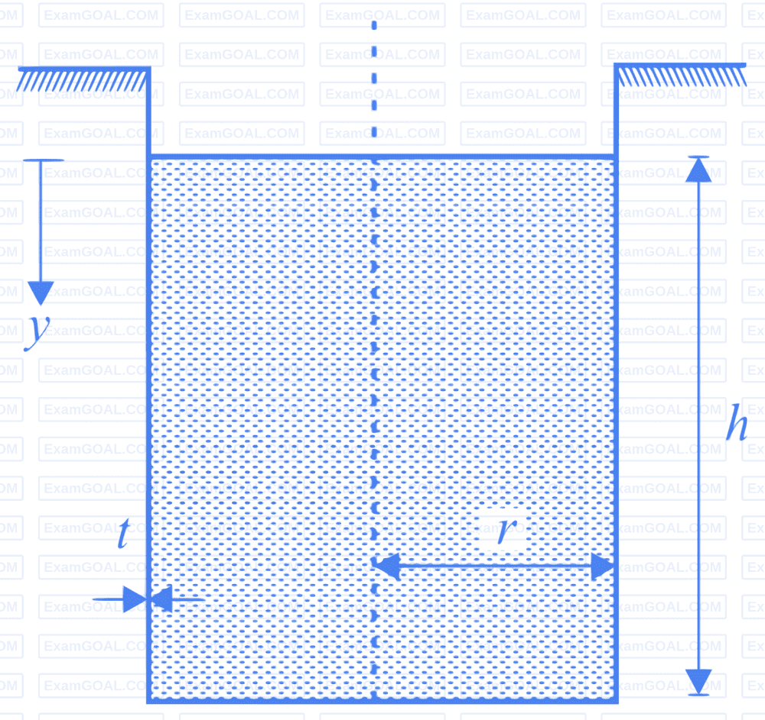
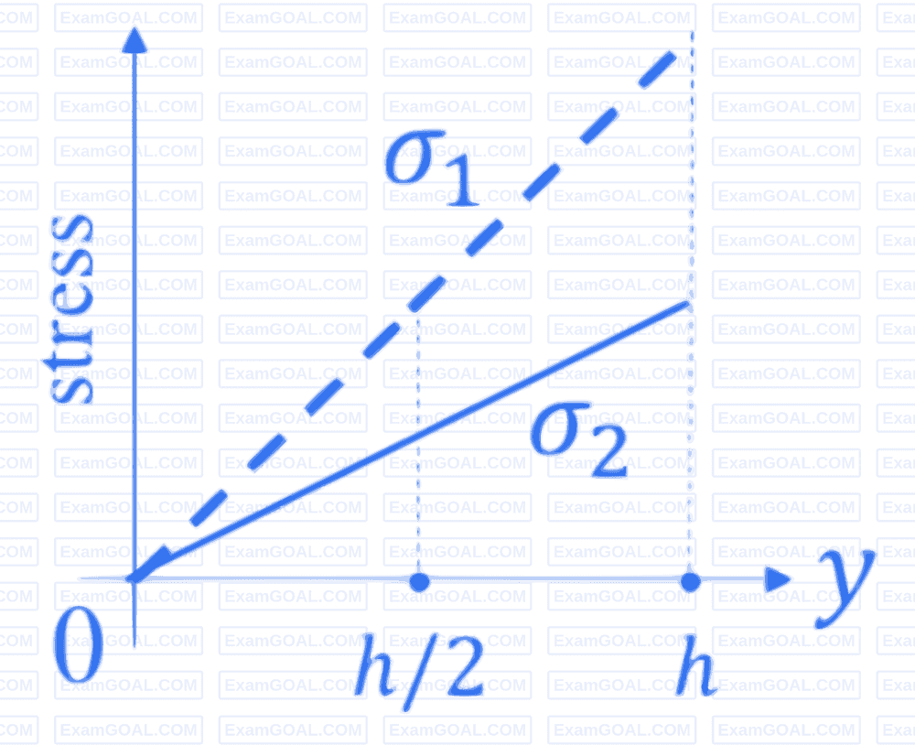
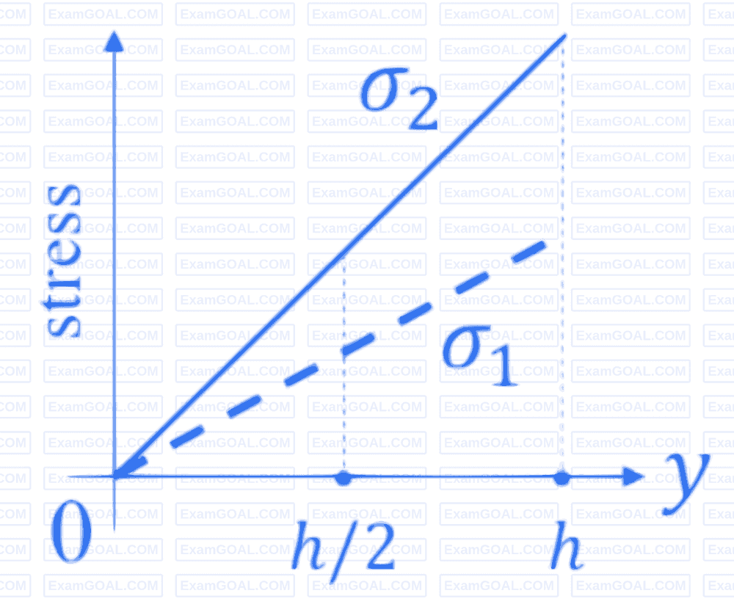
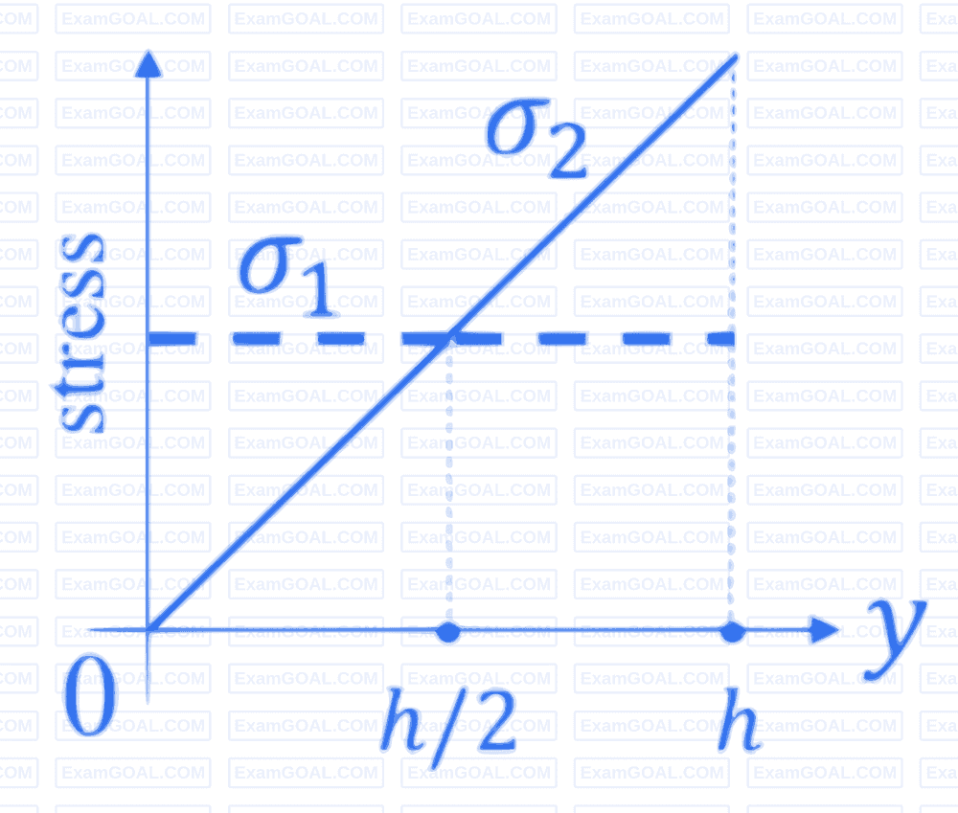
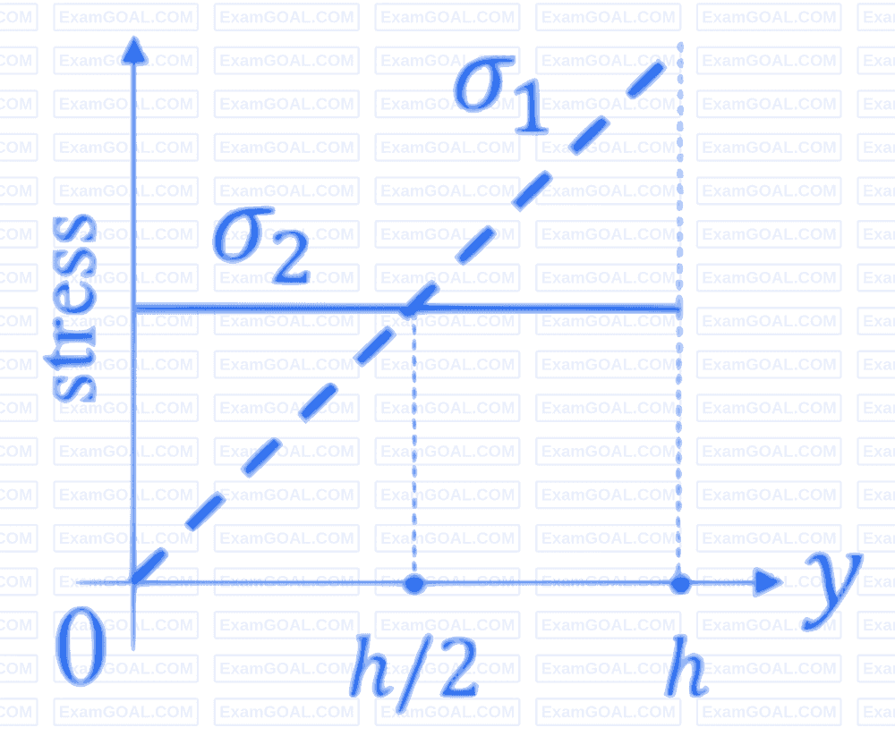
GATE QUESTION 4
The figure shows a thin-walled open-top cylindrical vessel of radius r and wall thickness t. The vessel is held along the brim and contains a constant-density liquid to height h from the base. Neglect atmospheric pressure, the weight of the vessel and bending stresses in the vessel walls.
Which one of the plots depicts qualitatively CORRECT dependence of the magnitudes of axial wall stress (σ1) and circumferential wall stress (σ2) on y?
a) b) c) d)

Slide 15
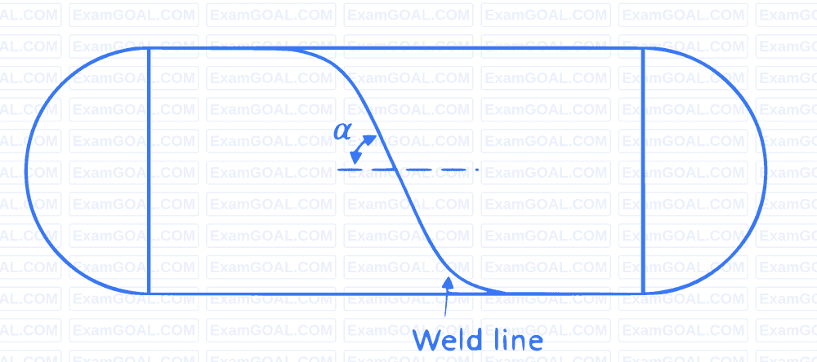
GATE QUESTION 5
The figure shows a thin cylindrical pressure vessel constructed by welding plates together along a line that makes an angle a = 60° with the horizontal. The closed vessel has a wall thickness of 10 mm and diameter of 2 m. When subjected to an internal pressure of 200 kPa, the magnitude of the normal stress acting on the weld is _______________MPa (rounded off to 1 decimal place).
12.3 - 12.7
12.0 - 12.2
11.5 – 11.7
13.3 – 13.5

Slide 16
GATE QUESTION 6
A cylindrical pressure vessel made of steel has diameter of 3 m and wall thickness of 15 mm. For steel, Young's modulus and Poisson's ratio are 210 GPa and 0.3, respectively. The cylinder is designed such that the allowable normal strain at the outer cylindrical surface is equal to 0.00034. The permissible pressure in the tank is ___________kPa (rounded off to 1 decimal place).
840
820
760
880

Slide 17
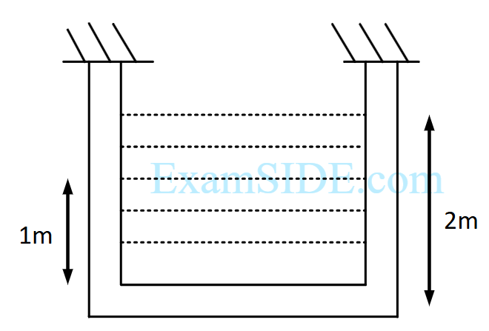
GATE QUESTION 7
A cylindrical container of radius R = 1m, wall thickness 1mm is filled with water upto a depth of 2m and suspended along with its upper rim. The density of water is 1000kg/m^3 and acceleration due to gravity is 10 m/s^2. The self weight of the cylinder is negligible. The formula for hoop stress in a thin walled cylinder can be used at all points along the height of the cylindrical container.
The axial and circumferential stress (σa, σc) experienced by the cylinder wall a mid-depth (1m as shown) are
(10, 5) MPa
(5, 10) MPa
(5, 5) MPa
(10, 10) MPa

Slide 18
GATE QUESTION 8
A cylindrical container of radius R = 1m, wall thickness 1mm is filled with water upto a depth of 2m and suspended along with its upper rim. The density of water is 1000kg/m^3 and acceleration due to gravity is 10 m/s^2. The self weight of the cylinder is negligible. The formula for hoop stress in a thin walled cylinder can be used at all points along the height of the cylindrical container.
If the Young's modulus and Poisson's ratio of the container material are 100GPa and 0.3, respectively. The axial strain in the cylinder wall at mid height is
2 x 10^-5
8 x 10^-5
12 x 10^-5
6 x 10^-5

Slide 19
GATE QUESTION 9
A long thin walled cylindrical shell, closed at both the ends, is subjected to an internal pressure. The ratio of the hoop stress (circumferential stress) to longitudinal stress developed in the shell is
0.5
1
2
4

Slide 20
GATE QUESTION 10
A cylindrical tank with closed ends is filled with compressed air at a pressure of 500KPa. The inner radius of the tank is 2m and it has wall thickness of 10mm The magnitude of maximum in-plane shear stress (in MPa) is ________
25
45
30
10

