Slide 1
Class Factory

Slide 2
Example System: HelloClassFactory
I:\chofmeister\CPSC430_530 \CourseDocuments \DesignInfoAndCodeExamples \InterfacesAndFactory\FlexibleHello
V0HelloProductFamily (later, with Linking & Libraries)
V1FlexibleHello (earlier, with Interfaces)
V2HelloInterface (earlier, with Interfaces)
V3HelloClassFactory (now)
V4HelloFactoryMethod (later, with Factory Method)

Slide 3
V3: Class Factory
(a.k.a. Abstract Factory design pattern in Design Patterns: Elements of Reusable Object-Oriented Software, Gamma, Helm, Johnson, Vlissides. Addison-Wesley 1995.)
Use a class factory when the creator of an object does not know what kind of object to create.
A class factory separates the decision of which object to create from the actual creation of the object.
A class factory is a class that simply creates objects, e.g.:
MessageFactory::MessageFactory(){ }
MessageFactory::~MessageFactory(){ }
IMessage* MessageFactory::newMessage() {
return new Message();
}
Different class factories create different kinds of objects.

Slide 4
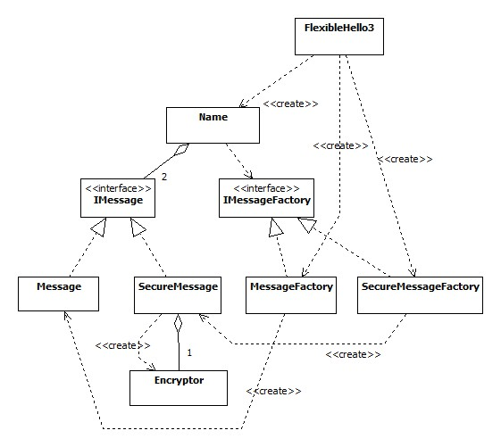
V3: Class Factory Example – Step 1
main() decides which kind of object to create: it creates either a MessageFactory object or a SecureMessageFactory object.
If it is a MessageFactory, then IMessageFactory ::NewMessage() will create a Message.
If it is a SecureMessageFactory, then IMessageFactory ::NewMessage() will create a SecureMessage.

Slide 5
V3: Class Factory Example – Step 2
After main() selects and creates either a MessageFactory object or a SecureMessageFactory object, main() passes it as an IMessageFactory object to the Name object.

Slide 6
V3: Class Factory Example – Step 3
Name does the creation of the IMessage object by calling IMessageFactory’s method NewMessage().
Depending on which kind of IMessageFactory object it received from main(), NewMessage() creates either a Message or a SecureMessage, and returns this object to Name as an IMessage.

Slide 7
V3: Class Factory Example - Summary
main() picks (creates) the Factory.
Name uses the IMessageFactory to create an IMessage object (without knowing exactly what type of object it is creating).
Name uses only the interfaces IMessageFactory and IMessage, even though the objects it accesses via these interfaces are really either MessageFactory and Message or SecureMessageFactory and SecureMessage.

Slide 8
Things to Note in V3
In FlexibleHello3.cpp we must change the constructor invocation from MessageFactory to SecureMessageFactory in order to get the other implementation.
In Name.h, we can use a forward declaration for IMessage and IMessageFactory.
Neither Name.h nor Name.cpp (nor anything they #include) refers to either Message, SecureMessage, MessageFactory, or SecureMessageFactory.
Inline of destructor in an interface.
There is no IMessage.cpp, and no IMessageFactory.cpp.
There is no FlexibleHello3.h.
To switch between variants, we must edit FlexibleHello3.cpp and rebuild.

Slide 9
Lab Exercise: LoudMessage Class Factory
Add a new kind of message: class LoudMessage. Use the LoudMessage code from the Interfaces exercise as a starting point.
Add a new kind of message factory: class LoudMessageFactory. You can copy one of the other factories as a starting point, but don’t forget to modify the include guard.
Modify the rest of the source code to use the LoudMessage and LoudMessageFactory classes.

Slide 10
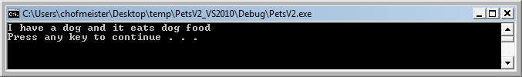
Class Factory : Pet Example
What I’ll show you:
Convert PetsV2 example to V3 (class factory).
What you will do:
Create a VS project and put this source code in it: I:\chofmeister\CPSC430_530\CourseDocuments\DesignInfoAndCodeExamples\FactoryMethodAndLinking\FactoryMethodPetExample\PetsV3
Add another method to the factories: IFood* NewFood()
Create IFood.h, FoodCat.h, FoodCat.cpp, FoodDog.h, FoodDog.cpp. These have method kind:
Change PetStore.cpp to show this:
void FoodDog::kind(void) {
std::cout<<"dog food";
}

