Slide 1
UML State Chart Diagrams

Slide 2
UML State Chart Diagram
State Chart Diagrams are used to model the dynamic behavior of one class or object. Such a diagram contains a state machine (the UML version is actually a form of extended finite state machines.)
state machine:
Good for describing the behavior of an object across several use cases.
Can show entire behavior of object, in addition to how it interacts with another.
Can show partial behavior, e.g. the legal order of operations of an object – the interaction protocol.

Slide 3



UML State Chart Diagram - State
State:
Represents some state the class/object can be in.
The state corresponds to a particular set of values assigned to the attributes.
Must have a name.
Can have associated activities; we won’t use this feature.
Start state shows where you enter the state machine.
End state shows where you exit the state machine.

Slide 4

UML State Chart Diagram - Transition
Transition:
Defines what causes the class/object to move from one state to another.
Only 1 transition out of a state can be taken at each step.
The transition label describes the transition.

Slide 5
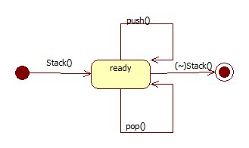
State Chart Diagram – Example (1)
Use a state chart diagram to specify the interaction protocol (i.p.) of a stack, meaning the legal order in which operations can be invoked. This is a subset of the full behavior of the stack. Assume that the stack has a maximum of 3 elements.
Must call constructor first.
Then any number of push() and pop() operations are allowed.
After destructor is called, no more operations are possible.
Is this correct?

Slide 6
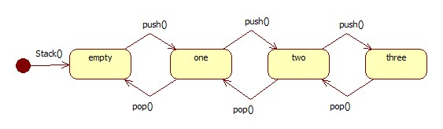
State Chart Diagram – Example(2)
Problems with the state machine:
Cannot pop on an empty stack.
Cannot push when there are already 3 elements in the stack.
The state machine must capture the restriction that:
0 <= #pushes - #pops <= 3.
Normally we don’t show the destructor, since it can be invoked from any state.

Slide 7
State Chart Diagram – Example(3)
What aspect of the behavior is missing from this diagram?
No information about return values.
The stack as described is no different from a FIFO queue.
What is another problem with the diagram?
Good only for a relatively small stack.

Slide 8
State Chart Diagram – Transition Label
The format of a transition label is:
<event> [<guard>] / <action>
<event>
describes what can trigger the transition
comes from outside the state machine
<guard> (if present)
must be true in order for transition to fire
is a logical condition – evaluates to t or f
<action>
is executed when the transition fires.
is generated by state machine
if processing is involved, it happens quickly and atomically

Slide 9
State Chart Diagram – Transition Firing
The transition occurs if and only if:
The activities of the state are complete.
The event occurs (if one is present in the transition label).
The guard is true (if one present).
Only 1 transition out of a state can be taken at each step:
If a state has multiple outgoing transitions, the conditions given by the event+guard must be mutually exclusive.
If an event occurs that is not covered by a transition, then you stay in the same state.

Slide 10
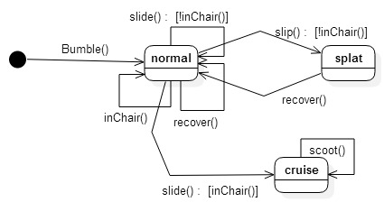
Exercise: Which Sequences are Legal?
Bumble(), ~Bumble().
Bumble(), if inChair() slide(), scoot(), scoot(), slide().
Bumble(), if !inChair() slide(), if !inChair() slip(), recover(), if inChair() slide(), ~Bumble().
Bumble(), recover(), recover(), slide(), ~Bumble().

Slide 11
Stack Example with Transition Guards
Add guards to the transition labels to overcome the “counting” problem.
New problem: who is keeping track of #pushes and #pops?
[#pushes - #pops < 3]
[#pushes > # pops]

Slide 12
State Chart Diagram – Exercise
Draw a state chart diagram describing the interaction protocol of a Stack with these operations:
Stack()
// postcondition: isEmpty() && !isFull()
void push(x)
// precondition: !isFull()
// postcondition: x is added to the stack
int pop()
// precondition: !isEmpty()
// postcondition: Remove the most recently added element and return it
bool isEmpty()
// postcondition: No state change. Return true if the stack contains
// no more elements; otherwise return false
bool isFull()
// postcondition: No state change. Return true if the stack can hold
// no more elements; otherwise return false
~Stack()
// destructor
Hint: use guards on your push() and pop() operations

Slide 13
Conventions for Describing Interaction Protocols with State Charts
Transitions are labeled with one of the public operations of the class.
Guards (on transitions) can only refer to public parts of the class: they may use the operation’s parameters and/or another public operation’s return value, but may not refer to the class’s private (or protected) attributes or operations.
deposit(amount) [amount > 0]
pop() [!isEmpty()]
pop() [numElements > 0]
Don’t need to show destructor transitions to stop state.
The state chart must describe ALL legal uses. So any usage not covered by the state chart is illegal, and its behavior is undefined.

Slide 14
Second Exercise: PiggyBank Spec
Here is a specification for MyPiggyBank. All operations are public.
MyPiggyBank(); // constructor
// postcondition: GetBalance() is 0
void Deposit (float amount);
// precondition: amount > 0
// postcondition: GetBalance() > 0
void Withdraw (float amount);
// precondition: 0 < amount <= GetBalance()
// postcondition: GetBalance() is decreased by amount, in other words:
// GetBalance()’ == GetBalance() - amount
float GetBalance();
// postcondition: No state change

Slide 15
Piggy Bank Interaction Protocol
Draw a UML State Chart diagram describing the interaction protocol of MyPiggyBank.

Slide 16
Piggy Bank Implementation 0
Does this implementation obey the specification?
Implementation 0:
The constructor sets private attribute _balance (float) to 0.
GetBalance() returns the value of _balance.
Deposit() checks whether amount is positive and non-zero. If so it adds amount to _balance; otherwise it leaves _balance unchanged.
Withdraw() checks whether amount is positive, non-zero, and not bigger than _balance. If so it subtracts amount from _balance; otherwise it leaves _balance unchanged.

Slide 17
Conventions for Checking an Implementation Against a Specification
Preconditions and postconditions of the specification may refer only to:
parameters of the operation being described
public parts of the class.
(Similar to transition labels on the class’s state chart describing interaction protocol.)
Postconditions should use ’ to indicate the state after executing the method, e.g.
GetBalance()’ == GetBalance() - amount
Where the specification is silent (doesn’t specify what happens), the behavior is undefined. For these cases the implementation could throw an exception or take any other action.
The implementation need not be “reasonable” (do what we expect); all that matters is that it fulfills the specification.

Slide 18
Piggy Bank Implementations 1-3
Which of these implementations obey the spec?
1. Like 0., but Withdraw() checks whether amount is positive, non-zero, and not bigger than _balance. If so it multiplies amount by 1.1 and subtracts this from _balance; otherwise it leaves _balance unchanged.
2. Like 0., but Deposit() checks whether amount is positive and non-zero. If so it multiplies amount by .9 and adds this to _balance; otherwise it leaves _balance unchanged.
3. Like 0., but Deposit() checks whether amount is positive and non-zero. If so it adds (amount – 1) to _balance; otherwise it leaves _balance unchanged. ($1 service charge)

