Slide 1
Coding Conventions and Polymorphism

Slide 2
Coding Conventions
See I: drive and D2L for the complete set of coding conventions:
CourseDocuments\ DesignInfoAndCodeExamples\ ImplementationInformation\ CodingConventionsAndVisualStudio.doc
For example:
Whenever possible, avoid #include statements in header files. Either:
Put them in body files (.cpp) instead, and/or use a class statement (forward declaration) in header file. (See Greeting.h for an example of this.)
Don’t put bodies of methods, however simple, in header files.

Slide 3
Polymorphism
There are a number of forms of polymorphism, but in OO we use subtype polymorphism (aka inclusion polymorphism):
In object-oriented programming, inclusion polymorphism is a concept in type theory wherein a name may denote instances of many different classes as long as they are related by some common super class. Inclusion polymorphism is generally supported through subtyping, i.e., objects of different types are entirely substitutable for objects of another type (their base type(s)) and thus can be handled via a common interface.
Subtype polymorphism, almost universally called just polymorphism in the context of object-oriented programming, is the ability of one type, A, to appear as and be used like another type, B.
(From wikipedia)

Slide 4
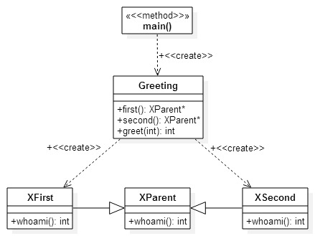
FirstGreet Example
I:\chofmeister\CPSC430_530\CourseDocuments\DesignInfoAndCodeExamples\PolymorphismExample

Slide 5
GreetApp.cpp
#include "Greeting.h"
#include <iostream>
int main(int argc, char* argv[]) {
Greeting g;
std::cout << "First: " << g.greet(1)
<< std::endl;
std::cout << "Second: " << g.greet(2)
<< std::endl;
return 0;
}

Slide 6
Greeting.h Greeting.cpp
#if !defined GREETING_H
#define GREETING_H
class XParent;
class Greeting {
public:
Greeting();
XParent *first();
XParent *second();
int greet(int selection);
virtual ~Greeting();
};
#endif
#include "Greeting.h"
#include "XFirst.h"
#include "XSecond.h"
Greeting::Greeting() { }
Greeting::~Greeting() { }
XParent *Greeting::first() {
XParent *x1 = new XFirst();
return (x1);
}
XParent *Greeting::second() {
XParent *x2 = new XSecond();
return (x2);
}
int Greeting::greet(int selection) {
XParent *x;
if (selection == 1) x = first();
else x = second();
return (x->whoami());
}

Slide 7
XParent.h XParent.cpp
#if !defined XPARENT_H
#define XPARENT_H
class XParent {
public:
XParent();
virtual int whoami();
virtual ~XParent();
};
#endif
#include "XParent.h"
XParent::XParent() {
}
XParent::~XParent() {
}
int XParent::whoami() {
return (0);
}

Slide 8
XFirst.h XFirst.cpp
#if !defined XFIRST_H
#define XFIRST_H
#include "XParent.h"
class XFirst : public XParent {
public:
XFirst();
int whoami();
virtual ~XFirst();
};
#include "XFirst.h"
XFirst::XFirst() {
}
XFirst::~XFirst() {
}
int XFirst::whoami() {
return (1);
}

Slide 9
XSecond.h XSecond.cpp
#if !defined XSECOND_H
#define XSECOND_H
#include "XParent.h"
class XSecond : public XParent {
public:
XSecond();
int whoami();
virtual ~XSecond();
};
#endif
#include "XSecond.h"
XSecond::XSecond() {
}
XSecond::~XSecond() {
}
int XSecond::whoami() {
return (2);
}

Slide 10
Create a .NET Project for FirstGreet
Create a .NET solution and project.
File / New / Project…
Select Visual C++ / Win32
Select Win32 Console Application.
For Location, browse to the desktop
Name the project Greet
Click “OK”
When the wizard pops up, click “Next”. On this screen,
Make sure “Console application” is selected
Check “Empty project” (uncheck everything else)
Click “Finish”

Slide 11
Insert the source files
Insert the .h and .cpp files for the polymorphism example.
In the File Explorer, locate your VS project folder (Desktop/Greet), and copy/move the .cpp and .h files into this folder.
Project / Add existing item…
Browse to the VS project folder (Desktop/Greet)
Select all the .cpp and .h files
Click “Add”

Slide 12
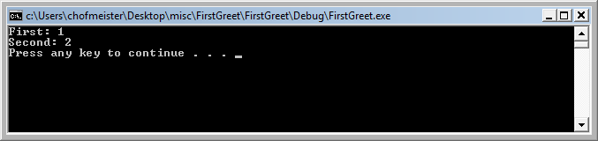
Build and Run FirstGreet
Build and run the example.
Insert system("pause"); at the end of the main, just before the return.
Click the green triangle to build and run:
Note: for classroom machines you may need to change the following project setting: Project /Retarget solution, change SDK version to 8.1

Slide 13
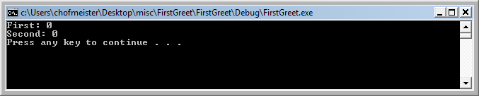
Modify FirstGreet
What happens when you remove the keyword ‘virtual’ from the declaration of whoami() in XParent.h?
It’s using XParent’s implementation of whoami() rather than XFirst’s and XSecond’s.

Slide 14
When whoami() is not virtual…
Greeting’s methods can still treat XFirst as an XParent, but when doing so can no longer access XFirst’s implementation of whoami(). (Same for Xsecond)
In order to invoke XFirst’s whoami() the object must be of type XFirst, not XParent. Then you’d have to do something like this:
int Greeting::greet(int selection) {
// XParent *x;
if (selection == 1) {
return ((XFirst*)first())->whoami();
} else {
return ((XSecond*)second())->whoami();
}
//return (x->whoami());
}

Slide 15
Method Binding
int Greeting::greet(int selection) {
XParent *x;
if (selection == 1) x = first();
else x = second();
return (x->whoami());
}
When a method is not ‘virtual’, C++ uses static method binding.
The compiler resolves the method call to use the object’s static type, which is XParent.
This runs faster, since no dynamic lookup is needed for the method call.
When a method is ‘virtual’, C++ uses dynamic method binding (aka dynamic dispatch).
The method call is not resolved until runtime, when the object’s dynamic type is used to decide which method should be called. In this case it could be XFirst or XSecond.
This is now the norm for object-oriented languages.

