Slide 1
Interfaces

Slide 2
Example System: FlexibleHello
I:\chofmeister\CPSC430_530 \CourseDocuments \DesignInfoAndCodeExamples \InterfacesAndFactory\FlexibleHello
V0HelloProductFamily (later, with Linking & Libraries)
V1FlexibleHello (now)
V2HelloInterface (now)
V3HelloClassFactory (later, with Class Factory)
V4HelloFactoryMethod (later, with Factory Method)

Slide 3
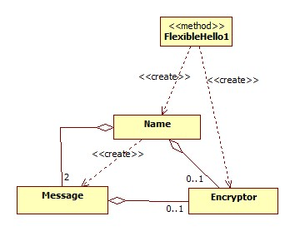
V1: FlexibleHello Starting Point
FlexibleHello1:
Creates a Name object, either with an Encryptor or not.
Calls Name’s firstName() and lastName() methods, and prints the result.
Name:
Creates two Message objects: _textin and _textout.
Methods firstName() and lastName() do the following:
Use _textout to set and show the prompt.
Use _textin to capture the user’s input, which is returned to the caller.

Slide 4
V1: FlexibleHello Starting Point (cont.)
Message:
setMessage(): saves the message string (saves it encrypted, if applicable).
showMessage(): displays the current message string (decrypted, if applicable) on the console.
readMessage(): reads a string from the console and returns it (encrypted, if applicable). (We don’t decrypt in this case simply because we want to see which version of Message was used.)

Slide 5
V1: FlexibleHello Source Code
Open the VS project for V1FlexibleHello and review the source code.

Slide 6
V1: FlexibleHello Dependencies
FlexibleHello1 knows about all the variants of Message that exist.
For the plain text variant, it uses 0 as the Encryptor*.
For the secure text variant, it creates an Encryptor.
FlexibleHello1 passes the Encryptor* to Name.
Name does not know about the Message variants.
Name simply passes the Encryptor* when it constructs its Message objects.
Message is capable of using both plain text and encrypted messages.
It uses the Encryptor* object if available (if it’s non-null).

Slide 7
Things to Note in FlexibleHelloV1
Coding Conventions
Use of include guards
Minimizing #includes
Use of STL for string and iostream
There is no FlexibleHello1.h.
To switch between variants, we must edit FlexibleHello1.cpp and rebuild.

Slide 8
Lab Exercise: LoudMessage
Add a new kind of message: a loud message.
The loud message should convert the message string to all uppercase. To convert a string to all uppercase, you can use code such as the following:
for (unsigned i=0; i<word.size(); i++)
word.replace(i, 1, 1, toupper(word[i]));
Modify the source code to use the loud message.

Slide 9
Notes on Lab Exercise
Modify Message to handle 3 variants instead of 2.
We can no longer use the Encryptor object to distinguish between message variants since now there are 3.
Put the #defines for the 3 message variants into Message.h (instead of in FlexibleHello1.cpp).
Modify main() to pick one of the 3 variants and pass a flag to Name.
Modify Name to pass the variant flag to Message.
Now we see that the Encryptor object was doing double duty, both as a flag to pick the variant and as the object itself.
An improvement would be to let Message create the Encryptor itself; there is no longer any need for main() to do this.

Slide 10
Interfaces
Interface:
Is a specification (what, not how).
To do something useful (computation) it needs an implementation.
The implementation must supply all the behavior specified in the interface.
In Java there is native support for interfaces.
In C++ there is not, but we can mimic interfaces.

Slide 11
Why Use Interfaces?
Since the interface is a specification, it:
Defines what an implementer must provide.
Shields code that uses (calls methods in) the interface from knowing anything about the implementation it is using.
Allows new implementations to be added/substituted without changing the calling code.
Hides any variations among the implementations.
Supports callbacks: the code being “called back” implements the interface supplied by the code that initiates the callback.

Slide 12
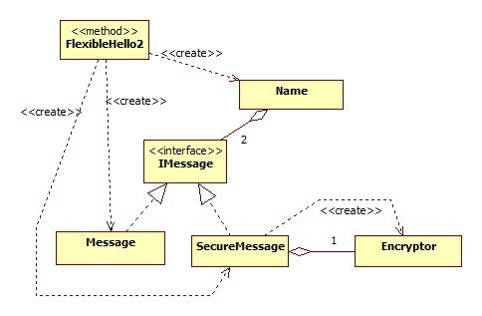
Preview: Next Stage for Hello Example
Instead of making the Message class handle multiple message variants, we will create a separate class for each variant.
We will hide these message variants behind an interface IMessage.

Slide 13
Comparing Interfaces and Classes
A class has:
attributes – for keeping state information:
class attributes (static variables/member data)
instance attributes (instance variables/member data)
operations (methods) – to provide behavior for the class
An interface differs from a class in that it has:
no attributes (no state!)
no bodies of methods (no implementation!)
no private or protected operations

Slide 14
.h Files in C++
C++ has no direct support for interfaces. However, some people refer to the class declaration in the .h file as the class’s “interface.”
IT’S NOT.
In C++, variables and classes must be declared before they can be defined, and defined before they can be used.

Slide 15
usually goes in .h file
 | For Variables | For Classes
Declaration | int j; | class SpreadSheet { public: string firstRow(); SpreadSheet(string filename); private: int currRow; int currCol; };
Definition | j = 5; | #include "SpreadSheet.h" string SpreadSheet::firstRow() { ... } SpreadSheet::SpreadSheet(string filename) { ... }
Use | cout << j; | #include “SpreadSheet.h” ... SpreadSheet s = new SpreadSheet(“gradelist”); cout << s.firstRow();
usually goes in .cpp file

Slide 16
.h files in C++
The class declaration specifies:
The classname and visibility.
The visibility, datatypes, and names of attributes.
The visibility, names, and signatures of methods.
For C++ classes, the convention is:
Declare class in a .h file.
Define class in a .cpp file.
Use class in a .cpp file.
The .h file is a mechanism for giving the class declaration to the compiler (#include). It can contain:
attributes
bodies of methods (definitions) *THIS IS DISCOURAGED*
private/protected attributes/operations
None of these belong in an interface!

Slide 17
Interfaces in C++
Thus in C++ we must mimic an interface by using an abstract class with only abstract public operations.
Abstract class:
Is not a fully defined class, meaning not all bodies are provided.
Contains one or more abstract operations .
Can’t be instantiated: can’t use it to create objects.
Could contain attributes.
Abstract operation:
no body (pure virtual method)

Slide 18
Interfaces in C++
In C++, an abstract class is not always an interface, but an abstract class with only abstract public operations (no attributes, no private or protected operations) can act as an interface.
Example of how we will define interfaces in C++:
class IX {
public:
// no constructor because this does not get instantiated
virtual int myMethod() = 0; // methods are pure virtual
virtual ~IX() { }; // for proper cleanup, need a destructor
// do an inline def because we do not want a .cpp file
};
For us, this is the only permitted use of an inline definition.

Slide 19
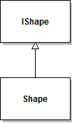
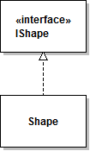
Relationship Between Classes and Interfaces
In languages with native interface support (e.g. Java),
a class can inherit from (extend) another class
a class can realize (implement) one or more interfaces

Slide 20
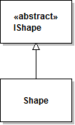
C++: Relationship Between Classes and Interfaces
In C++, using conventions we can mimic an interface. Conceptually the class realizes (implements) the interface:
However, the literal relationship is simply inheritance: the “realizing” class simply inherits from the abstract class that represents the interface:

Slide 21
Multiple Inheritance
Note that C++ supports multiple inheritance, so it is possible for a class to:
Inherit from a superclass, and
Implement one or more interfaces.
Although you may have heard that multiple inheritance is bad, that’s a bit simplistic.
Problems arise when you inherit multiple implementations (classes with attributes and method bodies).
It causes no problems to inherit multiple specifications (via multiple interfaces).

Slide 22
V2: Hello with Interfaces
Create two separate message classes: Message and SecureMessage. The Encryptor is now encapsulated in SecureMessage.
Provide an interface to the message classes (IMessage).
FlexibleHello2 (main()) chooses which variant of IMessage is used, creates the IMessage object and passes it to Name.

Slide 23
V2: Hello with Interfaces (cont.)
Name depends only on interface IMessage, not on any concrete message classes. It knows nothing about the variants.
Since Name requires two message objects, FlexibleHello2 must create both and pass both to Name. (ugly)
FlexibleHello2 could create two different kinds of messages to pass to Name.

Slide 24
V2: Hello with Interfaces (cont.)
When Name invokes setMessage(), showMessage(), or readMessage(), the method that executes depends on what type of object FlexibleHello2 created:
If it created a Message, then Message’s setMessage(), showMessage(), and readMessage() are executed.
If it created a SecureMessage, then the SecureMessage methods are executed.

Slide 25
V2: HelloInterface Source Code
Open the VS project for V2HelloInterface and review the source code.

Slide 26
Things to Note in V2
In FlexibleHello2.cpp we must change the constructor invocation from Message to SecureMessage in order to get the other implementation.
In Name.h, we can use a forward declaration for IMessage. Name.cpp must #include “IMessage.h”, since Name calls its methods.
Neither Name.h nor Name.cpp (nor anything they #include) refers to either Message or SecureMessage. We could add a LoudMessage class, have the main() create one of these, pass it to Name, and everything would work fine.
Inline of destructor in an interface.
There is no IMessage.cpp.
There is no FlexibleHello2.h.
To switch between variants, we must edit FlexibleHello2.cpp and rebuild.

Slide 27
Lab Exercise: LoudMessage With Interface
Add a new kind of message: class LoudMessage. Copy some of your code from the first exercise and put it in the new class.
Modify the rest of the source code to use the LoudMessage class.

