Slide 1
UML Use-Case Diagrams

Slide 2
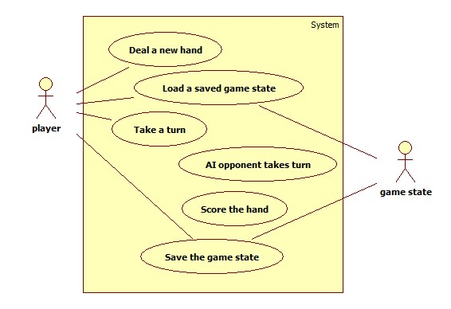
UML Use-Case Diagrams
Use-Case diagrams are usually used during Requirements Engineering, and become part of the Requirements Specification.
Use-Case Diagram

Slide 3
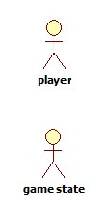
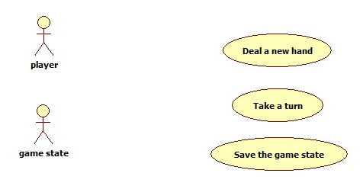
UML Use-Case Diagram
Contains actors, use cases, relationships among them.
Shows how actors participate in use-cases, and possibly how use-cases interact with each other.
Actors
Use Cases

Slide 4
Use Case
A use case is a unit of functionality provided by the system; it describes the behavior of the system.
A use case:
Is good for eliciting and clarifying requirements.
Is not so useful for identifying non-functional requirements.
Can be described in structured natural language, with a sequence diagram, or using other techniques.

Slide 5
UML Use Case
In a use-case diagrams, a use case:
Is shown as an ellipse with a label inside, identifying the use case.
Is initiated by an actor.
Can appear in multiple use-case diagrams.
Can appear multiple times within a use-case diagram.

Slide 6
Actor
Actors define the boundaries of the system.
An actor :
Is anyone or anything that exchanges data with the system. e.g.:
user
piece of external hardware
another system
Represents a particular class of users rather than a specific one.
In use-case diagrams, an actor is shown as a stick figure with a label below, indicating the type of actor

Slide 7
Example Use-Case Diagram

Slide 8
In-Class Exercise
Using this currency converter:
http://www.xe.com/ucc/
Make a list of the use cases.
Draw a Use-Case diagram.

Slide 9
Describing a Use Case
Example natural language format for describing a use-case:
Use case: <title>
Precondition:
Main flow of events:
Exceptional flow of events:
Exceptional flow of events:
…
Postcondition:
Note: actors appear in italics (underlined)

Slide 10
Example Use Case Description
How is this kind of description similar/different from instructions for how to play the game?
Use case: Take a turn
Precondition:
A new hand has been dealt or
A saved game has been loaded or
The AI opponent has just finished taking a turn.
Main flow of events:
Player picks from stock pile or discard pile.
Player may meld (lay out a combination).
Player may lay off (add a card to an existing set which was melded either by player or opponent).
Player discards one card, although it cannot be the same card that the player picked from the discard pile in 1.
Extension:
If the player melds, lays off, or discards all cards in hand, then the game is over and scoring takes place.
How is this kind of description similar/different from the list of requirements for the system?

Slide 11
Scenario
For each use-case there may be several scenarios, each of which describes the behavior in a different context
Scenario:
A sequence of events the system must handle—should usually be centered around one use-case.
May have preconditions & postconditions.
A use case is more general than a scenario, e.g.:
Use Case | Scenarios
Check out resource | Check out book Check out CD …
Search for the ESU equivalent of a course taken elsewhere | Does the institution have any courses equated with ESU courses? What does course Y at the institution transfer as?

Slide 12
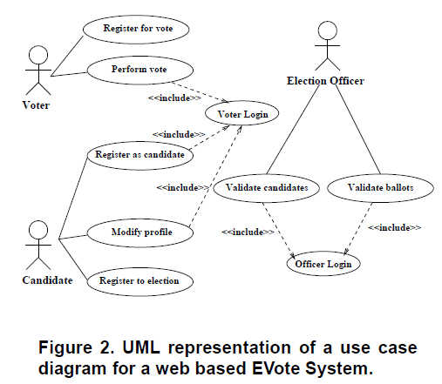
EVote Example: Use Case Diagram
This example uses a particular notation for describing use cases and scenarios.
“Enhancement of a Use Cases based Requirements Engineering approach with
Scenarios,” Stephane S. Some.

Slide 13
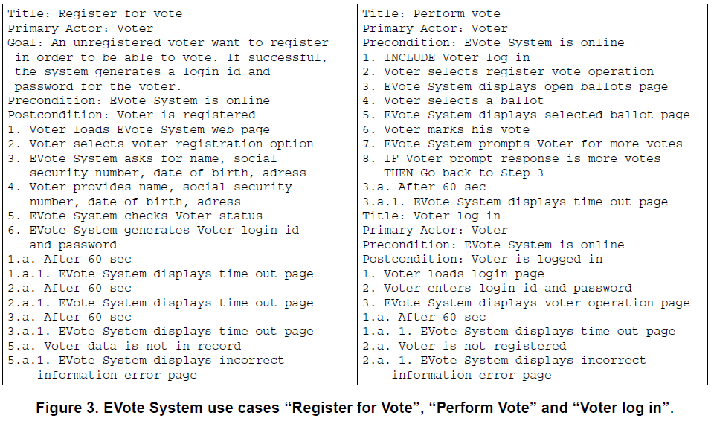
EVote Example: Three Use Cases
“Enhancement of a Use Cases based Requirements Engineering approach with
Scenarios,” Stephane S. Some.

Slide 14
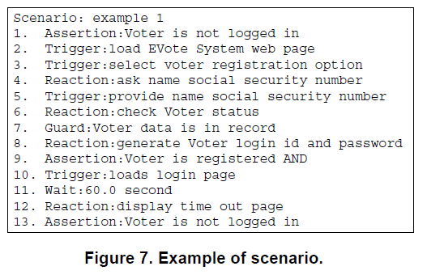
EVote Example: Scenario
Assertion: Must be true at that point in scenario.
Guard: Describes one of multiple guard conditions.
Wait: Wait before continuing.
“Enhancement of a Use Cases based Requirements Engineering approach with
Scenarios,” Stephane S. Some.

Slide 15
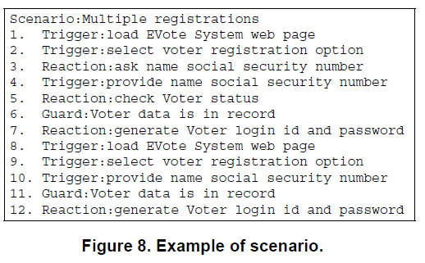
EVote Example: Scenario
A scenario:
describes interactions between systems and actors.
may cross over several use-cases.
“Enhancement of a Use Cases based Requirements Engineering approach with
Scenarios,” Stephane S. Some.

Slide 16
In-Class Exercise: Use Cases & Scenarios
1. Pick one of the use cases from the currency converter. Describe it. (Use the format from the Evote Example.)
2. Here is the Swimming World Time Conversion Utility:
http://www.swimmingworldmagazine.com/results/conversions.asp
What are the key scenarios?
What are the use-cases?

