Slide 1
UML Class Diagrams

Slide 2
Unified Modeling Language (UML)
The UML provides a (visual) language for modeling object-oriented concepts.
To model dynamic behavior:
UML Sequence Diagram:
Describes how groups of objects interact, e.g. within a use case.
UML State Chart Diagram:
Describes the behavior of a single object across many use cases.
To model static relationships:
UML Class Diagram:
Describes the static relations of classes/objects.
Contain classes, objects (including stereotyped classes/objects) and relations between them.
run-time
compile-time

Slide 3
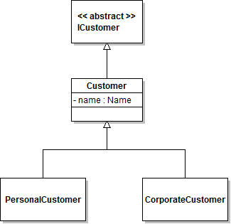
Example: Version 1
class ICustomer: public
{ // abstract class … }
class Customer: public ICustomer
{
private:
Name name;
…
}
class Name
{ … }
class CorporateCustomer: public Customer
{ … }
class PersonalCustomer: public Customer
{ … }

Slide 4
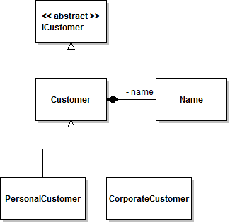
Example: Version 2
class ICustomer: public
{ // abstract class … }
class Customer: public ICustomer
{
private:
Name name;
…
}
class Name
{ … }
class CorporateCustomer: public Customer
{ … }
class PersonalCustomer: public Customer
{ … }

Slide 5



Class Diagrams: Classes/Objects
Rectangle represents a class or object. Show it with 1, 2, or 3 horizontal compartments.
Top Compartment contains name (identity):
If it’s a class: show name in bold.
If it’s an object: show object name (optional) followed by ‘:’ followed by class name (not bold, but underlined).
If it’s an abstract class: show name in italics, or use stereotype.
All methods are abstract:
virtual … = 0;

Slide 6

Class Diagrams: Classes/Objects
Middle compartment contains attributes.
Format:
<visibility> <name> : <type>
Underline the attribute if it’s a class attribute.
Visibility can be:
- private
+ public
# protected
static int ...

Slide 7
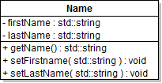
Class Diagrams: Classes/Objects
Lower compartment contains operations.
Format:
<visibility> <name> ( <param list> ) : <return type>
Underline the operation if it’s a class operation.
Abstract operation: shown in italics or with stereotype <<abstract>>.
Visibility can be:
- private
+ public
# protected
static void...

Slide 8
In-Class Exercise
Draw a UML Class Diagram to model the code below:
class CorporateCustomer: public Customer
{
private:
int creditLimit;
protected:
Name contactName;
std::string creditRating;
public:
virtual void remind();
virtual void billForMonth(int);
CorporateCustomer();
virtual ~CorporateCustomer();
}

Slide 9

Class Diagrams: Interfaces
To represent an interface,
Use the class/object notation, with the stereotype <<interface>> directly above the name (in the same compartment as the name).
Or use the lollipop notation (small hollow circle)
<< >> stereotype
a way of indicating that this class has a special meaning
ICustomer

Slide 10

Class Diagrams: Association Relationship
Association (general-purpose): solid line
Use a label (optional) to describe the relation. Use a small solid triangle (optional) to indicate how to read the label.
Bidirectional association
don’t need to show arrowheads
Uni-directional association
use arrowhead to show direction of association
Can have a rolename at each association end.

Slide 11


Class Diagrams: Aggregation Relationship
Aggregation (whole-part): hollow diamond on solid line
One class/object contains another (diamond is attached to the containing class)
For attributes that are primitive data types:
Put it in the attribute compartment.
For attributes that are objects:
Show the object’s class and use an aggregation or composition relationship.
If A has an attribute that is a pointer to an instance of B, then use the aggregation relationship.
class Customer: public ICustomer {
private:
Name* name;
…
}

Slide 12

Class Diagrams: Composition Relationship
Composition (a stronger form of aggregation): solid diamond on solid line
If B is part of A, then B “lives and dies” with A
If A has an attribute of type B that is a statically allocated variable, then use the composition relationship.
class Customer: public ICustomer {
private:
Name name;
…
}

Slide 13
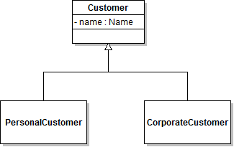
Class Diagrams: Generalization Relationship
Generalization (inheritance): hollow triangle on solid line
A special relation, denoting that one class/object is a subclass of the other (the triangle is attached to the superclass)

Slide 14
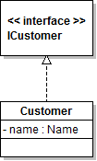
Class Diagrams: Realization Relationship
Realization (implementation): hollow triangle on dashed line
A special relation, denoting that an interface is realized by (implemented by) a class (triangle is attached to the interface).

Slide 15
In-Class Exercise
Use the code below to add to your diagram:
class ICustomer
{ // an interface }
class Customer: public ICustomer
{
private:
Name name;
std::string address;
public:
std::string getName();
void setFirstName(std::string);
void setLastName(std::string);
std::string getAddress();
void setAddress(std::string);
std:string creditRating();
Customer();
virtual ~Customer();
}

Slide 16
Class Diagrams: Dependency Relationship
Dependency: dashed line with arrowhead
A special relation, denoting that one class/object is dependent on another (arrowhead points away from dependent class/object).
When the dependency goes from B to A:
B depends on A.
Changes to A may affect B (but NOT vice versa).

Slide 17

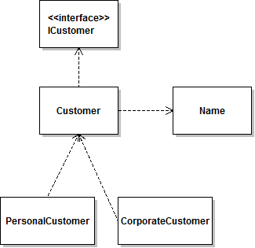
Class Diagrams: Dependency Relationship
Sometimes we’re interested in dependencies rather than more specific relationships:
Name is part of Customer, so Customer depends on Name.
PersonalCustomer inherits from Customer, so PersonalCustomer depends on Customer.
Customer implements ICustomer, so Customer depends on ICustomer.

Slide 18
Class Diagrams: Multiplicity
Generalization, Aggregation, Dependency, Realization are special kinds of Association.
You can annotate relationships with a multiplicity give more information about how the two entities are related. Multiplicity:
shown at association end
inside the class when using nesting notation
star (*) means 0 or more
use 0..1 to mean 0 or 1
use 1..* to mean 1 or more
use 2..4 to mean 2 to 4

Slide 19
Example – p.1
class ICustomer { // This class is abstract because one or more of its operations is abstract.
// An abstract class is one that can’t be instantiated.
public:
virtual std::string getName() = 0; // “pure virtual” – this means it’s abstract.
// An abstract operation means it has no body (no implementation).
virtual std::string getAddress() = 0;
virtual ~ICustomer() { }; // not “pure virtual”, just virtual.
}
class Customer: public ICustomer {
private:
Name name;
std::string address;
public:
std::string getName();
void setFirstName(std::string);
void setLastName(std::string);
std::string getAddress();
void setAddress(std::string);
std:string creditRating();
Customer();
virtual ~Customer();
}

Slide 20
Example – p.2
class CorporateCustomer: public Customer {
private:
int creditLimit;
protected:
Name contactName;
std::string creditRating;
public:
virtual void remind();
virtual void billForMonth(int);
CorporateCustomer();
virtual ~CorporateCustomer();
}
class PersonalCustomer: public Customer {
protected:
std::string creditCardNumber;
}
class Name {
private:
std::string firstName;
std::string lastName;
public:
Name();
virtual ~Name();
std::string getName();
void setFirstName(std::string);
void setLastName(std::string);
}

Slide 21
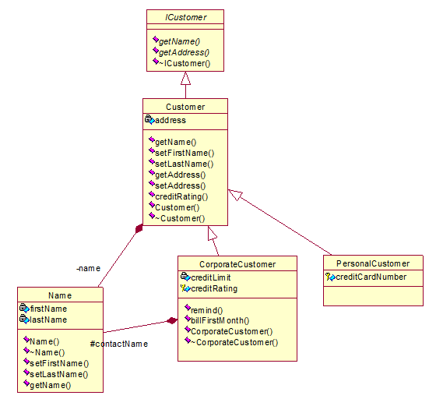
Example – p.3
Note: drawn in Rational Rose:
Pink box: public
Lock: private
Key: protected
ICustomer and its getter methods are abstract (note the italics).

Slide 22
Translating C++ Code Into Class Diagrams: Pitfalls
C++ uses the keyword ‘static’ to indicate a class attribute or class method. This attribute or method should be underlined in a class diagram. DO NOT PUT ‘static’ IN YOUR CLASS DIAGRAMS!
C++ uses the keyword ‘virtual’ to indicate that dynamic binding (instead of static binding) is used. This concept is not captured in a class diagram (dynamic binding is what’s typical for OO languages). DO NOT PUT ‘virtual’ IN YOUR CLASS DIAGRAMS!
C++ does not have a language construct for interfaces (unlike Java).

Slide 23
More Translation Pitfalls
Abstract classes in C++ do not have a special keyword (unlike Java), so you have to figure out when a class is abstract. (If any of its methods, including inherited methods, are abstract, then the class is abstract.)
A pure virtual method in C++ is an abstract method. (virtual ... = 0;)
In Java objects are always dynamically allocated. But in C++ you can also have statically allocated objects. Use:
composition for statically allocated objects
aggregation for dynamically allocated objects

Slide 24
Translation Hints
Guideline for representing inherited methods:
Show all methods that are abstract (declared pure virtual).
When a class inherits a method but doesn’t override it or implement it, don’t repeat the method for that class.
When a class overrides a method, show the method for that class.
Guideline for constructors and destructors:
You don’t need to show default constructors or destructors in your class diagrams.
It’s a good idea to show non-default constructors (along with parameters) and non-default destructors in your class diagrams.

Slide 25
More Translation Hints
First use the .h files and put methods and attributes into your diagram.
Next look at the .cpp files and add any dependencies found in the code bodies:
If one of A’s methods has a local variable of type B declared, show a dependency from A to B.
If one of A’s methods calls the constructor of C, show a dependency stereotyped with <<creates>>.

Slide 26
Class Diagrams: Exercise
Use the source code of the polymorphism example:
I:\chofmeister\CPSC430_530\CourseDocuments\DesignInfoAndCodeExamples\PolymorphismExample\Polymorphism_sourcefiles.doc
Draw a UML Class Diagram to describe these 5 classes.
You can draw it by hand or use a UML tool (e.g. VioletUML, StarUML).

