Slide 1
CS 4641/7641 hw4
swu321

Slide 2
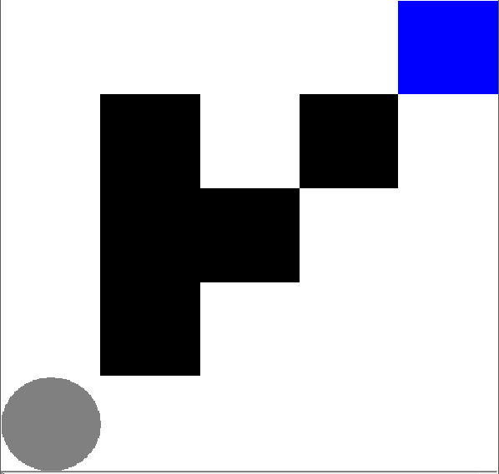
Easy Maze
The agent has 80% probability that it will follow the guidance of the action.
There are 20% probability that the agent might end up with going to the other directions. For each direction other than the action, the probability is 20%/3.
The reward value is correlate to the number of step taken. It is about the step value times -1 plus 100.
The goal of the agent is to reach the destination. Every step during the trip will have cost. Generally, the fast the agent can get to the destination, the higher the reward.
20 State

Slide 3
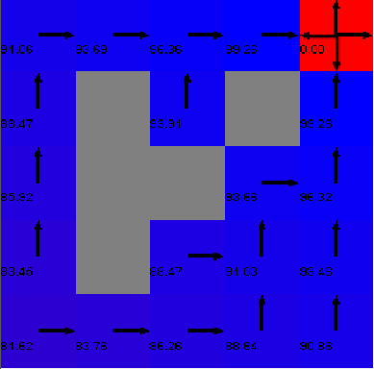
Easy Maze Value Iteration
i=4

Slide 4
Easy Maze Policy Iteration
i=3

Slide 5
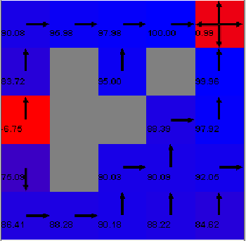
Easy Maze Q Learning
i=6

Slide 6
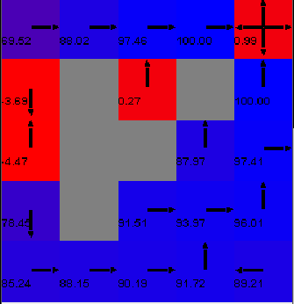
Simple Maze Q-learning Learning Rate

Slide 7
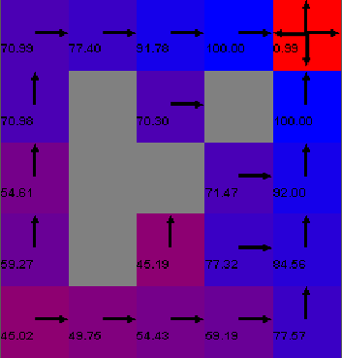
Simple Maze Q-learning Gamma

Slide 8
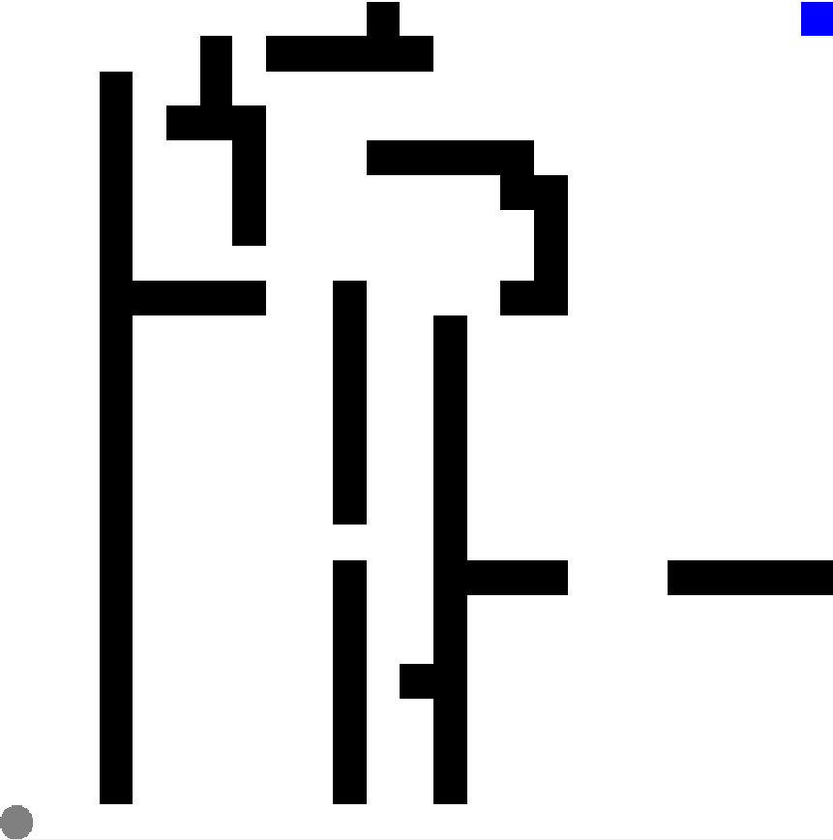
Complex Maze
513 State

Slide 9
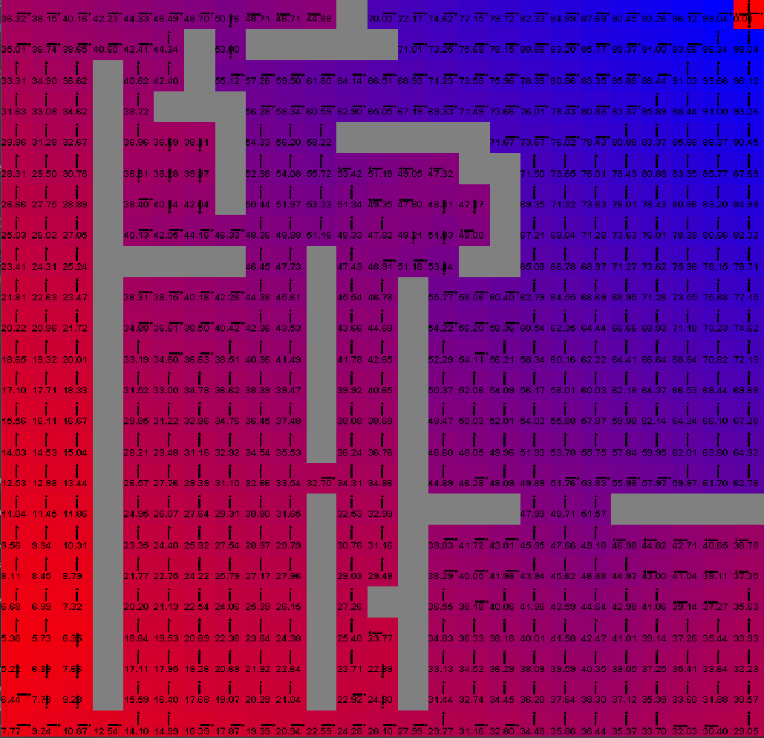
Complex Maze Value Iteration
i=20

Slide 10
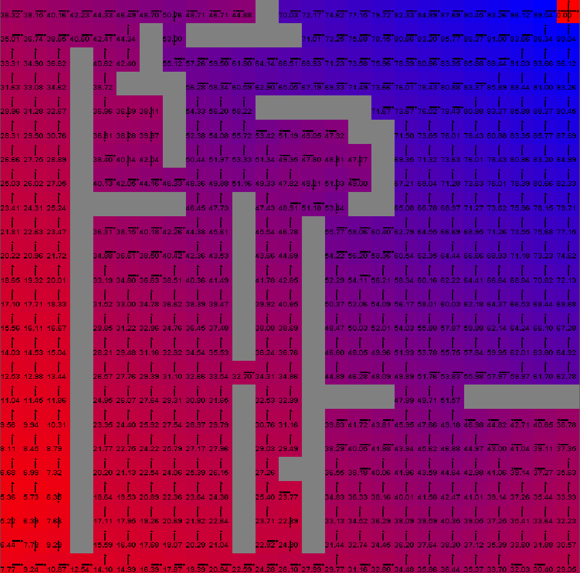
Complex Maze Policy Iteration
i=30

Slide 11
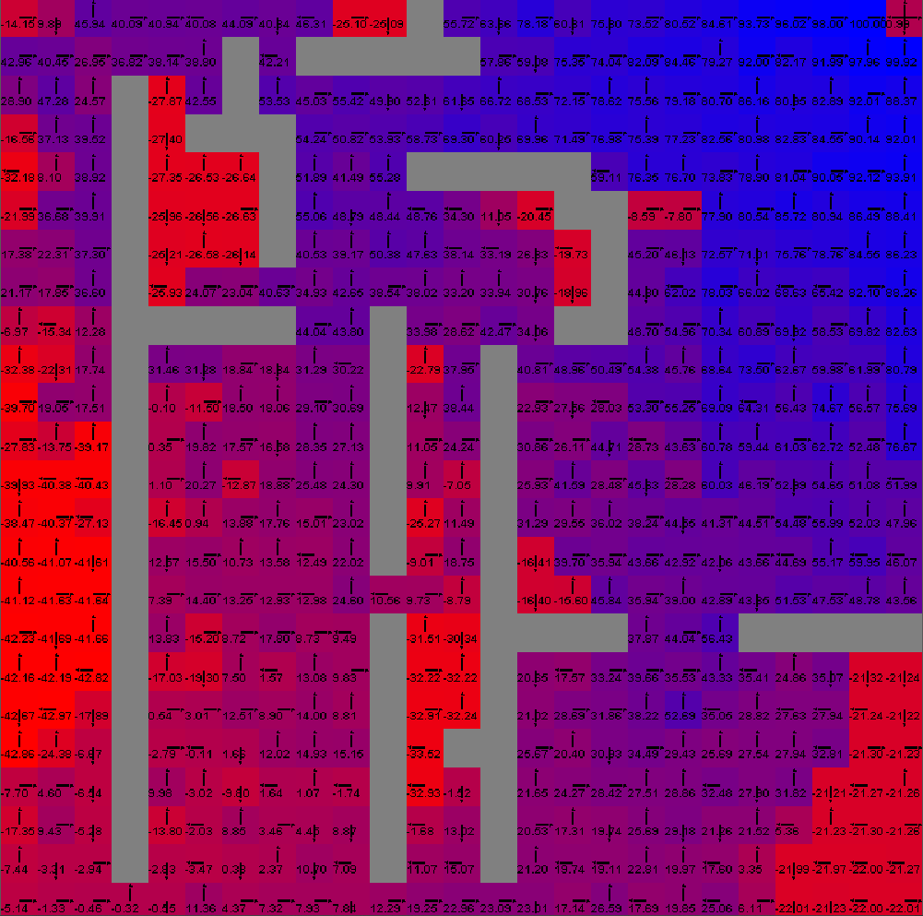
Complex Maze Q Learning
i=75

Slide 12
Simple vs. Complex Maze

Slide 13
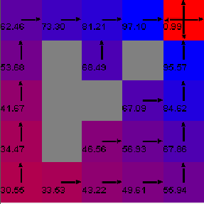
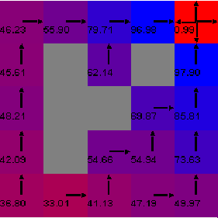
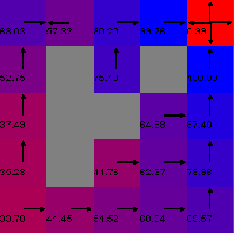
Simple Maze Q-learning
γ = 0.9; α = 0.2
γ = 0.9; α = 0.6
γ = 0.9; α = 0.8

Slide 14
