Slide 1
ML P3

Slide 2
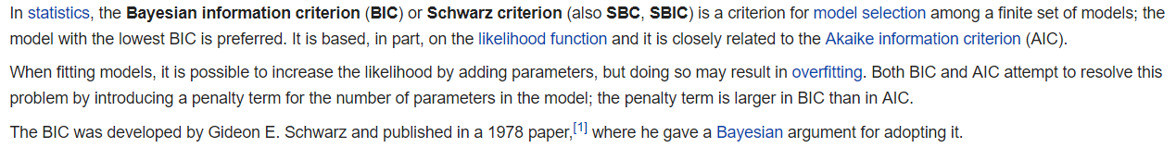
K-mean SA
GMM SA
Idea K = 3
Elbow method
Idea K = 6
Elbow method
Occam’s Razor principle of choosing the simplest solution

Slide 3
K-mean BD
GMM BD
Idea K = 7
Idea K = 7

Slide 4
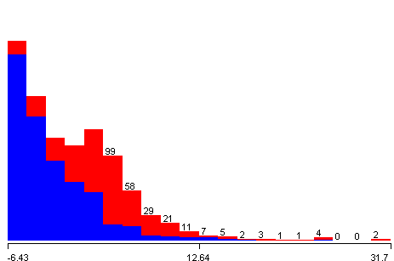
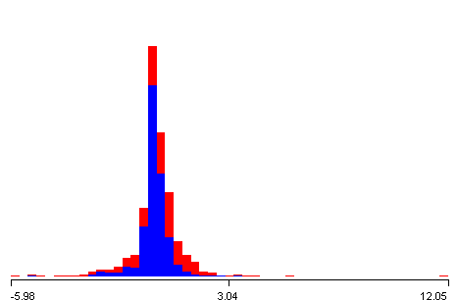
PCA SA
Ranked attributes:
0.4941 1 0.184totalWordsCount+0.178CD+0.178FW+0.178semanticobjscore+0.176baseform...
0.4401 2 0.445Quotes+0.43 RP+0.276past+0.275VB+0.231CC...
0.4035 3 0.326colon+0.326CC+0.29 PDT-0.255RP-0.249POS...
0.3747 4 0.502txtcomplexity-0.363exclamationmarks-0.287ellipsis-0.275questionmarks+0.197past...
0.3501 5 0.538ellipsis+0.534exclamationmarks+0.218VB+0.216past-0.193present3rd...
0.3282 6 0.495semicolon+0.323VBZ-0.294NN+0.262WP+0.26 RB...
0.3082 7 0.683JJS+0.334colon-0.259RB-0.227RBR-0.209compsupadjadv...
0.2896 8 -0.656sentencelast-0.601sentence1st+0.171pronouns1st+0.141TOs+0.129colon...
0.2716 9 -0.538TOs-0.411WP+0.373ellipsis+0.245JJS-0.202sentencelast...
0.2542 10 0.625sentence1st-0.484sentencelast-0.293JJS-0.214TOs+0.185PDT...
0.2375 11 -0.373TOs+0.366WP+0.349sentencelast-0.342sentence1st+0.272NN...
0.2212 12 -0.497RBR-0.336WP-0.289JJS+0.235sentencelast+0.219CC...
0.206 13 -0.385RBR-0.357semicolon+0.296WP+0.245TOs+0.229sentencelast...
0.1919 14 -0.453WP+0.337TOs+0.254RBR-0.251JJS+0.229semicolon...
0.1785 15 -0.621NNS+0.334pronouns1st+0.249RBR+0.23 RB+0.203JJS...
0.1655 16 -0.552NN+0.393colon+0.368RBR+0.189pronouns1st+0.181NNS...
0.1535 17 -0.335NNS+0.288pronouns3rd+0.272DT+0.268ellipsis+0.252TOs...
0.1422 18 0.379NN-0.377DT+0.301semicolon-0.255VBZ+0.235RB...
0.1315 19 -0.316DT+0.302EX+0.293txtcomplexity-0.249NN-0.241questionmarks...
0.121 20 0.592JJR-0.407RB-0.218PDT+0.187exclamationmarks+0.175WP$...
0.1113 21 0.332txtcomplexity+0.327colon-0.303CC-0.292RBS-0.287pronouns1st...
0.1023 22 0.465PDT-0.319RB-0.275colon-0.247WP$-0.218EX...
0.0937 23 0.375EX+0.329DT+0.324exclamationmarks-0.254questionmarks-0.224WDT...
0.0852 24 0.58 pronouns2nd-0.378RBS+0.241PDT-0.218pronouns1st-0.19ellipsis...
0.0772 25 0.394DT+0.36 RBS+0.255pronouns2nd-0.226pronouns1st+0.22 colon...
0.0697 26 0.358JJ-0.356RBS-0.315RB+0.279txtcomplexity+0.279questionmarks...
0.0629 27 -0.329exclamationmarks-0.255RBS-0.252questionmarks-0.251WP$+0.239imperative...
0.0566 28 -0.366JJR+0.339colon-0.321questionmarks+0.311JJ-0.266WDT...
0.0506 29 0.387WP$-0.346JJ-0.311WDT-0.272VBZ-0.258EX...
0.045 30 -0.517WDT-0.436LS+0.333pronouns2nd+0.269VBZ-0.232exclamationmarks...
1
VC = 0.95
Attributes | StdDev
Attribute 1 | 5.37
Attribute 2 | 1.753
Attribute 3 | 1.446
Attribute 4 | 1.28
Attribute 5 | 1.186
Attribute 6 | 1.117
Attribute 7 | 1.066
Attribute 8 | 1.031
Attribute 9 | 1.011
9

Slide 5
PCA SA

Slide 6
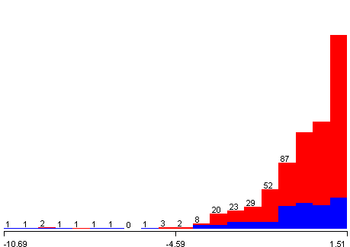
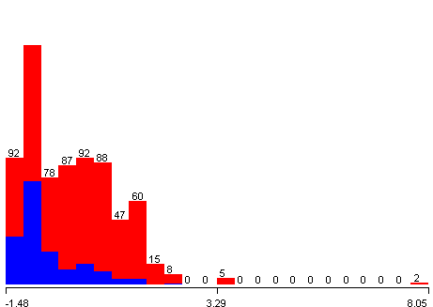
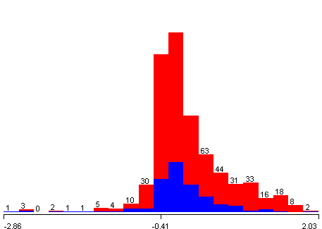
PCA BD
VC = 0.95
Attributes | StdDev
Attribute 1 | 1.594
Attribute 2 | 1.049
Attribute 3 | 0.598
Ranked attributes:
0.3647389769955831 1 -0.611Frequency (times)-0.611Monetary (c.c. blood)-0.494Time (months)+0.093Recency (months)
0.08939850714038855 2 0.915Recency (months)+0.384Time (months)-0.085Monetary (c.c. blood)-0.085Frequency (times)
-0.000000000000000222 3 0.78 Time (months)-0.391Recency (months)-0.345Monetary (c.c. blood)-0.345Frequency (times)
1
2
3

Slide 7
PCA K-mean SA
PCA GMM SA
Idea K = 5
Idea K = 6

Slide 8
PCA K-mean BD
PCA GMM BD
Idea K = 7

Slide 9
NN SA
K-mean NN SA
NN SA
# Layers | # Units | Training Accuracy | Verification Accuracy | Running Time (s)
25 | 15 | 0.83 | 0.87 | 0.22
25 | 25 | 0.87 | 0.82 | 0.13
50 | 25 | 0.87 | 0.82 | 0.15
50 | 50 | 0.83 | 0.79 | 0.17
100 | 50 | 0.84 | 0.83 | 0.19
100 | 100 | 0.82 | 0.86 | 0.19
200 | 100 | 0.83 | 0.85 | 0.14
200 | 200 | 0.83 | 0.82 | 0.2
200 | 500 | 0.83 | 0.83 | 1.16
NN SA via K-mean
# Layers | # Units | Training Accuracy | Verification Accuracy | Running Time (s)
25 | 15 | 0.35 | 0.32 | 0.07
25 | 25 | 0.73 | 0.75 | 0.07
50 | 25 | 0.71 | 0.72 | 0.1
50 | 50 | 0.72 | 0.7 | 0.11
100 | 50 | 0.74 | 0.74 | 0.09
100 | 100 | 0.63 | 0.71 | 0.19
200 | 100 | 0.73 | 0.77 | 0.2
200 | 200 | 0.72 | 0.67 | 0.15
200 | 500 | 0.48 | 0.48 | 0.29
PCA NN SA
NN SA via PCA
# Layers | # Units | Training Accuracy | Verification Accuracy | Running Time (s)
25 | 15 | 0.78 | 0.83 | 0.03
25 | 25 | 0.81 | 0.76 | 0.11
50 | 25 | 0.83 | 0.78 | 0.09
50 | 50 | 0.76 | 0.75 | 0.02
100 | 50 | 0.87 | 0.77 | 0.09
100 | 100 | 0.85 | 0.81 | 0.07
200 | 100 | 0.86 | 0.79 | 0.11
200 | 200 | 0.84 | 0.79 | 0.15
200 | 500 | 0.82 | 0.72 | 0.23
GMM NN SA
NN SA via GMM
# Layers | # Units | Training Accuracy | Verification Accuracy | Running Time (s)
25 | 15 | 0.69 | 0.73 | 0.19
25 | 25 | 0.7 | 0.69 | 0.16
50 | 25 | 0.69 | 0.7 | 0.17
50 | 50 | 0.72 | 0.71 | 0.16
100 | 50 | 0.71 | 0.68 | 0.16
100 | 100 | 0.73 | 0.75 | 0.14
200 | 100 | 0.7 | 0.68 | 0.19
200 | 200 | 0.7 | 0.7 | 0.16
200 | 500 | 0.7 | 0.67 | 0.28

