Slide 1
Decision Support Sprint 2
CS 495
Caleb Erickson, Brett Waldvogel, Donald Chanthirath, Josh Keane, Daniel Igbokwe

Slide 2
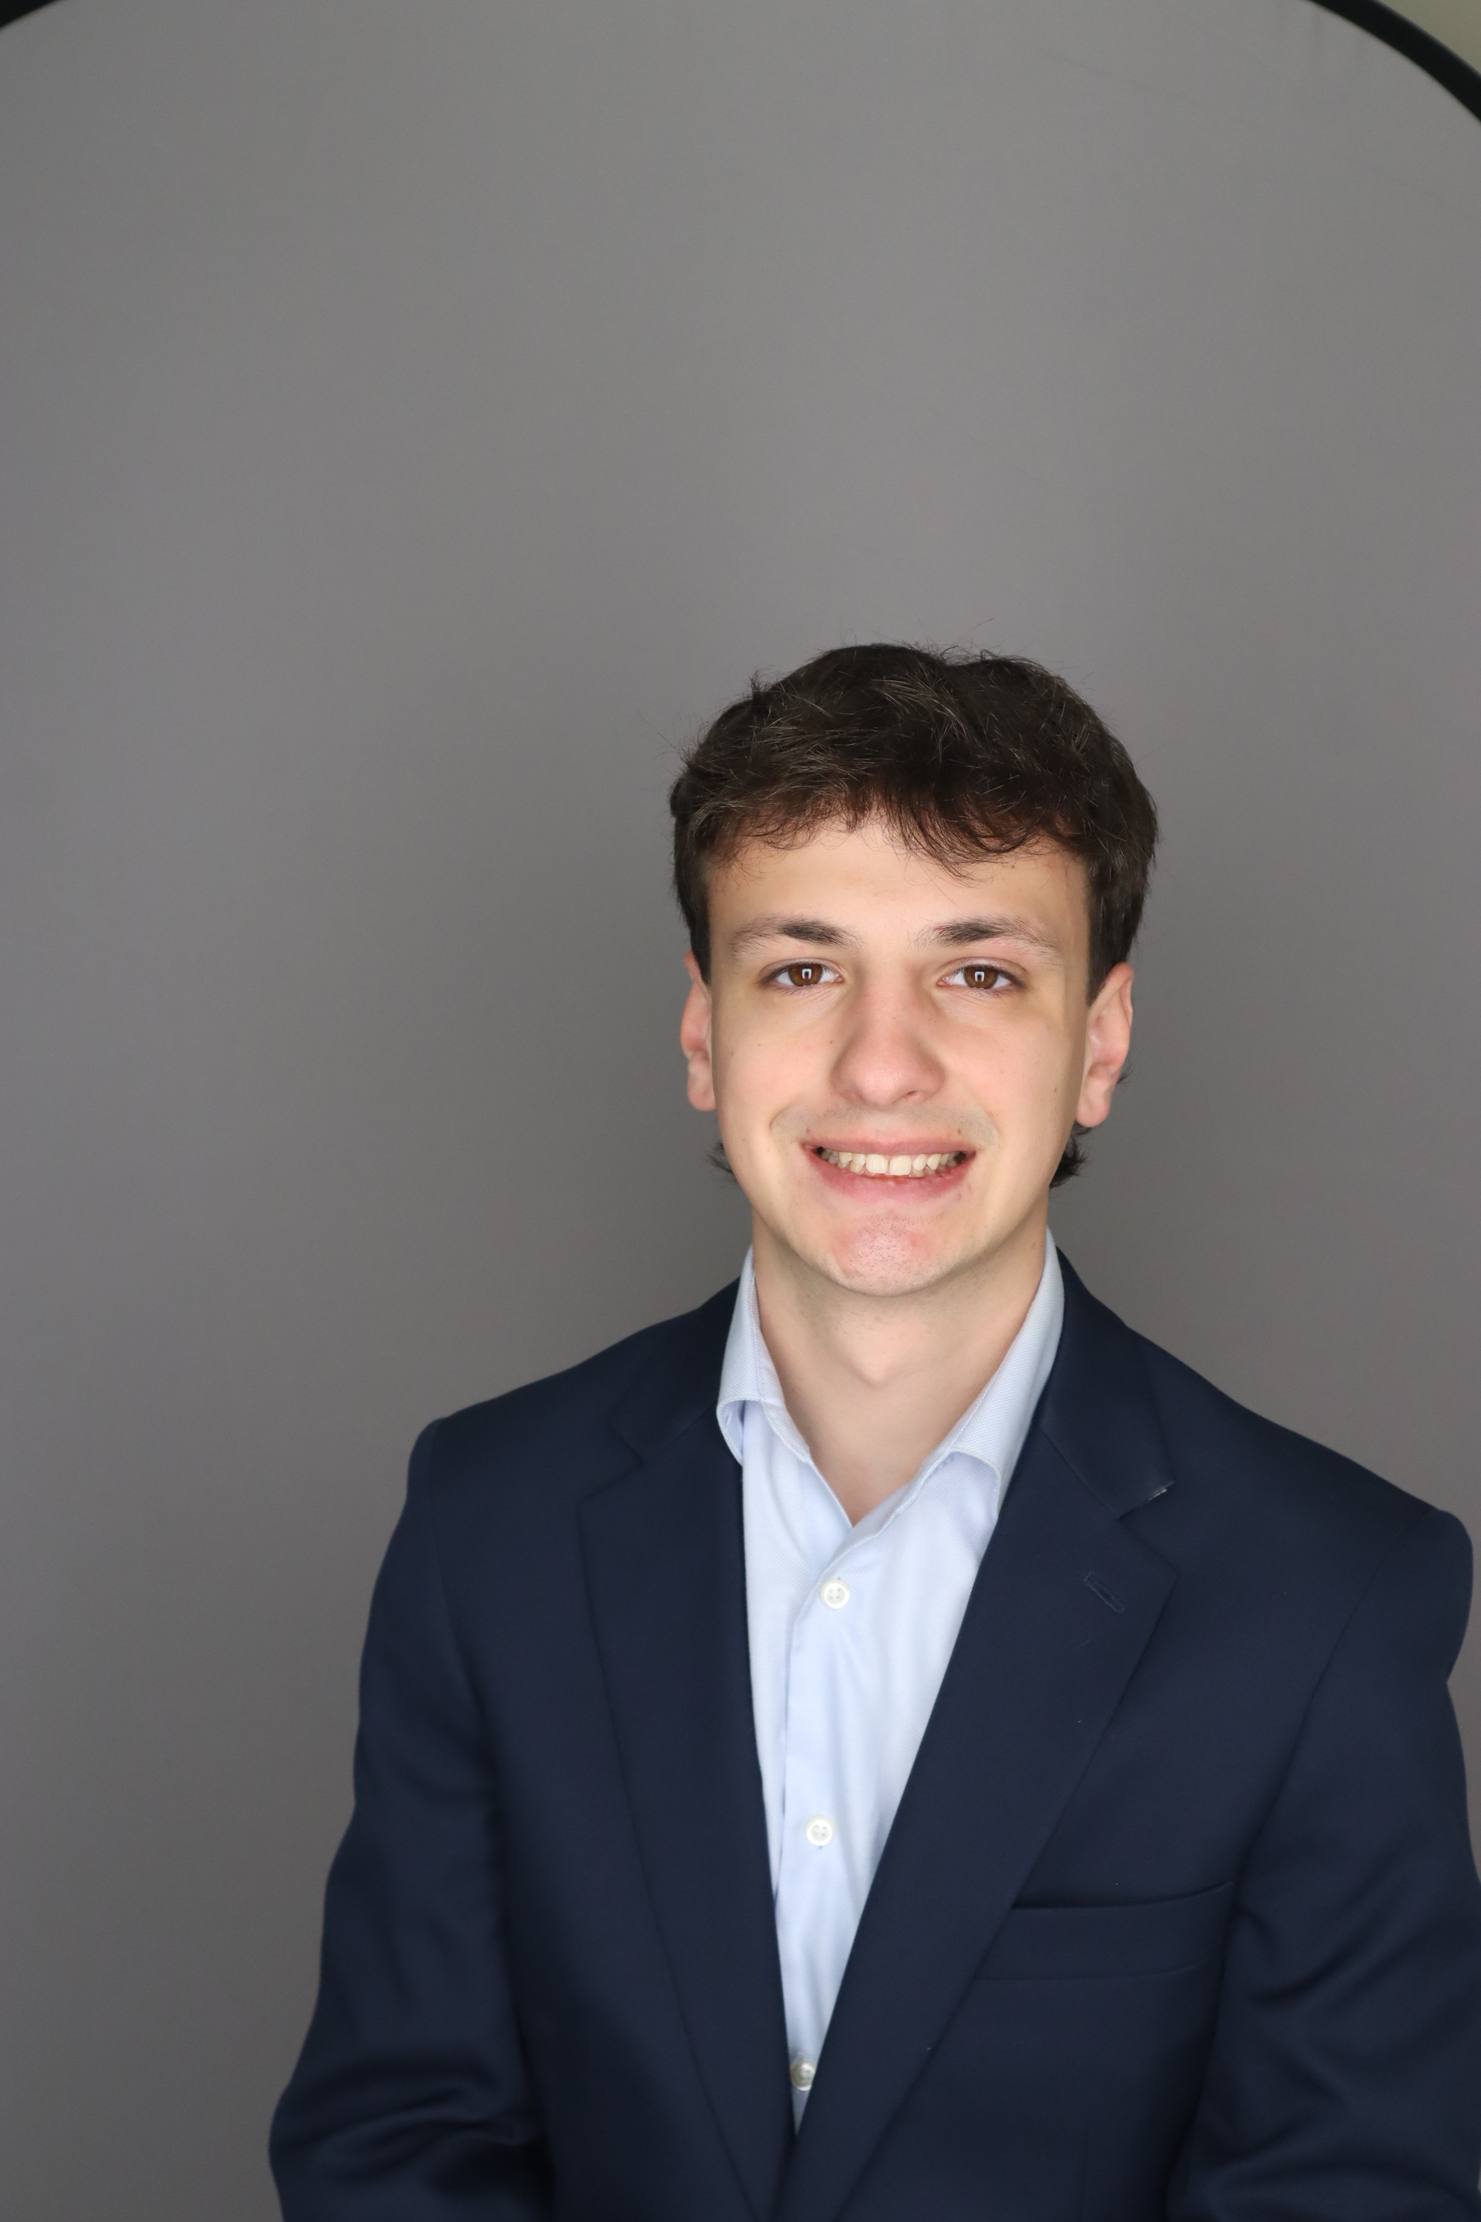
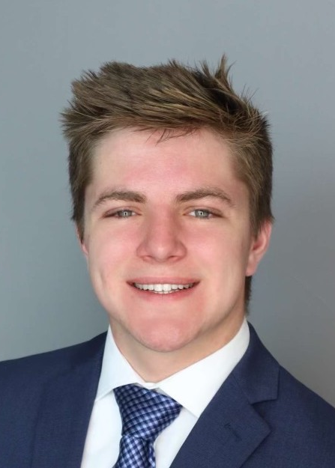

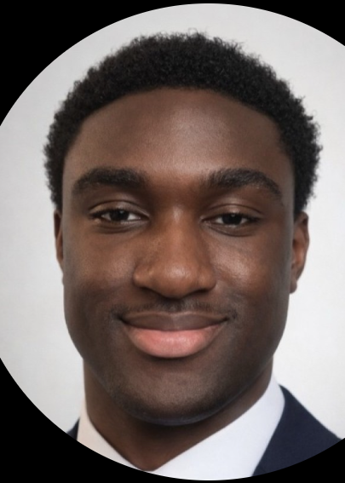

Decision Support Team
Brett
Waldvogel
Caleb Erickson
Donald
Chanthirath
Daniel
Igbokwe
Josh
Keane
Project Page: https://cs-495-project-page.vercel.app/
Project Github: https://github.com/CalebErickson21/CS495-Project-Page
Production Page: https://strata-capital-os.com/login
Production Github: https://github.com/doncha-poj/Strata-OS

Slide 3

Project Focus
Data driven dashboard for Strata Capital
Turned fragmented, siloes spreadsheets into unified source of truth
Create interactive visuals for
Cash flow
Project performance
Forecasts
Deliver simple executive scoreboard to track business health
Integrate AI to ask questions about dashboard data in natural language
Notes:
Josh

Slide 4
Sprint Priorities
Phase 2 of sponsor's three phase plan
Build executive dashboard
Lag measures: cash floor, revenue forecast, portfolio profit
Lead measures: production velocity, draw velocity, deal score
Visual components: Cash Tank Bar, Velocity Line Chart, Off-Track Counter
Split dashboard into front-end and back-end architecture
Implement user login and authentication
Notes:
Brett

Slide 5
Sprint Achievements and Sponsor Feedback
Built the 4DX Executive Scoreboard with all lag measures, lead measures, and visual components in a single Summary Tab
Split dashboard into separate front-end and back-end architecture for scalability
Login and authentication system implemented to secure dashboard access
Sponsor reiterates desire for finding best fit LLM + RAG framework for dashboard
Sponsor hints at desire for more visually appealing dashboard
Notes:
Josh

Slide 6
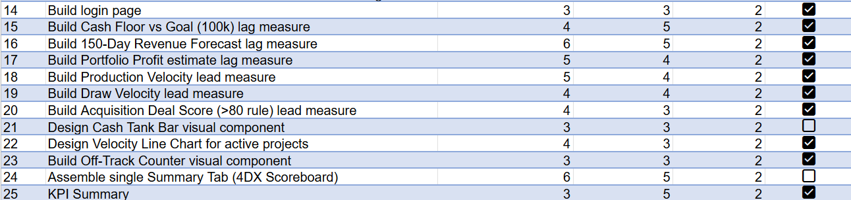
Sprint Backlog
Notes:
Donald

Slide 7
Cyber Feedback
SQL Security
Properly sanitize input data when using relational databases to avoid SQL injections
Do not construct with raw f-strings
VM security
SSH access
Inbound + outbound firewall traffic
Permission escalation attack
Notes:
Caleb

Slide 8

Sprint 3 Goals
LLM Implementation
1
"Monday morning huddle routine"
2
Commitment tracker
3
Interactive LLM
4
use LLM to create a weekly summary for stakeholders
Log for stakeholders to identify and report on responsibilities
Sponsor wants to be able to talk to website
Notes:
Brett

Slide 9
Lessons Learned
Separating the front-end and back-end
Created a cleaner, highly scalable foundation
Non-technical sponsors judge progress by visuals
Polish the interface earlier in the cycle
Notes:
Donald

Slide 10

Technologies
Docker
Containerization prevents dependency conflicts on different machines
Google Cloud VM
Web deployment of containerized app
GC interface is harder to navigate compared to Microsoft Azure
Cursor
AI integrated IDE with git-style interface for viewing AI code suggestions and changes
Different agent modes for asking, planning, debugging, and writing code
Notes:
Caleb

Slide 11
Brett's Contribution
Design and implement "lag measures"
Cash floor vs goal
150-day revenue forecast
Portfolio profit
Further refinement of data
Clean out faulty entries
Refine titles
Key in on useful entries
Notes:
Brett

Slide 12
Caleb’s Contribution
Development
Separated monolith architecture into separate frontend (React) and backend (FastAPI)
Dockerized frontend, backend, and nginx reverse proxy
Implemented login feature and authentication
Deployment
Configured VM access controls and ssh security
Google cloud to integrate cleanly with client's existing GC ecosystem
Notes:
Caleb

Slide 13
Josh’s Contribution
Scalable initial structure for app
Figure management scheme that sources all figures from a dictionary, making it simpler to integrate new items
Dataframe structure and fetching
Unified dictionary of all columns required by each figure, from which that figure's dataframe is automatically generated
Documentation
Notes:
Joshua

Slide 14
Donald’s Contribution
Designed lead measures (predictors) visuals and calculations
Production Velocity
Draw Velocity
Acquisition Deal Score
Notes:
Donald

Slide 15
Daniel’s Contribution
Designed and implemented executive KPI summary cards
Improved dashboard layout and visual hierarchy
Organized components for clear top-down information flow
Refined UI without altering backend functionality
Notes:
Daniel

Slide 16
Demo
https://strata-capital-os.com/login

Slide 17

Thank You! Questions?

