Slide 1
Decision Support Sprint 3
CS 495
Caleb Erickson, Brett Waldvogel, Donald Chanthirath, Josh Keane, Daniel Igbokwe

Slide 2
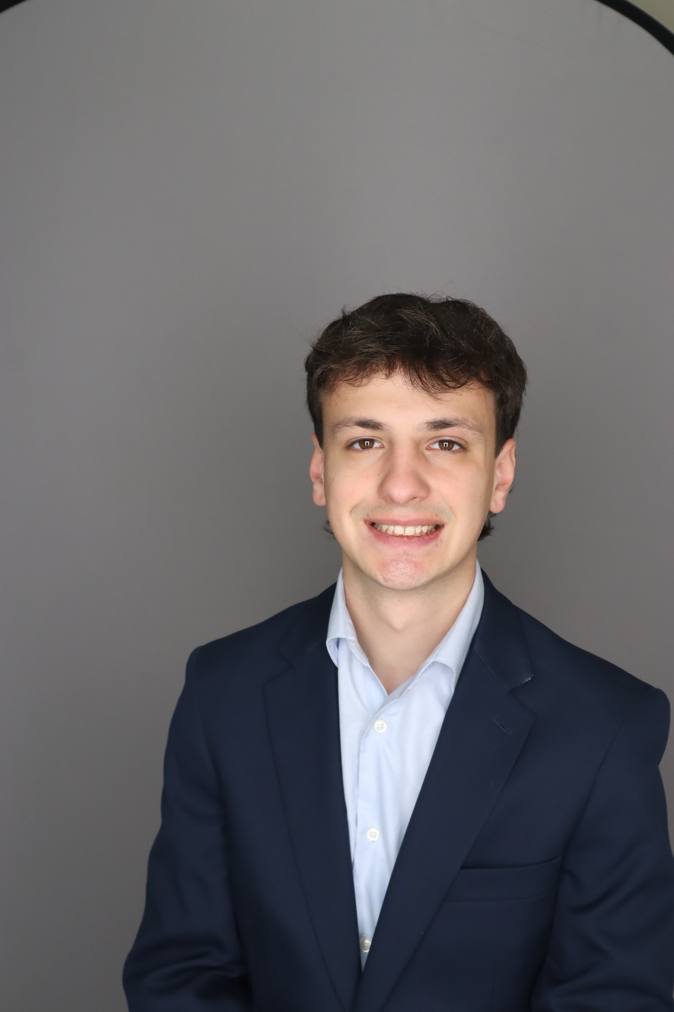
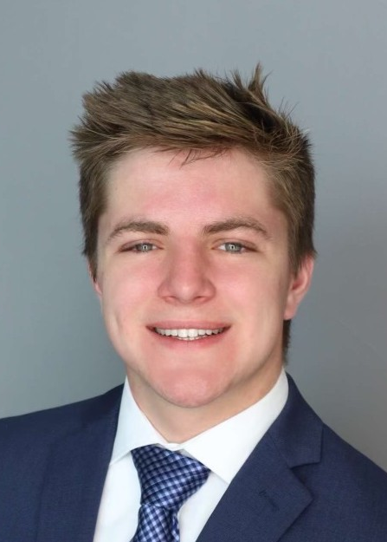

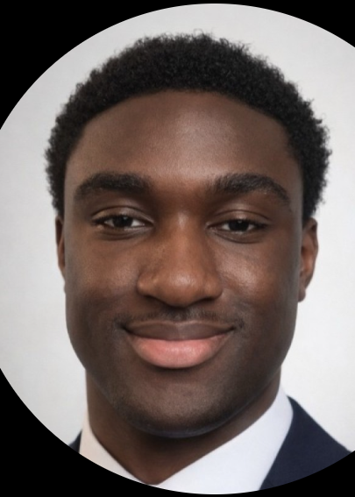

Decision Support Team
Brett
Waldvogel
Caleb Erickson
Donald
Chanthirath
Daniel
Igbokwe
Josh
Keane
Project Page: https://cs-495-project-page.vercel.app/
Project Github: https://github.com/CalebErickson21/CS495-Project-Page
Production Page: https://strata-capital-os.com/login
Production Github: https://github.com/doncha-poj/Strata-OS

Slide 3

Project Focus
Data driven dashboard for Strata Capital
Turned fragmented, multi-formatted spreadsheets into unified source of truth
Create interactive visuals for
Cash flow
Project performance
Revenue forecasts
Deliver simple executive scoreboard to track business health
Integrate AI to ask questions about dashboard data in natural language
Notes:
Josh

Slide 4

Prioritized Sprint 3 Goals
Implement TLS encryption to serve app over HTTPS
1
LLM Integration
2
Use LLM to create a weekly summary for stakeholders
Document final OS workflow and provide a handoff guide
4
Sponsor stressed seamless transition to next group
Cyber feedback
UI/UX improvements
3
Sponsor wants a tabbed dashboard view
Notes:
Brett

Slide 5
Sprint Achievements and Sponsor Feedback
Successfully embedded Claude Sonnet 4.6 to draw on data and communicate with stakeholders
Organized app elements into tabs for faster navigation & comprehension
Implemented various security measures including https encryption
Hosted under a domain named after the project
Sponsor is pleased overall with look & feel and satisfied with interactivity
Notes:
Brett

Slide 6
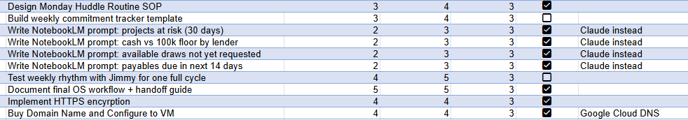
Sprint Backlog
Notes:
Donald

Slide 7
Cyber Feedback
Production Encryption
Only allow traffic over HTTPS port 443
Avoid cross-site scripting via secure cookies
VM security
SSH access limited to team member IP / keys
Inbound + outbound firewall traffic
Avoid running Docker as root to prevent privilege escalation
Use Nginx reverse proxy
Notes:
Caleb

Slide 8

Accessibility and Inclusive Design Features
Accessibility
ARIA labels for improved screen reader support
Screen reader-friendly labels on charts and data visualizations
Inclusive Design
Tabbed interface for simplified navigation across datasets
Chatbot for guided assistance and natural-language navigation
Notes:
Daniel

Slide 9
Lessons Learned
Google Sheets
Scripts made to clean sponsor's data to become usable
SQL Database
Enforces strict data types
Prevent anomalous entries
ETL Pipeline
Extract data from sheets
Transform data
Load into database
Notes:
Donald

Slide 10

Technologies
Anthropic LLM
Integrate Anthropic API to use Claude Sonnet as a chat interface so client can "talk" to dashboard
Google Domains
Located within GCP environment
Register domain names, configure A / AAA records, and configure Google DNS systems
Needed for TLS encryption for HTTPS requests
Google Cloud VM, Docker, and Cursor IDE all same from earlier sprints
Notes:
Caleb

Slide 11
Brett's Contribution
LLM Implementation lead
Extensive bug fixes
Continued sprint 2 work of refining and applying data
Notes:
Brett

Slide 12
Caleb’s Contribution
Development
Fixed data loading bug in Overview dashboard tab
Added rate limit of 5 requests / minute to LLM API endpoint to avoid misuse
Deployment
Registered and configured strata-capital-os.com domain name
Configured TLS protocols to only serve https (secure) traffic on port 443
Altered Nginx reverse proxy so domain name points at VM
Notes:
Caleb

Slide 13
Josh’s Contribution
Spreadsheet Details
Added new columns required by figures, modified order for clarity, wrote formulas
Bug fixes
Rectified or removed artifacts introduced from multiple refactors
Documentation
"Modify and Extend" documentation section, backlog & planning docs
Notes:
Josh

Slide 14
Donald’s Contribution
UI Changes
Lead Measures page readjusted for tabbed view
Documentation
Created test cases against code base
Notes:
Donald

Slide 15
Daniel’s Contribution
Introduced tabbed layout (Overview, Lag Measures, Lead Measures)
Improved dashboard organization and readability
Added sticky cash bar for real-time financial visibility
Refactored UI structure in App.tsx
Notes:
Daniel

Slide 16
Demo
https://strata-capital-os.com/login

Slide 17

Thank You! Questions?

