Slide 1
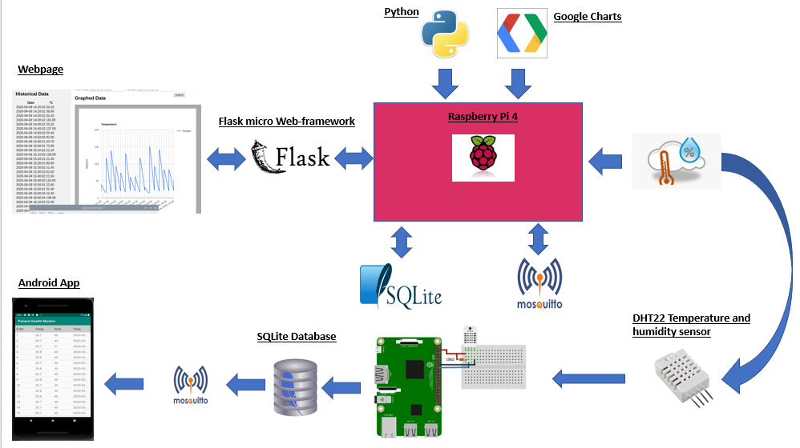
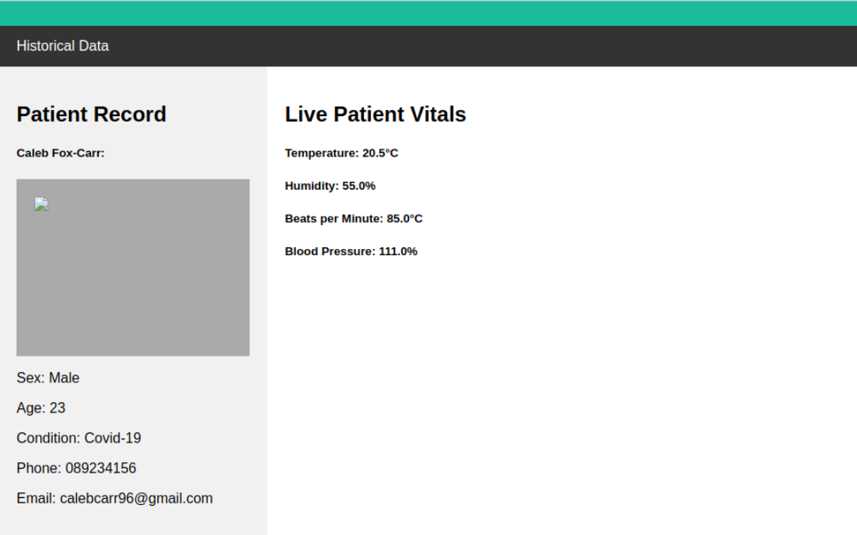
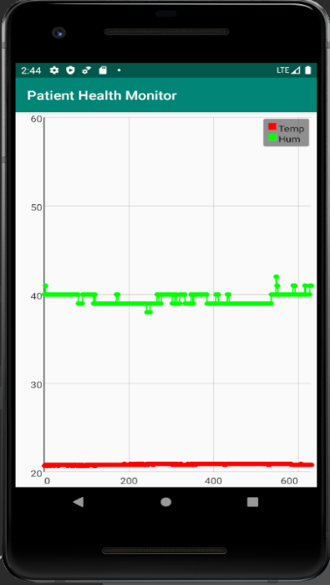
Smart Patient Health Monitoring System
Caleb Fox-Carr G00327455
Galway-Mayo Institute of Technology
Introduction
Architectural Diagram
WebPage
Functionality
Retrieve sensor data from SQLite Database and display the data in Historical data table.
Uses Google Charts to display database data in graph format
Allows the user to select from a range of dates using date/time picker
Provides Live sensor data
Displays personal information about the patient in the form of patient profile section.
Software & Tools
Python
JavaScript
Jquery
SQLite3
SMART Patient Health Monitoring System was designed with the aim of supplementing the work of overworked, understaffed doctors and nurses who are on the frontlines battling dangerous diseases and infections every day.
The system gathers patient vitals such (temperature, blood pressure, humidity using various sensors etc.) and stores the data in an SQLite3 database.
This data can then be used to form historical data tables and data graphs, allowing the user to analyse the data over a period of time. Data can be accessed securely via a webpage hosted on AWS EC2 or via an android app.
Android Application
Live Sensor Data Page
Graphed Data on app
Functionality
Secure log in screen where user must provide credentials
Easy to navigate menus
Live sensor data screen
Graphed data sensor screen
Historical Data table screen
Live streaming webcam from the patients location
Software & tools
Java
Android Studio
SQLite3
MQTT Mosquito
Android GraphView
Android TableView
Raspberry Pi camera V2

