Slide 1
The Association of Computing Machinery (ACM) Database
By: Caleb Hamilton

Slide 2
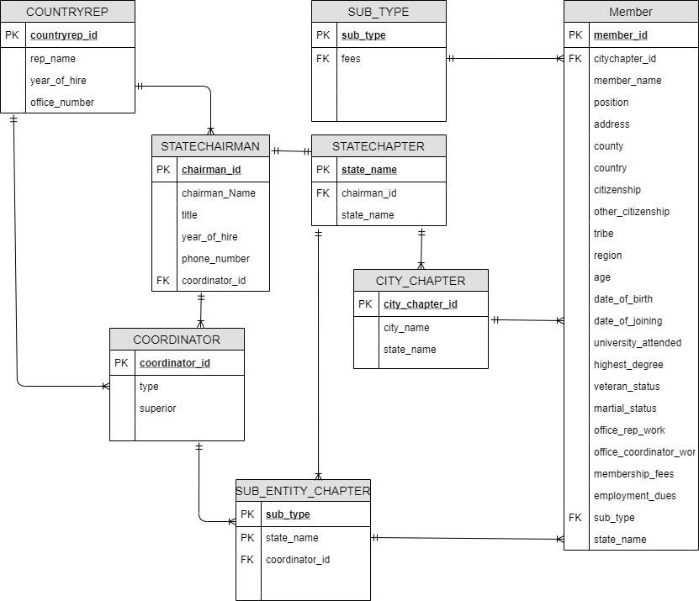
Original ERD
Complex
Too much going on
Not entirely Correct
Repeating data

Slide 3
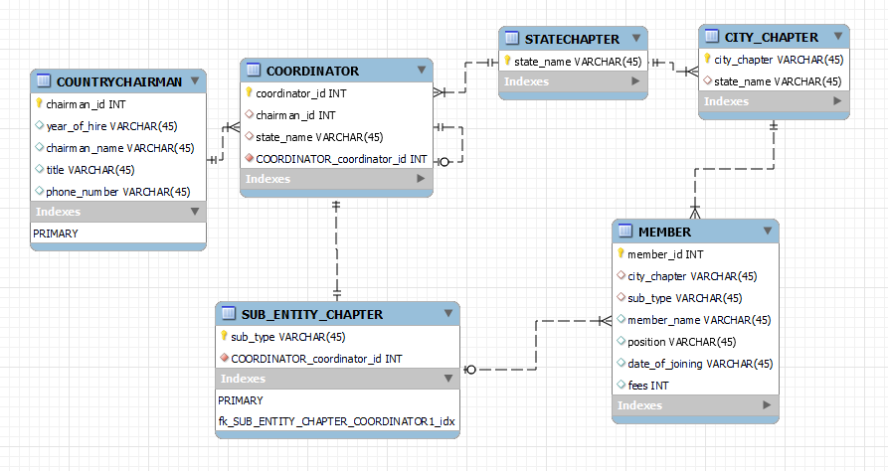
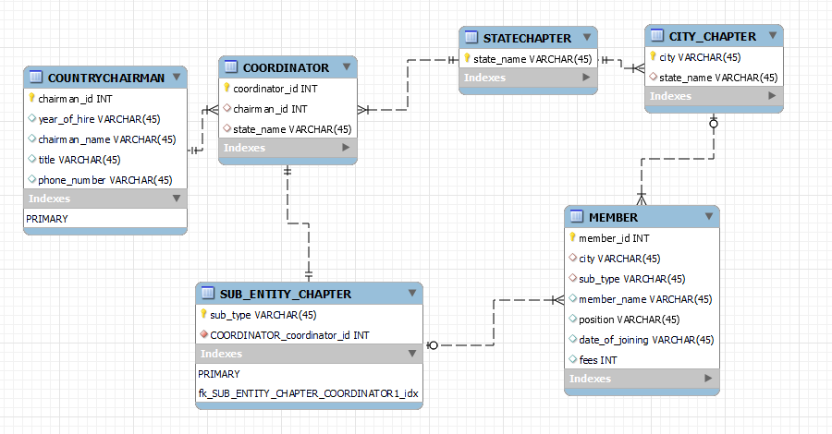
Steps 1-x
Database I Got v
Database I wanted ^

Slide 4
One to One Relationships
Coordinator has a 1 to 1 relationship with sub_entity
“This includes different types of sub_types, and ACM coordinator title, since it was hard to implement elsewhere”
Coordinator has a 1 or 0 to 1 relationship with itself
“ACM coordinator in charge of the rest”

Slide 5
One to Many Relationships
Country Chairman has a 1 to Many relationship with Coordinator
“1 country for all the coordinators”
Coordinator has a many to 1 relationship with STATECHAPTER
“Since you can only be in 1 state”
State Chapter has a 1 to many relationship with City Chapter
“This is because many cities are in a state”

Slide 6
Associative Relationships
Member is an associative relationship between Sub Entity and City chapter, with a many to 1 relationship with city chapter, and a many to 1 or 0 relationship with sub entity
“The reason for 1 or 0 is because not all members have to be a part of a subtype, but there can be many members in a certain city or type”

Slide 7
Challenges faced
Giant Puzzle
Getting the database to forward engineer
Adding data to the database
Getting relationships I wanted to work properly

Slide 8
What did I learn?
How databases work in their entirety
Data manipulation in databases
How to manage and build a database from scratch
How to write SQL code

Slide 9
Is there anything I wish I got from this?
Better understanding of inserting data via SQL code
More time spent on real world applications of content
Real applications of what we were doing and learning
A hug

Slide 10
Would I do it again

