Slide 2
목적(상황)에 따른 통계분석법의 적용
분석 목적 | 비척도 (연속자료, 값) | 명칭척도 (범주형 자료, 율[%]) | 순위척도 (비모수 검정법)
2군간 비교 | t-test (Student t-test) | χ2-test (Pearson) χ2-test with Yate's correction χ²-test for trend (Mantel-Haenszel χ²-test) Fisher's exact test | Mann-Whitney(U) test
 |  |  | Kruskal-Wallis test Friedman's Two way ANOVA
≥3군간 비교 | One way ANOVA (F-test) Two way ANOVA
2군간 Pair (짝,쌍) 비교 | Paired t-test | McNemar's χ2-test | Wilcoxon signed-rank test
상관분석 | Pearson 상관 |  | Spearman 순위상관
영향요인 분석 | 선형회귀분석 (Multiple linear regression) | 로지스틱회귀분석 (Multiple logistic regression)

Slide 3
가설검정의 개념
모집단의 분포 혹은 모수의 참값에 관한 가설
가설 1 : 우리 대학 학생의 키는 정규분포를 따른다.
가설 2 : 우리 대학 졸업생의 5년 후 평균연봉은
3500만원을 넘는다.
가설 3 : 부산의 유권자 중 민주노동당 후보에 대한
지지도는 5%를 넘지 않는다.

Slide 4
통계적 가설검정의 순서
적절한 통계적 가설의 설정
귀무가설
대립가설
가설의 기각 여부를 위한 기준 설정
검정통계량
분포확인
표본자료를 이용한 가설의 기각 여부 결정
검정통계량 계산
결과 해석

Slide 5
통계적 가설의 설정
귀무가설(null hypothesis ) 및 대립가설(alternative hypothesis)이 존재한다.
귀무가설은 H₀로 나타내고 대립가설은 H₁으로 나타낸다.
H₀ : null hypothesis
H₁ : alternative hypothesis

Slide 6
검정의 오류
실제현상 검정결과 | 귀무가설 지지 | 대립가설 지지
귀무가설 채택 | 옳은 결정 | 제2종 오류
대립가설 채택 | 제1종 오류 | 옳은 결정

Slide 7
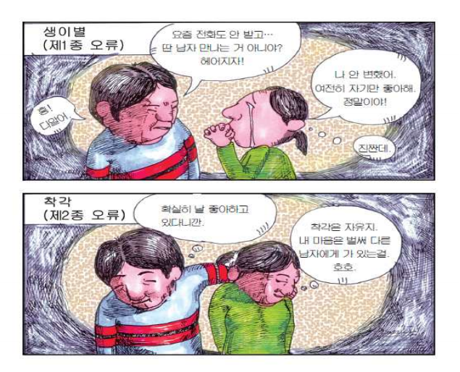

Slide 8
T-test

Slide 9

t-tests
comp
infer
12
10
95% CI
8
6
Left hemisphere
right hemisphere
Exp. 1 Exp. 2
lesion site
Compare the mean between 2 samples/ conditions
if 2 samples are taken from the same population, then they should have fairly similar means
⇨ if 2 means are statistically different, then the samples are likely to be drawn from 2 different populations, ie they really are different
Notes:
assesses whether the means of two samples are statistically different from each other. This analysis is appropriate whenever you want to compare the means of two samples/ conditions
mean
arithmetic average
a hypothetical value that can be calculated for a data set; it doesn’t have to be a value that is actually observed in the data set
calculated by adding up all scores and dividing them by number of scores
assumptions of a t-test:
from a parametric population
not (seriously) skewed
no outliers
independent samples

Slide 10


Populations and samples
Population
⇨ z-tests and distributions
Sample
(of a population)
t-tests and distributions
Notes:
Populations require z-tests
Samples require t-tests
General: hypothesis testing relates to POPULATIONS, not samples. Because we usually only test/ study samples, we need to use sample means in order to infer to population means. T-distribution has to be used for samples (this is similar to z-distributions in that it is symmetrical but flatter and changes with sample size).
Z-tests and tables: used with normally distributed population data (see above)
T-tests and tables: used with normally distributed sample data

Slide 11

Comparison between “Samples”
Are these groups different?
Notes:
Usually, you only have access to samples which means you never capture a population as a whole
Need to be careful that your samples is representative of your population

Slide 12
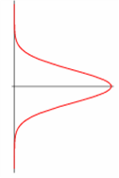
Formula
Cond. 1
Cond. 2
Notes:
I admit I stole this from last year’s presentation: you may read this at your own leisure ☺
To calculate the t score,
Take mean from condition 1 (x bar)
Then the mean from condition 2
Find the difference between these two
And divide this by their shared standard error
Calculate this by…
Taking the variance for group 1 and dividing it by the sample size for this group
Do the same for group 2 and add together.
Then finally take the square root of this and put the resulting value back into the original calculation to get your t value.

Slide 13
Formula
Difference between the means divided by the pooled standard error of the mean
Notes:
t-value+ an end product of a calculation
df = degrees of freedom (the number of individual scores that can vary without changing the sample mean)
Standard error
Is the standard deviation of sample means
It is a measure of how representative a sample is likely to be of the population
Large SE (relative to the sample mean): lots of variability between means of different samples ⇨ used sample may not be representative of a population
Small SE: most sample means are similar to the population mean ⇨ sample is likely to be an accurate reflection of the population

Slide 14
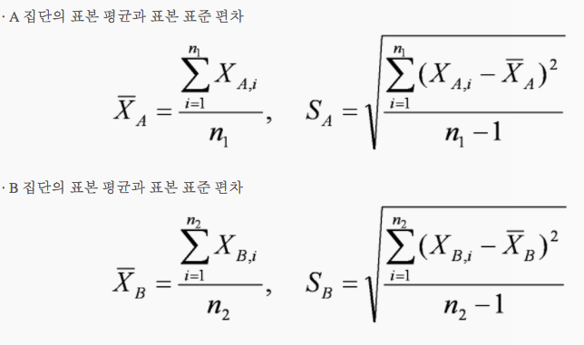

Slide 15
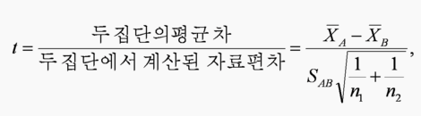
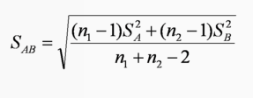
A와 B집단의 차이는 T값(t score)으로 분석하는데 , T- score는 두 집단의 평균 차이를 두 집단에서 측정된 자료가 퍼진 정도(자료 편차)로 나눈 값을 의미

Slide 16

Types of t-tests
 | Independent Samples | Related Samples also called dependent means test
Interval measures/ parametric | Independent Samples T-test* | Paired samples T-test**
Ordinal/ non-parametric | Mann-Whitney U-Test | Wilcoxon test
* 2 experimental conditions and different participants were assigned to each condition
** 2 experimental conditions and the same participants took part in both conditions of the experiments
Notes:
There are lots of different types of t-tests, which need to be used depending on the type of data you have
(equal) interval measures
Scales in which the difference between consecutive measuring points on the scale is of equal value throughout
No arbitrary zero, ie positive and negative measures, eg temperature
Ordinal measures
Scales on which the items can be ranked in order
There is an order of magnitude but intervals may vary, ie one item on the scale is more or less than another but it is not clear by how much as this cannot be measured
Often statements/ feelings are attached to numbers which can then be used for rating; in fact, this data can only be ranked (from highest to lowest) , ie what score had the highest turn-out
1= very good, 2= good, 3= neutral, 4= bad, 5= very bad
Different measurements have a direct influence on the way analysis is conducted because some of them are more amenable to mathematical operations than others

Slide 17
The Alternative Hypothesis H_{A} | The Critical Region
t_{α} and t_{α/2} are critical values under the t distribution with n – 1 degrees of freedom

Slide 18
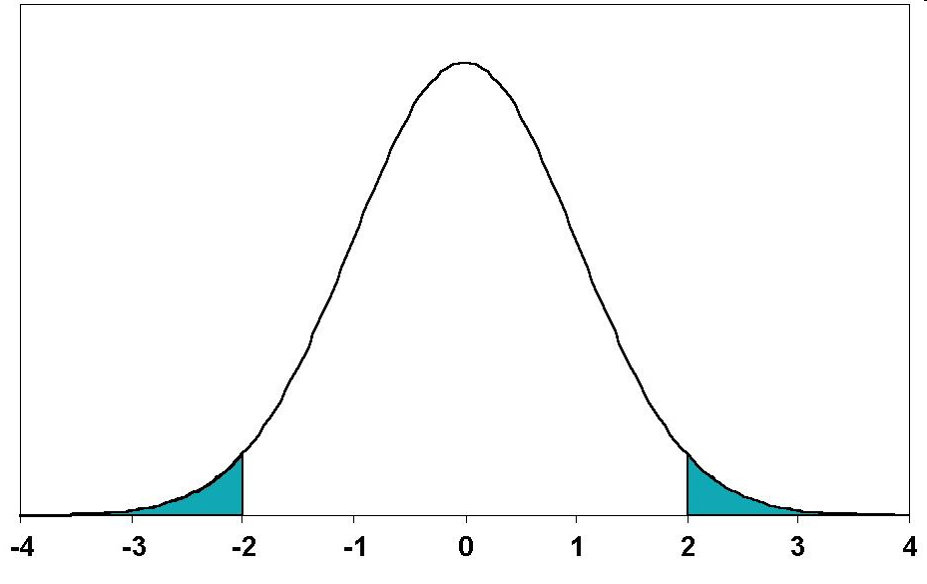
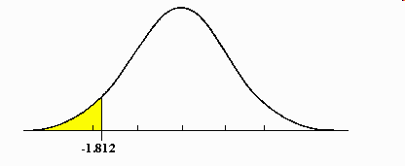
Types of t-tests cont.
2-tailed tests vs one-tailed tests
2 sample t-tests vs 1 sample t-tests
2.5%
2.5%
Mean
Mean
Total : 5%
A known value
Mean
Notes:
2-tailed tests vs one-tailed tests
If you set alpha-level at 0.05, there is 5% “area” in which a score would fall (outside where it is expected)
2-tailed tests leave room for this area to occur on both extreme ends, ie improvement may be either positive or negative (ie, 2,5% at either end)
One-tailed tests deny this and assume that the 5% can only occur at one extreme end (5%)
Both tails are meaningful in behavioural studies and should be favoured
2 sample t-tests vs 1 sample t-tests
2 sample t-tests compare the mean of 2 samples (both means are measured within the experiment)
1 sample t-tests compare the mean of one sample to a known value, often a (previously known) population mean
In fMRI: compare either 2 activation means of 2 different groups to each other or see if your one sample reaches a level of activation that you are expecting given some prior knowledge

Slide 19
Critical values for the t-distribution
α or α/2

Slide 20


Comparison of more than 2 samples
Tell me the difference between these groups…
Thank God I have ANOVA
Notes:
In an experiment with more than 2 samples or more than 2 tasks (or 2 samples and 2 tasks), one could do lots of t-tests and compare all the different groups with each other this way but actually you increase the possibility of falsely rejecting the null-hypothesis tremendously (this is referred to as familywise/ experimentwise error rate). It is much better to use ANOVA.

Slide 21
For small sample sizes:
The sampling distribution of
is called “students” t distribution with n –1 degrees of freedom

Slide 22
Critical values for the t-distribution are provided in tables.

Slide 23
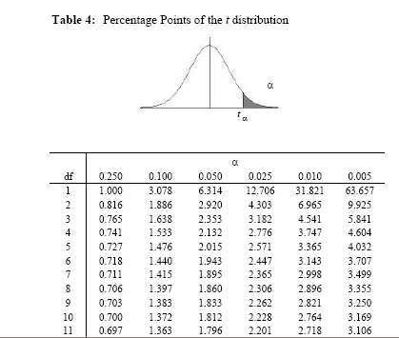
Look up α
Look up df

Slide 24
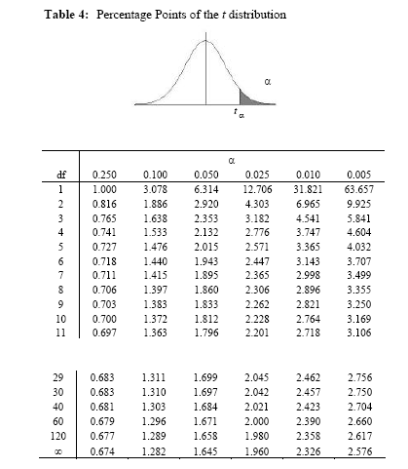
Note: the values tabled for df = ∞ are the same values for the standard normal distribution, z_{α}
…

Slide 25
Example
Let x₁, x₂, x₃ , x₄, x₅, x₆ denote weight loss from a new diet for n = 6 cases.
Assume that x₁, x₂, x₃ , x₄, x₅, x₆ is a sample from a normal population with mean μ and standard deviation σ. Both μ and σ are unknown.
we want to test:
New diet is not effective
versus
New diet is effective

Slide 26
The Test Statistic
The Critical region:
Reject if

Slide 27
The Data
The summary statistics:

Slide 28
The Test Statistic
The Critical Region (using α = 0.05)
Reject if
Conclusion: Accept H₀:

Slide 29
Confidence Intervals

Slide 30
Confidence Intervals for the mean of a Normal Population, μ, using the Standard Normal distribution
Confidence Intervals for the mean of a Normal Population, μ, using the t distribution

Slide 31
Example
Let x₁, x₂, x₃ , x₄, x₅, x₆ denote weight loss from a new diet for n = 6 cases.
The Data:
The summary statistics:

Slide 32
The Data
The summary statistics:

Slide 33
Confidence Intervals (use α = 0.05)

