Slide 1
Function Overloading
Caleb Lefcort
Bowers CPSC 326
Spring 2024

Slide 2
Description
I implemented function overloading in mypl. Function overloading is the ability to name two functions the same thing and differentiate between the two based on the types of the parameters. For example you could write a function called sum that would take two integers and return the sum of the two ints and then have another function of the same name but for doubles instead. This can improve readability of code and can allow the coder to worry less about types. I also made all of the built in functions overloadable which can be nice especially for functions such as print.

Slide 3
Real uses
Overloading similar function for different types.
Overloading built in functions for structs.
Overloading functions for similar structs.

Slide 4
Unit tests
I developed 50 unit tests for this extension divided into several categories.
AST tests for call expression nodes.
Basic sematic checks for normal functions, positive and negative.
Semantic tests for general overloading both positive and negative.
Semantic tests for built in function overloading, positive and negative.

Slide 5
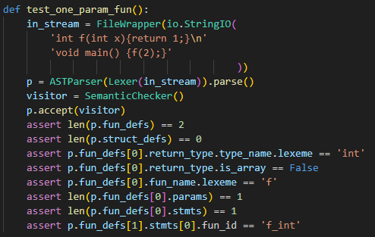
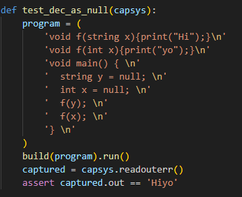
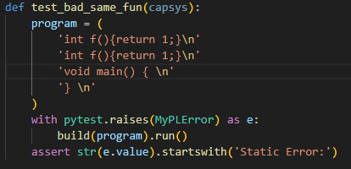
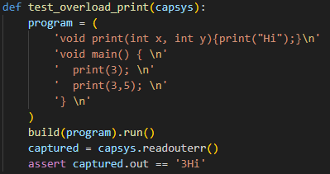
A few example tests

Slide 6
Modifications
I modified the call expr node in the AST so that it could hold a function id. The majority of my modifications were in the semantic checker. I added a function for generating function ids. I also modified how built ins worked and were defined. I modified call expr so that after type checking parameters, they were added to the call expr node. I also modified some similar parts of code gen for dealing with function defs, built ins, and function calls.

Slide 7
Completion
I completed everything I intended to do and function overloading is fully functional for user defined and built in functions. In the future I would like to explore operation overloading as that is a similar vein and would further improve readability.

