Slide 1
Project Presentation
Paslay

Slide 2
Introduction
There are many research projects conducted on vastly different organisms that are not related to virus research. Because the focus on a given research task does not involve the detection or discovery of viruses, this is often overlooked and provides an opportunity for virologists to comb through the data and see if viruses are present. Given that each organism present on plant Earth is estimated to be infected by at least one virus, this provides ample opportunity to discover novel viruses in a host of interest.
Not only is this conceptual, but this as been applied in a variety of hosts. I will focus on viruses isolated from roses in this case.

Slide 3
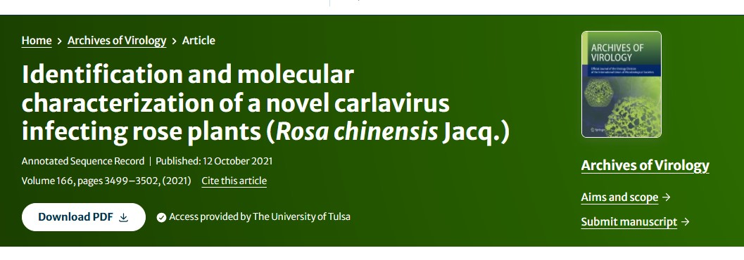
Examples from the literature
In roses:

Slide 4
RVC was found by looking through transcriptome data
This can help in the future as growers and diagnosticians decide which viruses they should screen for.
Reference: Xing, F., Gao, D., Habili, N., Wang, H., Zhang, Z., Cao, M., & Li, S. (2021). Identification and molecular characterization of a novel carlavirus infecting rose plants (Rosa chinensis Jacq.). Archives of Virology, 166, 3499-3502.

Slide 5
Research Questions
Are there novel viruses that have not yet been characterized but were sequenced as a “byproduct” of some other experimental focus?
Are there viruses that are capable of infecting roses that have not yet been reported, but have been sequenced “serendipitously” by HTS methods?

Slide 6
Predictions/expected outcomes
I am hopeful to develop a useful tool for analyzing our own HTS data. In addition, I am hopeful to use this tool to “screen” available HTS data for the presence of plant viruses in roses. In practice, this could be used for any plant host to determine if there are novel or unreported viruses from a given region of the world. Ideally, it would be useful to create a pipeline where we can simply input the raw fastq files and output the results from the BLAST search.

Slide 7
Overview of the project
Obtain SRA data (RNA-seq)
Download reference genome/s
QC and trimming of raw SRA data
Reference mapping of reads to host genome
Gather unmapped reads using the flags
Assembly of reads (rnaSPADES)
Create a database of viruses for nucleotide blast
Use Diamond for nucleotide-to-protein blasting
Evaluate results of unmapped reads

Slide 8
1. Obtain SRA data (RNA-seq)
Fastq dump was used to obtain data associated with specific accessions
Steps: 1) NCBI 2) SRA 3) search species 4) download accession list
NCBI link for Rosa chinensis
Below are the files submitted to OSCER:
sh file
sbatch script
.args

Slide 9
2. Download reference genome/s
In this case, we will use the Rosa chinensis genome as a reference. This reference corresponds with the RNA-seq data downloaded in the previous section.
Steps: 1) Go to NCBI 2) Go the genomes 3) Search organism of interest 4) Select FTP 5) Copy link for file of interest (in our case, we will copy the link for both genomic.fna.gz and genomic.gff.gz)
LINK to download reference genome
sh script
sbatch file

Slide 10
3. QC and trimming of raw SRA data
Here we are only looking at one sample, which is SRR29872023_1 and SRR29872023_2. If we wanted to use an array system, we could look at all of the files and have fastqc run for each of them.
Below are the files submitted to OSCER:
sbatch file
sh script

Slide 11
3. QC and trimming of raw SRA data

Slide 12
3. QC and trimming of raw SRA data

Slide 13
3. QC and trimming of raw SRA data
Below are the files submitted to OSCER:
sh script
sbatch file

Slide 14
4. Reference mapping of reads to host genome
Usually, we would use BWA (currently called minimap2) to map reads to a reference genome. We will be using Hisat2 for read mapping because this program is optimized for mapping RNA reads onto a DNA genome.
Steps: 1) Create a reference index of the reference sequence 2) Map raw, trimmed, or de novo assembled reads to the indexed reference sequence 3) Generate a .SAM file (Simple Alignment format) 4) Convert the .SAM to a .BAM (Binary alignment format) 5) Sort the .BAM file.

Slide 15
4. Reference mapping of reads to host genome
creating a new environment
conda create -n hisat2_env
activate the environment
conda activate hisat2_env

Slide 16
4. Reference mapping of reads to host genome
Below I have included the script file for the hisat2 mapping.
sh script
sbatch file
sh script
sbatch file

Slide 17
4. Reference mapping of reads to host genome
x
48805428 + 0 in total (QC-passed reads + QC-failed reads)
1532032 + 0 secondary
0 + 0 supplementary
0 + 0 duplicates
43288907 + 0 mapped (88.70% : N/A)
47273396 + 0 paired in sequencing
23636698 + 0 read1
23636698 + 0 read2
39080286 + 0 properly paired (82.67% : N/A)
39441476 + 0 with itself and mate mapped
2315399 + 0 singletons (4.90% : N/A)
171226 + 0 with mate mapped to a different chr
152303 + 0 with mate mapped to a different chr (mapQ>=5)

Slide 18
4. Reference mapping of reads to host genome
x
BamQC report
———————————–
>>>>>>> Input
bam file = /scratch/biol726310/BIOL7263_Genomics/rrv_project/sorted_hisat2.bam
outfile = /scratch/biol726310/BIOL7263_Genomics/rrv_project/bamqc/genome_results.txt
>>>>>>> Reference
number of bases = 515,588,973 bp
number of contigs = 55
>>>>>>> Globals
number of windows = 454
number of reads = 47,273,396
number of mapped reads = 41,756,875 (88.33%)
number of secondary alignments = 1,532,032
number of mapped paired reads (first in pair) = 20,965,602
number of mapped paired reads (second in pair) = 20,791,273
number of mapped paired reads (both in pair) = 39,441,476
number of mapped paired reads (singletons) = 2,315,399
number of mapped bases = 30,019,458,809 bp
number of sequenced bases = 6,217,039,734 bp

Slide 19
4. Reference mapping of reads to host genome
x
23636698 reads; of these:
23636698 (100.00%) were paired; of these:
4096555 (17.33%) aligned concordantly 0 times
19022555 (80.48%) aligned concordantly exactly 1 time
517588 (2.19%) aligned concordantly >1 times
—-
4096555 pairs aligned concordantly 0 times; of these:
70100 (1.71%) aligned discordantly 1 time
—-
4026455 pairs aligned 0 times concordantly or discordantly; of these:
8052910 mates make up the pairs; of these:
5516521 (68.50%) aligned 0 times
2441427 (30.32%) aligned exactly 1 time
94962 (1.18%) aligned >1 times
88.33% overall alignment rate

Slide 20
5. Gather unmapped reads using the flags
After mapping the reads to the host genome (remove unnecessary reads), we can use the samtools flag command to extract unmapped reads. In our case, we are interested in the unmapped reads, as these may contain virus reads and subsequent virus sequences.
Steps: 1) Gather the unmapped reads with the soomtools flagstats command 2) convert the .BAM file to fastq.
I was able to use both tools (bedtools and samtools) to generate fastq files from the .BAM file. Below are the documents submitted to OSCER:
sh script
sbatch file

Slide 21
6. Assembly of reads (rnaSPADES)
Below I have included my files for OSCER submission:
sh script
sbatch file
x
All statistics are based on contigs of size >= 500 bp, unless otherwise noted (e.g., “# contigs (>= 0 bp)” and “Total length (>= 0 bp)” include all contigs).
Assembly transcripts
# contigs (>= 0 bp) 51321
# contigs (>= 1000 bp) 3542
# contigs (>= 5000 bp) 39
# contigs (>= 10000 bp) 0
# contigs (>= 25000 bp) 0
# contigs (>= 50000 bp) 0
Total length (>= 0 bp) 23962415
Total length (>= 1000 bp) 6046849
Total length (>= 5000 bp) 226142
Total length (>= 10000 bp) 0
Total length (>= 25000 bp) 0
Total length (>= 50000 bp) 0
# contigs 11871
Largest contig 7867
Total length 11673416
GC (%) 40.75
N50 1035
N75 687
L50 3336
L75 6846
# N’s per 100 kbp 36.15

Slide 22
7. Create a database of viruses for blast searches
update_blastdb.pl --decompress nt_viruses
Here is the taxon ID for viruses 10239. I was able to generate a link from the Uniprotkb website that will download all of the protein sequences using the link (rather than downloading manually).
Below I have included my files for OSCER submission:
.sh script
.sbatch file
Here is the command for building the database. This step is critical as it will generate the .dmnd formatted file.
diamond makedb --in /scratch/biol726310/BIOL7263_Genomics/rrv_project/databases/protein_db/all_virus_protein -d /scratch/biol726310/BIOL7263_Genomics/rrv_project/databases/protein_db/virus_protein_db

Slide 23
8. Use Diamond for nucleotide-to-protein blasting
Below I have included my files for OSCER submission:
.sh script
.sbatch file
This script contains code for both the nucleotide and protein blast. This will run each of the searches at the same time. Additionally, the code has been created to output .csv file, which will become more important in the following step.

Slide 24
9. Evaluate results of unmapped reads
Using R, we manipulated the input .csv file to make it more user friendly, and to include important sequencing results.

Slide 25
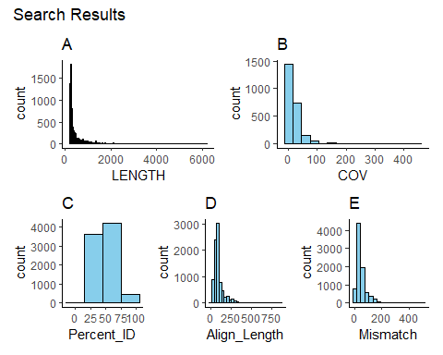
9. Evaluate results of unmapped reads

Slide 26
9. Evaluate results of unmapped reads
Arranging by LENGTH
Seq_Title_Org
NODE
LENGTH
COV
Percent_ID
Mismatch
Evalue
NA
9
6217
14.05225
33.3
188
0
OS=Acanthamoeba polyphaga moumouvirus
9
6217
14.05225
30.9
155
0
OS=Saudi moumouvirus
9
6217
14.05225
30.9
155
0
OS=Moumouvirus Monve
9
6217
14.05225
30.9
155
0
OS=Moumouvirus australiensis
9
6217
14.05225
33.8
117
0
OS=Aedes aegypti To virus 2
17
5832
16.36256
30.1
296
0
OS=Lampyris noctiluca errantivirus 1
17
5832
16.36256
30.7
282
0
OS=Aedes aegypti To virus 1
17
5832
16.36256
29.6
267
0
OS=Chibugado virus
17
5832
16.36256
27.0
306
0
OS=Ceratitis capitata metavirus 2
17
5832
16.36256
29.4
290
0

Slide 27
9. Evaluate results of unmapped reads
Arranging by COV
Seq_Title_Org
NODE
LENGTH
COV
Percent_ID
Mismatch
Evalue
OS=Hokovirus HKV1
1770
1418
435.1115
93.3
15
0.000000
OS=Bovine viral diarrhea virus 2
1770
1418
435.1115
83.1
29
0.000000
OS=Bovine viral diarrhea virus 2
1770
1418
435.1115
91.9
14
0.000000
OS=Bovine viral diarrhea virus
1770
1418
435.1115
91.5
15
0.000000
OS=Bovine viral diarrhea virus 2
1770
1418
435.1115
92.0
13
0.000000
OS=Megaviridae environmental sample
1679
1450
382.6333
54.5
20
0.000114
OS=Dishui lake phycodnavirus 1
3664
977
314.6836
86.8
18
0.000000
OS=Sylvanvirus sp
3664
977
314.6836
72.5
36
0.000000
OS=Manila clam xenomavirus
3664
977
314.6836
57.0
50
0.000000
OS=Marseillevirus LCMAC102
3664
977
314.6836
53.0
51
0.000000

Slide 28
9. Evaluate results of unmapped reads
Arranging by Percent_ID
Seq_Title_Org
NODE
LENGTH
COV
Percent_ID
Mismatch
Evalue
OS=Rose partitivirus
1222
1687
29.425031
100
0
0
OS=Rose cryptic virus 1
1952
1351
81.942097
100
0
0
OS=Rose cryptic virus 1
2018
1336
133.779097
100
0
0
OS=Rose cryptic virus 1
2785
1138
10.477934
100
0
0
OS=Escherichia phage TR2
13394
466
2.633588
100
0
0
OS=Rose cryptic virus 1
15249
432
8.384401
100
0
0
OS=Rose cryptic virus 1
15249
432
8.384401
100
0
0
OS=Rose cryptic virus 1
15249
432
8.384401
100
0
0
OS=Rose partitivirus
18543
388
3.387302
100
0
0
OS=Rose partitivirus
18607
387
4.152866
100
0
0

Slide 29
9. Evaluate results of unmapped reads
Arranging by Mismatch
Seq_Title_Org
NODE
LENGTH
COV
Percent_ID
Mismatch
Evalue
OS=Rose partitivirus
1222
1687
29.425031
100
0
0
OS=Rose cryptic virus 1
1952
1351
81.942097
100
0
0
OS=Rose cryptic virus 1
2018
1336
133.779097
100
0
0
OS=Rose cryptic virus 1
2785
1138
10.477934
100
0
0
OS=Escherichia phage TR2
13394
466
2.633588
100
0
0
OS=Rose cryptic virus 1
15249
432
8.384401
100
0
0
OS=Rose cryptic virus 1
15249
432
8.384401
100
0
0
OS=Rose cryptic virus 1
15249
432
8.384401
100
0
0
OS=Rose partitivirus
18543
388
3.387302
100
0
0
OS=Rose partitivirus
18607
387
4.152866
100
0
0

Slide 30
9. Evaluate results of unmapped reads
We can filter by a specific observations. This is a very useful tool, as we can obtain all of the nodes (contigs) that correspond to a given virus or other organism.
Filtering by RoPV
Seq_Title_Org
NODE
LENGTH
COV
Percent_ID
Mismatch
Evalue
OS=Rose partitivirus
1222
1687
29.425031
100.0
0
0
OS=Rose partitivirus
18543
388
3.387302
100.0
0
0
OS=Rose partitivirus
18607
387
4.152866
100.0
0
0
OS=Rose partitivirus
29377
300
2.709251
100.0
0
0
OS=Rose partitivirus
37931
267
3.876289
97.7
2
0
OS=Rose partitivirus
43976
249
1.750000
100.0
0
0

Slide 31
9. Evaluate results of unmapped reads
Filtering by RCV-1
Seq_Title_Org
NODE
LENGTH
COV
Percent_ID
Mismatch
Evalue
OS=Rose cryptic virus 1
1952
1351
81.942097
100.0
0
0
OS=Rose cryptic virus 1
1952
1351
81.942097
99.4
2
0
OS=Rose cryptic virus 1
1952
1351
81.942097
99.7
1
0
OS=Rose cryptic virus 1
1952
1351
81.942097
99.5
1
0
OS=Rose cryptic virus 1
2018
1336
133.779097
100.0
0
0
OS=Rose cryptic virus 1
2018
1336
133.779097
99.1
2
0
OS=Rose cryptic virus 1
2785
1138
10.477934
100.0
0
0
OS=Rose cryptic virus 1
2785
1138
10.477934
99.7
1
0
OS=Rose cryptic virus 1
2785
1138
10.477934
98.2
5
0
OS=Rose cryptic virus 1
15249
432
8.384401
100.0
0
0
OS=Rose cryptic virus 1
15249
432
8.384401
100.0
0
0
OS=Rose cryptic virus 1
15249
432
8.384401
100.0
0
0

Slide 32
9. Evaluate results of unmapped reads
Filtering by NA’s
Seq_Title_Org
NODE
LENGTH
COV
Percent_ID
Mismatch
Evalue
NA
9
6217
14.052246
33.3
188
0
NA
20
5681
14.309914
33.3
188
0
NA
25
5377
12.118024
37.9
128
0
NA
41
4949
12.783634
37.4
182
0
NA
56
4578
8.661043
NA
98
297
NA
NA
NA
NA
NA
NA
NA
NA
68
4242
8.828256
33.8
182
0
NA
101
3888
16.414155
43.5
156
0
NA
135
3636
34.223407
34.8
179
0
NA
135
3636
34.223407
NA
274
1707
NA
NA
NA
NA
NA
NA
NA
NA
150
3572
39.972278
38.4
144
0

Slide 33
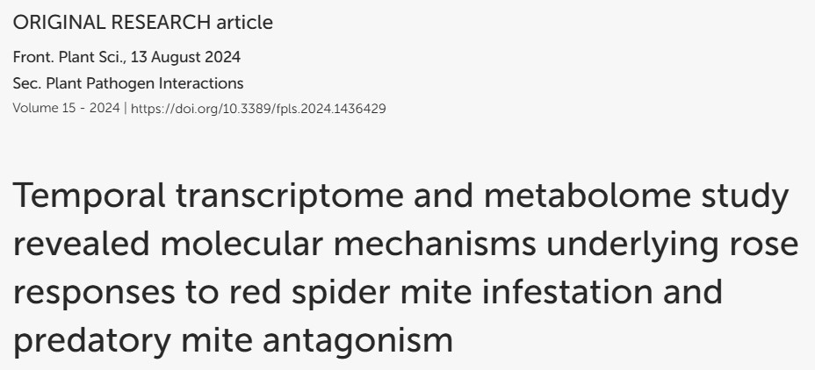
Conclusions and Final Remarks
Two previously characterized viruses were found that were not reported from this data previously
RoPV has been previously reported from roses in China, BUT RCV-1 has not yet been reported

Slide 34
Conclusions and Final Remarks
Novel viruses may be present but this would require further analysis of the NA's
Reusable pipeline in an Rmarkdown format
Setting up an array-like pipeline

Slide 35
Questions ?

