Slide 1
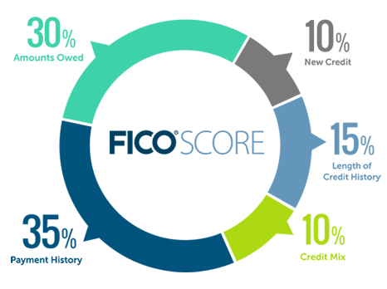
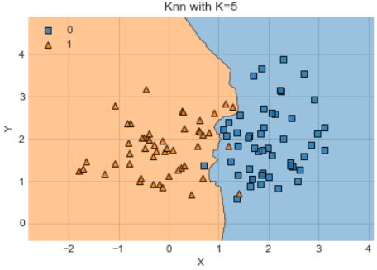
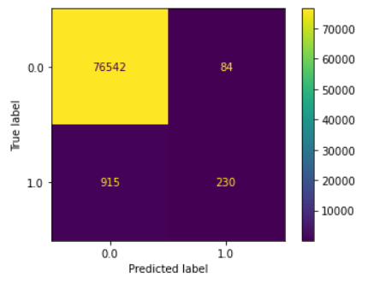
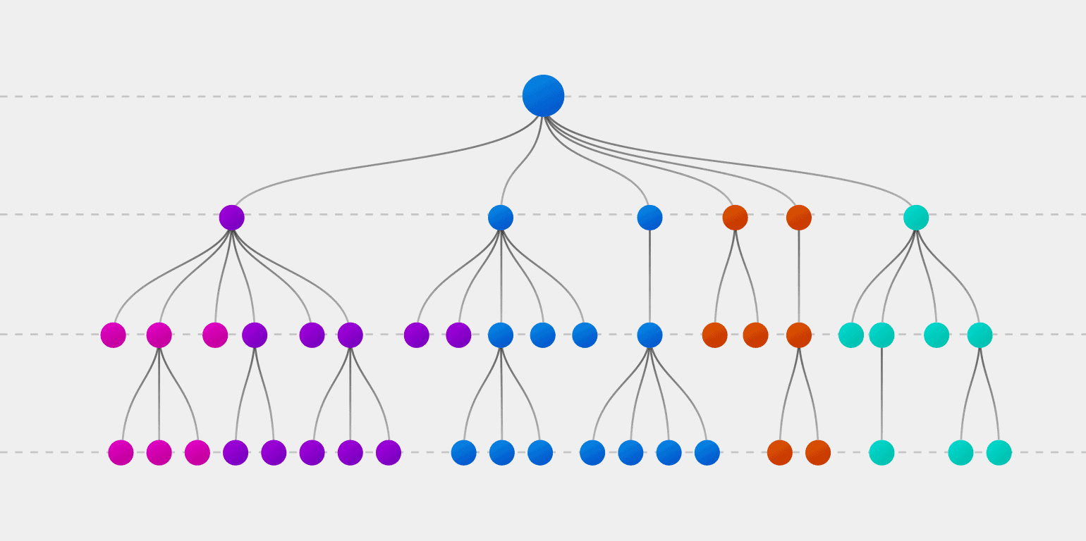
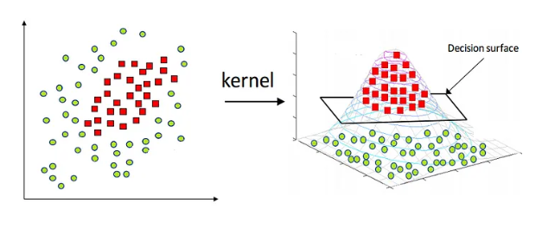
Predicting Credit Risk
Caleb Puckett, Dr. Robert Kelley
Bellarmine University Data Science Program
ABSTRACT
METHODS
RESULTS
CONCLUSIONS/FUTURE WORK
A credit score communicates the likelihood of defaulting on a loan; this project will use predictive analytics to analyze factors not used as typical determinants of this score. The current factors of credit score have been chosen for good reason, but in this project, an attempt will be made to link credit risk with more general indicators of one’s situation. This can help remove the high bar to entry to obtain a good credit score.
Data was gathered online from Kaggle
Data cleaning and manipulation were performed
Exploratory data analysis was performed
Two machine learning models were implemented for predictive purposes: Decision Tree and K-Nearest Neighbor
Work was all done in Python besides the occasional use of Tableau for visualizations
Models used in this project were not especially accurate at predicting inability to repay loans
Both models were ~98.5% accurate – insufficient because ~98% of the payments in the data are not late
Approximately the same accuracy could be obtained if our model predicted on-time payments for every individual
Below is a confusion matrix showing the prediction results
The results were not robust and did not accurately predict credit risk as hoped
Decision Tree and K-Nearest Neighbor machine learning models were used, but there are more models worth trying
These include Random Forest (many Decision Trees) and Kernel Support Vector Machine (more complex analysis)
These will likely provide more accurate results based on their ability to analyze more rigorously
After running these additional models, it is worth considering the addition of other variables not included in these data
K-Nearest Neighbor Visual
Confusion Matrix
OBJECTIVES
REFERENCES
Using more general circumstances to predict likelihood of credit default
The current measure is effective at predicting this risk, but every factor is dependent upon previous borrowing activity
This creates difficulty when individuals without previous borrowing experience attempt to get a good credit score
Catch-22 scenario which could be handled by understanding other indicators of credit risk
This would not replace current credit scoring system – it would complement it for those with no borrowing history
Decision Tree Visual
Data obtained from Kaggle at the following link:
https://www.kaggle.com/datasets/rikdifos/credit-card-approval prediction?select=application_record.csv
CONTACT
Support Vector Machine Visual
Puckettcaleb7@gmail.com
(502)-608-6668

