Slide 1
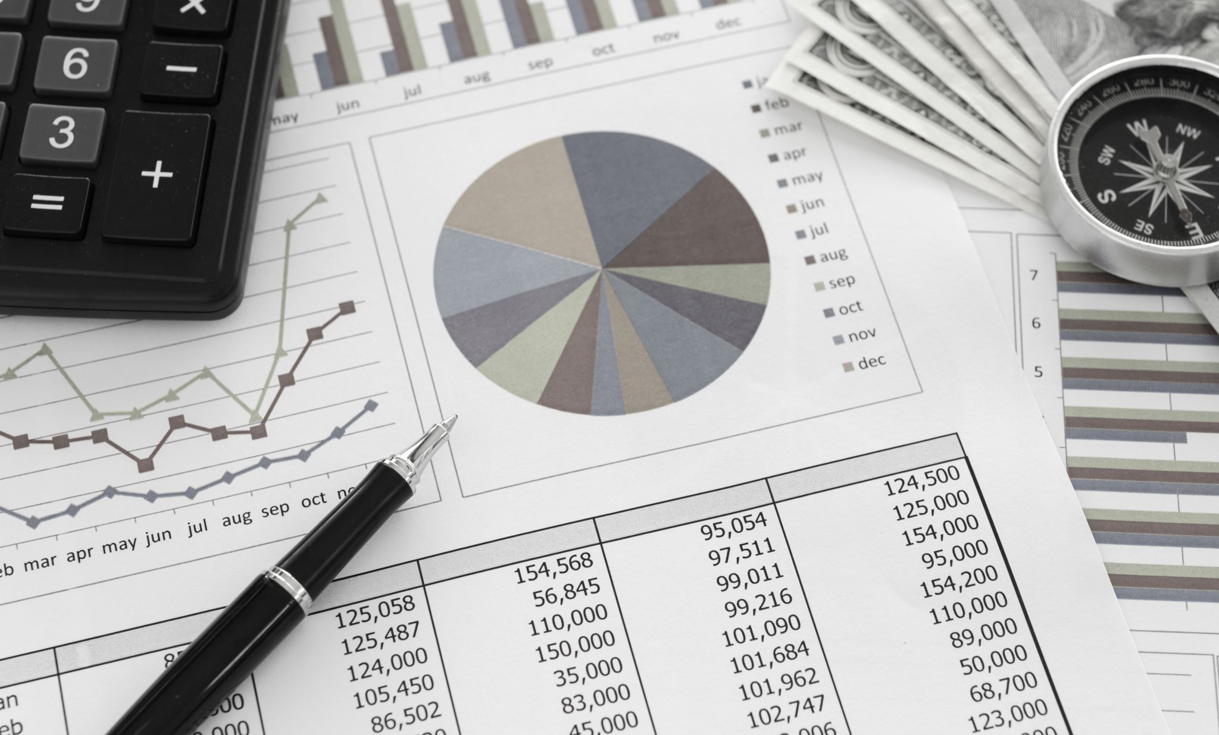
Predicting Credit Risk
Caleb Puckett
Dr. Robert Kelley

Slide 2
Overview
Discussion of the current credit scoring system
Purpose of this project
Details
Predictive models
Results
Conclusion

Slide 3
Current Credit System
A credit score is determined based on previous borrowing history
Depends on factors like previous payment history, age of credit history, etc.
I chose this topic because I have been interested in obtaining and benefitting from good credit since I entered college

Slide 4
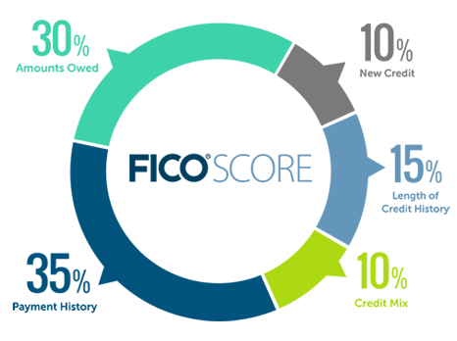
Credit Factors
Payment History
Amounts owed (utilization)
Length of Credit History
Credit Mix (credit cards, mortgage, auto loan, etc.)
New Credit (Inquiries)

Slide 5
Purpose of This Project
The current credit system poses difficulty for people who have no credit score and therefore no ability to prove their credit worthiness (difficult barrier to entry)
The aim is to find out if other factors, which are not based on previous borrowing history, can be used to predict credit worthiness
This would benefit those who have no credit but who would like to obtain a line of credit

Slide 6
Details of the Project
Attempting to predict whether an individual is late making a payment (on either a loan or credit card payment)
Variables used for prediction were based on factors like income, age, etc.
Exploratory data analysis was performed but nothing abnormal was found
Some data cleaning was performed, but this only involved the removal of a few columns and the conversion of some columns to dummy variables

Slide 7
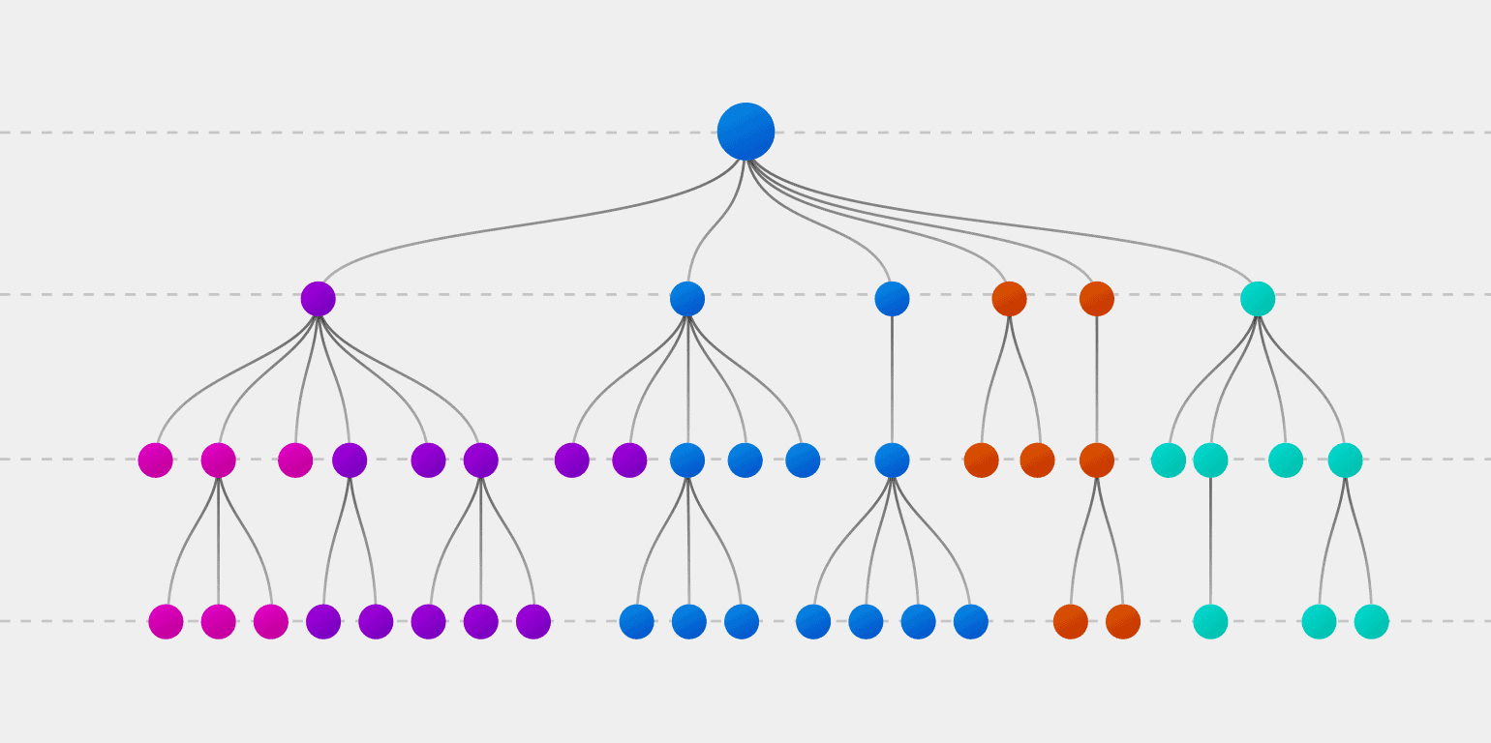
Decision Tree Model
A tree-like structure that represents a series of decisions and their possible consequences
Returned an approximate accuracy score of 98.3%

Slide 8
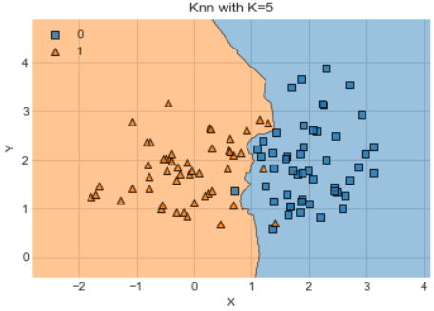
K-Nearest Neighbors Model
Uses proximity to make classifications or predictions about the groupings of data
Returned an accuracy score of approximately 98.5%

Slide 9
Results
With these models producing accuracy scores of ~98.3% and ~98.5%, they seem to be accurate and successful models
This is misleading, however, because approximately 98% of the data was described as non-late payments
For this reason, predicting that no individuals make late payments would give us approximately the same accuracy as these models; the results are not insightful

Slide 10
Conclusion
Although no valuable insights were found, I had a lot of fun in the process!
There is a fundamental flaw with this idea; even if certain characteristics (income, sex, age) could be used to predict credit worthiness, using some of these may constitute discrimination
For this reason, any further analysis should be careful to primarily include behavioral variables that are within a person’s control

Slide 11

Questions?

Slide 12

Thank you!!!

