Slide 1

Context-Aware -Style Ratings for NCAA Basketball
Baker Dean & Caleb Ramsey

Slide 2
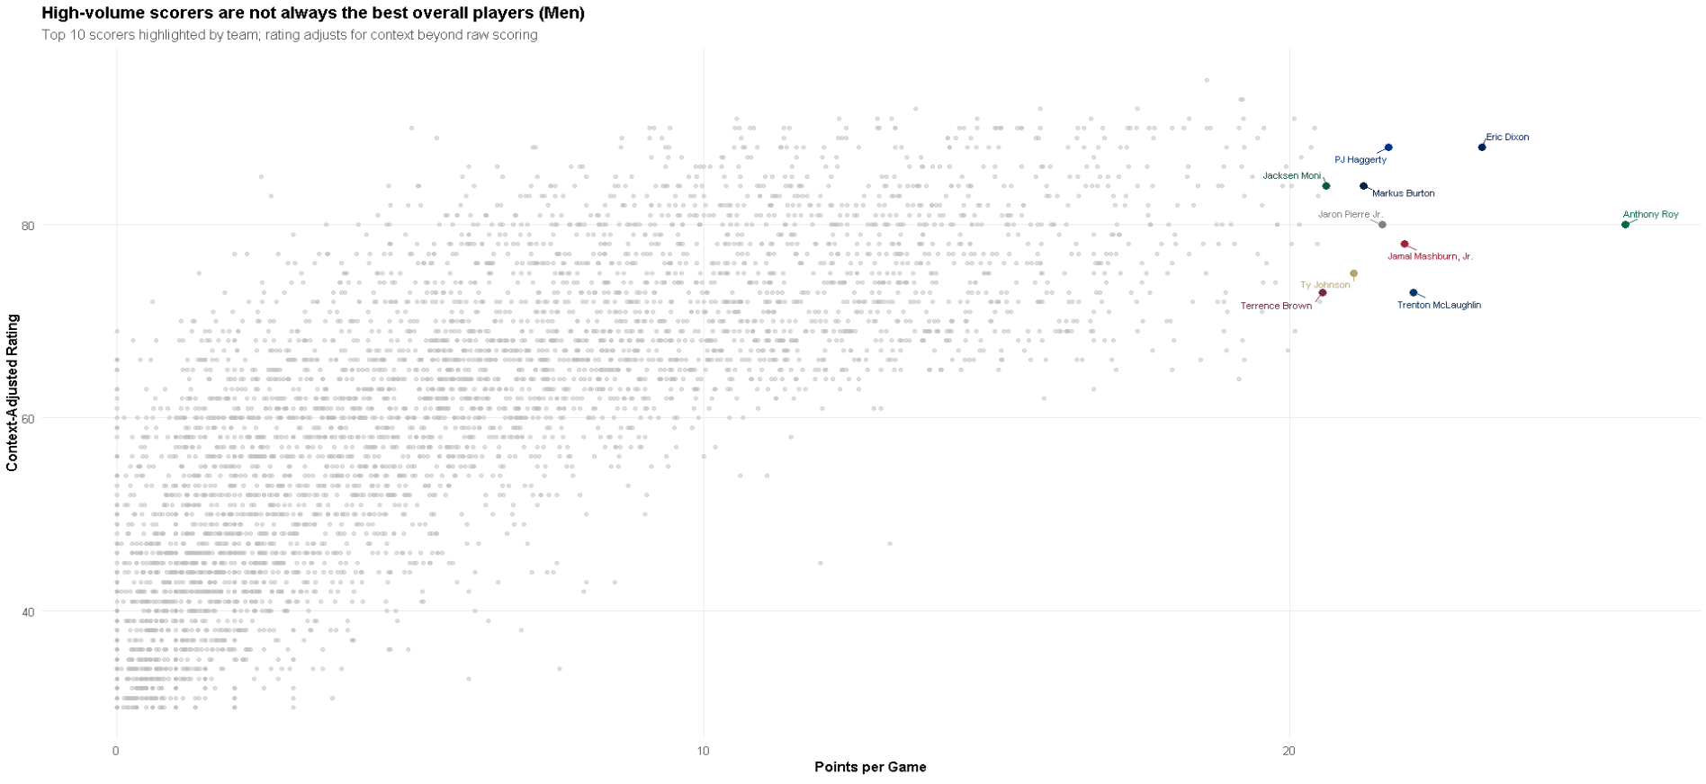
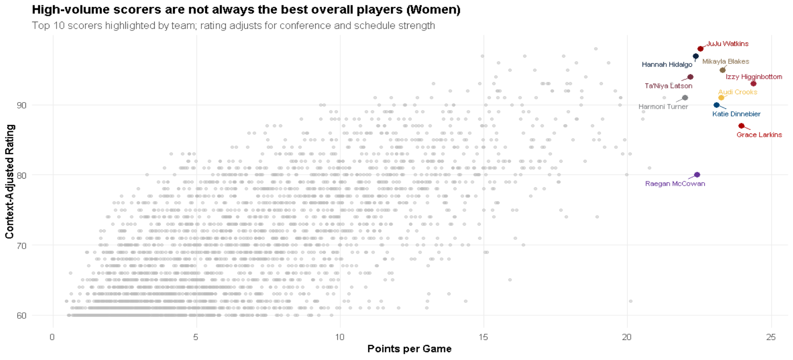
Why Traditional Stats Mislead
PPG rewards usage, not efficiency or impact
Box scores ignore opponent strength

Slide 3
Methods
🏀 Player Performance
🎽 Team Strength
💪 Schedule Difficulty
🗺️Conference Strength
How much a player produces
(ppg, rpg, apg, efficiency)
How strong the players team is
Average difficulty of opponents
Aggregated strength of each
conference
Data Processing: Joined HDI + Torvik + ESPN, cleaned naming conflicts, removed non-D1 & low-minute players

Slide 4
Data Sources
HDI Ratings (Provided by VT MBB)
Bart Torvik player stats (cbbdata)
ESPN play-by-play & box scores (wehoop)
Official 2025 schedules (wehoop)
Manual team to conference mapping

Slide 5
Men’s Pipeline
Women’s Pipeline
HDI Ratings
ESPN Box Scores
Player Stats
Season Aggregation
Name Matching & Cleaning
Team & Conference Mapping
Merged Player Dataset
Minutes/Stats Normalization
SOS & Conference Strength
SOS & Conference Strength
Adjusted Player Rating
Adjusted Player Rating

Slide 6
How a Rating is Made
1 - Raw Stats Rating assigned by Model
Name | School | Rating
Cooper Flagg | Duke | 90.41477
Name | School | Rating
Paige Bueckers | UConn | 77.02615
2 - Stats Adjusted By Scale Factors
Name | School | Rating
Cooper Flagg | Duke | 91.61226
Name | School | Rating
Paige Bueckers | UConn | 78.04127
3 - Conference Difficulty Adjuster Applied
Name | School | Rating
Cooper Flagg | Duke | 103.0
Name | School | Rating
Paige Bueckers | UConn | 81.1
4 - Ratings Scaled 2K-Style
Name | School | Rating
Cooper Flagg | Duke | 96
Name | School | Rating
Paige Bueckers | UConn | 99
Notes:
Women’s initial ratings are lower since the model was trained on men’s stats
These examples are from strong conferences but players from smaller conferences would be lowered by the Conference Difficulty Adjuster instead of raised
The Scale Factors slightly reduce the impact of big-man stats due to our project having more of them available to avoid bias
Flagg is lower than Bueckers despite higher initial rating since the scaling is done relative to peers

Slide 7
Initial Ratings
vs
Final Ratings
Player | School | Rating
Ryan Kalkbrenner | Creighton | 99
Johni Broome | Auburn | 99
Cooper Flagg | Duke | 98
Hunter Dickinson | Kansas | 98
Collin Murray-Boyles | South Carolina | 98
Zuby Ejiofor | St. John's | 97
Yaxel Lendeborg | UAB | 97
Zakai Zeigler | Tennessee | 97
Bent Leuchten | UC Irvine | 96
Oumar Ballo | Indiana | 96
Name | School | Rating
Ryan Kalkbrenner | Creighton | 99
Johni Broome | Auburn | 98
Collin Murray-Boyles | South Carolina | 97
Cooper Flagg | Duke | 96
Zakai Zeigler | Tennessee | 96
Zuby Ejiofor | St. John's | 96
Kam Jones | Marquette | 95
Walter Clayton Jr. | Florida | 95
Hunter Dickinson | Kansas | 94
Bruce Thornton | Ohio St. | 94
Name | School | Rating
Paige Bueckers | UConn | 99
Ally Becki | Ball State | 98
Katie Dinnebier | Drake | 98
Serena Sundell | Kansas State | 97
Sarah Strong | UConn | 97
Megan McConnell | Duquesne | 96
Olivia Miles | Notre Dame | 96
Payton Verhulst | Oklahoma | 96
Georgia Amoore | Kentucky | 96
Kymora Johnson | Virginia | 96
Name | School | Rating
Paige Bueckers | UConn | 99
Serena Sundell | Kansas State | 98
Georgia Amoore | Kentucky | 98
Olivia Miles | Notre Dame | 97
Kymora Johnson | Virginia | 97
Payton Verhulst | Oklahoma | 97
Katie Dinnebier | Drake | 96
Sarah Strong | UConn | 96
Emily Ryan | Iowa State | 96
Kiki Rice | UCLA | 96
Notes:
Midmajor players from UC Irvine, Ball State, and Duquesne all fall out of the rankings due to the conference adjustment
Guards like Zeigler, Amoore, and Johnson get moved up due to accounting for the big-man bias in the stats
The ACC is strong in women’s basketball but weak in men’s, as can be seen by Virginia boosting Johnson but Duke hurting Flagg

Slide 8
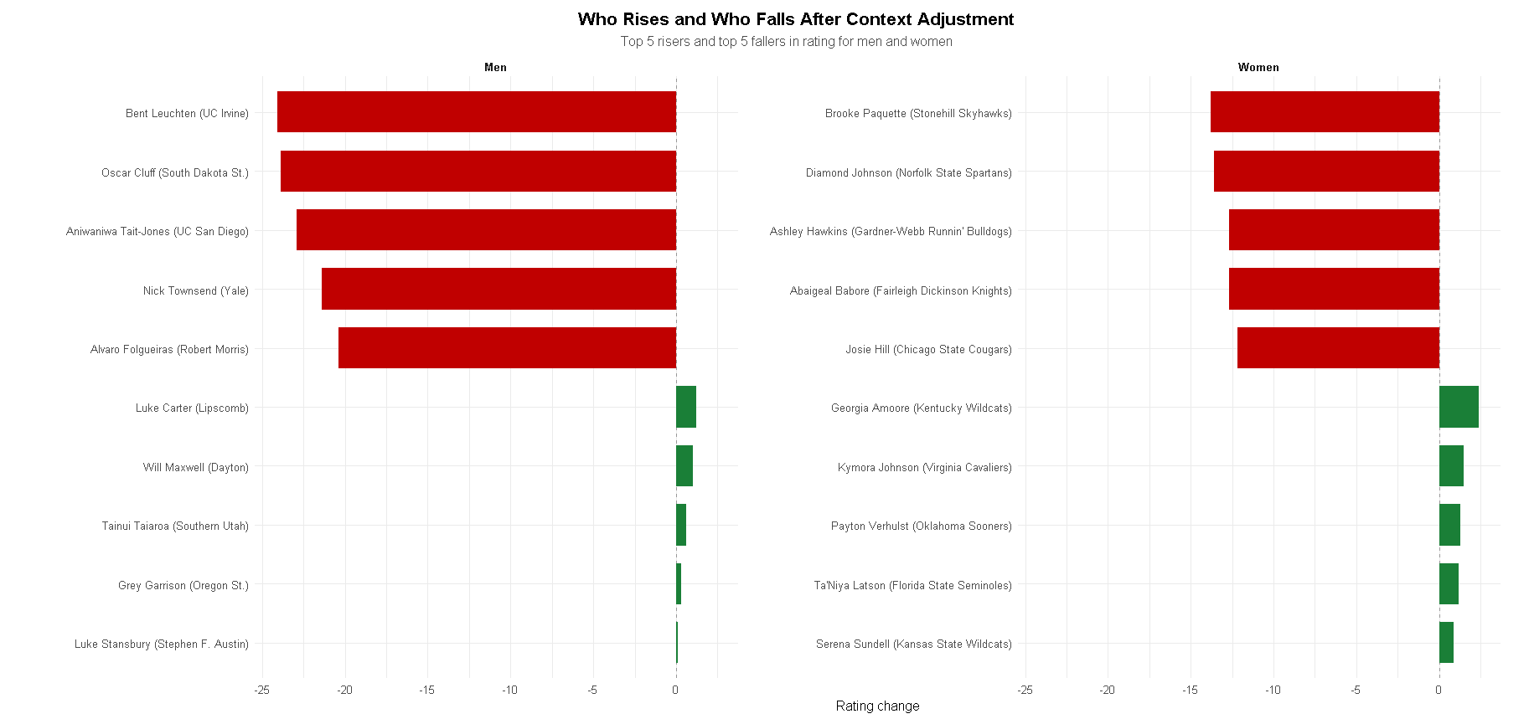
Who Rises & Who Falls?

Slide 9
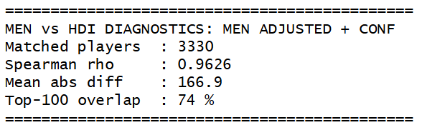
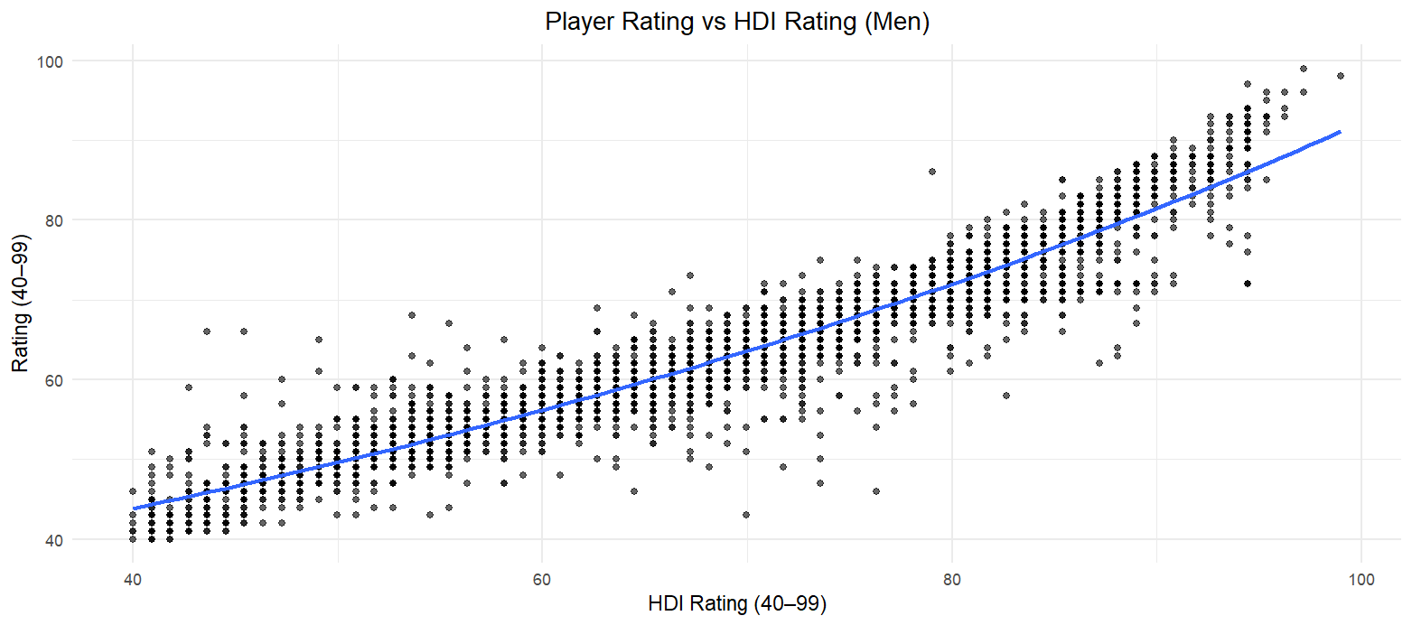
Comparison with HDI
Spearman rho is a metric that explains how similar the ranks of two lists are: 0.9626 is quite good
Notes:
The plot shows a very encouraging trend between the two rankings, especially given that our goal wasn’t to match HDI - just a sign our rankings aren’t unreasonable
Considering there are over 3000 players, many of whom in the lower ranks are very similar, an average difference of only 167 spots is quite good
Most of the outliers below the trendline are midmajor players with very high stats from very bad conferences, which is reasonable given how we built the rankings
Differences in the middle of the rankings are likely more valuable than gaps at the top, since everyone knows the top players are good

Slide 10
Predictive of Team Success?
Top Teams by Rotation Average Rating
Men
Women
School | Rating
Auburn | 85.5
Florida | 84.4
Alabama | 84.1
Kentucky | 83.4
Arizona | 83.1
Duke | 82.9
Tennessee | 82.6
Illinois | 82.5
Iowa State | 82.4
Houston | 82.0
School | Rating
UConn | 81.5
Baylor | 79.8
South Carolina | 79.1
Georgia Tech | 78.8
USC | 79.1
Tennessee | 77.8
Oklahoma | 77.6
Notre Dame | 77.5
TCU | 77.2
Creighton | 77.1
These lists capture:
6 of the 8 Final 4 Teams
11 of the 16 Elite 8 Teams
Both National Champions (within the top 2)
Both National Player of the Years and Runner Ups
Men’s teams seeded
1, 1, 1, 1, 2, 2, 2, 3, 3, 4
Women’s teams seeded
1, 1, 2, 2, 3, 3, 4, 4, 5, 9
Notes:
The fact that this captures Final 4 Teams and #1 seeds suggests it was a good predictor of both regular season and tournament success
The women’s ratings are again slightly lower due to a more balanced distribution of the high overall players compared to the men
The Top Team section uses an 8-player rotation to avoid teams getting messed up by their walk-ons/end-of-bench players

Slide 11
How Staffs Can Use It
Player Evaluation
(Portal & Recruiting)
Identify mid-major stars that translate up to high major leagues
“Players between 70-80 overall in the Big West tend to perform well at the ACC level; Players who have low stat ratings in the Big East don’t translate well to high-major schools”
Compare players to historical precedent with similar profiles
Scout
Identify targets in portal/HS
Evaluate
Use context-adjusted rating & role
Compare
Benchmarks by conference/rotation
Roster Construction
Understanding ratings that predict deep tournament runs
Build optimized lineups using rating thresholds for Guard/Wing/Big
Teams that advance to the Sweet 16 from the SEC always have a guard who ≥84 overall & a big who is ≥82 overall.”
Decision
Pass / dive into film

Slide 12
Limitations
Men → Women translation required scaling
Conference adjustments unstable at times
Box-score only inputs
Margin based team strength assumptions
Data inconsistency across sources
One-season validation
Recommendations
Add play-by-play and Synergy-style data
Use lineup-level impact in models (on/off, adjusted +/-)
Gender specific scaling for positional value
Automate school/team keys for reproducible matching
Multi-season testing
Build interactive dashboard
⚠️
⭐

Slide 13

Thank You!

