Slide 1

Moffat Bay Marina
Group 2

Slide 2
Group 2 Members
Jacob Darling
Madisyn Kovacic
Giancarlo Ruiz
JARRED Santos
Caleb Stark
Mikaila Steinbrugge
Hugo Vega Hernandez

Slide 3
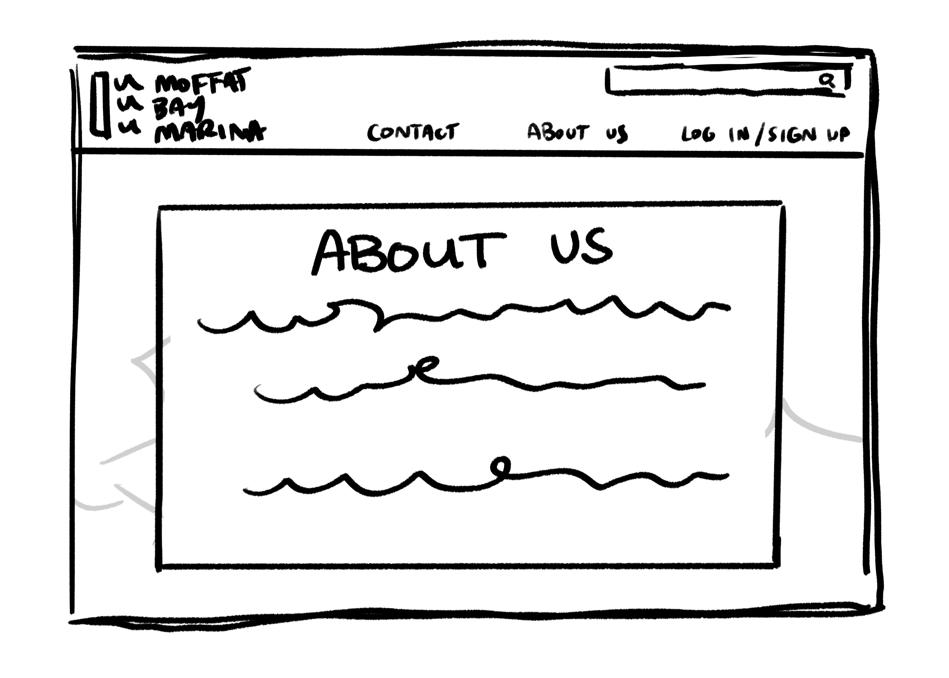
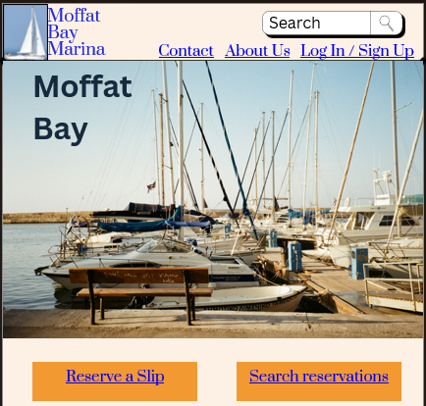
Sample of prototypes

Slide 4
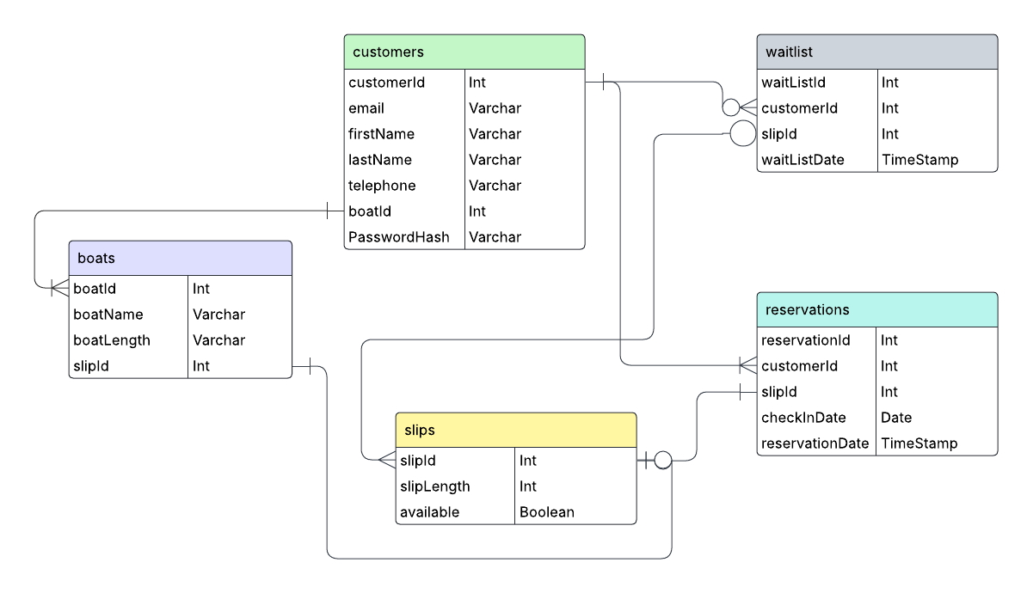
ERD pt.1

Slide 5
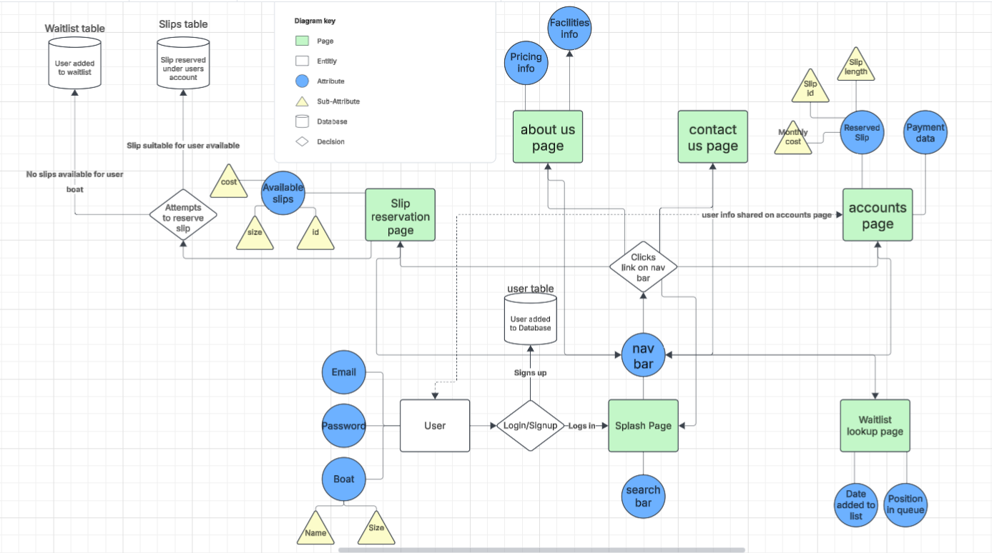
ERD pt.2

Slide 6
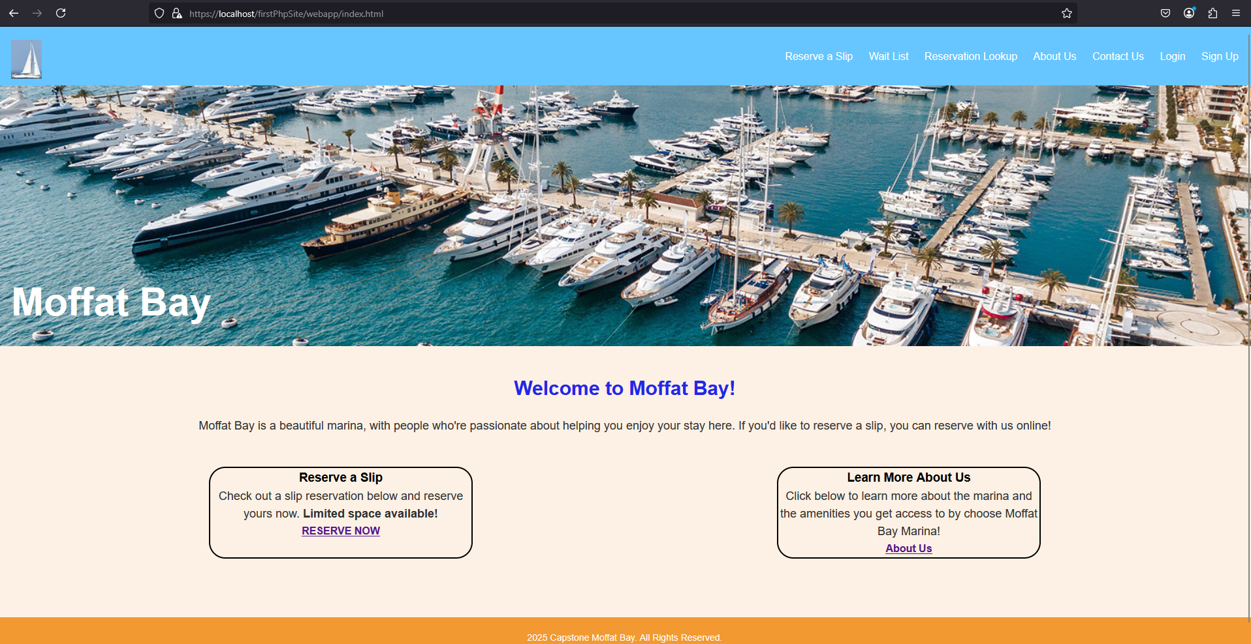
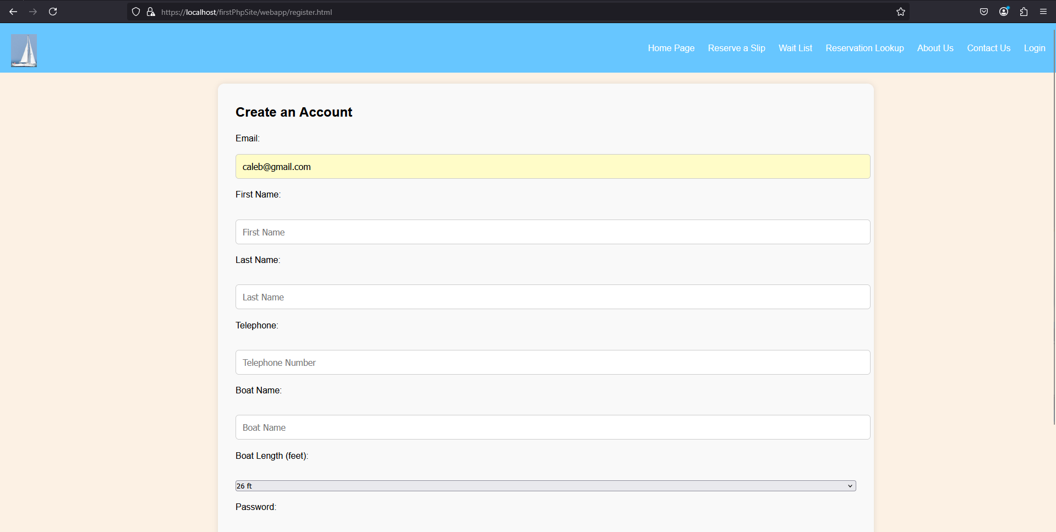
Test 1- Log-In Validation
Step No. | Action
1 | Open index.html
2 | Click Register link

Slide 7
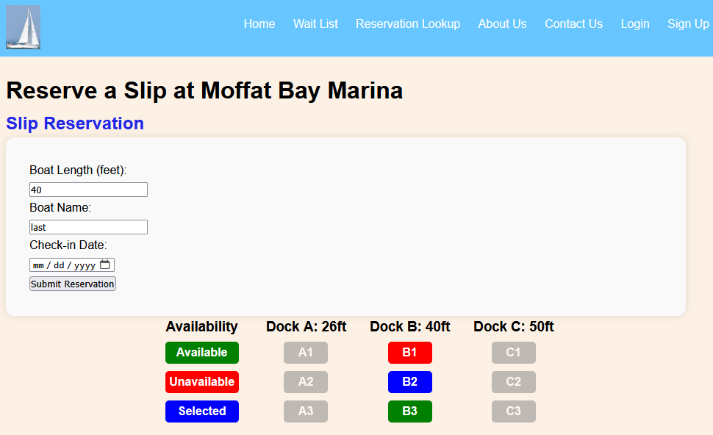
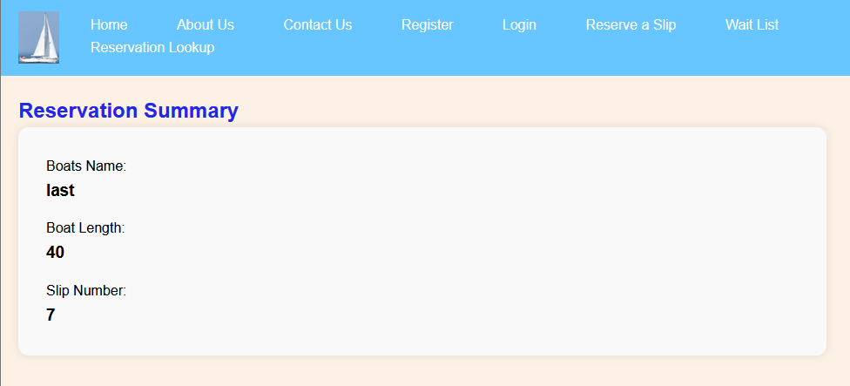
Test 2 Verifying Input Data
Step | Action | Expected results
1 | User enters valid reservation data in the form fields. | The system accepts the data and displays a confirmation message.
2 | User presses the 'Submit' button. | The form is submitted successfully, and the confirmation page is displayed.

Slide 8
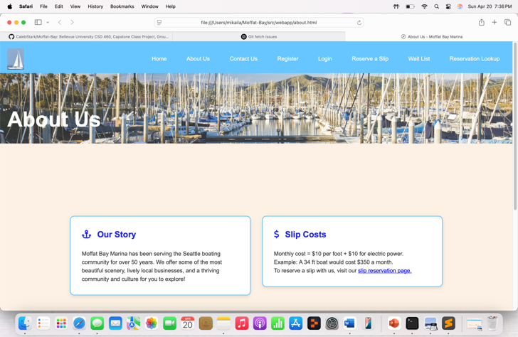
Test 3 About Us Page Display and Content Verification
Step | Action | Expected Results
1 | Open the "About Us" page | Page loads without errors
2 | Check if the header ("About Us") is present | Header should be visible

Slide 9
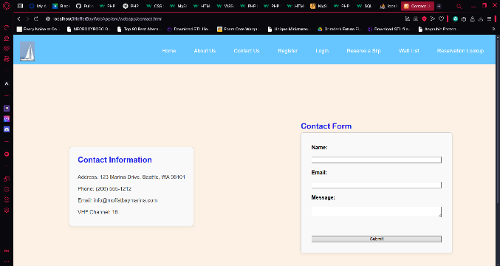
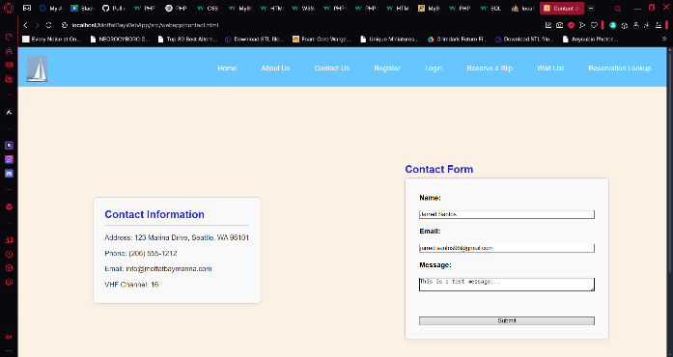
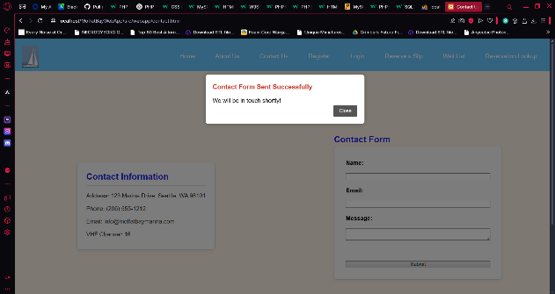
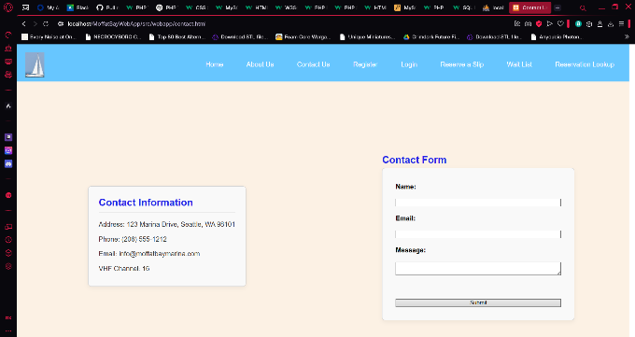
Test 4 - Submit Contact Us Form Successfully
Step | Action | Expected Result
1 | Navigate to the Contact Us page | Page loads successfully
2 | Fill in all fields with valid data | Data appears correctly in input fields
3 | Click "Submit" | Success message appears (e.g., “Message sent”)
5 | Refresh page | Form is cleared/reset

Slide 10
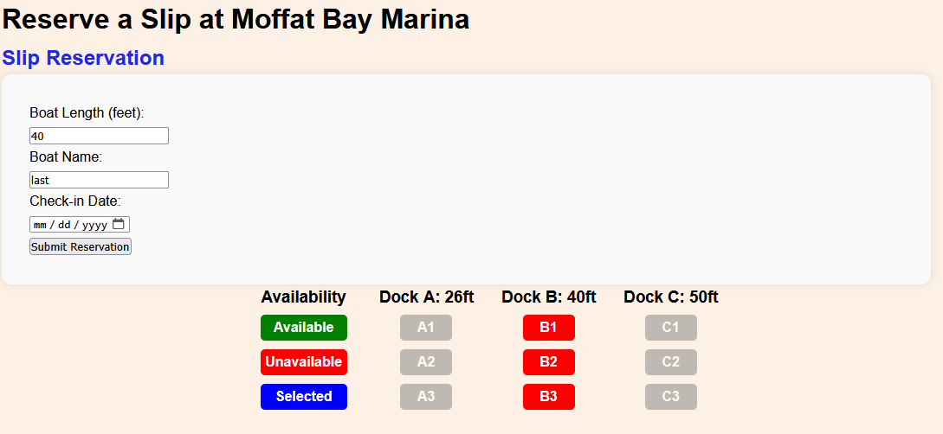
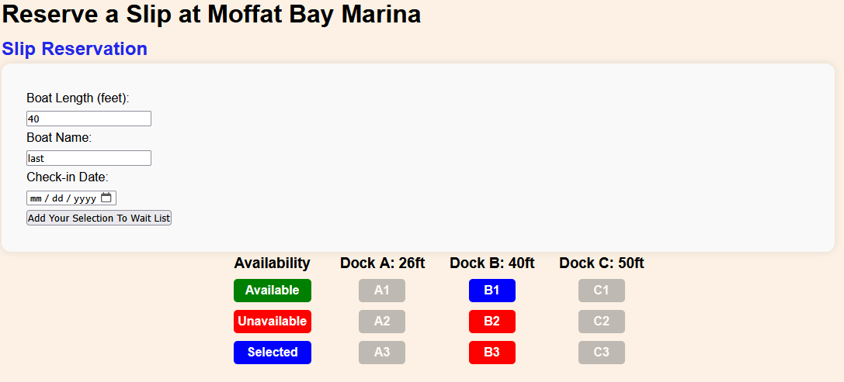
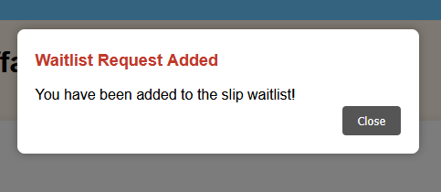
Test 5
Step | Action | Expected Result
1 | Navigate to reservation page | Page loads successfully
2 | Select a slip that is not available | The submit button should indicate adding selection to waitlist.
3 | Click "Submit" button | Should be added to wait list successfully

Slide 11
What We Learned
Throughout the course of this project, our team gained valuable experience both technically and collaboratively. Some of the key lessons learned include:
Effective Communication is Crucial: Regular team meetings and consistent updates helped keep everyone aligned and allowed us to quickly address issues as they arose.
Version Control Matters: Using tools like Git and GitHub ensured smooth collaboration and helped avoid overwriting each other’s work, especially during code integration.
Clear Requirements Save Time: We learned that investing time in clearly defining and understanding requirements early on significantly reduced rework and confusion later.
Flexibility is Key: We encountered unexpected challenges (technical and scheduling), and being adaptable allowed us to overcome those hurdles and stay on track.
Working together on this project not only enhanced our technical skills but also strengthened our ability to work effectively as a team under real-world constraints.

