Slide 1


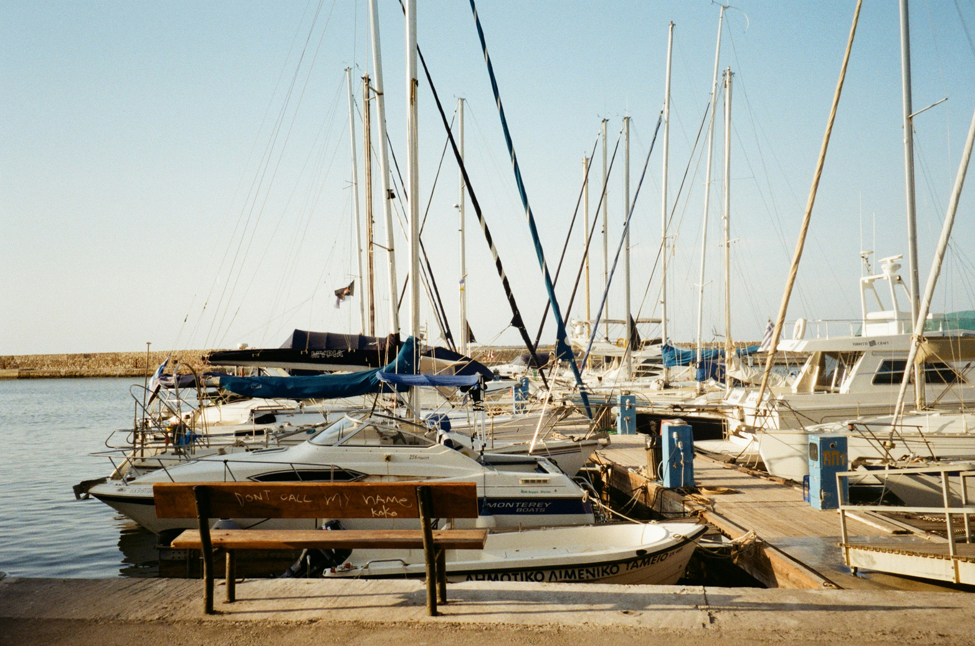
Moffat
Bay
Marina
Search
Contact
About Us
Log In / Sign Up
Moffat
Bay
Reserve a Slip
Search reservations

Slide 2
Contact Us

Slide 3
Login

Slide 4
About Us

Slide 5
Slip Reservation

Slide 6
Reservation Search

