Slide 1
Cyclistic: Comparison of Casual to Membership Riders
Created by: Caleb Wallace Last updated: 4/27/2022

Slide 2
What’s Covered
Objective/Goal
Information Uncovered
Insights
Recommendations
Questions

Slide 3
Objective
To analyze the different ways Casual riders and Members use Cyclistic’s bike program to better understand and determine new marketing strategies to convert Casual riders into annual Members

Slide 4
Data Used
The information used was monthly breakdowns provided directly from the company’s website
The time period for the data is April 2020 – April 2021
Data anomalies were cleaned as best as possible
Notes:
Trip lengths that were negative were removed
Trips that started and ended at the same time were removed (0-minute length)

Slide 5
Discoveries
Number of trips broken down by month and day
Differences between casual and membership riders
Preferred bike choices of casuals and members

Slide 6
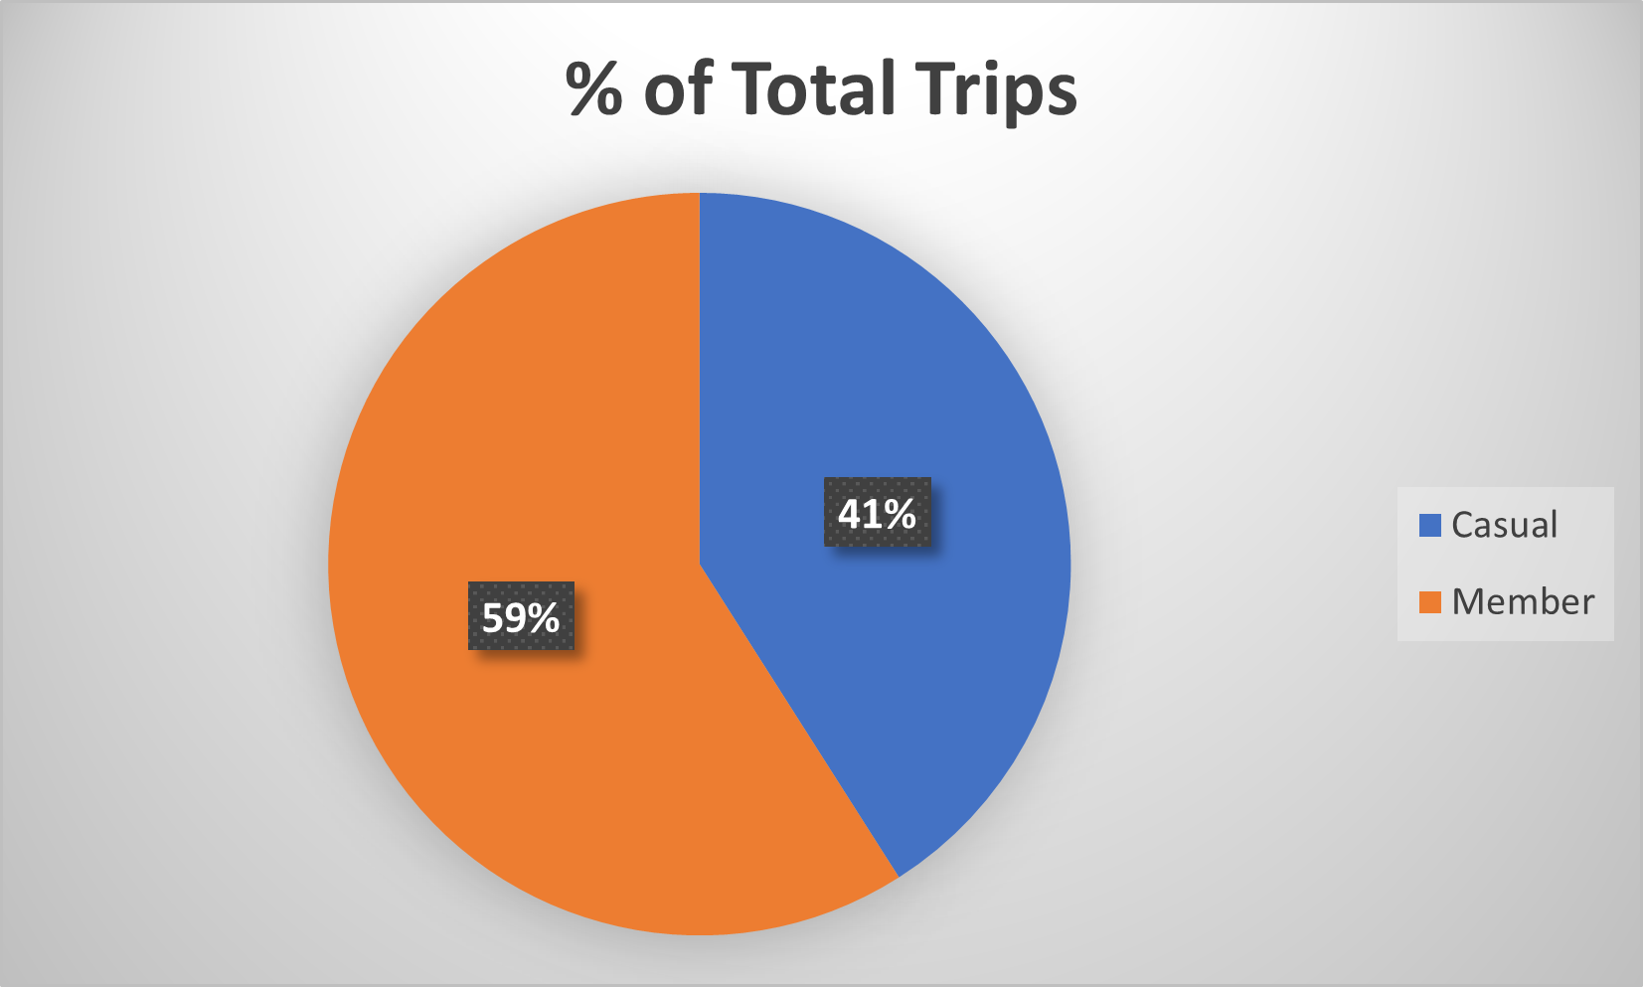
Number of Overall Trips
Members currently make up more of the overall trips
Notes:
*Based on a total count of all trips included in the year Graph represents total trip percent breakdown for the entire year's worth of information

Slide 7
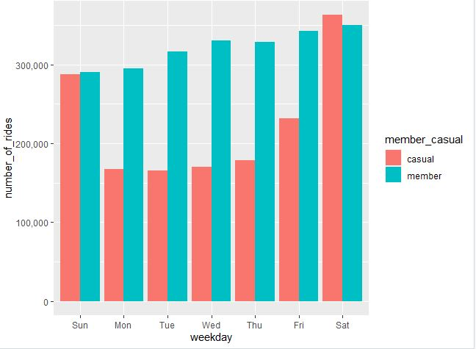
Number of Weekday Trips
Casual members vastly prefer weekends to weekdays
Members keep a consistent trip number throughout the week
Notes:
*Information taken from the started_at to find days Graph represents weekday breakdown throughout the entire year's worth of data
Friday does have a decent jump but not quite as large as Saturday/Sunday

Slide 8
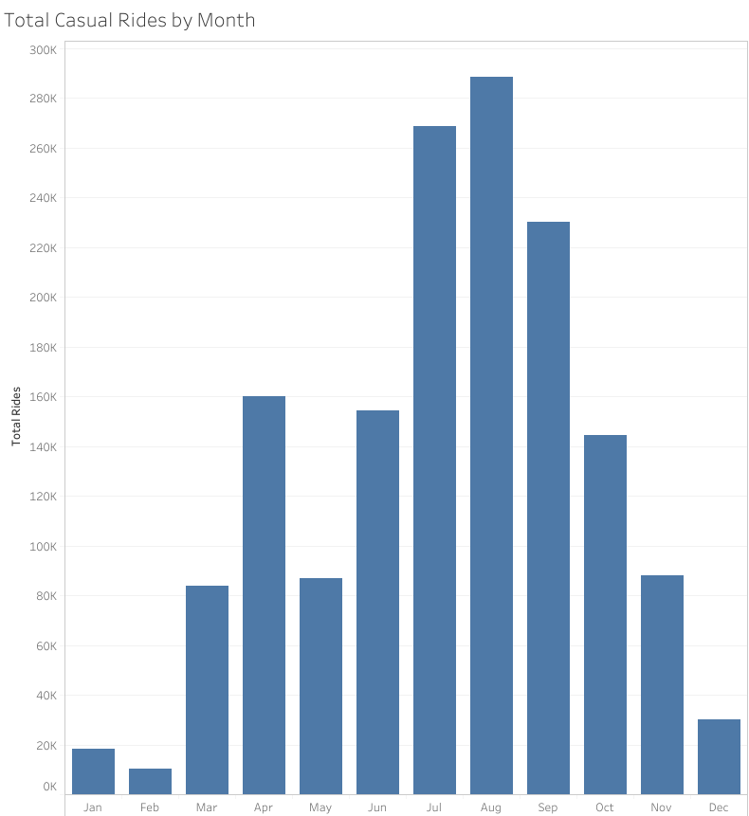
Casual Rides by Month
The busiest time period for casual rides is summer leading into fall
Steep drop in total number of rides during winter
*April includes 2020 and 2021 but on average is in line with other spring months
Notes:
*Information taken from the abbreviated month column created from the month as number April has double the other spring months due to including April 2020 and 2021
Potential to be found in summer months for promotions?

Slide 9
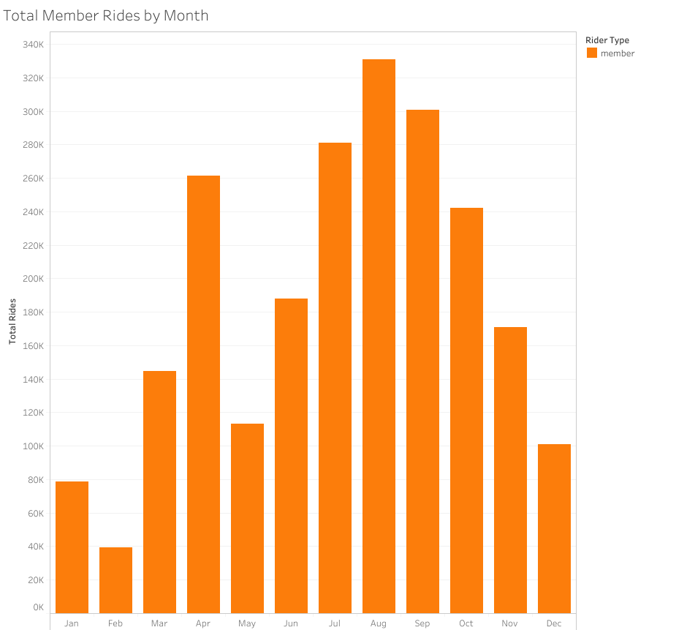
Member Rides by Month
While Member use does slow down in winter its not as bad as casual rider drop-off
Summer and start of fall are also the most popular times
*April is also doubled due to 2020 and 2021 data
Notes:
*Information taken from the abbreviated month column created from the month as number April has double the amount of other spring months due to including 2020 and 2021
Summer into fall also most busy like casual riders

Slide 10
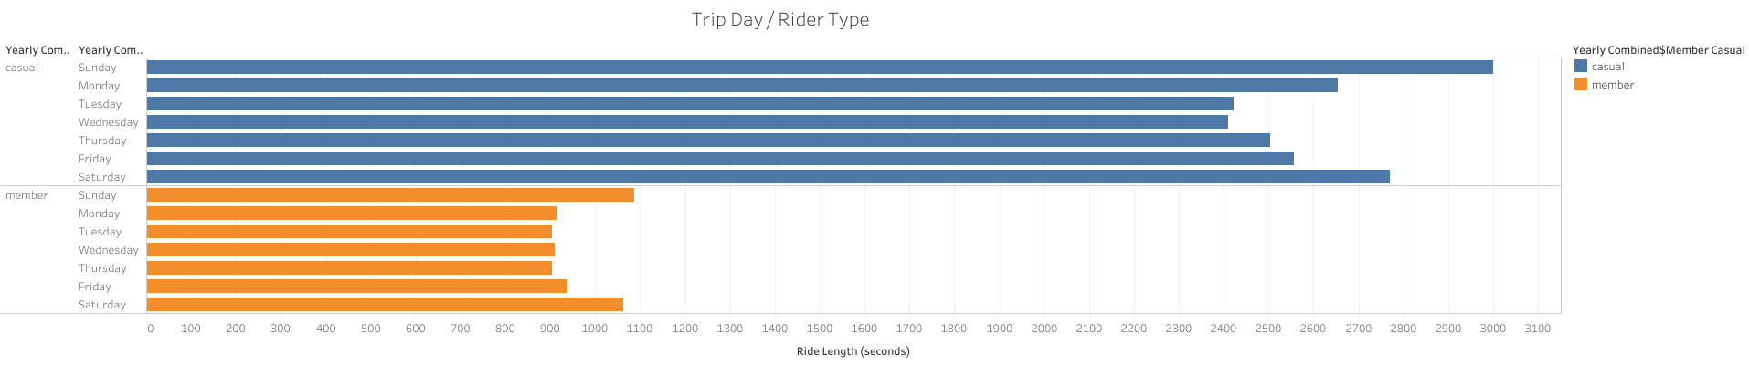
Average Ride Length by Day
Casual riders on average have longer trips everyday of the week compared to members
Weekends also have the highest average trip length for both casuals and members
Notes:
*Information taken from calculation of started_at compared to ended_at
Casual riders on average almost twice as long ride lengths

Slide 11
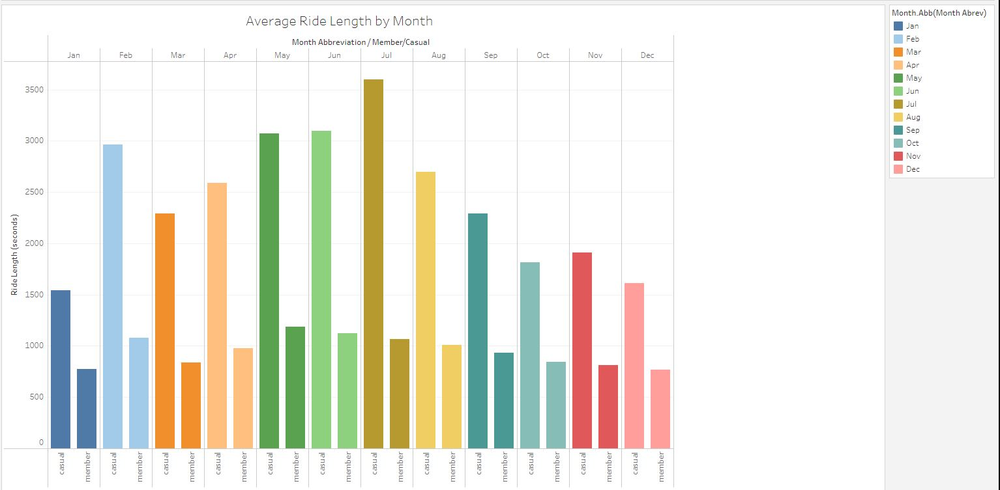
Average Ride Length by Month
Casual Riders trip length varies month to month, members length stays more consistent Casual Riders longest average trips focus come around May, June, and July
Notes:
*information taken from started_at and member_casual and converted to Month Abbreviaton Interesting to note casual ride length average peaks in July where member length goes down from the previous month
Winter months include some of the lower average times

Slide 12
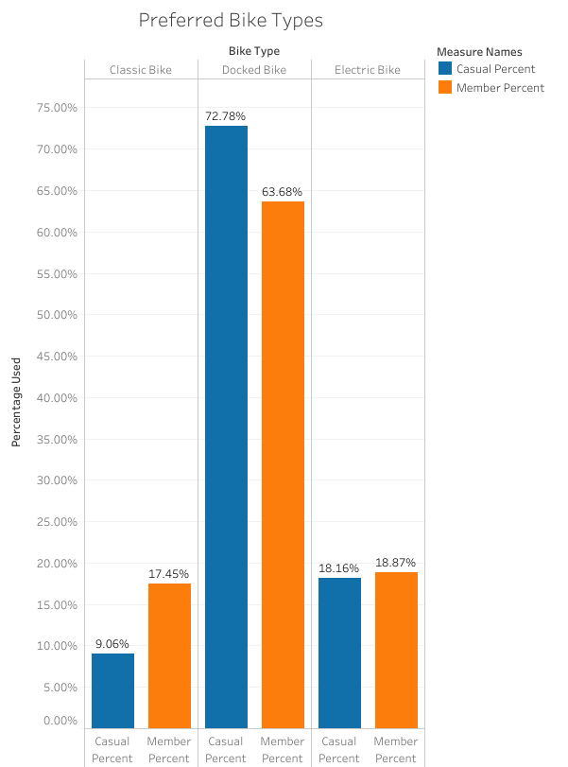
Bike Types
Both Casual riders and Members heavily prefer Docked Bikes over other options
Least preferred option is the Classic Bike
Electric bikes see very similar use between both casual and members
Notes:
*information taken from rideable_type and member_casual Potential to see what makes riders so heavily favor docked bikes over other options
Might be worth looking into promotions based around Docked Bikes

Slide 13
New Insights
Even though members make up more total % of overall rides, casual riders have a lot longer average ride lengths and time spent on the bikes
Members use the bikes consistently throughout the week where casual riders prefer to really use them on weekends and less on weekdays
Summer months leading into fall are the busiest for both Casual and Member riders, although Member riders have a lot more trips during winter months
Docked Bikes are by far the most popular bike but even more so for casual riders then any other option

Slide 14
Recommendations
Look into promotions targeting casual riders on weekends since that is when most of them use Cyclistic
The busiest time of the year is Summer leading into fall, potentially could investigate promotions around the end of springtime to get people interested in Cyclistic and get membership rolling when they use it the most
The favorite bike of Casual riders is the Docked Bike by a large amount, potential bike specific promotions to target this audience
Winter promotions may not be advisable, very low number of casual riders during these time periods

Slide 15
Clarifications
Look into the potential anomalies in the data
Trips that had no length
Trips that have weird starting or ending locations
Consistency of station IDs
Potential areas for further analysis
Look into other months/years for similar trends
More in-depth specifics on riders (maybe even look deeper into Single-Ride vs Full Day)
Larger amount of winter use by Membership users compared to Casuals (maybe asking riders directly how they use the pass in winter months)

Slide 16
Questions!

