Slide 1
Lecture 1
Introduction

Slide 2
Contents
Introduction to this course
What is a computer?
Computing system
The history of computing
Subareas of computing

Slide 3

Objectives
Explain the importance of learning computer and how to learn it.
Define the term computer and identify the components of a computer (Describe the von Neumann model).
Describe hardware devices for input, processing, storage, output, and communication.

Slide 4
Objectives
Describe the categories of computers and their uses.
Describe the layers of a computer system
Describe the history of computer hardware and software
Distinguish between system programmers and applications programmers
Describe subareas of computing

Slide 5
part 1
INTRODUCTION
TO THIS COURSE

Slide 6
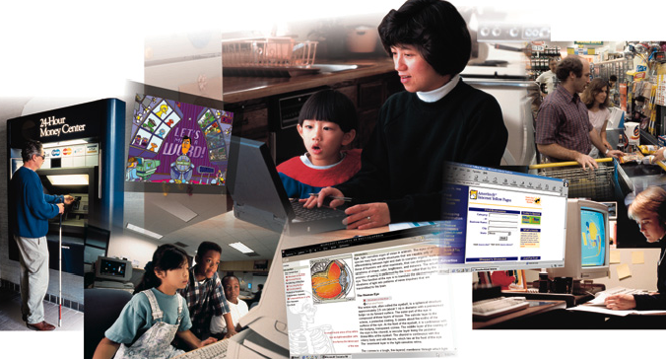
Computer is everywhere
Computers are affecting our lives and the whole society profoundly
Without computers, the world won't go around

Slide 7
Why should we learn computer & how to learn it
computer professional or common computer user?
  A computer professional is a person who has a certain amount of experience and/or at least a two-year degree in the technical aspects of using computers.
  for example
    software programmer
    system analyst
    network administrator

Slide 8
Why should we learn computer & how to learn it
computer professional or common computer user?
  The user (or end-user) is a person without much technical knowledge of computers but who uses or wants to use computers to perform work-related or personal tasks, enhance learning and productivity, or have fun.

Slide 9
Why should we learn computer & how to learn it
Why should I learn computer?
  work requirement
  improve life quality

Slide 10
Why should we learn computer & how to learn it
different from learning mathematics
use computer as much as possible
  by making stuff
read extensively

Slide 11
What will we learn in this course
The big picture
Information layer: number systems & data representation
Hardware layer: computing components
Programming layer: algorithm design, programming language, data structure & algorithm, and operating system
Application layer: information system, artificial intelligence and other applications
Communication layer: networks, world wide web.
conclusion

Slide 12
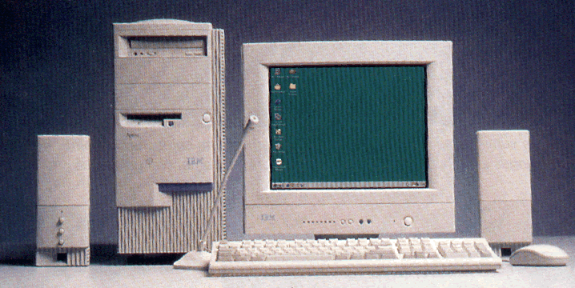
part 2
WHAT IS A COMPUTER?

Slide 13
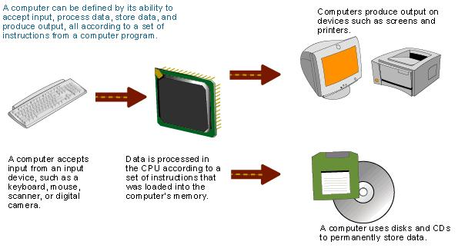
Definition of computer
A computer is an electronic device that receives data (input), processes data, stores data, and produces a result (output) .

Slide 14
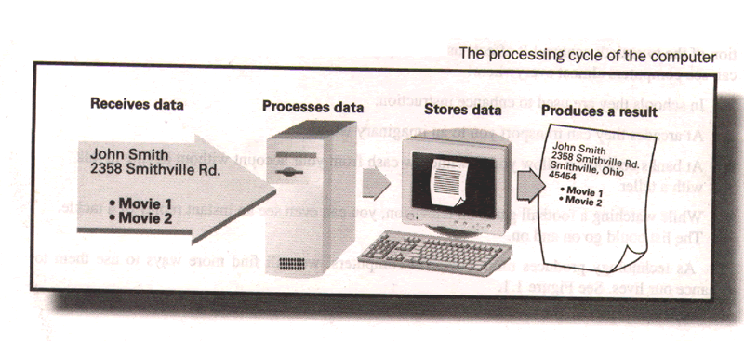
Definition of computer
How is a computer used in a video store

Slide 15

Definition of computer
A computer is a programmable data processor.
A program is a set of instructions that tells the computer what to do with data.
Program (sorting)
Input
8,12,22,3
3,8,12,22
Output

Slide 16
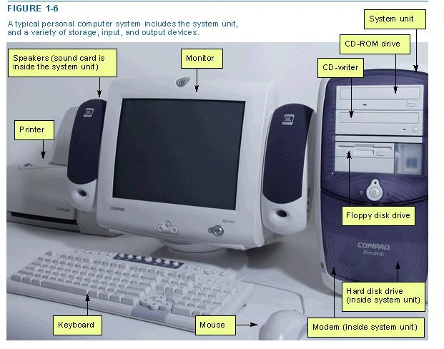
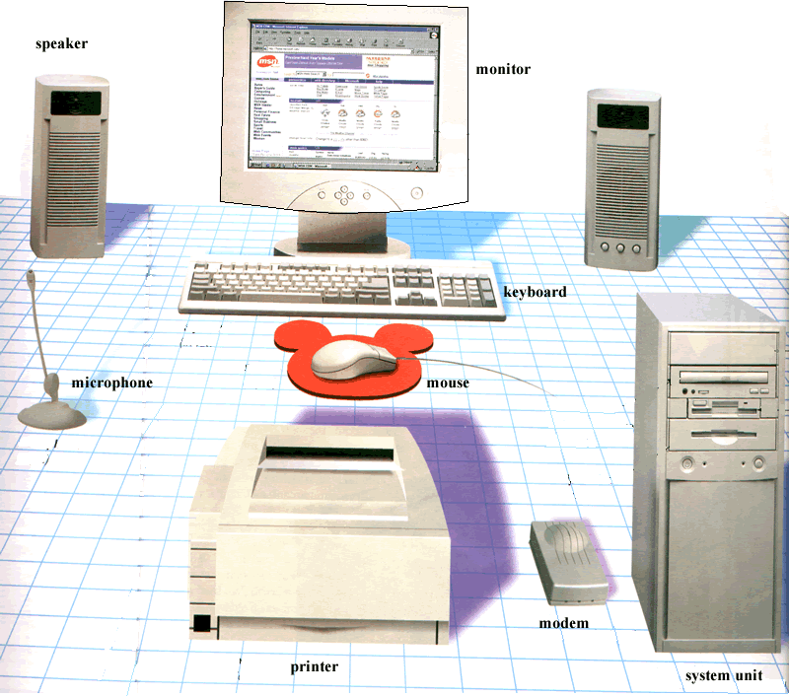
Computer hardware
The electric, electronic, and mechanical equipment that makes up a computer is called hardware.

Slide 17
Computer hardware
We can divide these devices into 4 basic categories:
  System unit
  Input/Output devices
  Secondary storage devices
  Communications devices

Slide 18
Computer hardware
system unit
Two important components of the system unit are the microprocessor and memory. The microprocessor controls and manipulates data to produce information. Memory, also known as primary storage or random access memory (RAM), holds data and program instructions for processing the data. It also holds the processed information before it is output.

Slide 19
Computer hardware
Input/Output devices
  Input devices translate data and programs that humans can understand into a form that the computer can process. The most common devices are the keyboard and the mouse.
  Output devices translate the processed information from the computer into a form that humans can understand. The most common output devices are monitors and printers.

Slide 20
Computer hardware
Secondary storage devices
Unlike memory, secondary storage devices hold data and programs even after electrical power to the computer system has been turned off. The most important kinds of secondary media are floppy, hard, and optical disks.

Slide 21
Computer hardware
Communications devices
Communications hardware sends and receives data and programs from one computer or secondary storage device to another. Many computers use a modem to convert electrical signals from one computer into electronic signals that can travel over a telephone line and onto the Internet. that is, modem is used to communicate between different computers via telephone lines.

Slide 22
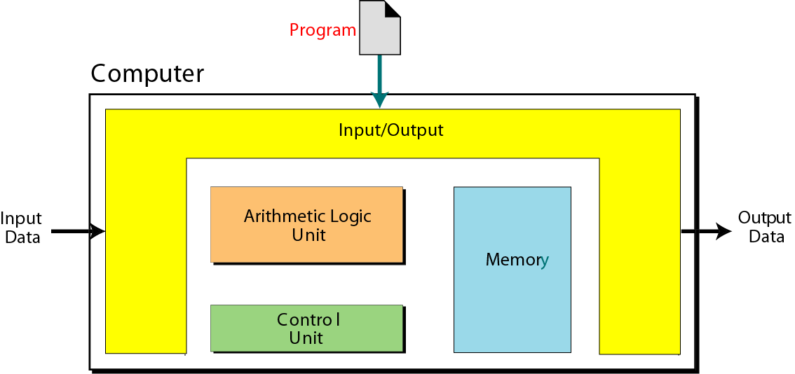
Von Neumann Model
The model looks at the inside of a computer (black box) and defines how processing is done. It is based on 3 ideas.
Idea 1: The model defines a computer as four subsystems: memory, arithmetic logic unit, control unit, and input/output.

Slide 23
Von Neumann Model
Idea 2: The program must be stored in memory.
Idea 3: A program in the von Neumann model is made of a finite number of instructions. And the instructions are executed one after another (sequentially).

Slide 24
Computer software
Software is the instructions that tell the computer how to process data into the form you want. In other words, Software is instructions issued to the computer so that specific tasks may be performed.
There are two basic types of software：
  system software
  application software

Slide 25
Computer software
System software
System software is background software that helps the computer manage its own internal resources.
The most important system software is the operating system, which interacts with the application software and the computer.

Slide 26
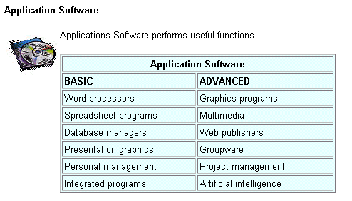
Computer software
Application software
  Application software is the software we use everyday to perform certain task, such as word processing or data analysis.
  There are several kinds of application software almost everyone should learn, such as the browser .
  For the summary of the basic and advanced applications, see the following figure.

Slide 27
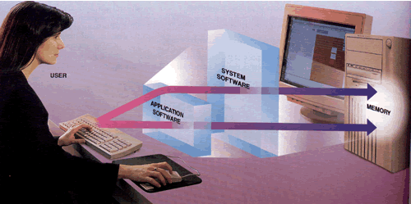
Computer software
The relationship between software and hardware

Slide 28
Types of computers
There are four types of computers:
  supercomputers
  mainframe computers
  minicomputers
  microcomputers

Slide 29
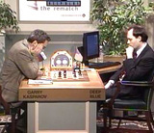
Types of computers
Supercomputers
  Supercomputer is the most powerful type of computer. These machines are special, high-capacity computers used by very large organizations. For example, NASA uses supercomputers to track and control space explorations.

Slide 30
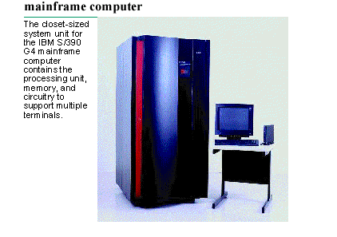
Types of computers
Mainframe computers
  They are not as powerful as supercomputers, but they are also capable of great processing speeds and data storage. For example, insurance companies use mainframes to process information about millions of policyholders.

Slide 31
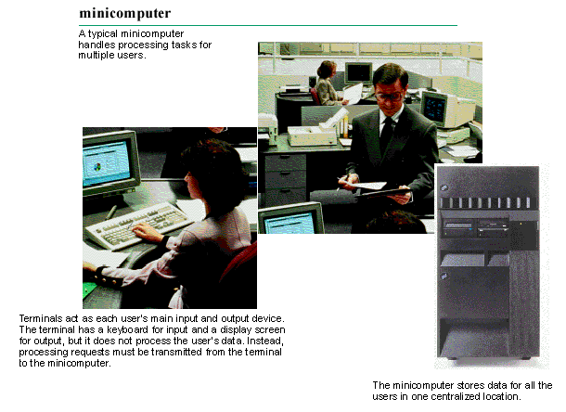
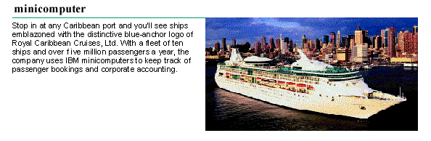
Types of computers
minicomputers
  Minicomputers are desk-sized machines, which can be used by medium-sized companies or departments of large companies to do certain tasks. For example, production departments may use minicomputers to monitor certain manufacturing processes and assembly-line operations.

Slide 32
Types of computers
microcomputers
  Although the least powerful, microcomputers are the most widely used and fastest-growing type of computer. Categories of microcomputers include desktop, notebook, and personal digital assistants(PDA).

Slide 33
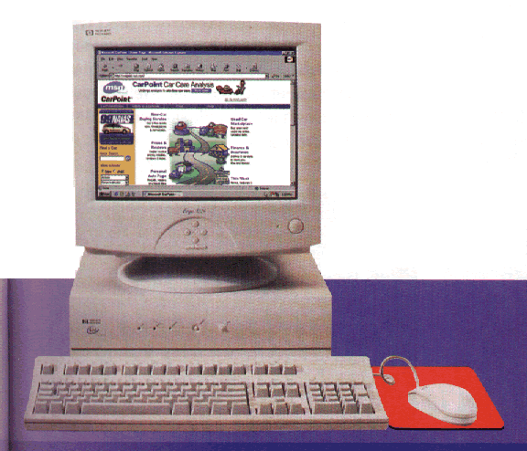
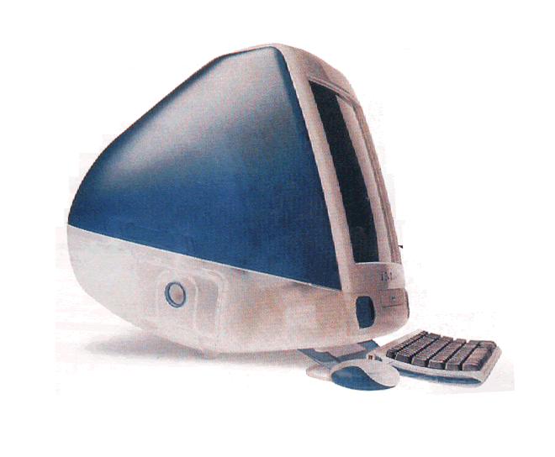
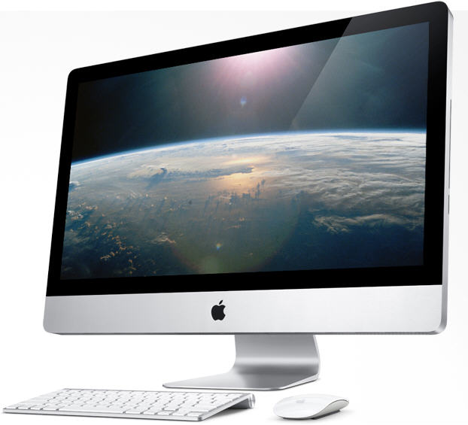
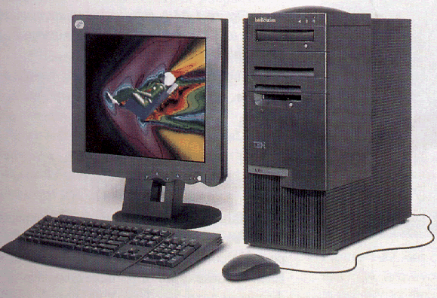
Types of computers
microcomputers
  Desktop computers are small enough to fit on top of or alongside a desk yet are too big to carry around .

Slide 34
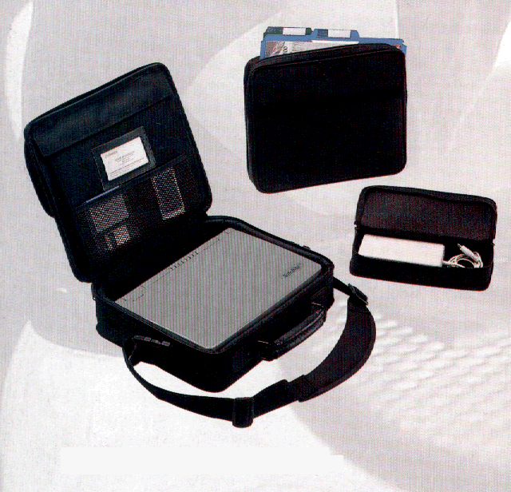
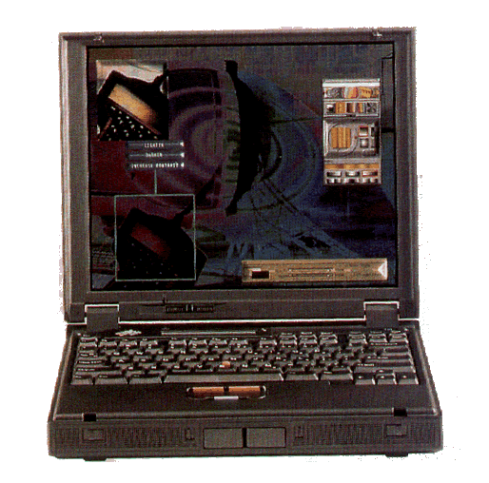
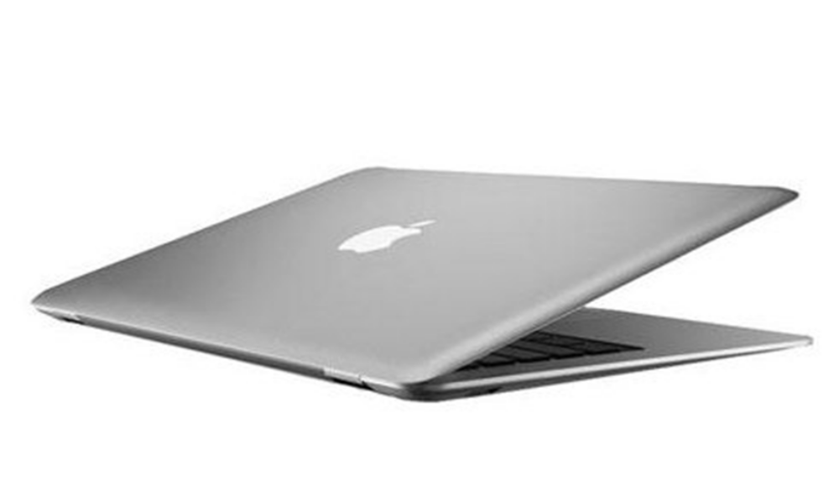
Types of computers
microcomputers
  Notebook are portable, they weigh 1 or several kilograms, and can be contained in a briefcase.

Slide 35
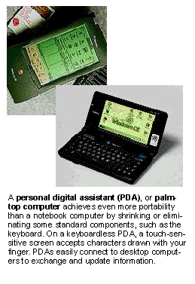
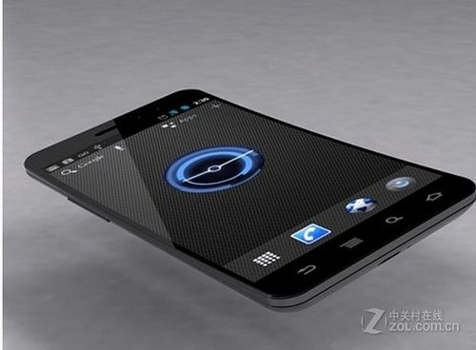
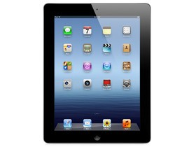
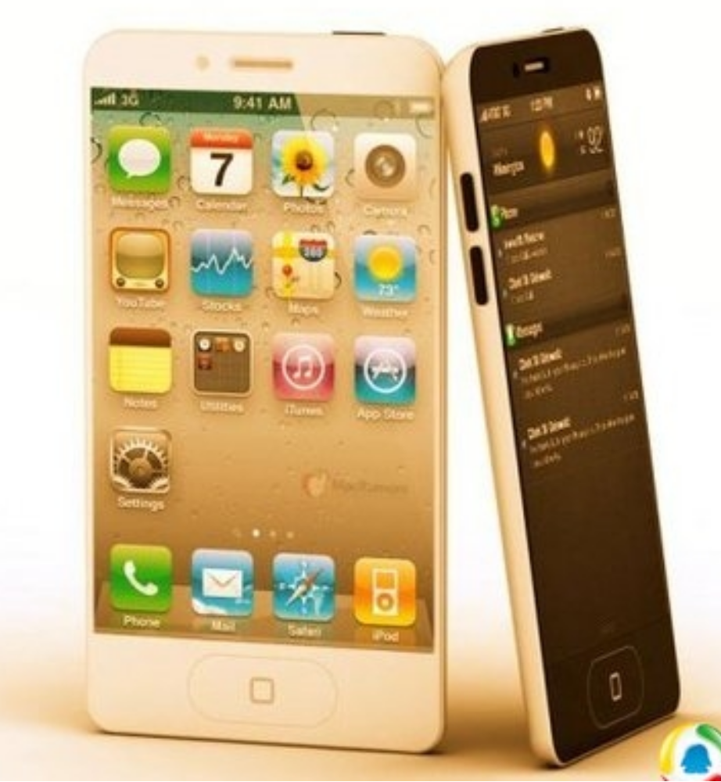
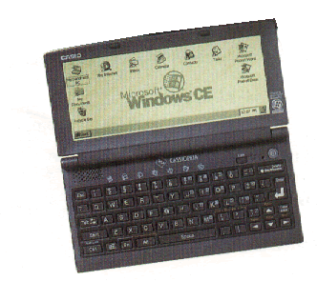
Types of computers
microcomputers
  Personal digital assistants are also known as palmtop computers or handheld computers. They combine pen input, writing recognition, personal organizational tools, and communications capabilities in a very small package.

Slide 36
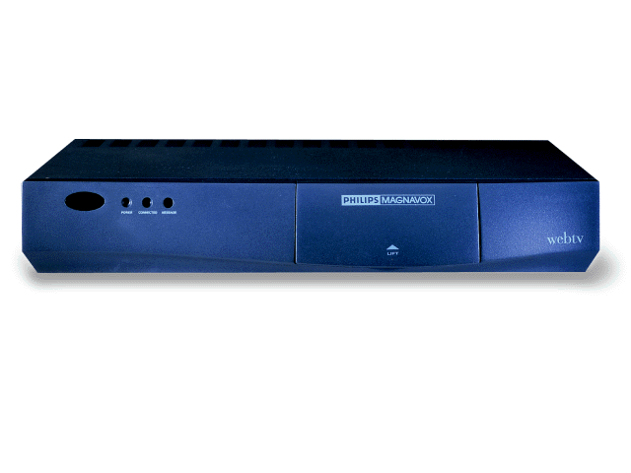
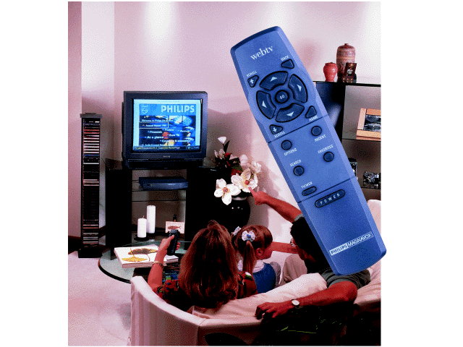
Types of computers
microcomputers
  Set-top box.

Slide 37
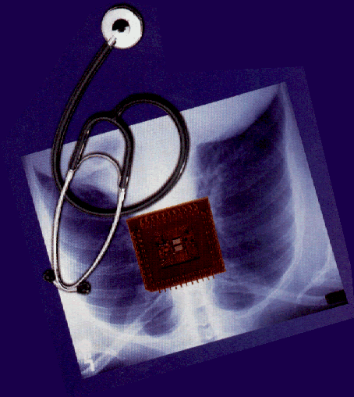
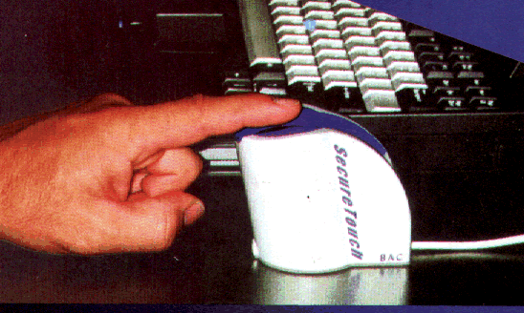
Some future trends
User Interface
Human computer integration

Slide 38
Part 3
Computing system

Slide 39
---A computer is a device while a computing system is a dynamic entity used for solving problems and interacting with environments
---Layers of computing system(from the inside out)
Information layer: how to represent information on a computer
Hardware layer: physical components like CPU and memory
Programming layer: how to solve problems with software

Slide 40
Operating system: to help manage resources and interact with computer system
Application layer: to focus on using computer to solve specific real-world problems instead of making computer system work
Communication layer: to connect computers so that information and resources can be shared
*Note that we form layers of a computing system by use of abstraction, a mental thinking model, which hides complex details and leaves only the information necessary to accomplish tasks.

Slide 41
Part 4
The history of Computing

Slide 42
The history of computing hardware : early history
Stonehenge and abacus in the sixteenth century
Leibniz machine in the seventeenth century
Jacquard’s loom in the late eighteenth century
Analytical engine in the nineteenth century
The first programmer: Ada Augusta
The first electro-mechanical tabulator in the beginning of twentieth century
Turing machine in 1936
The delivery of the UNIVAC1 in 1951

Slide 43
The history of computing hardware : modern history
  First generation (1951-59) (Vacuum Tube Age)
  Second generation (1959-65) (Transistor Age)
  Third generation (1965-71) (Integrated Circuit Age)
  Fourth generation (1971-?) (Large-scale integration)
  Parallel computing(since late 1980s)
  Networking(since 1980s)

Slide 44
A brief history of computing software
  First generation (1951-59) (machine language, assembly language , system programmers who write translators)
  Second generation (1959-65) (high level languages: fortran, cobol and lisp, compilers, application programmers who use the tools like compilers and assemblers created by system programmers)
  Third generation (1965-71) (operating system, system software which include operating system, utility programs and languages translators, general-purpose applications programs like SPSS)
  Fourth generation (1971-1989) (Structured programming, basic/pascal/c, pc-dos/ms-dos/unix, applications packages)
  Fifth generation(1990-present)(object-oriented design, c++/java, windows, office suites, world wide web)

Slide 45
Part 5
Subareas of computing

Slide 46
Algorithms and data structure
Programming languages
Architecture
Numerical and symbolic computation
Operating system
Software methodology and engineering
Database and information retrieval
Artificial intelligence and robotics
Human-computer communication
Graphics
Organizational informatics
Bioinformatics
* Note that of these subareas, the first half are called systems area relating to understanding or building computing tools in general, and the second half are called applications areas

Slide 47
Objectives
Explain the importance of learning computer and how to learn it.
Define the term computer and identify the components of a computer (Describe the von Neumann model).
Describe hardware devices for input, processing, storage, output, and communication.

Slide 48
Objectives
Describe the categories of computers and their uses.
Describe the layers of a computer system
Describe the history of computer hardware and software
Distinguish between system programmers and applications programmers
Describe subareas of computing

Slide 49
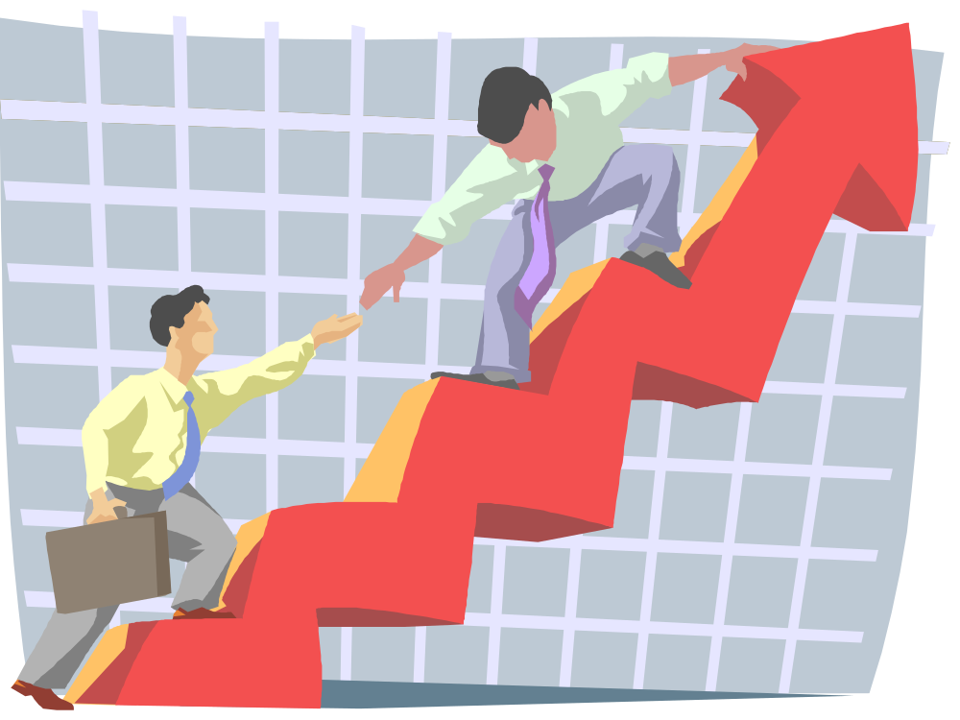
That’s all for this lecture!

