Slide 1
Limitations of Computing

Slide 2
Outline
Hardware
Software
problems

Slide 3
Limitation of Computing
Goals
1.describe the limits that the hardware places on the solution to computing problems
2.describe the limits inherent in computable problems themselves
3.describe the limits that the finitness of the computer influences thesolutions to numeric problems
4.describe the limits that the software places on the solutions to computing problems
5.discuss ways to build better software
6.discuss the continuum of problem complexity from problems in Class P to problems that are unsolvable

Slide 4
Part1 Hardware
Limits On Arithmetic
Limits Of Components
Limits Of Communications

Slide 5
Limits On Arithmetic
The hardware of a particular machine determines the limits of the numbers,both real and integer,that can be represented.Some software solutions,however ,allow programs to overcome these limitations.

Slide 6
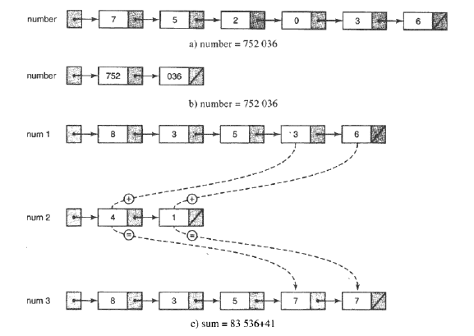

Slide 7
Limits On Arithmetic
Real Numbers
Precision
Significant Digits
1.representational error
2.underflow
3.overflow

Slide 8
Limits Of Components
Problem of hardware

Slide 9
Limits Of Communications
Parity Bits,Check Digits,Error-Correct Codes

Slide 10
Part2 Software
Complexity of Software
As our machines have grown increasingly more powerful,the problems that can be tackled have become increasingly more complex.

Slide 11
Limits Of Software
How to improve the quality of the software?
Software Engineering
Formal Verification
Open-source Movement:Unix,Linux

Slide 12
Software Error
AT&T Down for Nine Hour
-- Of the 148 million long-distance and toll-free calls placed with AT&T that day,only 50% got through.This failure caused untold collateral damages:
-- Hotel lost bookings.
-- Rental car agencies lost rentals
-- American Airlines' reservation system traffic fell by 2/3
-- A telemarketing company lost $75,000 in estimated sales
-- AT&T lost some $60 million to $75 million

Slide 13
Software Error
Thral-25
The Therac-25 was a radiation therapy machine produced by Atomic Energy of Canada Limited (AECL) after the Therac-6 and Therac-20 units .It was involved in at least six accidents between 1985 and 1987, in which patients were given massive overdoses of radiation. Because of concurrent programming errors, it sometimes gave its patients radiation doses that were thousands of times greater than normal, resulting in death or serious injury.These accidents highlighted the dangers of software control of safety-critical systems,and they have become a standard case study in health informatics and software engineering.
Bugs in Goverment Projects
1.In October 1999,the Mars Climate Orbiter entered the Martian atmosphere about 100 kilometers lower than expected,causing the craft to burn up.
2.An unmanned Ariane 5 rocket lauched by the European Space Agency exploded on June 4,1996,just 40 seconds after lift-off.

Slide 14
Part3 Problems
Comparing Algorithms
Turing Machines
Halting Problem
Classification of Algorithms

Slide 15
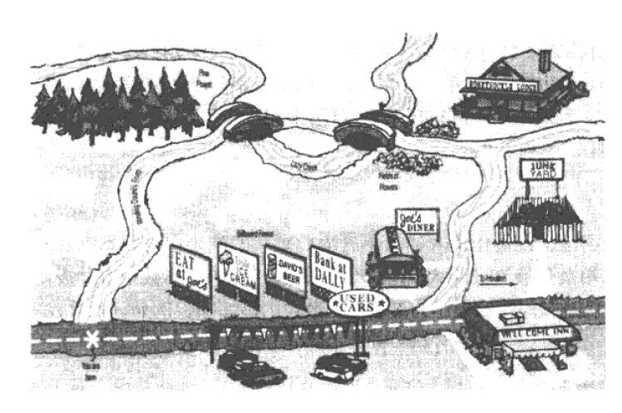
Comparing Algorithms
E.G.
If you were asked for directions to Joe’s Diner , you could give either of two equally correct answers:
1.Go east on the big highway to the Y’all Come Inn , and turn left.
2.Take the winding country road to Honeysuckle Lodge , and turn right.
If the request for directions contained special requirements , one should might be preferable to the other.
1.I’m late for dinner , What’s the quickest route to Joe’s Dinner?
2.Is there a scenic road that I can take to get to Joe’s Diner?

Slide 16
Comparing Algorithms
The analysis of algorithms
○ The first solution that comes to mind is simply to code the algorithms and then compare the execution times for running the two programs.
○ A second possibility is to count the number of instructions or statements executed.
○ Another idea is to isolate a particular operation fundamental to the algorithm and then count the number of times that this operation is performed.

Slide 17
Comparing Algorithms
BIG-O Analysis
We have been talking about works as a function of the size of the input to the operation (for instance , the number of elements in the list to be summed).
E.G. f(N)=N⁴ + 100N² + 10N + 50

Slide 18
Comparing Algorithms
Common Orders of Magnitude
A. O(1) is called bounded time.
B. O(log₂N) is called logarithmic time.
C. O(N) is called linear time.
D. O(Nlog₂N) is called (for lack of a better term) Nlog₂N time.
E. O(N²) is called quadratic time.
F. O(2^{N}) is called exponential time.
G. O(N!) is called factorial time.

Slide 19
Comparing Algorithms
N | log₂N | Nlog₂N | N² | N³ | 2^{N}
1 | 0 | 1 | 1 | 1 | 2
2 | 1 | 2 | 4 | 8 | 4
4 | 2 | 8 | 16 | 64 | 16
8 | 3 | 24 | 64 | 512 | 256
16 | 4 | 64 | 256 | 4096 | 65536
32 | 5 | 160 | 1024 | 32768 | 4294967396
64 | 6 | 384 | 4096 | 262144 | About 5 years’ worth of instructions on a supercomputer
128 | 7 | 896 | 16384 | 2097152 | About 600000 times greater than the age of the universe in nano-seconds(for a 6-billion-year estimate)
256 | 8 | 2048 | 65536 | 16777216 | Don’t ask
TABLE : Comparison of rates of growth

Slide 20
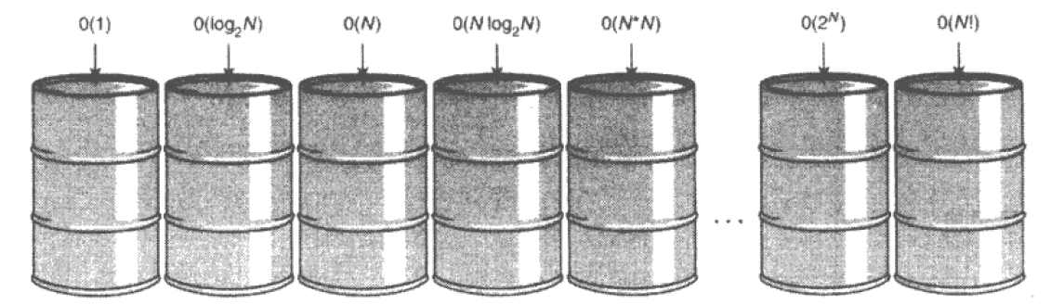
Comparing Algorithms
Think of common orders of complexity as being bins into which we sort algorithms.
Figure 17.3 Orders of complexity

Slide 21
Turing Machines
Alan Turing
Church-Turing thesis
-It is widely accepted that anything that is intuitively computable can be computed by a Turing machhine.
Conclusion from church-turing thesis
-If we can find a problem for which a Turing -machine solution can be proven not to exit,then that problem must be unsolvable

Slide 22
Halting Problem
The halting problem restates the question in this way
-Given a problem and an input to the program,determine if the problem will eventually stop with this input.
Halting problem
-The unsolvable problem of determing whether any problem will enventually stop given a particular input

Slide 23
Program Example
and
SampleData
"Halls"
or
"Loops"
Program Example
and
SampleData
"Halls"
or
"Loops"
Program Example
and
SampleData
Program Example
and
SampleData
"Halls"
or
"Loops"
SolvesHaltingProblem
SolvesHaltingProblem
SolvesHaltingProblem
SolvesHaltingProblem
Input
Input
Program
Output
Output
FIGURE 17.5 Proposed program for solving the halting problem

Slide 24
Program Example
and
SampleData
"Halls"
or
"Loops"
SolvesHaltingProblem
Input
Program
Output
FIGURE 17.6 Proposed program for solving the halting problem

Slide 25
New Program uses
algorithm for
SolvesHaltingProblem
to produce output
Program Example
and
SampleData
"Halls"
"Loops"
"Halts"
Input
Program
Newprogram
Output form NewProgram
FIGURE 17.7Construction of NewProgram

Slide 26
Classification of Algorithms
Class p problems problems that can be solved with one processor in polynomial time
Class NP problems problems that can be solved in polynomial time with as many processors as desired
NP-complete problems A class of problems witnin Class NP that has the property that if a polynomial time solution with one processor can be found for any member of class,such a solution exists for every member of the class

Slide 27
Class p
Exponential Factorial
Unsolvable
FIGURE 17.8 a reorganization of algorithm classifications

Slide 28
ClassNp
Exponential Factorial
Unsolvable
Class p
FIGURE 17.9 Adding Class NP

Slide 29
The Traveling Salesman problem
A classic NP problem is called the Travelling Salesman problem.
A well-known graph algorithm
The solution with one processor is o(n!)

Slide 30
Summary
Limits are imposed on computer problem solving by the hardware,the software,and the nature of the problems to be solved.
The sheer size and complexity of large software projects almost guarantee that errors will occur.
Problems vary from those that are very simple to solve to those that cannot be solved at all.
Notes:
what else can you think of?

