Slide 1
REGULARIZATION

Slide 2
What and why?
Regularization is a technique that applied in Cost Function J(θ) in order to avoid Overfitting.
It keep’s more important features and ignore unimportant ones.
Reduce the variance of the model.
Training error = 1%
Dev error = 11%
Variance 10%
=

Slide 3
L1
L2
Dropout
Lasso Regression
Ridge Regression
Deep Learning

Slide 4
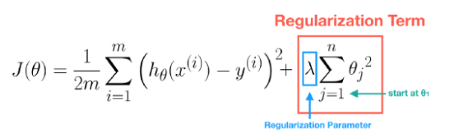
Training Data
If λ is too large, then all the values of θ may be near to zero and this may cause Underfitting. In other words, this model has both large training error and large prediction error.
If λ is zero or too small, its effect on parameters θ is little. This may cause Overfitting.

Slide 5
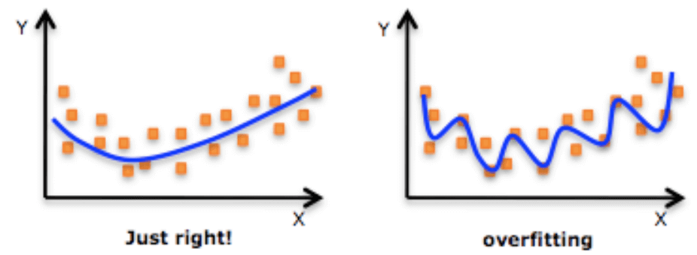

Slide 6
END

