Slide 1
Lab. 2
Modify the multithreaded JAVA code we practiced in Lab. 1 to C code with pthread library.
Pthread library works in UNIX environment.
Use cygwin for programming
You may use Text editor : nano or vim
In cygwin, compiling “> gcc ex1.c -lpthread” will generate a.exe
Execute : “> ./a.exe”

Slide 2
Exercise 1 : ex1.java
Modify following JAVA code ex1.java to C code with pthread library for Thread Creation and Execution
class C extends Thread {
int i;
C(int i) { this.i = i; }
public void run() {
System.out.println("Thread " + i + " says hi");
System.out.println("Thread " + i + " says bye");
}
}
class ex1 {
public static void main(String[] args) {
System.out.println("main thread start!");
for(int i=1; i <= 5; ++i) {
C c = new C(i);
c.start();
}
System.out.println("main thread end!");
}
}

Slide 3
Exercise 1 : lab2_ex1.c
Sample C code with pthread library
#include <pthread.h>
#include <stdio.h>
void *c(void* i) {
printf("Thread %d says hi\n",i);
printf("Thread %d says bye\n",i);
}
int main (int argc, char *argv[]) {
pthread_t threads[20];
int rc, t;
printf("main thread start\n");
for(t=1; t<=20; t++){
rc = pthread_create(&threads[t], NULL, c, (void *)t);
if (rc) {
printf("ERROR code is %d\n", rc);
exit(-1);
}
}
printf("main thread end\n");
pthread_exit(NULL);
}

Slide 4
Exercise 2 : parallel summation
Modify following multithreaded JAVA code ex2.java to C code with pthread library
class SumThread extends Thread {
int lo, hi; // fields for communicating inputs
int[] arr;
int ans = 0; // for communicating result
SumThread(int[] a, int l, int h) {
lo=l; hi=h; arr=a;
}
public void run() {
// insert your code here
}
}
class ex2 {
private static final int NUM_END = 10000;
private static final int NUM_THREAD = 4; // assume NUM_END is divisible by NUM_THREAD
public static void main(String[] args) {
int[] int_arr = new int [NUM_END];
int i,s;
for (i=0;i<NUM_END;i++) int_arr[i]=i+1;
s=sum(int_arr);
System.out.println("sum=" + s) ;
}
static int sum(int[] arr) {
// insert your code here
}
}

Slide 5
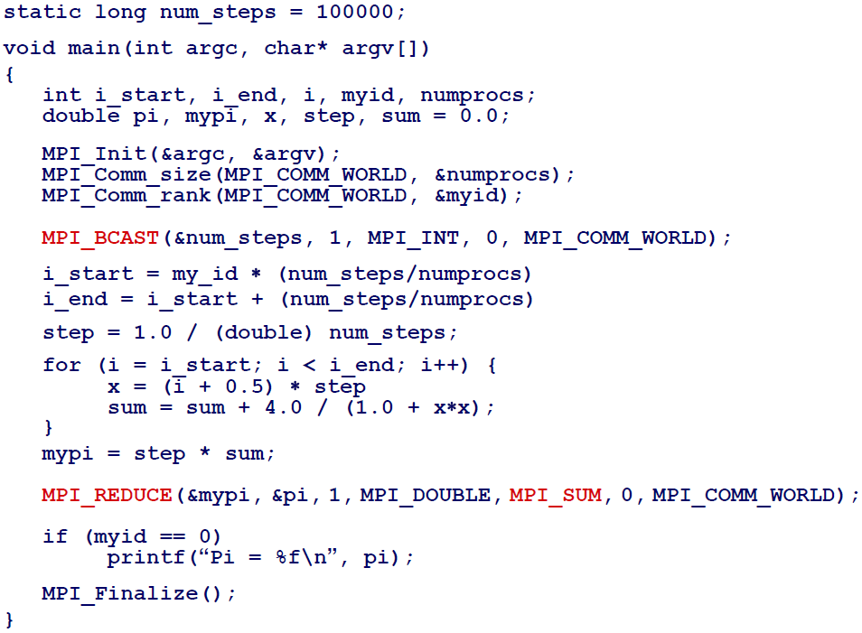
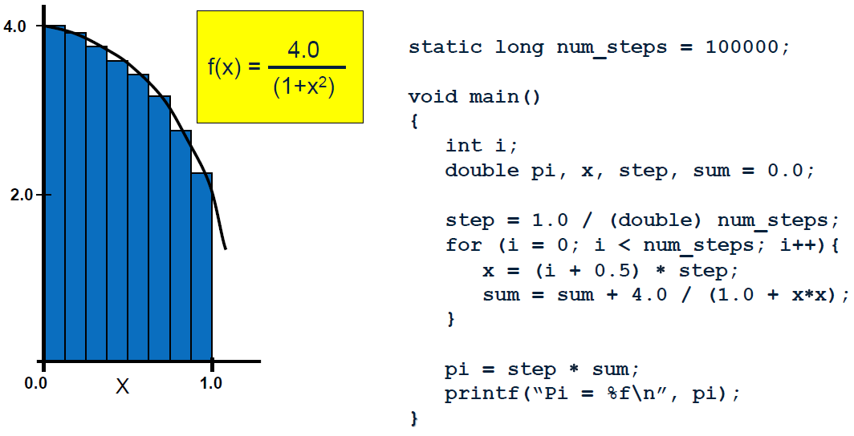
Exercise 3 : parallel integration
Modify your multithreaded JAVA code ex3.java to C code with pthread library

Slide 6
Exercise 4 : Prime numbers
Modify your multithreaded JAVA code ex4.java to C code with pthread library
class ex4_serial {
private static final int NUM_END = 100000;
public static void main(String[] args) {
int counter=0;
int i;
long startTime = System.currentTimeMillis();
for (i=0;i<NUM_END;i++) {
if (isPrime(i)) counter++;
}
long endTime = System.currentTimeMillis();
long timeDiff = endTime - startTime;
System.out.println("Execution Time : "+timeDiff+"ms");
System.out.println("1..."+(NUM_END-1)+" prime# counter=" + counter +"\n");
}
private static boolean isPrime(int x) {
int i;
if (x<=1) return false;
for (i=2;i<x;i++) {
if ((x%i == 0) && (i!=x)) return false;
}
return true;
}
}

Slide 7
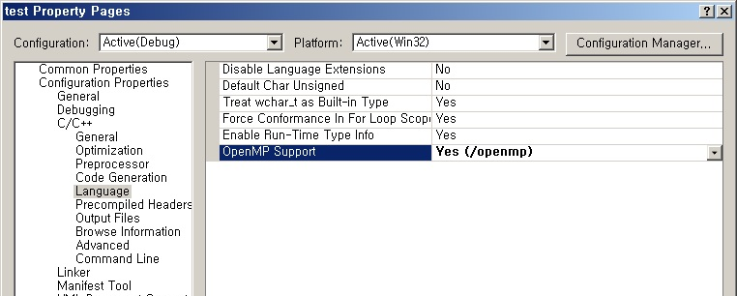
Practice OpenMP
You may use either cygwin or visual studio for using OpenMP
Compiling in cygwin
  “> gcc –fopenmp ex1.c” will generate a.exe
  Execute : “> ./a.exe”
Compiling in visual studio: set “OpenMP Support” to Yes

Slide 8
Exercise 5 : ex5.c
Compute sum=1+2+3+…+10000 using 1,2,3,4 threads using OpenMP and measure time for each case.
Use reduction
// sample solution
#include <omp.h>
#include <stdio.h>
#define NUM_THREADS 4
#define END_NUM 10000
int main ()
{
int i;
int sum=0;
double start_time, end_time;
omp_set_num_threads(NUM_THREADS);
start_time = omp_get_wtime( );
#pragma omp parallel
{
#pragma omp for reduction(+:sum)
for (i = 1; i <= END_NUM; i++) {
sum+=i;
//printf_f("(%d/%d) : %d\n",omp_get_thread_num(),omp_get_num_threads(),i);
}
}
end_time = omp_get_wtime( );
printf("sum = 1+2+..+%d = %d\n",END_NUM,sum);
printf("time elapsed: %lfs\n",end_time-start_time);
return 1;
}

Slide 9
Exercise 6 : Numerical Integration
Parallelize following code using OpenMP.
Test the code with 1,2,3,4,8,16 threads and with different load balancing approach (e.g. static, dynamic, guided, try different chunk size). Measure the time for each case.

Slide 10
Exercise 7 : Matrix multiplication
Compile and run omp_ex3.c (available on our class webpage) and try different number of threads (1,2,4,8,16,32) and different load balancing approaches (e.g. static, dynamic).
Read and understand the source code omp_ex3.c

Slide 11
Exercise 8 : Prime numbers
Modify following multithreaded JAVA code to C code with OpenMP library.
Test your code with 1,2,4,8,16 threads and measure performance.
Test your code with static load balancing and dynamic load balancing using schedule(static|dynamic|guided [,4])
class ex4_serial {
private static final int NUM_END = 200000;
public static void main(String[] args) {
int counter=0;
int i;
long startTime = System.currentTimeMillis();
for (i=0;i<NUM_END;i++) {
if (isPrime(i)) counter++;
}
long endTime = System.currentTimeMillis();
long timeDiff = endTime - startTime;
System.out.println("Execution Time : "+timeDiff+"ms");
System.out.println("1..."+(NUM_END-1)+" prime# counter=" + counter +"\n");
}
private static boolean isPrime(int x) {
int i;
if (x<=1) return false;
for (i=2;i<x;i++) {
if ((x%i == 0) && (i!=x)) return false;
}
return true;
}
}

