Slide 1

Classification of Oil Wells in the DSEATS Field Using Machine Learning.
Team DBTel
TEAM MEMBER | SPE ID | SPE SECTION | SCHOOL
Ojuu Oleka John | 5558635 | Ghana Section | KNUST
Laryea-Adjei Nii Sowah | 5552984 | Ghana Section | KNUST
Takyi-Amponsem Deon | 5432268 | Ghana Section | KNUST
Acheampong Richard | 5558634 | Ghana Section | KNUST
Nimpong Christian | 5558634 | Ghana Section | UMaT
KNUST – Kwame Nkrumah University of Science
UmaT – University of Mines and Technology
21st July 2025

Slide 2

Outline
Introduction
Background
Data and EDA
Methodology
Results
Contributions
Conclusion
Multi-Target Classification with XGBoost + K‑Means and RF, Team DBTel
2/10

Slide 3
Introduction
Multi-Task Learning for Oil Well Classification
Objective:
Automate classification of wells across multiple engineering tasks
Approach:
Supervised multi-task classification using well-level data
Benefit:
Leverages task interdependence for better accuracy and consistency
Multi-Target Classification with XGBoost + K‑Means and RF, Team DBTel
3/10

Slide 4
Exploratory Data Analysis
Visual trends of oil, gas, and water production are observed.
Behavior of temperature, pressure, onstream hours are analyzed.
Anomaly detection or missing value handling.
Highlight engineering logic (how accurate shutdowns, restarts, or pressure drops are interpreted).
Emphasized seasonality, trend shifts, and any assumptions made.
Multi-Target Classification with XGBoost + K‑Means and RF, Team DBTel
4/10

Slide 5
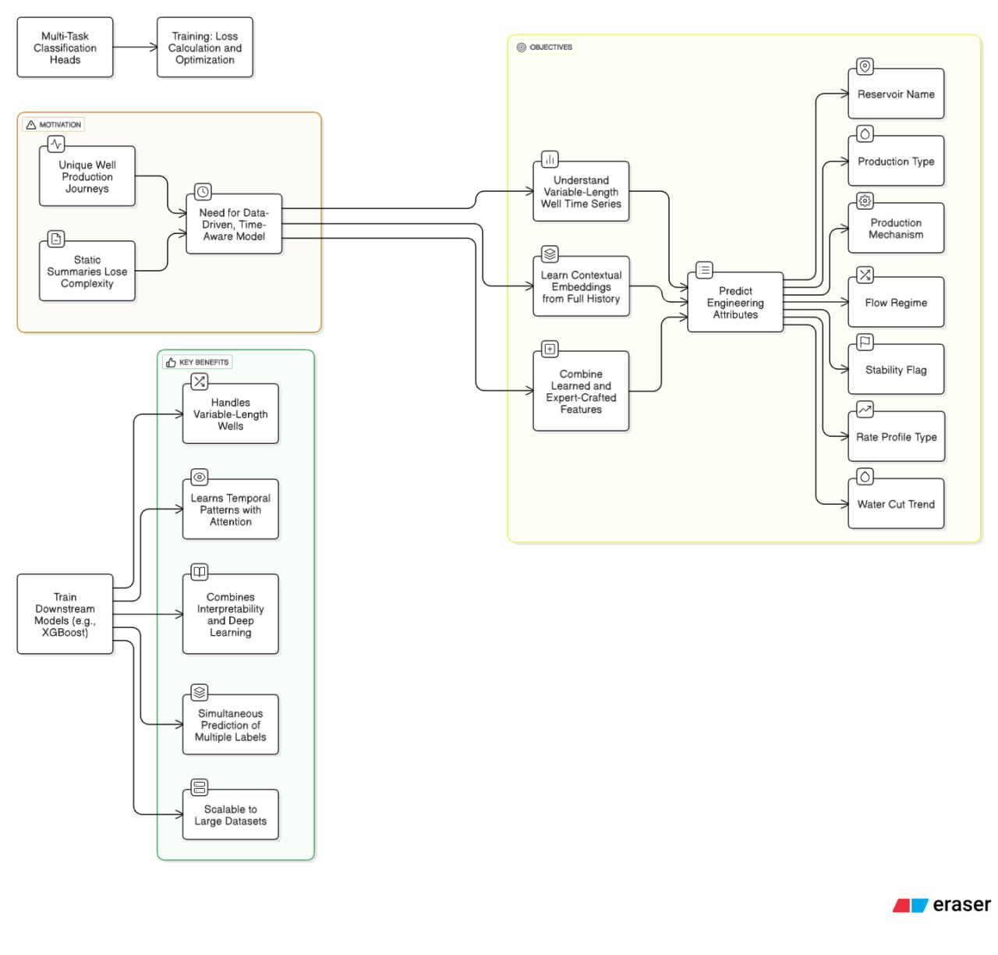
Model Building
Multi-Target Classification with XGBoost and K‑Means, Team DBTel
5/10

Slide 6
Methodology Pipeline
Multi-Target Classification with XGBoost + K‑Means and RF, Team DBTel
6/10

Slide 7
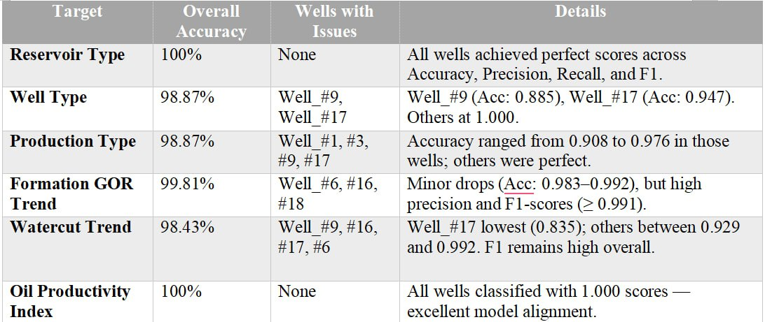
Results
Multi-Target Classification with XGBoost + K‑Means and RF, Team DBTel
7/10

Slide 8
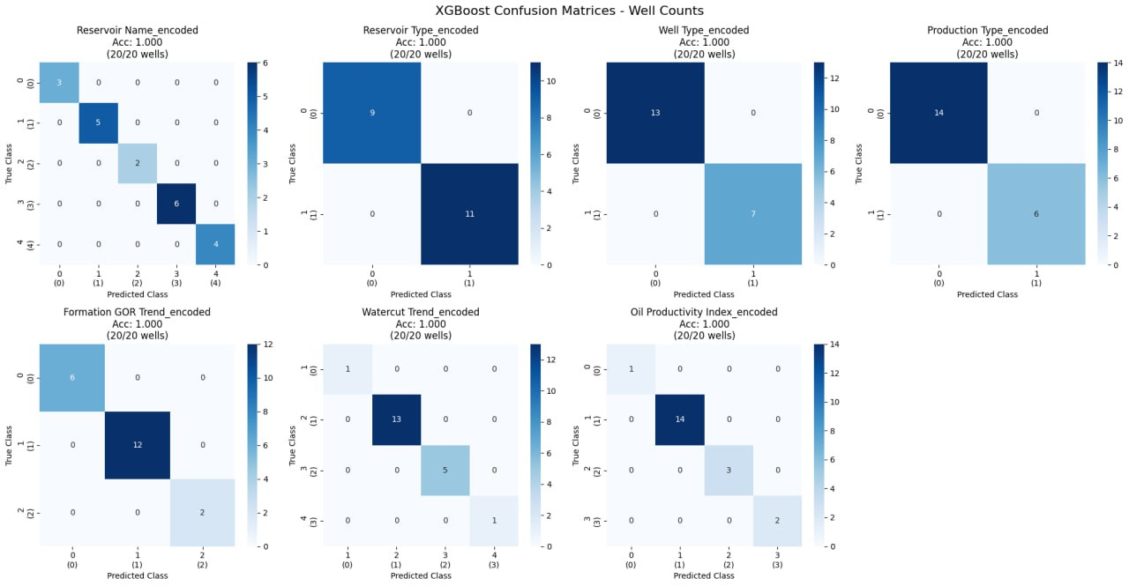
Results
Multi-Target Classification with XGBoost + K‑Means and RF, Team DBTel
8/10

Slide 9
Total Production Estimation
Assigned Reservoir | Total Oil Production, bbl
KEMA | 2,098,767.0
DEPU | 1,268,679.0
ACHI | 1,082,816.0
MAKO | 964,689.0
JANI | 217,938.0
Multi-Target Classification with XGBoost + K‑Means and RF, Team DBTel
9/10

Slide 10
Contributions
TEAM MEMBER | Contributions
Ojuu Oleka John | Exploratory Data Analysis (EDA), Data Cleaning & Preprocessing, pipeline, architecture, Well classifications
Laryea-Adjei Nii Sowah | Model Design & Development, Well classifications, pipeline, architecture, and assumptions
Takyi-Amponsem Deon | Exploratory Data Analysis (EDA), Well classifications, pipeline, architecture, and assumptions
Acheampong Richard | Model Design & Development. pipeline, architecture, and assumptions, Well classifications
Nimpong Christian | Pipeline, architecture, and assumptions, Engineering Review.
Multi-Target Classification with XGBoost + K‑Means and RF, Team DBTel
10/10

