Slide 1

HotTakes
Fire Nation!!

Slide 2



HotTakes
Our goal is to build a social networking platform in which everyone can share their opinions of various media forms such as:
Movies
Video Games
Books
This was done by having our post focused on:
Media items being reviewed
Giving the media a score of:
Different fire levels

Slide 3

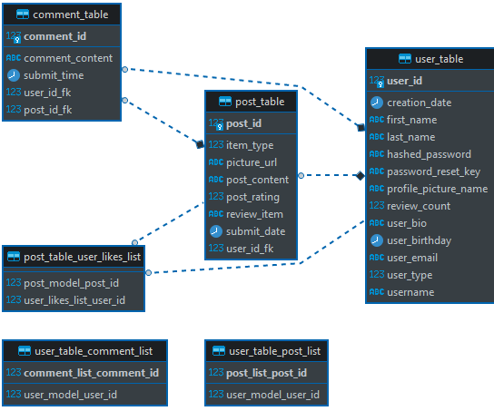
Technologies Used
Database Schema
Spring Data, Boot, Web
Context, WebMVC, Test - version 2.6.3
Other Maven Dependencies
ProjectLombok - version 2.6.3
PostgreSQL - version 2.6.3
JacksonDatabind - version 2.6.3
AWS - S3, EC2, and RDS
HTML/CSS/AJAX/JS

Slide 4
DEMO

Slide 5
Post App Development
Our team had a vote of confidence
We discussed with each other where each team member felt strongest in and distributed responsibilities accordingly.
Difficulties
Every time we would get 2 things working together it would break,.
We would have to fix it.
What we learned
Learned to work together
Better time management
Task organization
Future Implementations
Comments
Admin account
User rankings

Slide 6


Thank You
Fire Nation!!
HotTakesReview@gmail.com
HotTakes.com

