Slide 1
Carrom
Ayush Satyavarpu
Calix Tang
Akshat Jain

Slide 2





What is Carrom?
Similar to pool
Knock pieces into holes in corners
Different colored pieces
Different point values
10
50
20
Striker

Slide 3
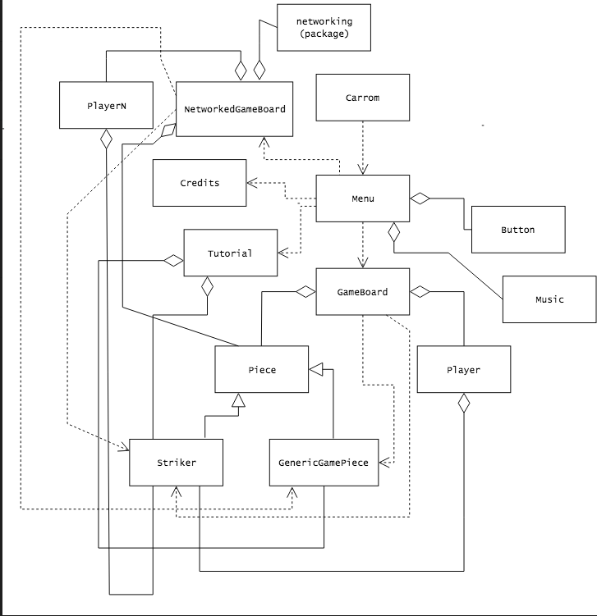
UML and Code Design
Networking classes
PlayerN
NetworkedGameBoard
DrawingSurface/Main classes
Tutorial
GameBoard
Menu
Credits
Factory classes
Piece
GenericGamePiece
Striker
Miscellaneous
Music

Slide 4
Design problems and code challenges
Design decisions:
Networking
How to implement?
Hooked up networking to Player objects
Game function & mech
Turn system
What objects use which other objects
Graphics
What should the buttons look like?
How should we draw images so that speed isn’t compromised?
Code challenges:
Networking in general
Redid Shelby’s code
Collisions
Clipping & cons. of momentum
Images
Drawing the images efficiently

Slide 5
Rules of Carrom
Game board with four holes
With the striker, goal is to sink the game pieces into the corner pockets
The striker must stay between the two lines of the player’s playing side
Different pieces are worth different points
Black: 10
White: 20
Red (Queen): 50
If you sink a piece, you get another chance
For the red piece, you must sink another piece immediately after or you lose the queen
Finally, when all the pieces are off, the winner is the player with the most points
10
50
20
Striker

Slide 6

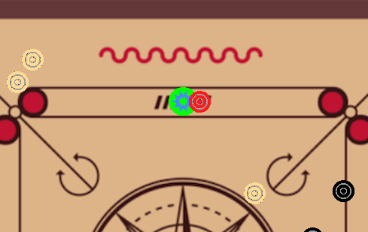
Bugs
Networked Bugs:
Limited to two players
Third player makes bad things happen
Win condition exits program
General Bugs:
Used to have buggy collision system
Side hits resulted in a perpetual cycle of circular motion
Fixed w/ an “unCollide” system
Pieces can spawn in each other
Cannot move on top of pieces
Can still spawn in them

Slide 7
Controls
Use the arrow keys to move the striker between your two lines
When ready to aim, hit the enter key
Use the mouse to move the trajectory line and aim
Right click to fire the striker

Slide 8
Next Steps
Revamp controls
Counterintuitive at moment
Make networking work for 3+ players
Make the window resizable
Add sound effects for pieces colliding
Make images efficient by drawing them less frequently
Would reduce the lag

